Slide 1
Security Data Analysis
Karla Avilés Mendoza

Slide 2
Desired population
 | RECORDS AFTER EACH FILTER (SEPARATELY) | RECORDS AFTER ALL FILTERS
FILTER 1 | 623 242 | 623 242
FILTER 2 | 1 205 906 | 487 424
FILTER 3 | 1 486 541 | 464 075
FILTER 4 | 1 500 000 | 450 562
FILTER 5 | 499 989 | 7 963
 | Desired population : | 7 963
The desired population represent the 1% of all clients

Slide 3
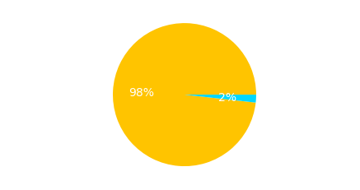
Desired population
After selecting the required data, the data corresponding to each of the labels was plotted. As shown, there is a large data imbalance.

Slide 4
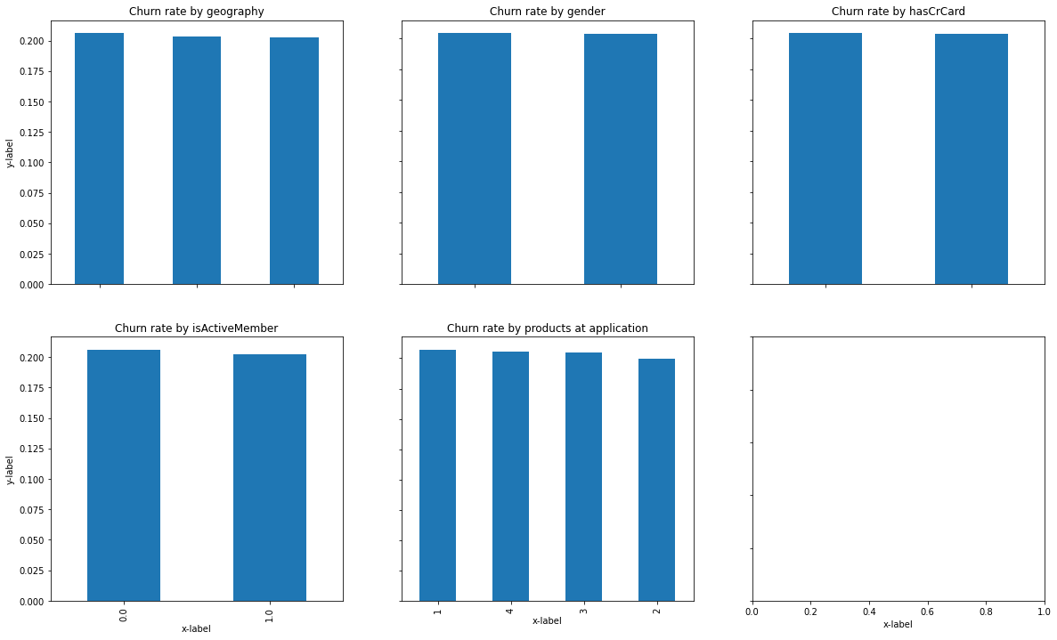
Categorical variable analysis
As shown, no numerical variable directly affects the label

Slide 5
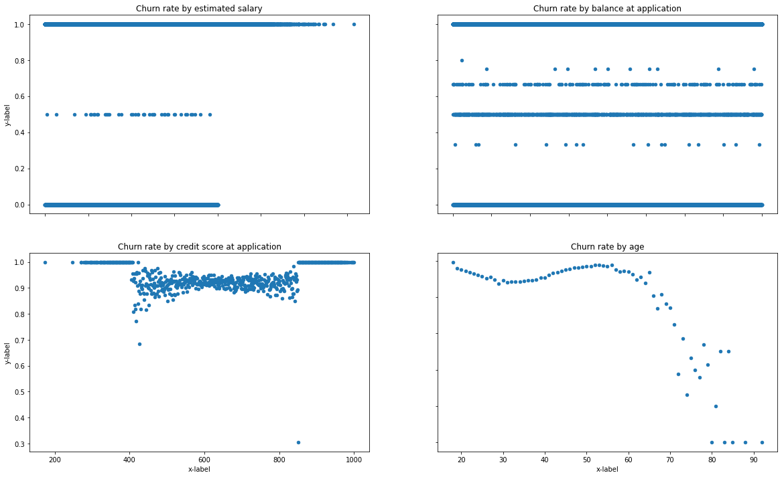
Numerical variable analysis
As shown, Age column can be grouped using some clustering algorithm.

Slide 6
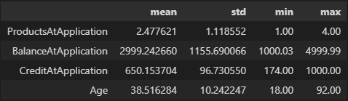
Descriptive statistics of new variables

Slide 7
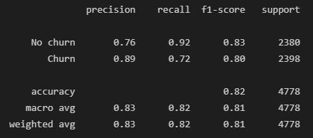
Predictive statistical model
I chose this model because is very efficient when it comes to classification problems, mainly because of its boosting techniques. In comparison qith more classical models for churn prediction problems, as Logistic Regression, it showed an outstanding performance.
XG Boost
For purpose matters it is more important not to penalize loyal clients than to reward not-loyal ones.
In this case, the most relevant value to analyze is recall, since it is important to detect as many negative cases as possible, to penalize them and not lose money, and as many positive cases as possible to reward them and increase their loyalty. In this case, 92% of the people who were ”loyal” were detected. However only 89% of the positive Churn prediction were right, this number should be improved, as it is important not to penalize the ones that are thinking about staying.

