Slide 1

VOTING SYSTEM
GUIDED BY:
K.KALAIARASAN
Mr.S.SHANMUGA VELAYUTHAM

Slide 2
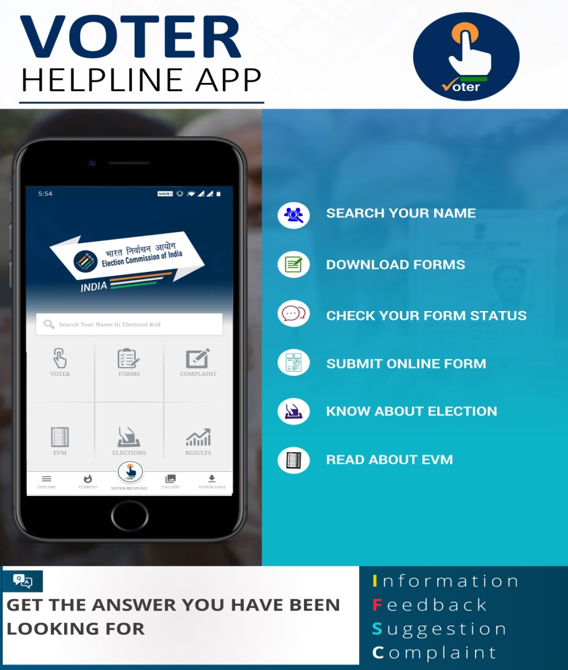
VOTING SYSTEM TO SOLVE CRIMES
P.KAVIN
S.LOGESWARAN
E.TAMILSELVAN
S.VIJAY

Slide 3
ABSTRACT
A voting system consists of rules which must be followed for a vote to be considered valid and counted to yield a final result.
The project explained where normal process of election in Marine society, that is (PNK) to select their organization for the community.
Basically counting ballots need to consider a long time that dragged the results to be published on the next day. Furthermore, process of calculating requires manpower whom could be bias or dishonest person while doing the calculation. In additional, the result could be taking a long time to show up.
Thus, it will make the voters keep on waiting to know the result. The Voting System using Android Application is more efficient that the classic method to do an election. The project has develop an interactive GUI panel for voting system. Besides, Apps Inventor 2 had been used to design the entire project.
The database that created also does the calculation of the data before transfer the data to the official website. This system has better accuracy compared to the traditional method of counting.

Slide 4
The application is especially developed for organizations to get employees votes for any new policy regulation or issues. The issues or arguments are fed into the system by the admin. Employees can then cast their vote as yes or no. One voter can only post one vote for an argument.
Each and every vote casted is stored in the database for the respective argument. At the end of the voting process the system counts the total votes and generates a brief report of it to the admin.
Thus the app helps the company to get proper feedback of the employees.

Slide 5
ADVANTAGES
The system can be used anytime and from anywhere by the employees.
It excludes the use of manual voting process.
Employees can keep themselves updated with all things going on in the organization.
Saves time and reduces human intervention.
Admin can get instant result.

Slide 6
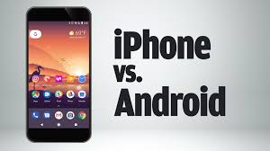
DISADVANTAGES
Every employee must have an android device for casting the vote.

Slide 7
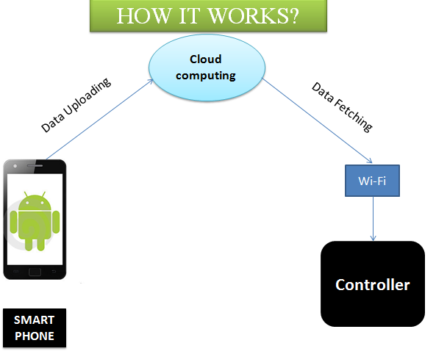
WORKING

Slide 8
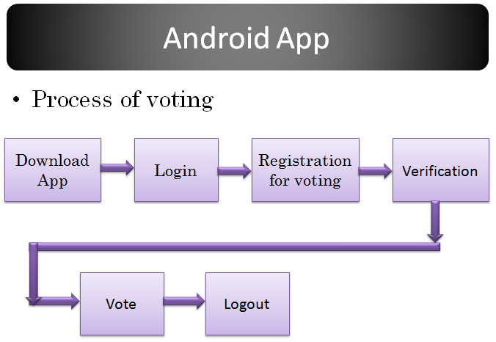
VOTING PROCESS

Slide 9
CONCLUSION
This work presents an e-voting system which uses a secure e-voting protocol based on bilinear pairings. The system allows emitting the vote over the Internet through an Android Smartphone. It was necessary to develop two cryptographic libraries, one for the Servers and other for the Android Smartphone. Both libraries implement the scalar multiplication in the and G₂ groups, besides of the arithmetic operations of elliptic curves
The implementation of the library in both entities (Android Smartphone and Servers) the integrity of the vote and the anonymity of the voter using digital signatures and blind signatures based on bilinear pairings. This is very useful in applications that require to guarantee more security without utilize 1024-bit length numbers at least.
The time consumed by cryptographic operations on the Android Smartphone is also very short, compared with other implementations. Then, the developed e-voting system introduced in this work is reliable and efficient.

Slide 10
THANK YOU

