Slide 1
X-RAY DETECTION USING CNN
KAVIN S
KGISL INSTITUTE OF TECHNOLOGY 711721243044
3/21/2024 Annual Review
1

Slide 2


AGENDA
Identifying the Issue
Overview of the Project
Target Audience
Proposed Solution and its Benefits
Approach to Modeling
Achieved Results
3/21/2024 Annual Review
2

Slide 3

PROBLEM STATEMENT
The current method of X-ray detection lacks efficiency and accuracy, leading to potential errors in medical diagnosis and security screening. There is a pressing need for an innovative project to develop a robust X-ray detection system that enhances detection accuracy, reduces false positives, and improves overall efficiency in medical and security applications.
This project aims to address these challenges by leveraging advanced technologies to design and implement a reliable X-ray detection system capable of providing accurate results in real-time.
Medical diagnosis relies heavily on accurate and timely interpretation of X-ray images. However, manual analysis by radiologists can be time-consuming, prone to human error, and subjective, especially for subtle abnormalities.
3/21/2024 Annual Review

Slide 4

PROJECT OVERVIEW
This project investigates the potential of deep learning for automating X-ray analysis in the medical field. We aim to develop a CNN model capable of detecting and classifying specific abnormalities or patterns within X-ray images.
Project Goals:
Develop a CNN model for X-ray analysis.
Train the model to achieve high accuracy in detecting and classifying relevant features in X-rays (e.g., identifying specific diseases, fractures, or anomalies).
Evaluate the model's performance using relevant metrics (accuracy, precision, recall).
Project Benefits
Improved Efficiency
Enhanced Accuracy
Increased Consistency
Target Audience
Project Scope
Future Considerations
3/21/2024 Annual Review

Slide 5

WHO ARE THE END USERS?
The primary end users for the X-ray detection using a CNN project would be:
Radiologists: They are the medical professionals who interpret X-ray images for diagnosis. The CNN model can be a valuable tool to:
Assist them in their analysis: By automatically detecting and highlighting potential abnormalities, the model can save radiologists time and improve the efficiency of their workflow.
Enhance diagnostic accuracy: CNNs can potentially learn subtle patterns that might be missed by the human eye, leading to more accurate diagnoses.
Reduce subjectivity: The objective analysis provided by the model can help minimize human bias and ensure consistent interpretation of X-rays.
Other Medical Professionals: Depending on the specific application of the X-ray detection project, other medical professionals like emergency room physicians or general practitioners who utilize X-rays in their practice might also benefit from the model's ability to provide a preliminary analysis.
3/21/2024 Annual Review

Slide 6

YOUR SOLUTION AND ITS VALUE PROPOSITION
Proposed Solution:
This project proposes a Convolutional Neural Network (CNN) based solution for automatic X-ray analysis. CNNs are a powerful deep learning architecture particularly adept at identifying patterns in image data.
Detect specific abnormalities: Train the model to recognize and highlight relevant features in X-rays, such as fractures, tumors , or signs of pneumonia.
Classify X-rays: Categorize X-rays as normal or abnormal, or even further classify them based on the type of abnormality detected.
Value Proposition:
This CNN-based X-ray detection solution offers several compelling advantages:
Improved Efficiency: Automating the initial analysis of X-rays can significantly reduce turnaround time, allowing radiologists to focus on complex cases and patient interaction
.
Enhanced Accuracy: CNNs can learn subtle patterns and relationships within X-rays that humans might miss, potentially leading to more accurate diagnoses and earlier detection of critical conditions.
3/21/2024 Annual Review

Slide 7

THE WOW IN YOUR SOLUTION
This X-ray detection project using CNNs has the potential to revolutionize medical imaging analysis. By automating initial screening, the CNN can save radiologists valuable time, while its ability to detect subtle abnormalities holds promise for improved diagnostic accuracy.
This objective analysis can reduce subjectivity and lead to more consistent diagnoses, potentially enabling earlier disease detection and improving patient outcomes.
Reduced Subjectivity and Increased Consistency: Explain how CNNs offer objective analysis, minimizing bias and leading to more consistent diagnoses across different radiologists.
Early Disease Detection Potential: Project the potential for earlier diagnoses based on the CNN's ability to detect subtle anomalies.
This can have a significant impact on patient outcomes for diseases like cancer.
3/21/2024 Annual Review
7

Slide 8
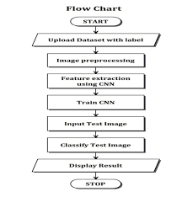
MODELLING
3/21/2024 A nual Review
8
n

Slide 9
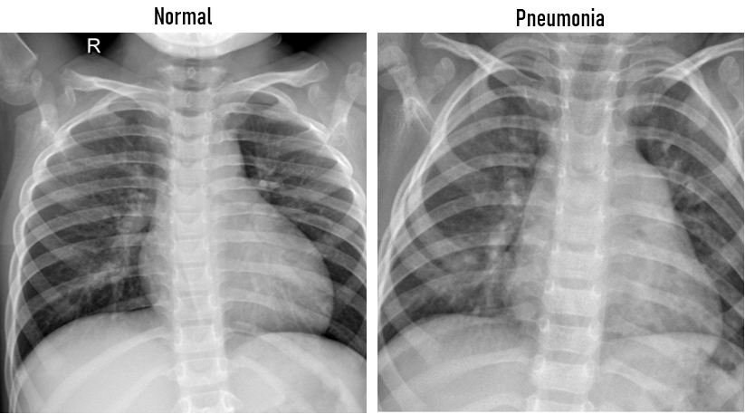
RESULTS
Demo Link
3/21/2024 A nual Review
9
n

