Slide 1
GENERAL AES WORKFLOW
CYBERSECURITY · TECHNICAL OVERVIEW
AES ENCRYPTION
AND DECRYPTION
—
From readable input to protected output, and back again.

Slide 2
WHY PROTECTING DATA MATTERS
THE CONTROL
Encryption keeps readable information from becoming an exposed copy.
CONFIDENTIALITY
—
Plaintext is readable and exposed if stored or transmitted without protection.
Protect the message while it is stored or moving between systems.
THIS PROJECT EXPLAINS THE WORKFLOW AND CONNECTS IT TO THE APPLICATION.
—
Encryption converts plaintext into ciphertext using a secret key.
—
Decryption reverses the process for an authorized user.

Slide 3
AES IS A SYMMETRIC BLOCK CIPHER
One secret key, a fixed block size, and a matching operation on both sides.
SYMMETRIC
KEY SIZES
BLOCK SIZE
Same secret key
AES-128 · 192 · 256
128-bit blocks
The key used to encrypt is also required to decrypt.
The standard defines three key-size variants.
Each AES variant operates on 128-bit blocks.
THE FINAL APPLICATION MUST VERIFY ITS KEY SIZE AND OPERATING MODE. THIS DECK EXPLAINS THE GENERAL AES WORKFLOW, NOT AN UNVERIFIED IMPLEMENTATION DETAIL.

Slide 4
THE GENERAL AES WORKFLOW
The protected result depends on the input, the key, and the parameters used by the operation.
01
02
03
04
05
Plaintext
Key + parameters
AES operation
Ciphertext
Decrypt + verify
Start with readable text or file data.
Prepare the secret key and required values.
Apply the selected encryption process.
Produce protected output for storage or transmission.
Use matching inputs to recover the original.
THE REVERSE PATH IS NOT A SEPARATE SECRET: IT IS THE MATCHING OPERATION WITH THE SAME REQUIRED INPUTS.

Slide 5
ENCRYPTION: PLAINTEXT BECOMES CIPHERTEXT
ENCRYPTION PATH
Protect the bytes before they leave the application.
—
—
—
The application accepts text or file data, represents it as bytes, supplies a secret key, and passes the input to the AES routine.
The result is ciphertext that should not reveal the original message. Store or transmit the protected result together with the parameters needed for valid recovery.
Input
Protect
Output
Plaintext
or file bytes
Secret key
+ AES routine
Ciphertext
for storage or transfer
THE SELECTED MODE MAY ALSO REQUIRE AN INITIALIZATION VALUE OR NONCE. DO NOT ASSUME WHICH ONE UNTIL THE FINAL APPLICATION IS VERIFIED.

Slide 6
DECRYPTION: CIPHERTEXT RETURNS TO PLAINTEXT
PROJECT EVIDENCE
Insert actual decryption screenshot
Recovery succeeds only when the required inputs match.
Reserved space for confirmed project evidence. Do not substitute a fabricated interface or output.
—
—
—
Ciphertext
Matching inputs
Restore
Protected input arrives.
Successful decryption returns the original plaintext.
VERIFY THE SCREENSHOT AGAINST THE FINAL APPLICATION BEFORE SUBMISSION.
Key and mode-specific parameters are available.
WRONG KEYS OR ALTERED DATA SHOULD FAIL OR PRODUCE UNUSABLE OUTPUT.

Slide 7
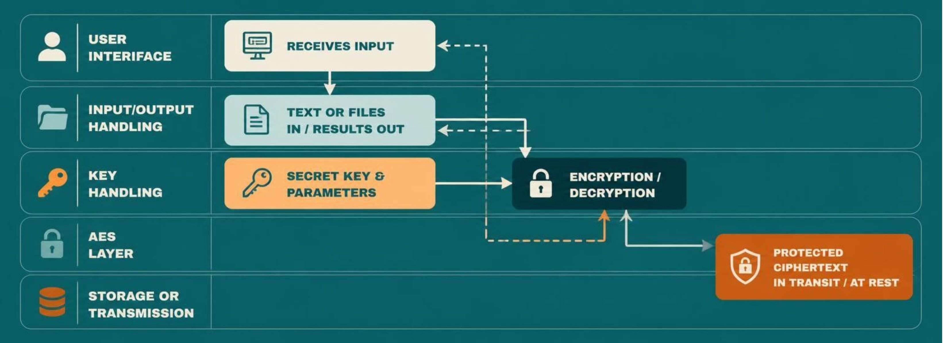
APPLICATION ARCHITECTURE AND DATA FLOW
The interface, key handling, AES layer, and output path form one connected system.
PROJECT-SPECIFIC IMPLEMENTATION DETAILS REMAIN SUBJECT TO VERIFICATION. INSERT AN ACTUAL PROJECT SCREENSHOT IF AVAILABLE.

Slide 8

TESTING THE IMPLEMENTATION
A useful test proves the round trip, then checks how the application behaves when inputs are wrong.
Encrypt a known plaintext and record the ciphertext
Decrypt the ciphertext with the matching key
Confirm the recovered plaintext matches the original
Test incorrect keys and malformed inputs
Test empty, short, and longer inputs
PROJECT EVIDENCE — Insert an actual test or output screenshot here if available. Use a confirmed result from the final application, not a representative mock-up.

Slide 9
WHAT MUST BE VERIFIED BEFORE FINAL SUBMISSION
Separate general AES concepts from facts that belong to the final application.
VERIFY | EVIDENCE TO CONFIRM
Key size | Exact AES key size used by the final application.
Operating mode | Mode selected by the final application.
Key handling | How keys are generated, stored, and entered.
Initialization | Whether an IV or nonce is required and how it is handled.
Representation | How padding, encoding, and errors are handled.
Project evidence | Replace placeholders with screenshots or confirmed details.

Slide 10
KEY TAKEAWAY
PROTECT THE DATA.
PROVE THE ROUND TRIP.
AES protects confidentiality by transforming plaintext into ciphertext
Encryption and decryption depend on matching keys and parameters
A clear data-flow diagram explains the project better than dense implementation prose
The final presentation should distinguish verified implementation facts from general AES concepts
Next step: confirm the final mode and key size, then add screenshots from the application.

