Slide 1


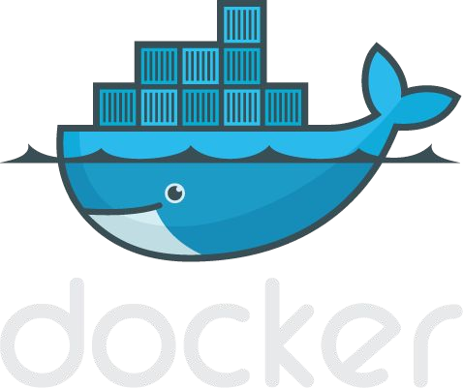

Slide 2
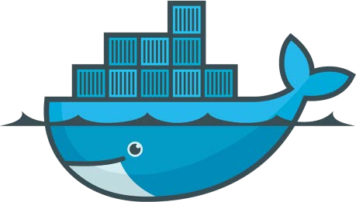
Lightweight, open, secure platform
Simplify building, shipping, running apps
What Is Docker?
Runs natively on Linux or Windows Server
Runs on Windows or Mac Development machines (with a virtual machine)
Relies on "images" and "containers"

Slide 3
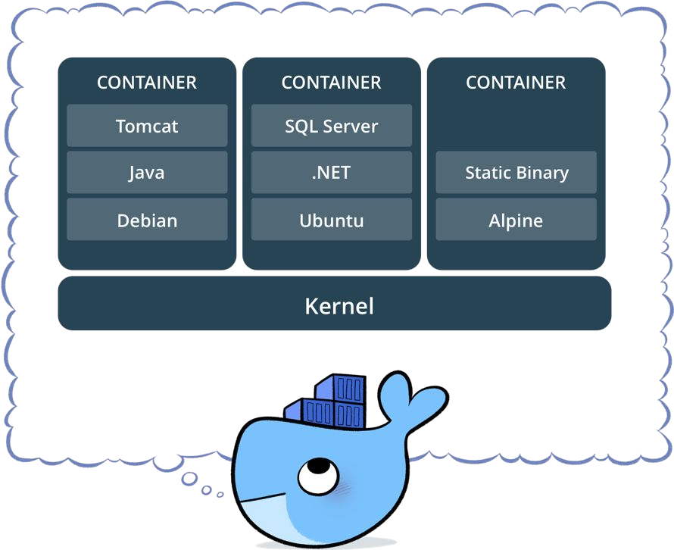
What is a container?
Standardized packaging for software and dependencies
Isolate apps from each other
Share the same OS kernel
Works for all major Linux distributions
Containers native to Windows Server 2016

Slide 4
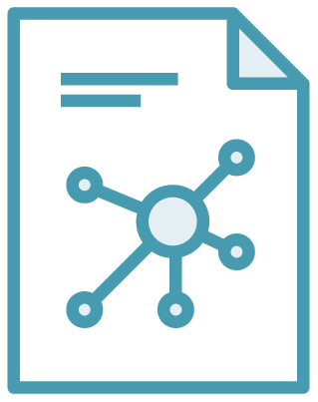

The Role of Images and Containers
Docker Image
Docker Container
Example: Ubuntu with Node.js and Application Code
Created by using an image. Runs your application.

Slide 5




Some Docker vocabulary
Docker Image
The basis of a Docker container. Represents a full application
Docker Container
The standard unit in which the application service resides and executes
Docker Engine
Creates, ships and runs Docker containers deployable on a physical or virtual, host locally, in a datacenter or cloud service provider
Registry Service (Docker Hub(Public) or Docker Trusted Registry(Private))
Cloud or server based storage and distribution service for your images

Slide 6
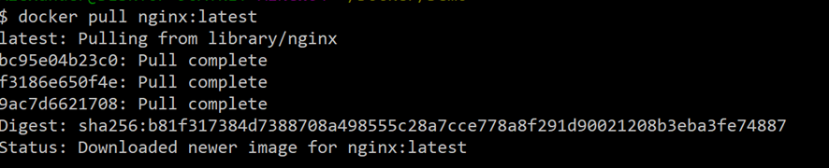
Docker Image Pull: Pulls Layers

Slide 7




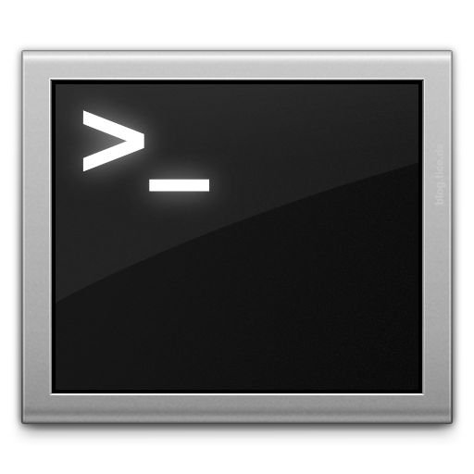







Docker Compose: Multi Container Applications
Build and run one container at a time
Manually connect containers together
Must be careful with dependencies and start up order
Define multi container app in compose.yml file
Single command to deploy entire app
Handles container dependencies
Works with Docker Swarm, Networking, Volumes, Universal Control Plane
49

Slide 8

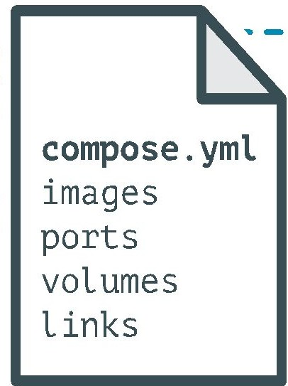
Docker Compose: Multi Container Applications
version: '2' # specify docker-compose version
# Define the services/containers to be run
services:
angular: # name of the first service
build: client # specify the directory of the Dockerfile
ports:
- "4200:4200" # specify port forewarding
express: #name of the second service
build: api # specify the directory of the Dockerfile
ports:
- "3977:3977" #specify ports forewarding
database: # name of the third service
image: mongo # specify image to build container from
ports:
- "27017:27017" # specify port forewarding

Slide 9
Basic Docker Commands
$ docker image pull node:latest
$ docker image ls
$ docker container run –d –p 5000:5000 –-name node node:latest
$ docker container ps
$ docker container stop node(or <container id>)
$ docker container rm node (or <container id>)
$ docker image rmi (or <image id>)
$ docker build –t node:2.0 .
$ docker image push node:2.0
$ docker --help

