Slide 1
Kubernetes intro

Slide 2
Kubernetes definition
Kubernetes is ancient Greek for "Helmsman". Root of the word "Governor", "Cybernetics".
Kubernetes is a "Container Orchestrator" or "Cluster Manager".
Places containers on nodes
Recovers automatically from failure
Basic monitoring, logging, health checking
Enables containers to find each other.

Slide 3
Google grown
Based on ideas proven at Google over 10 years
Google launches 2 billion containers per week.
Part of a larger set of tools that make up the internal Google platform.
Everything at google runs in containers

Slide 4
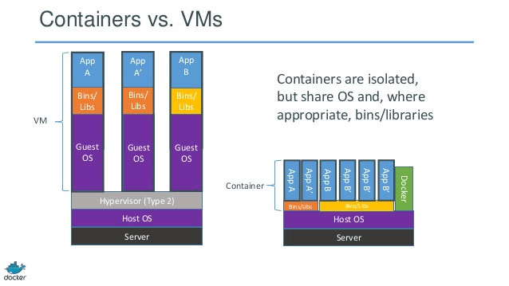
Linux containers

Slide 5

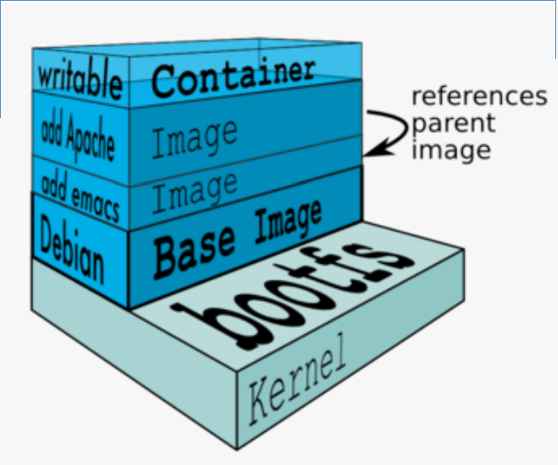
Docker container: layers, union filesystem
Docker images are read-only templates from which Docker containers are launched.
Only top layer is writeable
Copy on write
Only changed layers need to be transferred
Natively supports ZFS for storing layers (zvol)

Slide 6
We need more than just packing and isolation
Scheduling: where should my container run?
Lifecycle and health: Keep my containers running despite failures
Discovery: Where are my containers now?
Monitoring: What’s happening with my containers?
Auth{n,z}: Control who can do things to my containers
Aggregates: Compose sets of containers into jobs
Scaling: Making jobs bigger or smaller
Provisioning storage: block volumes, shared FS

Slide 7
PODs
Pods are the basic building block of Kubernetes
Pods are the smallest deployable units that are created and managed in Kubernetes
A Pod is a group of one or more deeply coupled containers
Shared network
Shared storage
Options to run the containers
Each pod is assigned a unique, DYNAMIC IP address

Slide 8
Service
An interface to a set of replicated pods, which acts as a load-balancer
Provides an abstraction layer
No need to worry about containers location.

Slide 9
Thank You

