Slide 1
Patient View Point
For WebSite Users:
Page-1
First Patient Open the WebSite
Then enter their name and mobile number to send the OTP
Enter OTP and Submit

Slide 2
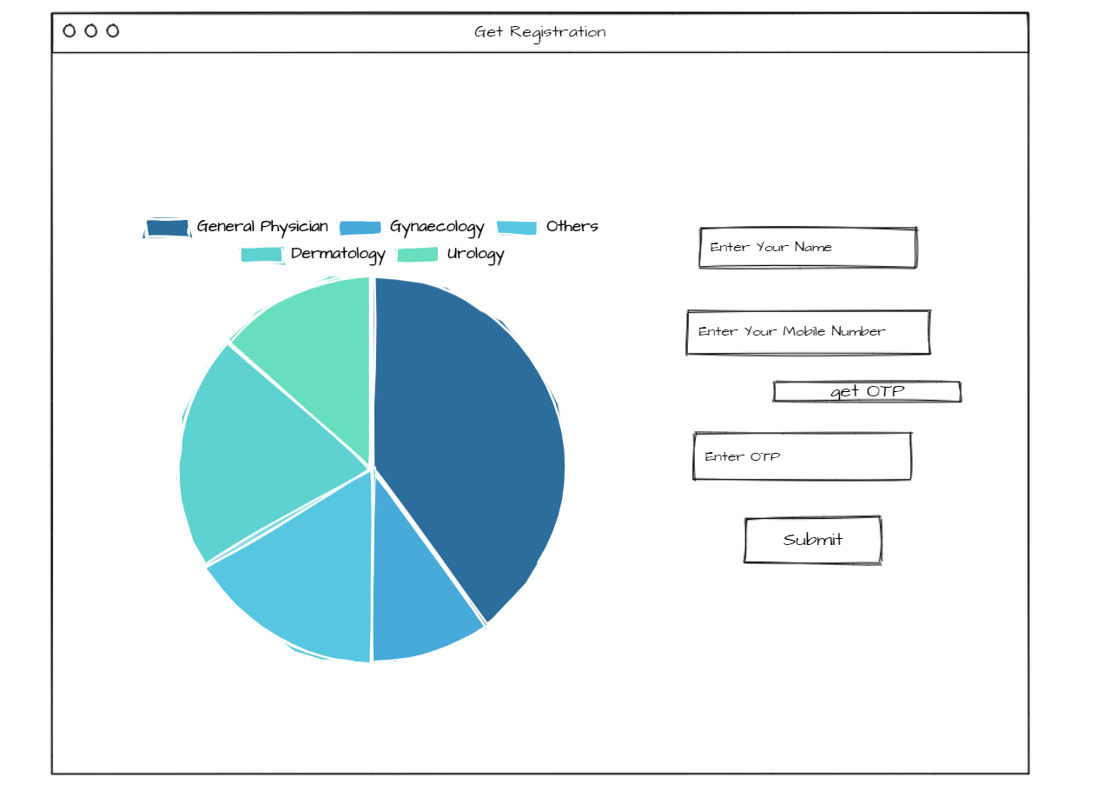

Slide 3
Page-2
In this page shows that patient have to select their location , health issue , Date for appointment then search it
It shows the list of Doctors that were available at that time period with Doctor name , year of experience , Hospital working , Location ,consult fees , rating for the doctor
On right side shows that doctor available slots
We have to select one and then click book

Slide 4
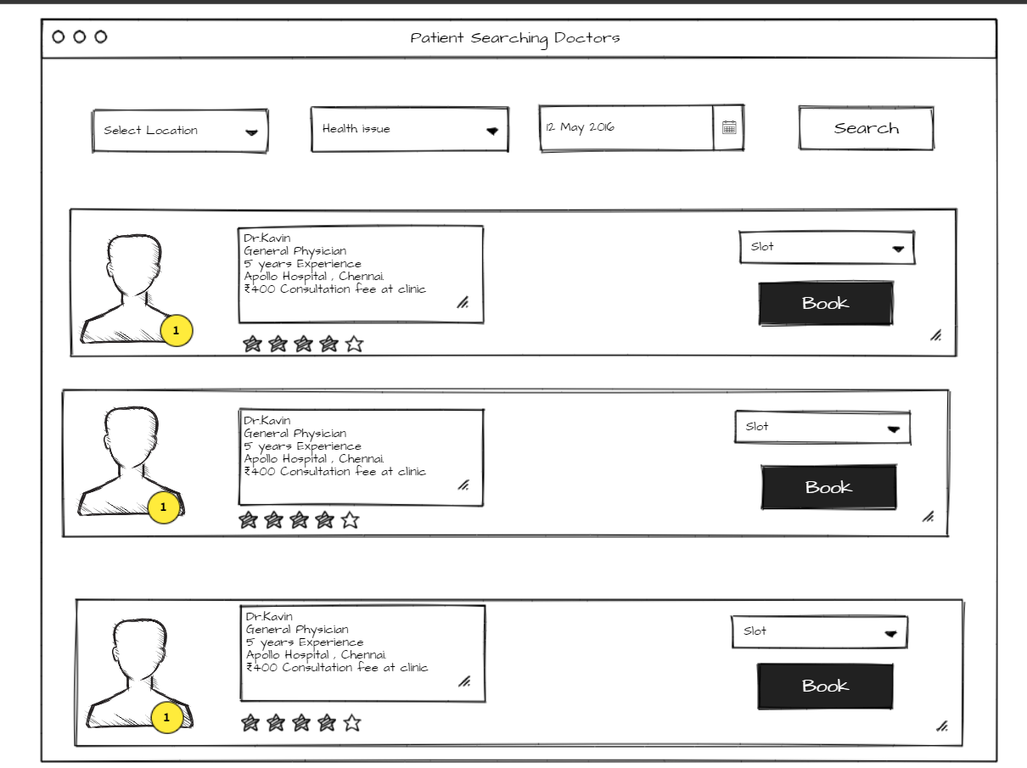

Slide 5
Page-3
After Booked the slot notification send to doctor to approve
If doctor confirm the solt it send a text msg to patient mobile no and url to redirect the path
Else doctor denied it send a text msg to patient that “Sorry he is busy !Consult another doctor !!!! ”

Slide 6
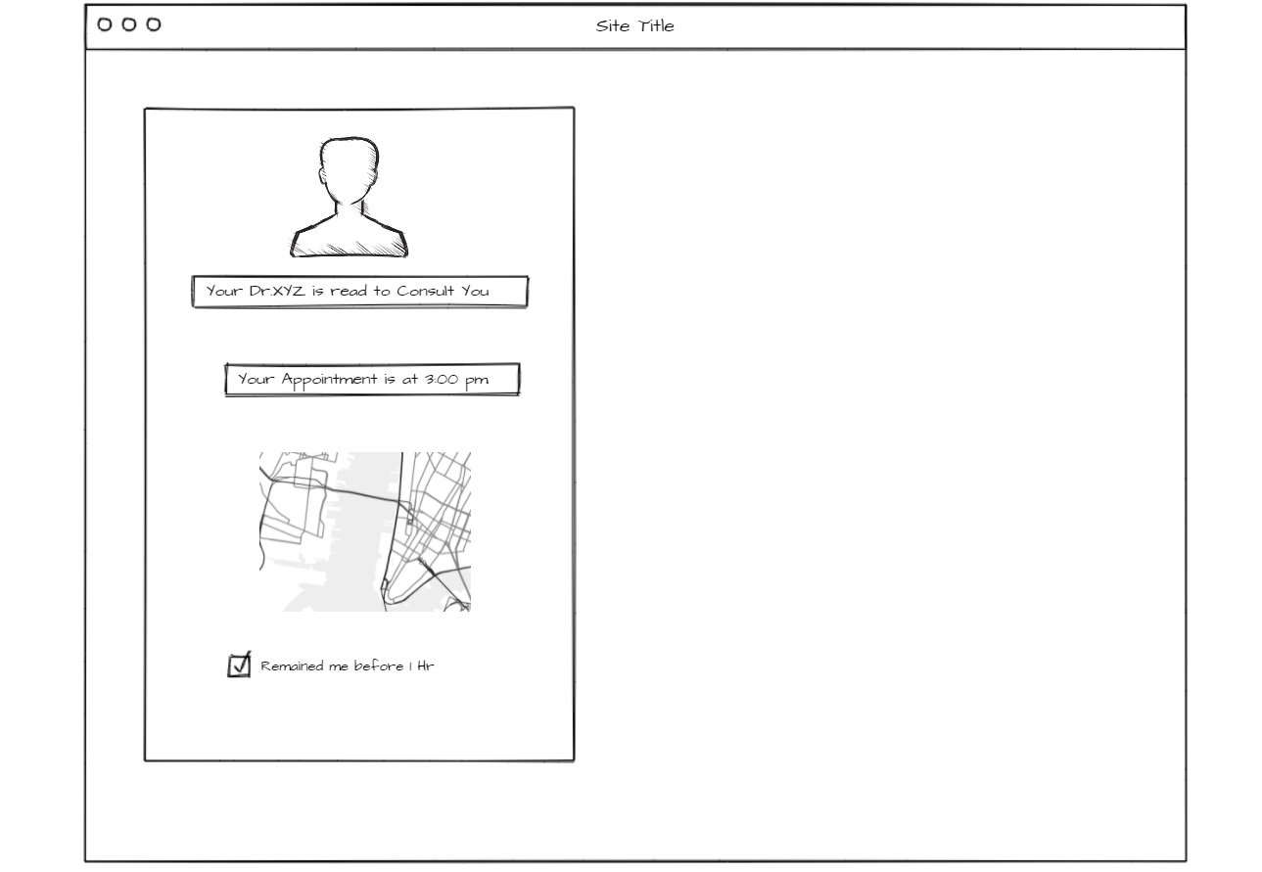

Slide 7
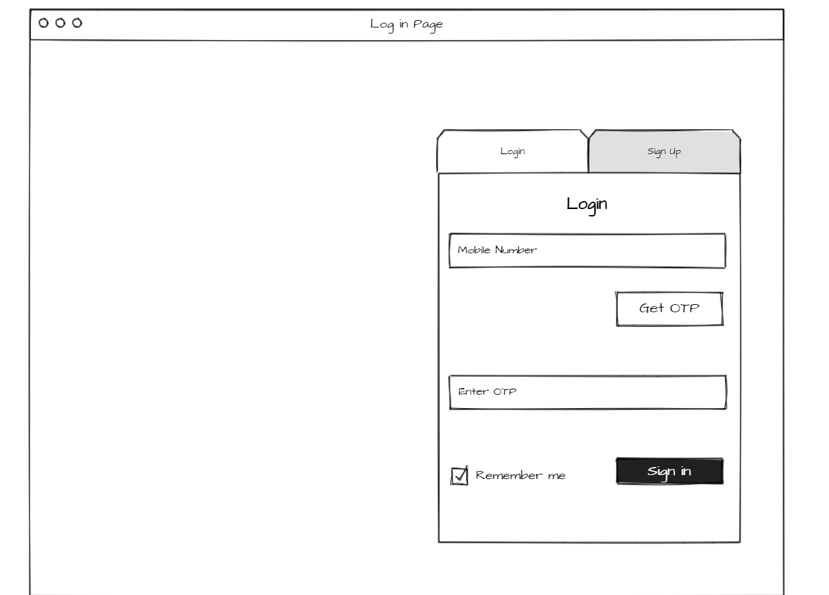
Doctor View

Slide 8
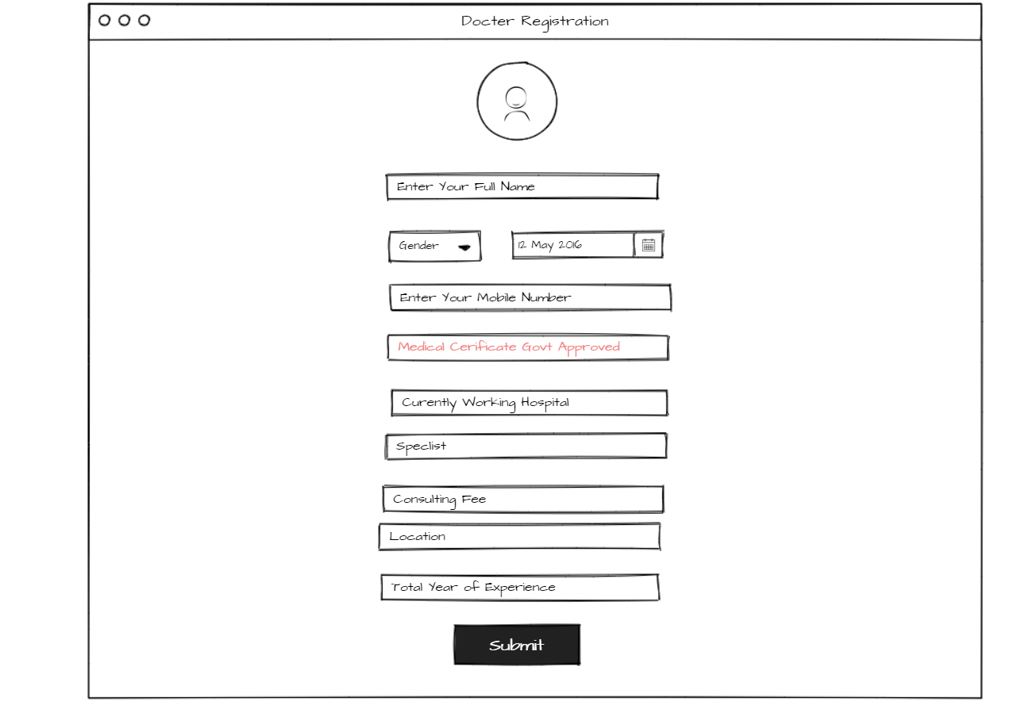
Doctor View

Slide 9
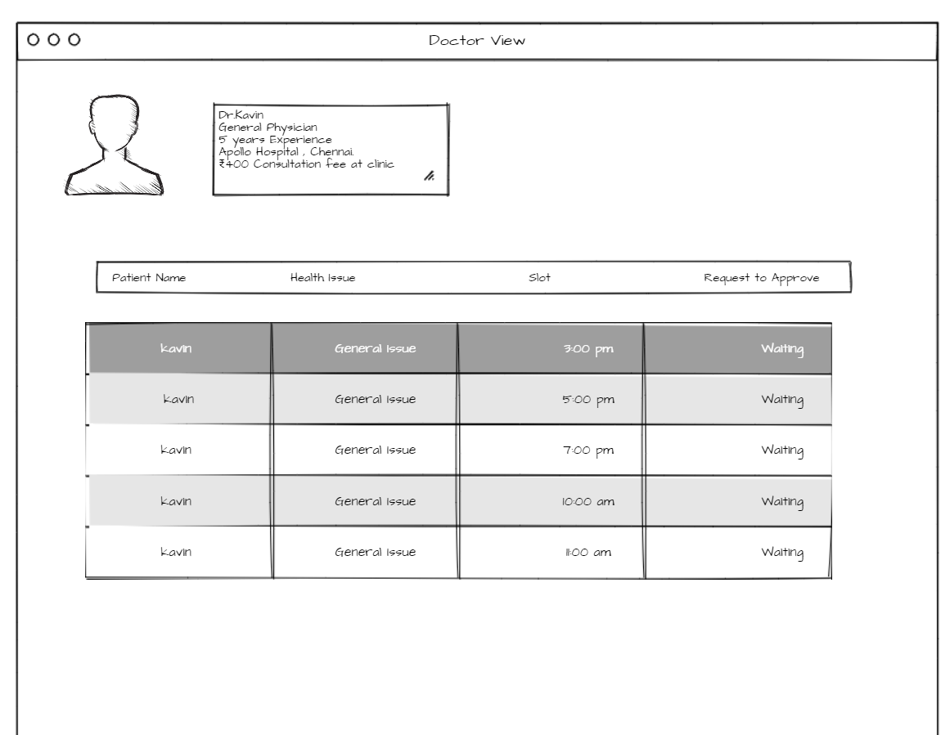

Slide 10
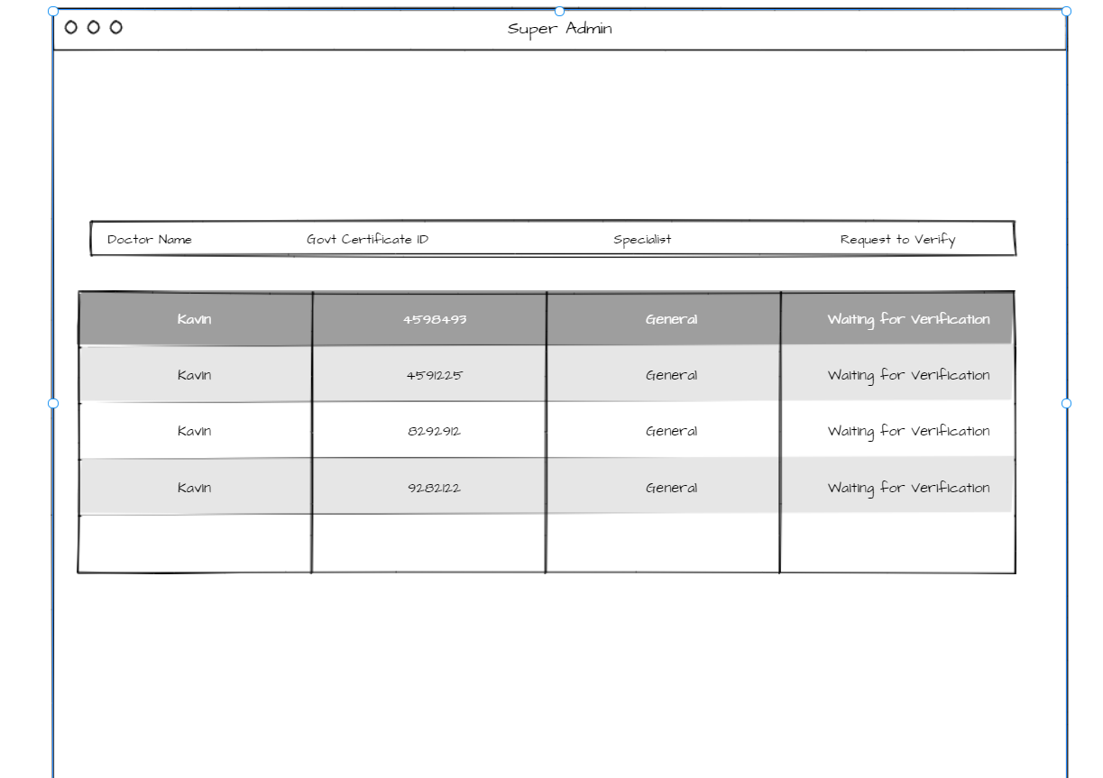
Super Admin

