Slide 1
AUTOMATED PROCESSING FOR SOCIAL MEDIA DATA IN A MASS EMERGENCY

Slide 2


External Supervisor
Local Supervisor
Dr Raj Prasanna
PhD, MSc in IT, MBA, BSc Eng (Hons), CEng in IT Senior Lecturer Massey University , New Zealand.
Mr Nuwan Kuruwitaarachchi
BSc(Hons) (SHU) M.Sc(IT) (SLIIT) MBA- (PIM- USJ) Sri Lanka Institute of Information Technology
Department of Information Technology.

Slide 3
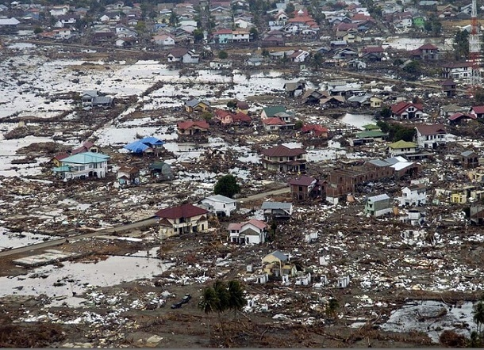
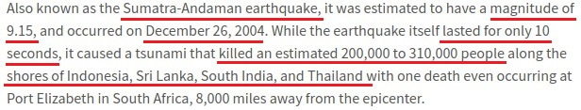
Indian Ocean Earthquake (2004)

Slide 4
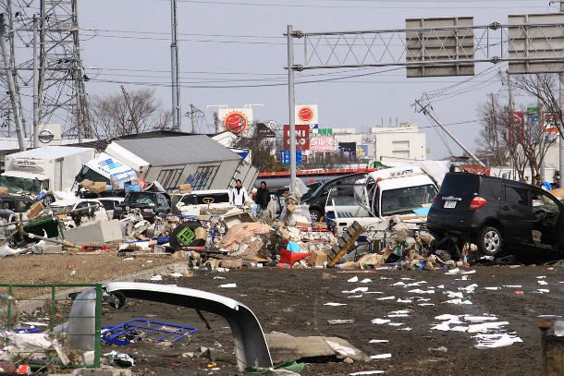
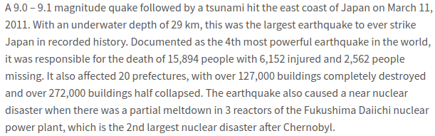
Tōhoku Earthquake and Tsunami (2011)

Slide 5
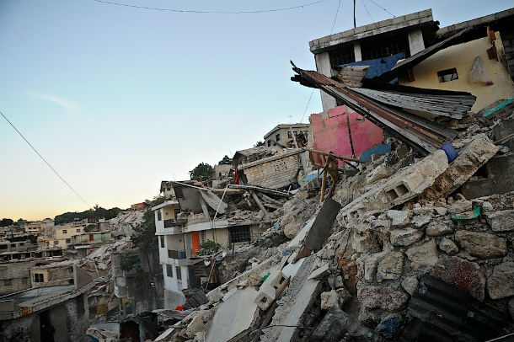
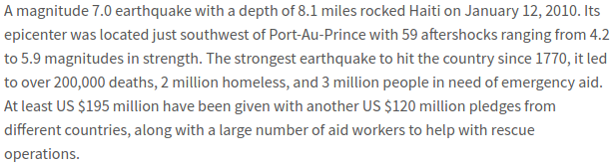
Haiti Earthquake (2010)

Slide 6
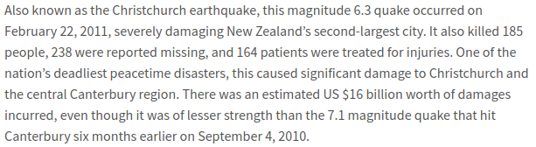
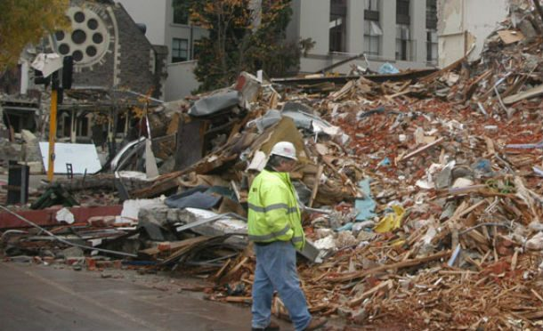
New Zealand Earthquake (2011)

Slide 7
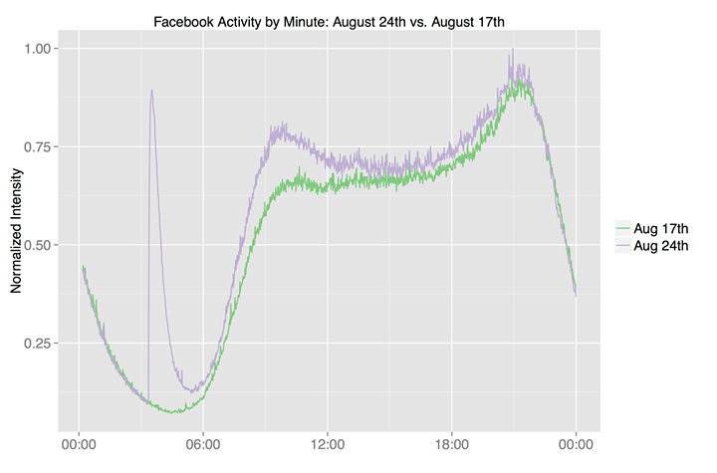
August 24th 2014, 3:20 a.m Pacific time, an earthquake of magnitude 6.0 occurred in the Bay Area, 3.7 miles (6.0 km) northwest of American Canyon near the West Napa Fault. - Facebook Data Science Team [1]

Slide 8
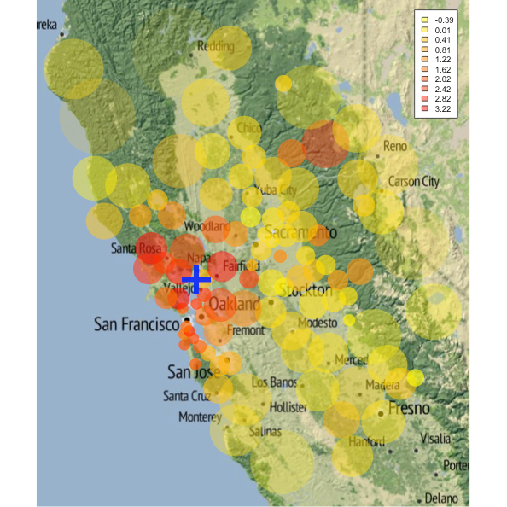
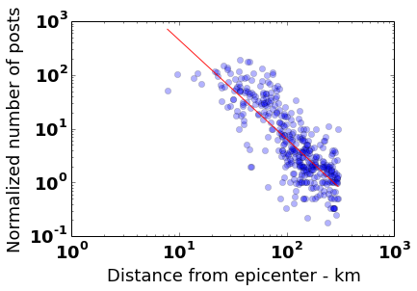
Facebook activity during bay area earthquake 24th Aug 2014 - Facebook Data Science Team [1]

Slide 9
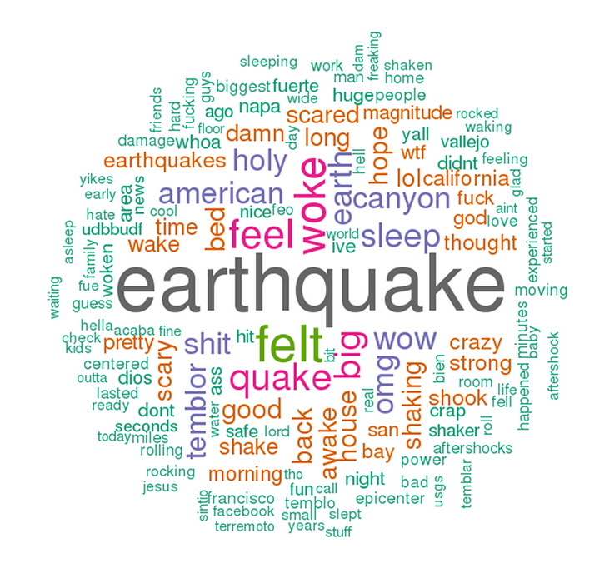
Word cloud of public posts within one hour of the earthquake - Facebook Data Science Team [1]

Slide 10
Problem
Burst of information generated via social media during an emergency.
Finding situational awareness information is hard.
Done manually by teams called intelligent teams/ Digital volunteers.
Collecting relevant information is important.
Ensuring trustworthiness and reliability of information.
First responders take critical decisions depending on the available information which is scarce.

Slide 11
AUTOMATED PROCESSING FOR SOCIAL MEDIA DATA IN A MASS EMERGENCY

Slide 12





Existing Systems
Notes:
AIDR uses crowdsourcing as the main method to develop a model.
It takes time so it is only useful in aftermath of a incident.
None of these contains a component to evaluate the accuracy of the information.

Slide 13
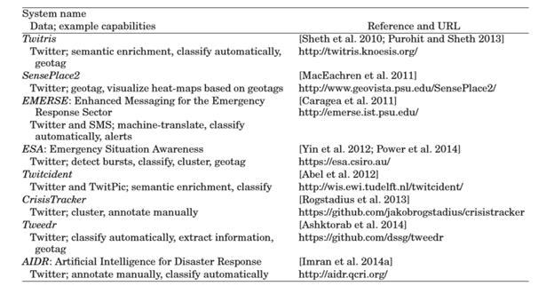
Existing Systems cont.
Existing systems and where to find them [2]

Slide 14
Existing Systems cont.
Features | Twitris | Senseplace 2 | EMERSE | AIDR | Proposed System
Automated Classification
Prioritizing
Criticality Analysis
Accuracy Validation
Text Summarization

Slide 15



Data Sources

Slide 16
Benefits
Reduce the amount of information to be examined by humans.
Trend identification.
Evaluate the accuracy of information to identify false rumors.
Use in all three stages of an emergency namely pre, during and post.

Slide 17




Categorizing and Prioritizing Entries
Sentiment Analysis to Determine Criticality
Automatic Text Summarization
Validating Accuracy

Slide 18
Categorizing and Prioritizing
By K.C.Kodithuwakku

Slide 19
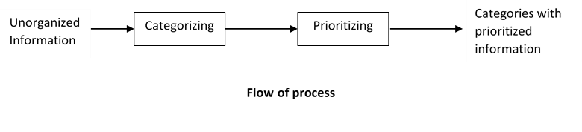
Categorizing and Prioritizing Entries
Is the component where the entries will be extracted,categorized and prioritized.

Slide 20
Type of information that we are interested in
"OMG! The fire seems out of control: It’s running down the hills!” (bushfire near Marseilles, France, in 2009, quoted from Twitter in De Longueville et al. [2009])
“Red River at East Grand Forks is 48.70 feet, +20.7 feet of flood stage, −5.65 feet of 1997 crest. #flood09” (automatically-generated tweet during Red River Valley floods in 2009, quoted from Twitter in Starbird et al. [2010])
“Anyone know of volunteer opportunities for hurricane Sandy? Would like to try and help in any way possible” (Hurricane Sandy 2013, quoted from Twitter in Purohit et al. [2013])
“My mom’s backyard in Hatteras. That dock is usually about 3 feet above water [photo]” (Hurricane Sandy 2013, quoted from Reddit in Leavitt and Clark [2014])
“Sirens going off now!! Take cover ... be safe!” (Moore Tornado 2013, quoted from Twitter in Blanford et al. [2014])

Slide 21
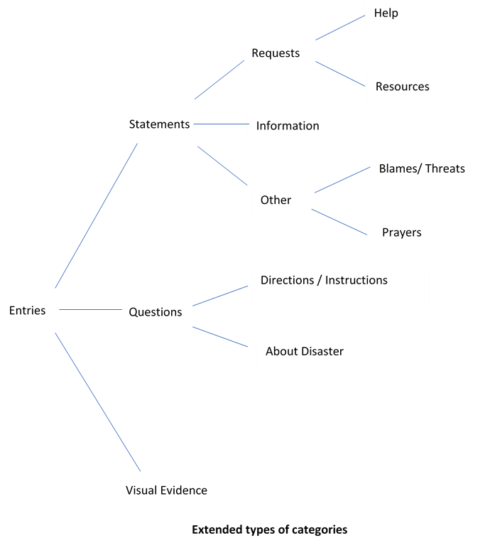
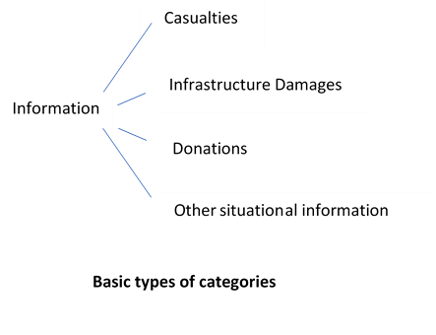
Categorization

Slide 22
Prioritizing
Entries with visual evidence (images or videos) in each category.
Entries which have drawn a lot of attention. ( more likes , shares or retweets).
Entries which contains prioritized words.

Slide 23
Motivation
While understanding the meaning of a text, identifying meaningful (relevant) text is more important.
Filtering only the information that are useful.
Different types of information sought by different kinds of stakeholders.
Provide fast insight into the situation to help first responders in their critical decision making.

Slide 24
Concepts to be used
Regular Expressions for pattern matching.
Natural Language Processing concepts tokenizing ,stemming etc for filtering, identifying and categorizing relevant information.
N-gram is the way of identifying the probability of 1 or more (N) number of words occurring in a sequence.

Slide 25
Determine Criticality
By P.A.D.Perera

Slide 26
Sentiment analysis
What is sentiment analysis?
Sentiment analysis is the multidisciplinary field of study that deals with analyzing people’s sentiments, attitudes, emotions and opinions about different entities using machine learning techniques.
How does sentiment analysis can be used with disaster management in social media?
There are millions of social media posts that are generating during emergencies and disasters.
Sentiment analysis of disaster related posts in social media is one of the techniques that could gear up the detecting of posts for situational awareness.
By using sentiment analysis as a natural language processing technique for analysing those posts, it can be derived various contexts from them.

Slide 27
Sentiment analysis component
What does the Sentiment analysis component do?
It is about performing a sentiment analysis of the social media posts and predicting the criticality of the situation.
Why we need sentiment analysis component for this project?
To help supporting team for identify and prioritizing the people and places who need help first.
To help supporting team for getting the idea about criticality of the situation.
To help supporting teams for getting the correct decisions.

Slide 28
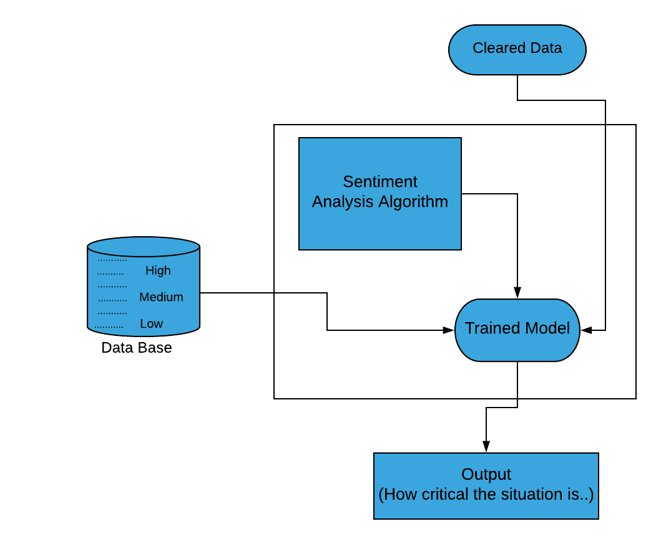
How sentiment analysis component works

Slide 29
Automatic Text Summarization
By T.M.T.A.Gunarathna

Slide 30
Why will automatic text summarization be used?
Has been a tremendous amount of text data from a variety of sources.
Would be invaluable source of information and knowledge
Needs to be summarized to be useful.
Helps to gain required information in less time.
Produces a shorter representation of the original text.

Slide 31
What is automatic text summarization?
According to Radef et al. a summary is defined as,
“a text that is produced from one or more texts, that conveys important information in the original text(s), and that is no longer than half of the original text(s) and usually, significantly less than that”.

Slide 32
Automatic text summarization is the task of producing a concise and fluent summary while preserving key information content and overall meaning.
Is a process of extracting or collecting important information from original text and presents that information in the form of summary.
Text summarization approaches
Extractive summarization
Abstractive summarization

Slide 33
Extractive summarization
Extractive summarizations extract important sentences or phrases from the original documents and group them to produce a summary without changing the original text.
Abstractive summarization
Abstractive summarization consists of understanding the source text by using linguistic method to interpret and examine the text
need a deeper analysis of the text.
have the ability to generate new sentences.
improves the focus of a summary.
reduce its redundancy and keeps a good compression rate.

Slide 34
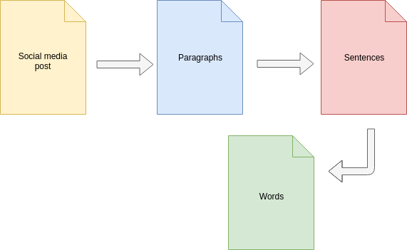
How will automatic text summarization be done?

Slide 35
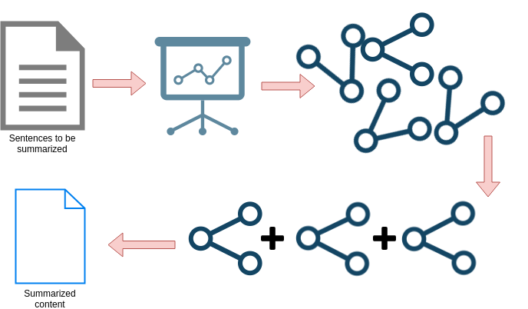
Automatic text summarization process

Slide 36
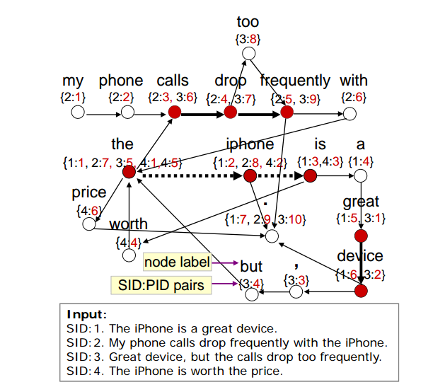

Slide 37
Validating Accuracy
By S.D.S.Madushani

Slide 38
“Don’t believe everything you read or see on the internet”

Slide 39
Why validating accuracy?
To measure reliability of the entries
To avoid hearsay and rumors
Sharing false information can be tragic
To give up to date information
“Should do even though response time might hindered”

Slide 40
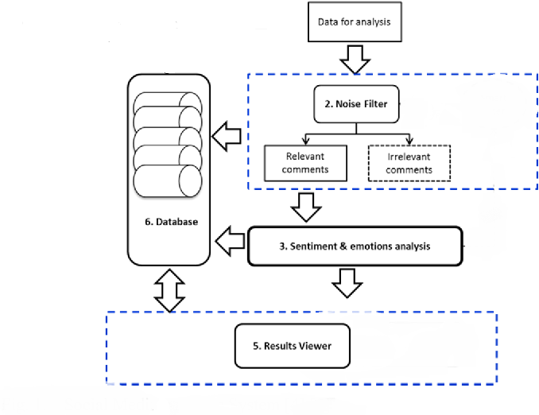
Process of Validating Accuracy

Slide 41
Technologies and Concepts to be Use
Collaborative filtering
Natural Language Processing for sentiment analysis
N-gram with sentiment analysis

Slide 42
Solution Architecture
Filtering /Categorizing and Prioritizing
API
Client
DB
Criticality Analyzer
Accuracy Validator
Text Summarizer

Slide 43
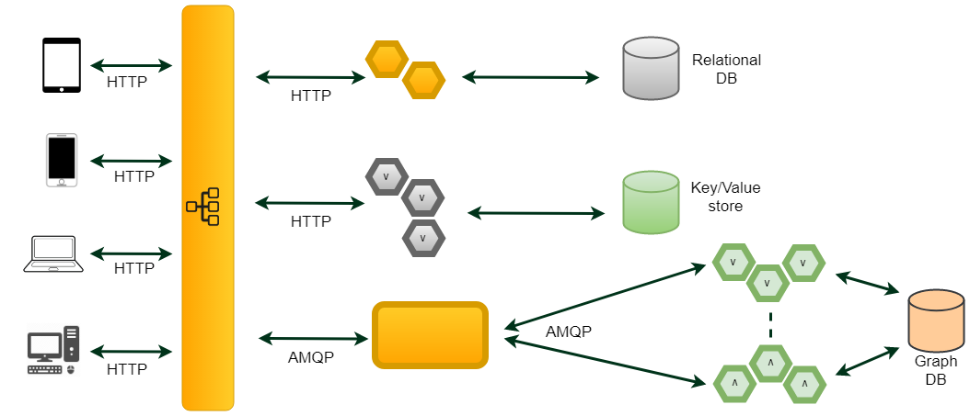
Software Architecture

Slide 44







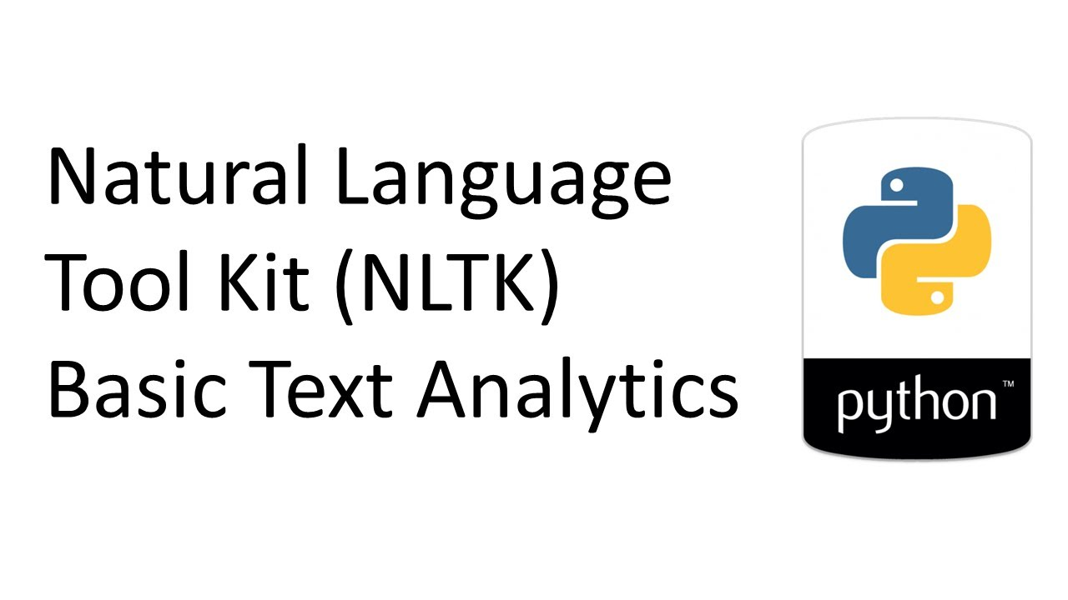




Slide 45
Commercial Value
Can get useful information within short period of time
Useful for disaster response teams (government or private)
Volunteering and community service teams can use to get information

Slide 46
Thank You!

Slide 47
Reference
[1] https://www.facebook.com/notes/facebook-data-science/on-facebook-when-the-earth-shakes/10152488877538859
[2] Muhammad Imran, Carlos Castillo, Fernando Diaz, and Sarah Vieweg. 2015. Processing social media messages in mass emergency: A survey. ACM Comput. Surv. 47, 4, Article 67 (June 2015), 38 pages.DOI: http://dx.doi.org/10.1145/2771588

