Slide 1


Slide 2
VELALAR COLLEGE OF ENGINEERING AND TECHNOLOGY MINI PROJECT WEB SCRAPER FOR AMAZON E-COMMERCE WEBSITE
BATCH NO : 31
GUIDED BY :
MS.S. PONNI
SUBMITTED BY :
J. ABDUL RAHMAN (17CSR001)
G. KAVIN (17CSR046)

Slide 3
INTRODUCTION
Web scraping is the process of extracting content and data from a website.
This information is collected and then exported into a format that is more useful for the user.
Web scraping is used to collect only visible information that is displayed in webpage.
No private data is stolen, so there are no reasons to be afraid for reputation or any law violations.

Slide 4
INTRODUCTION
Web scraping a web page involves fetching it and extracting from it.
Web scraping software may access the World Wide Web directly using the Hypertext Transfer Protocol, or through a web browser.
The content of a page may be parsed, searched, reformatted, its data copied into a spreadsheet, and so on.

Slide 5
ABSTRACT
Information is the most valuable commodity in the world.
So Data is required to sell or buy goods online.
Unfortunately, all the abundant data on the internet is not open and available for download.
So, Web scraping is the ultimate way to collect this data.
Data once collected can be further analyzed to get valuable insights into almost everything.

Slide 6

Web scraping allows to extract large amounts of data in a short time.
For e-commerce it is very importance to know the prices of other companies.
Web scraping allows to extract data from different stores and thus make strategic decisions.

Slide 7
Objective and Scope
The main objective of the system is to scrape data from e-commerce website.
E-commerce web scraping is a kind of data scraping related to the e-commerce segment of the web.
It helps companies to find out charges from different sites for the same product or service.
This gives the business an opportunity to decide the offering’s price.

Slide 8
Objective and Scope
Price optimization helps e-commerce businesses to boost profits tremendously.
By using e-commerce web scraping all possible information about goods and services available on a competitor’s website can be extracted.
Predictive analysis helps E-Commerce merchants to know what customers want and how much they will pay for it.

Slide 9
LITERATURE SURVEY
Web scrapers are an attractive technological development.
In order to be able to automatically identify, extract and store the attributes of all products of any e-shop website. in a structured format the approach needs to provide the following functions in a sequential order:
Product page detection: Automated detection of all Web pages containing product lists within the e-shop websites.

Slide 10
LITERATURE SURVEY
Product record detection: Automated detection of the product lists and the single product records within the Web pages.
Product attribute extraction: Automated detection, extraction and structured storing of the product attributes of the product records.
Product attribute assignment: Automated assignment of the extracted attributes to a defined product property for further processing steps and calculations.

Slide 11
Existing System
Beautiful Soup is a Python libraries which helps in parsing HTML or XML documents into a tree structure to find and extract data.
This tool features a simple, Python interface and automatic encoding conversion to make it easy to work with website data.
But the problem with Beautiful Soup is it can’t able to do the entire job on its own.

Slide 12
DRAWBACKS
To analyze the retrieved data, it needs to be treated first. This often becomes a time-consuming work.
For those, who are not much tech-savvy and aren’t an expert, web scraping can be a confusing process. Even though, it’s not a major issue.
Sometimes web scraping services take time to become familiar with the core application and need to adjust to the scrapping language.
Most web scrapping services are slower than API calls and another problem is the websites that do not allow screen scrapping.

Slide 13
Proposed System
Scrapy is a open source python framework which is written for web scraping.
Scrapy contains an integrated pipeline for processing the scraped data.
The page fetch in Scrapy is asynchronous; this means that several pages can be downloaded in parallel.
Thus, Scrapy is well suited for scraping projects with a high volume of pages to be processed.

Slide 14
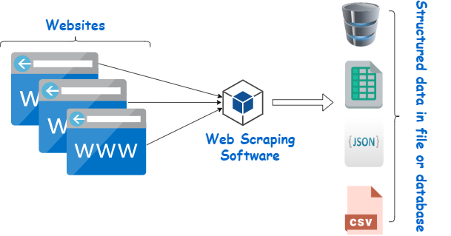
PROPOSED DIAGRAM FOR WEB SCRAPING

Slide 15
Advantages
Web scraping helps in deriving accurate details.
This gives the business an opportunity to decide their own offering’s price.
Price-monitoring and Product Research.
Better Customer analysis.
Influences Marketing and Sales Strategy.
Helps in Future analysis.

Slide 16
Hardware Requirement
This section gives the details and specification of the hardware on which the system is expected to work.
Processor : Intel dual core processor
RAM : 2 GB SD RAM
Hard disk : 500 GB

Slide 17
Software Requirement
This section gives the details of the software that are used for the development.
Operating System : Windows 7 and above or Linux
Environment : Python Editor
Language : Python-Language

Slide 18
PROPOSED METHODOLOGY
SCRAPY
It is a scraping framework, used to crawl websites and extract structured data from their pages.
It can be used for a wide range of purposes, from data mining to monitoring and automated testing.
Scrapy also provides a web-crawling shell, which can be used by developers to test their assumptions on a site’s behavior.

Slide 19
PROPOSED METHODOLOGY
SPIDER
Spiders are classes which define how a certain site will be scraped.
Including how to perform the crawl and how to extract structured data from their pages.

Slide 20
PROPOSED METHODOLOGY
SELECTOR
Scrapy Selectors is a thin wrapper around parsel library.
The purpose of this wrapper is to provide better integration with Scrapy Response objects.
They are called selectors because they “select” certain parts of the HTML document specified either by XPath or CSS expressions.

Slide 21
MODULES DESCRIPTION
Product data to be scraped from Amazon
ASIN ID
PRODUCT NAME
PRODUCT RATING
NUMBER OF REVIEWS
PRODUCT PRICE

Slide 22
MODULES DESCRIPTION
ASIN ID
Amazon Standard Identification Number (ASIN) is a unique ten-digit alphanumeric code that identifies products on Amazon.

Slide 23
MODULES DESCRIPTION
CSV file (for saving the scraped data from Amazon)
A CSV is a comma-separated values file, which allows data to be saved in a tabular format.
CSVs look like a garden-variety spreadsheet but with a .csv extension.

Slide 24
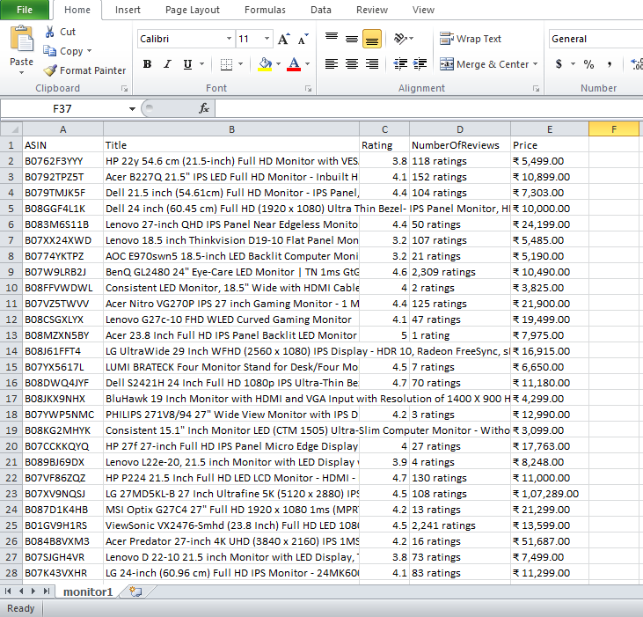
SCREEN SHOT

Slide 25
CONCLUSION
Data has become the basis of all decision-making processes to business and non-profit organization.
Therefore, web scraping has found its applications in every endeavor of note in contemporary times.
It is clear that those who will make advanced use of web scraping tool will gain a competitive advantage.
It is safe to say that web scraping has become an essential skill to acquire in today’s digital world.

Slide 26
FUTURE SCOPE
The Future of web scraping is indeed bright and it will become more and more essential for every business with the passage of time.
The upcoming forecasts of the market and web scraping can play an important role in tracking marketing trends.
The Web Scraping of user reviews and customer feedback will be very important in the near future.
It can be helpful to make online business directories or real-estate websites and search engines.

Slide 27
REFERENCE
[1] https://ieeexplore.ieee.org/document/7345488
[2] https://ieeexplore.ieee.org/document/7405846
[3] https://en.wikipedia.org/wiki/Web_scraping
[4] https://www.geeksforgeeks.org/project-idea-web-scraping/
[5] https://en.wikipedia.org/wiki/Data_scraping
[6] Deepak Kumar Mahto, Lisha Singh, A Dive into Web Scraper World, 2016 International Conference on Computing for Sustainable Global Development (INDIACom), 978-93805-4421-2/16/$31.00 c , 2016 IEEE.
[7] List of Web Harvester, Data Scraper, Web Scraping Software and Tools, n.d.WebData Scraping. URL http://webdata-scraping.com/webscraping-software/
[8] S.C.M. de S Sirisuriya,2015, A Comparative Study on Web Scraping .Proceedings of 8th International Research Conference, KDU.

Slide 28
THANK YOU

