Slide 1

Department of Electrical and Electronics Engineering
Avoid fire accident in EV vehicle with multiple fault detection Using AI and IoT
Batch No. 5
Project member:
BOOMIKA P : 613521105007
KAVINAYA P : 613521105020
SUVITHA M : 613521105045
Under the guidance of, Dr.P.KARPAGAVALLI M.E.,Ph.D.
ASSOCIATE PROFESSOR/EEE

Slide 2
Objective
The objective of this project is to develop a real-time electric vehicle fault detection system using Arduino, IoT, and multiple sensors.
It aims to monitor key EV parameters like battery temperature, engine temperature, voltage, and vibration to ensure safety by preventing hazards such as overheating and fire.

Slide 3

Proposed Project Work – Block Diagram
PC
INTERFACE
USER
INTERFACE
OUTPUT
ANALYSIS
IoT
USB TO PC
ARDUINO
NANO
Motor
  Temperature
  Vibration
BUZZER & LCD
BATTERY
  Temperature
  Voltage
  Flame sensors
THERMAL MANAGEMENT

Slide 4
Explanation of block diagram:
Sensors (Temperature, Voltage, Flame, Vibration)
Arduino Nano (Microcontroller for data processing)
LCD Display (Shows real-time status)
Buzzer (Alerts when faults are detected)
Relay and Motor/Fan (Controls the load in case of faults)
IoT Module for cloud updates.

Slide 5
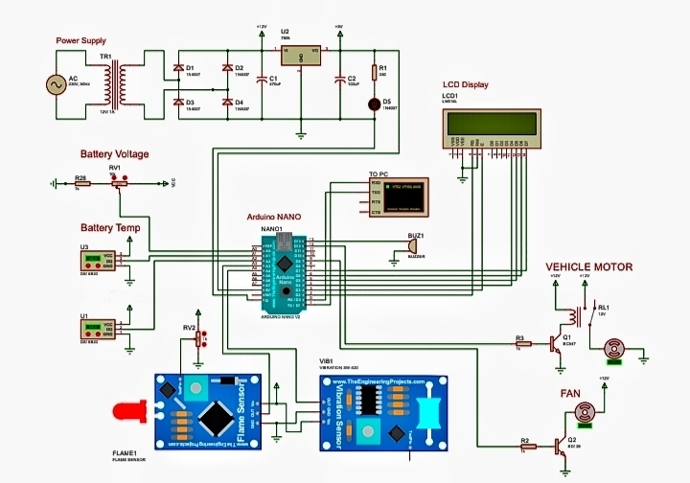
Simulation developed :

Slide 6
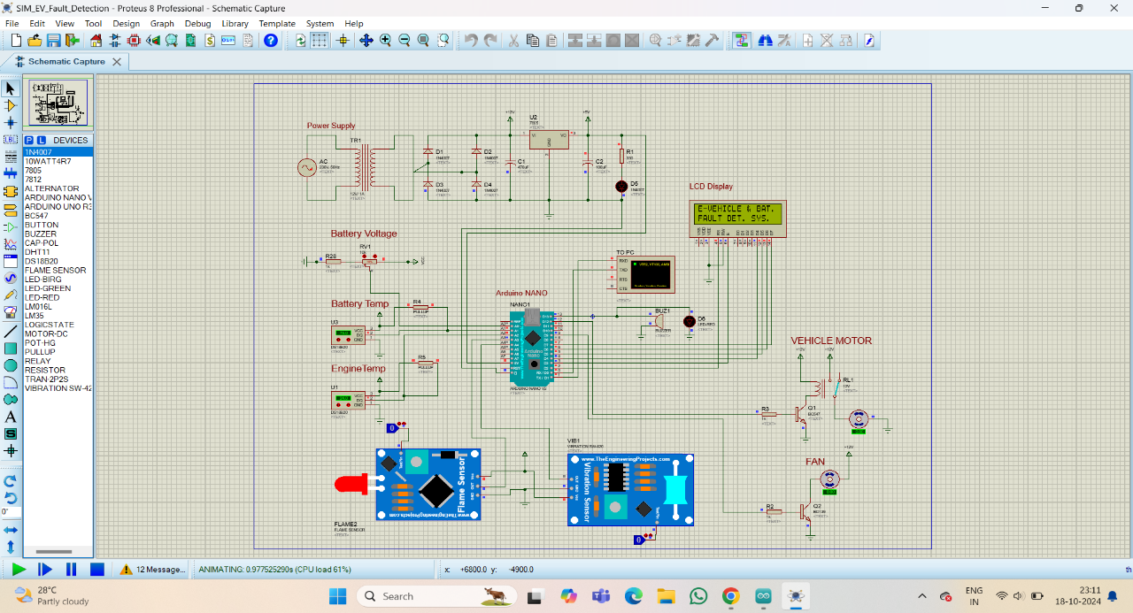
Simulation

Slide 7
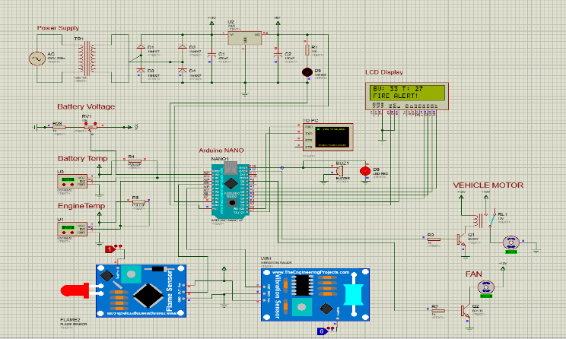
Simulation

Slide 8
Explanation of Each Block
Arduino Nano: Core controller that reads sensor data and controls output devices.
DS18B20 Sensors: Monitor battery and motor temperature.
Voltage Sensor (RV1 + R28): Measures battery voltage using voltage divider.
Flame Sensor: Detects fire near battery/motor area.
Vibration Sensor (SW-420): Senses abnormal shocks or impacts.
Relay & Motor: Relay (via transistor) controls motor ON/OFF during faults.
LCD Display: Shows real-time temperature, voltage, and fault alerts.
Buzzer: Beeps during fault detection to alert the user.
Power Supply: Converts AC to regulated DC for system operation.

Slide 9
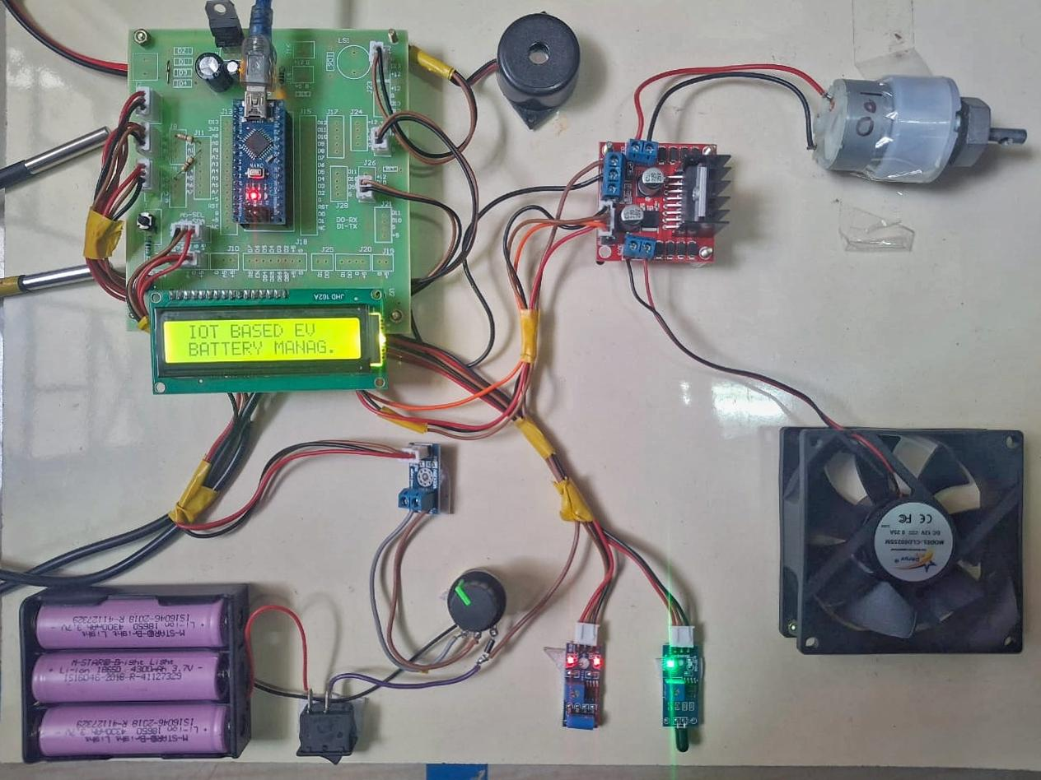
Hardware system of the project:

Slide 10
Fault’s :
High battery temperature fault
High motor temperature fault
Low voltage fault
Vibration fault
Flame falut .

Slide 11
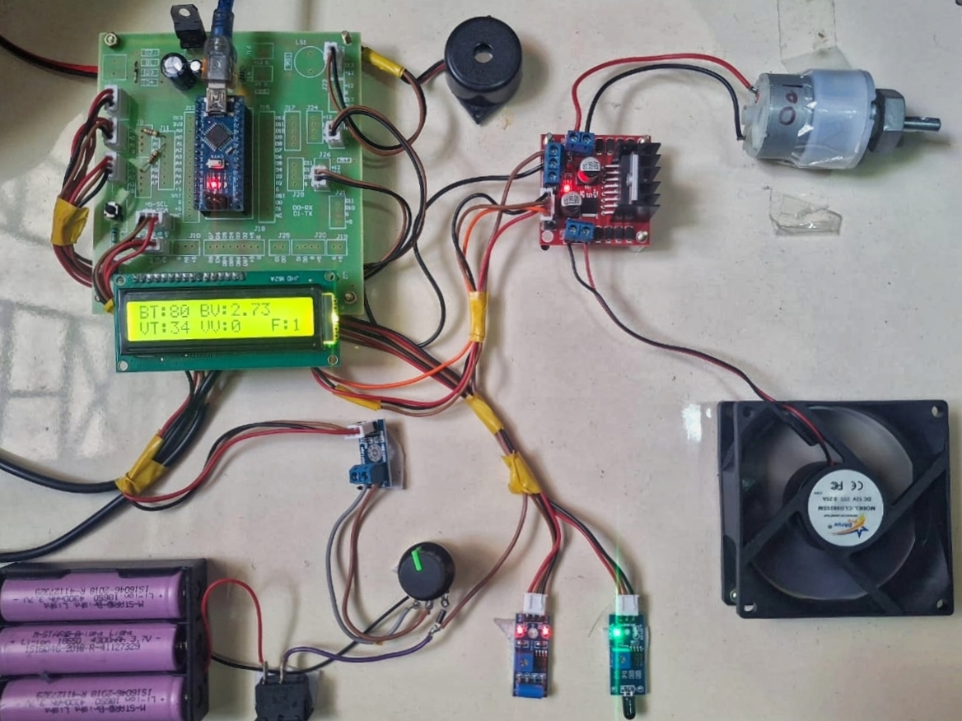
High battery temperature fault :
A temperature sensor is attached to the battery section. When the temperature exceeds 37°C, it is considered as high-temperature fault.

Slide 12
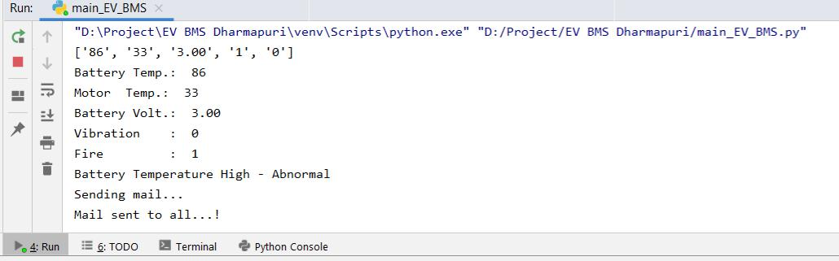
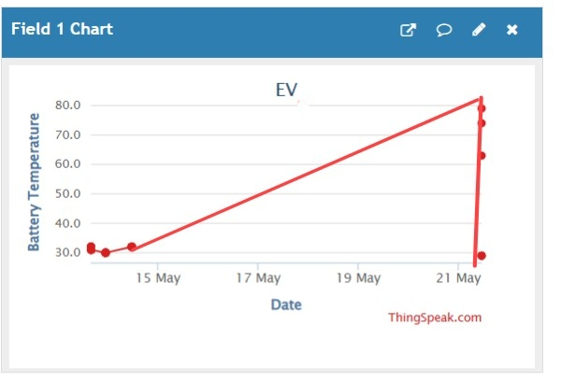
AI Pycharm output:
ThingSpeak Iot data cloud output:

Slide 13
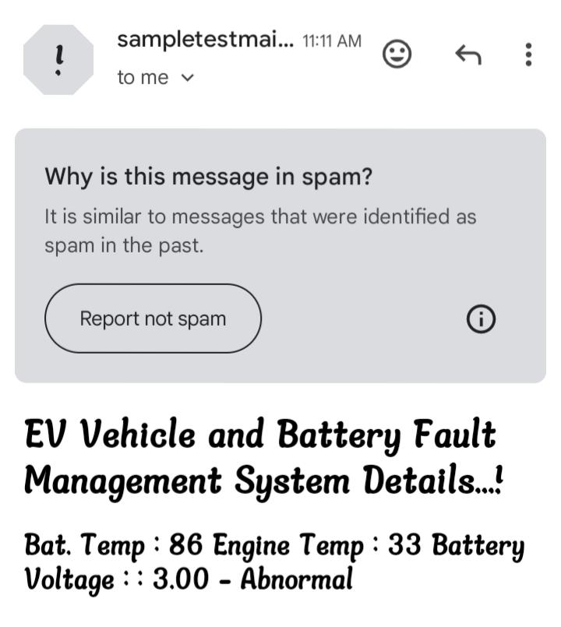
Email alerts for high battery temperature fault :

Slide 14
2. High motor temperature fault :
A sensor monitors the motor temperature. If the temperature rises above 37°C, it indicates overheating.
Outcome:
When a high motor temperature fault occurs, the motor is disconnected immediately to prevent damage.
The buzzer is turned ON to notify the user of overheating.

Slide 15
3. Low voltage fault :
The system monitors the voltage level using a voltage sensor. A fault is triggered when the voltage drops below 2V, which may lead to inefficient or unstable operation.
Outcome:
The motor is shut down automatically to prevent malfunction or damage due to insufficient power.
The buzzer is turned ON and A warning message is displayed on the LCD.

Slide 16
Vibration fault:
When vibration is detected, the motor is disconnected to avoid further mechanical stress or damage.
The system also displays a warning on the LCD
Flame Fault:
A flame or heat sensor detects the presence of fire or excessive heat.
The buzzer is turned ON as an emergency alarm.
The cooling fan is activated to help reduce the heat or disperse smoke.

Slide 17


