Slide 1
An Ensemble Approach to Artificial Conversations
-Kavin Chandrasekaran

Slide 2
Introduction
Siri
Cortana (Kinect!)
Alexa (Echo View!)
Google Assistant
Replika

Slide 3
Background:
Communication - Who doesn’t like to talk!
Got Accustomed?
Part of every day life.
Remember the racial-slur swearing , Microsoft’s twitter bot?

Slide 4
Background
Emotions
Major limiting factor in the inter-species communication between Homosapiens and Autobots
Emotional manipulation is strong way to win arguments and decide which path a conversation takes.

Slide 5
Method
POS-tagger
Using RNN-LSTM
Emotional Analysis
MLP, BPP NN
Decision making
Trees
Text generation
Using RNN-LSTM

Slide 6
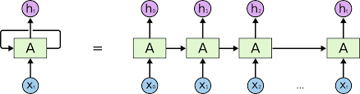
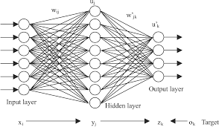
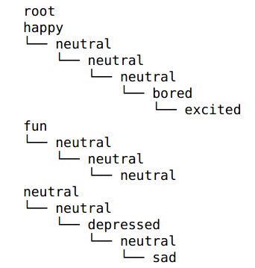
You Moon magic shine
Hi, Donna.
How are you.

Slide 7
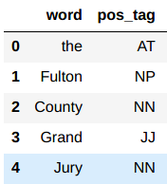
Tagger
Using recurrent NN.
Total of 303 unique parts of speech!
By using the recurrent NN we can predict the pos of the next word.
Why not just do classification? Will discuss that later.

Slide 8
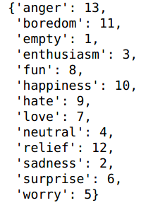
Emotional Analysis
Twitter data set with labelled data.
Clean lot of twitter lingo features from the text.
Did simple classification of the sentence based on the
Words and their previous occurrences
Gives a number corresponding to an emotion.

Slide 9
Trees
Stores all the emotions and their path in a conversation.
Assists in finding a emotion
Helps to find a path that could lead to that emotion

Slide 10
Text Generation
RNN-LSTM again
Trained based on movie conversation and social media conversation
Added cost for not reaching the desired emotional state

Slide 11
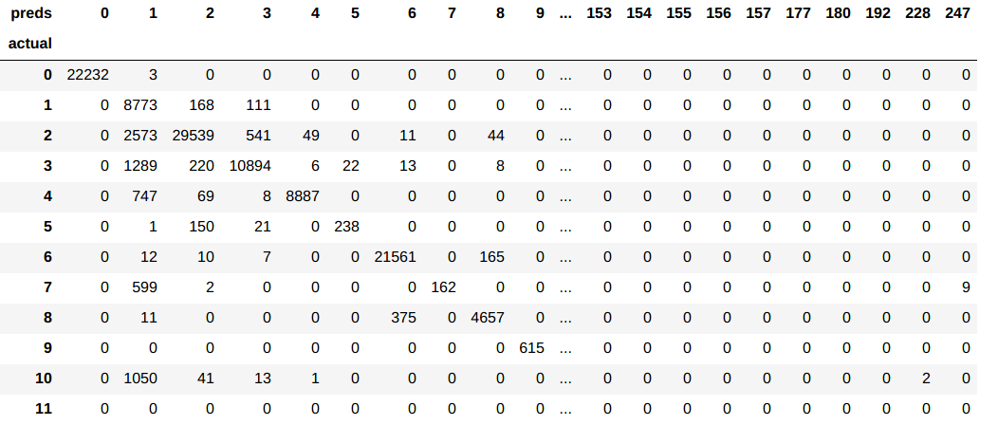
Results
Demo

Slide 12
Limitations & Future Work
Output is not following grammar.
Tried to use POS as additional feature when deciding the word.
But the POS tagger accuracy was low enough to not make any impact.
Integrating other features? POS

