Slide 1

COMP60022 Decision Analytics
Staffordshire Student Reference Number:-
CB Number:-
Student Full Name:-
21035795/1
CB010406
Kavinda Kethiya Rajapaksha

Slide 2


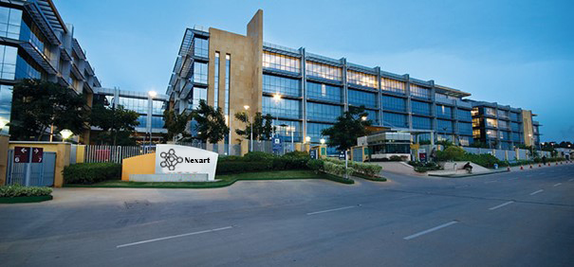
Entity
Nexart is an enterprise which produces and sells network devices and accessories for clients.
They maintain a clientele all around the globe.
Companies which provide network infrastructure services are Nexart’s clients.

Slide 3
Evaluating the Issue of Nexart
What factors caused the revenue loss? .
Why did the revenue decline occur?
Where did the revenue decline occur?
When did the revenue decline occur?
Who is part of the revenue decline?

Slide 4
Evaluating the Issue of Nexart
What are the measures that can be taken to enhance the accuracy of real-time data processing and downsize query latency?.
How much expenditure can be saved from migrating all the data that is in the MSSQL to MongoDB database?
What actions can be taken to manage data storage effectively in terms of scaling data?
How does the database can manage the real-time sensor data that is being generated in production?
How to ensure redundant connectivity to the database as the number of users grows?
How does the latencies in query responses can affect customer satisfaction?

Slide 5
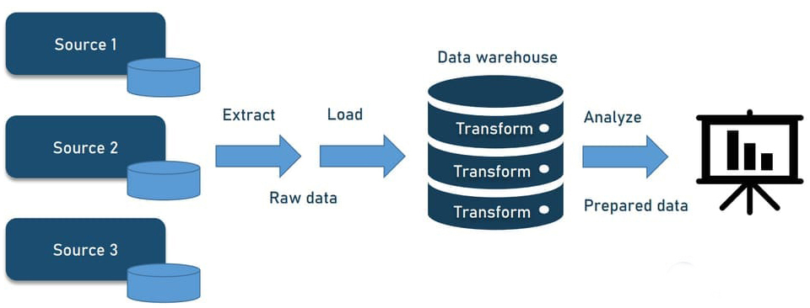
Nexart Data Engineering Pipelines
Data engineers of Nexart decided to implement two pipelines for their organization.
Batch processing data pipeline.
Streamline Processing data pipeline.
Both of these pipeline use the ELT(Extract Load Transform) method.

Slide 6
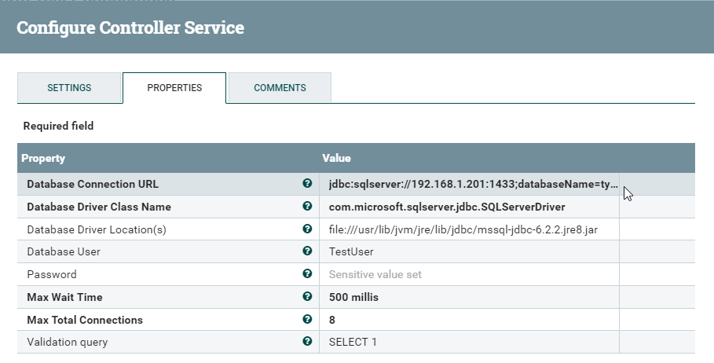
Data Extraction
Extracting data from the MSSQL Server.

Slide 7
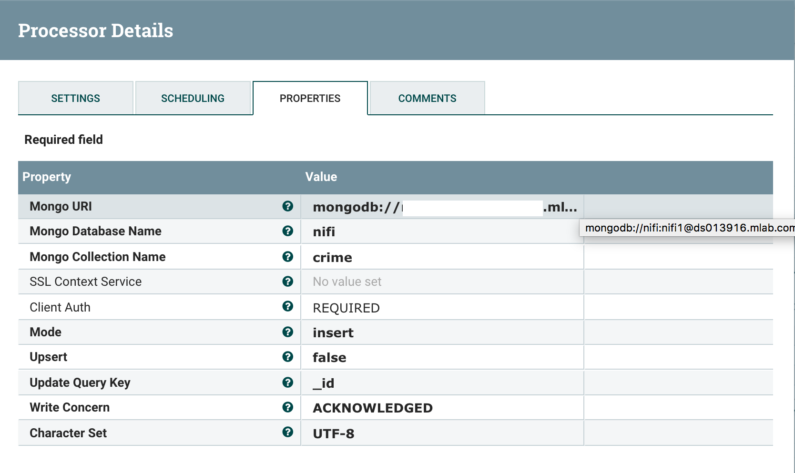
Data Loading
Loading the extracted data into the MongoDB database.

Slide 8
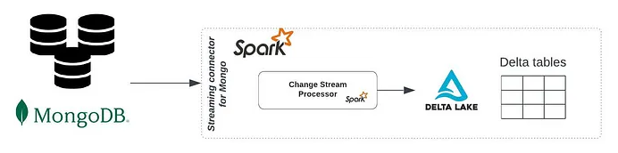
Data Transformation
Transforming stored data in the MongoDB database and export it to another source.

Slide 9
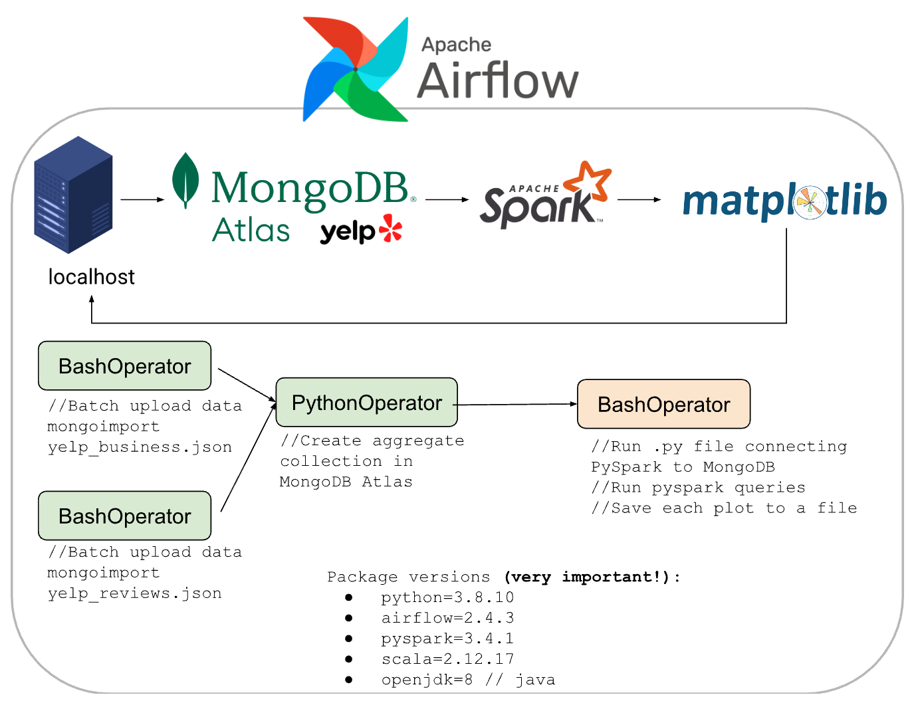
Automating Data Transformation Tasks
Some of the data transformation repetitive tasks can be automated.

Slide 10
MongoDB Database
Advantages of MongoDB
Disaster Recovery
Scalability
Continuous Operation
Enhanced Performance
Availability

Slide 11
MongoDB Database
Disadvantages of MongoDB.
Complexity
Maintenance
Higher Resource Usage
Lags in propagation
Consistency Issues

Slide 12
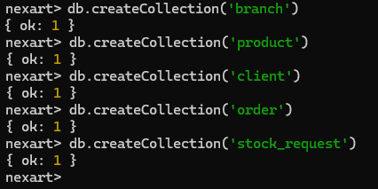
MongoDB Shell
Command Line Interface of MongoDB

Slide 13
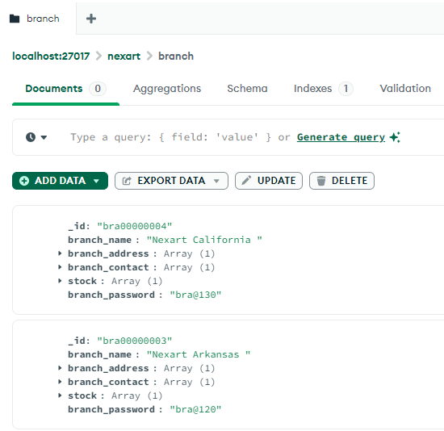
MongoDB Compass
Graphical User Interface of MongoDB

Slide 14
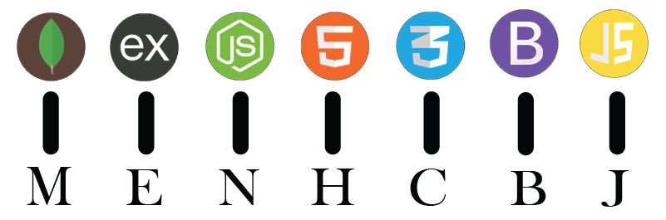
MongoDB Application
Technical Stack
MongoDB
Express JS
HTML
CSS
Bootstrap
JavaScript

Slide 15
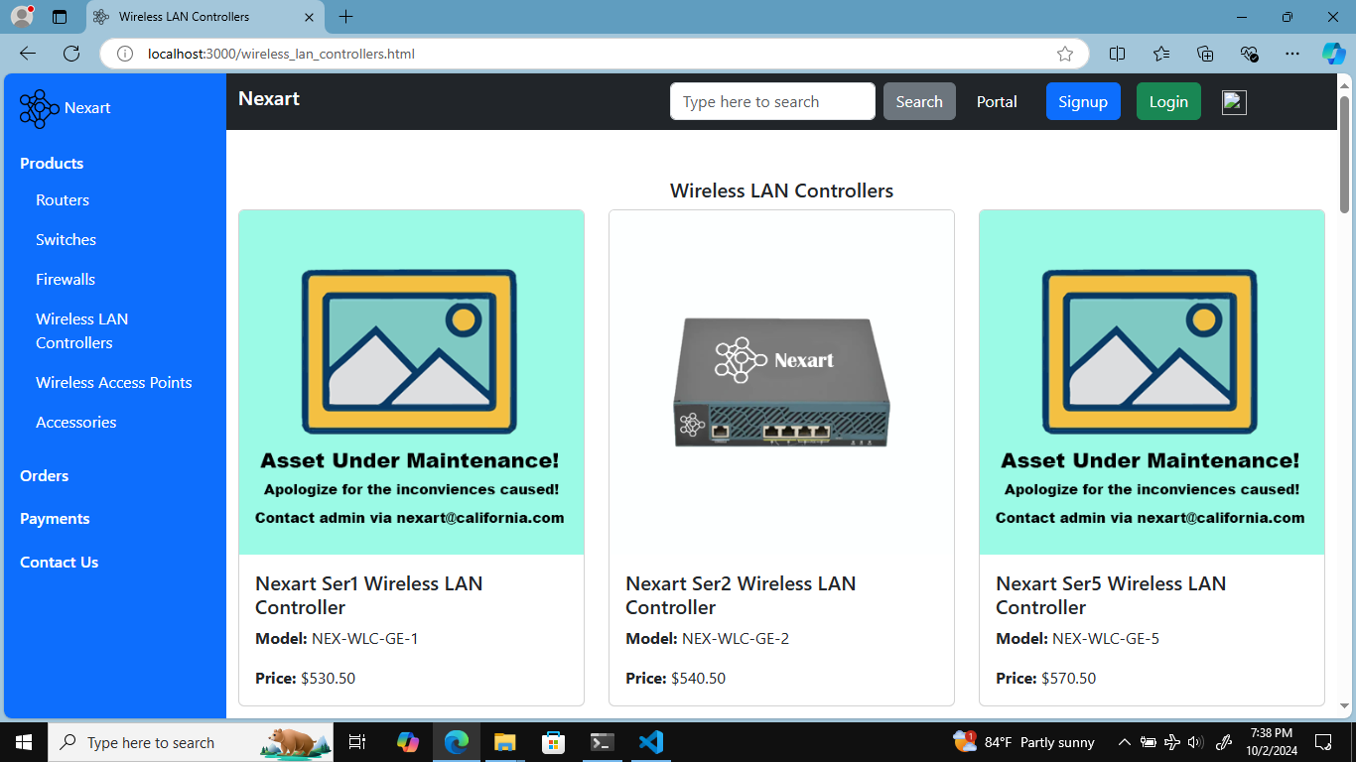
MongoDB Application
Graphical User Interface sample

Slide 16
Analytical Questions
Orders and Client Behavior
What is the most ordered product item across all branches?
Which product item have been ordered a lot in quantity wise?
Which payment method is preferred by most of the clients?
Which branch has received the most orders?
What is the frequency of making repeat orders?

Slide 17
Application Demo
Now Let’s jump towards the functionality of the application!

