Slide 1
LUMI

Slide 2
WHAT IS LUMI ?
a photo and video gallery application with account authentication, album management, location-aware media viewing, quota enforcement, and Stripe-based subscription billing.

Slide 3
PROJECT PURPOSE
The platform is designed for users to:
create and manage personal media collections
upload photographs and videos from a mobile app
organize content into albums
browse media by gallery and map view
protect storage usage with quota checks
manage subscription plans and billing through Stripe
access admin tools for protected operational workflows

Slide 4
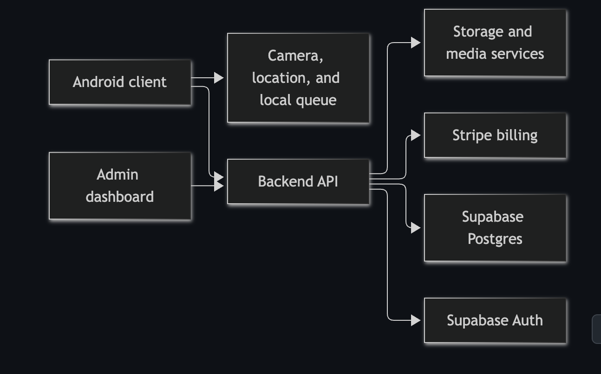
SYSTEM ARCHITECTURE

Slide 5
WHY SUPABASE ?
I chose Supabase over Firebase primarily because it is built on top of PostgreSQL, which gives us the power of a full relational database. While Firebase is great for quick prototyping, its NoSQL architecture forces us to denormalize data early on, which makes complex queries difficult as the app scales. Supabase gives us strict data integrity, powerful SQL querying, and most importantly, zero vendor lock-in because it is open-source and our data is just a standard Postgres database.

Slide 6
LUMI BACKEND
Lumi backend is the service layer for a photo-first memory platform. It authenticates users, manages albums and media metadata, enforces storage quotas, synchronizes billing with Stripe, and exposes admin tooling for operational oversight.
The project is built around the Next.js App Router and uses Supabase for authentication, Postgres, and storage identity, while keeping server-side services like Stripe and object storage integration in the backend layer.

Slide 7
LUMI ANDROID CLIENT
Lumi Android is the mobile client for a photo-first, geotagged memory platform. It lets users sign in, capture photos and videos, organize them into albums, browse a gallery, view media on a map, and complete billing-related redirects from the backend subscription flow.
The app is implemented as an Android Java project and connects to the Lumi backend through authenticated API requests and token-based session management.

Slide 8
ARCHITECTURE OF THE ANDROID PROJECT
Activities
The main application flow starts from the sign-in and main app screens:
activities.SignIn
activities.SignUp
activities.MainActivity
activities.PhotoViewerActivity
These classes handle authentication, app navigation, the gallery viewer, and the billing callback route from the backend.
Fragments
The interface is split into primary screens:
fragments.HomeFragment
fragments.AlbumsFragment
fragments.MapFragment
fragments.SettingsFragment
fragments.ChangePlanFragment
The home screen is the primary library and upload area. The map screen shows a geographic view of media based on captured coordinates. Settings and billing screens manage configuration and plan changes.
Core libraries and helpers
The lib package contains reusable platform logic:
API.java for backend requests
SessionManager.java for signed-in state
SupabaseAuth.java for auth integration
UploadQueueStore.java for queued uploads
Toast.java and ToastManager.java for feedback messages
Models
The model layer defines the data structures used across the app:
Album.java
GalleryDay.java
Image.java
ImageMetaData.java
Plan.java
QueuedUploadItem.java
Workers and background behavior
The workers package contains background upload processing so captures can complete even after the app is not actively visible.

Slide 9
KEY CAPABILITIES IN THE CLIENT
Camera capture flow
The HomeFragment uses the Android camera APIs and file provider to capture photos and videos. After capture, each item is assigned a timestamp and the user location if permission is available.
Gallery and media viewer
Images and videos are displayed in a grid and can be opened in the PhotoViewerActivity. The app merges remote API items with locally queued uploads to show a unified, current gallery view.
Location-aware browsing
The map fragment fetches photo metadata from the backend and places markers on an OpenStreetMap view. This allows users to browse content by where it was captured.
Session-aware API access
The app stores user session information and includes the access token in authenticated requests. API calls are performed against the backend routes for photos, albums, subscription state, and usage data.
Billing callback handling
The app listens for deep links in the manifest using the lumi://billing scheme. A successful or canceled billing flow updates the UI with a toast message after the user returns from Stripe checkout.

Slide 10
PRODUCTION
The Lumi backend is engineered for production-grade reliability, security, and performance. Rather than relying on basic hosting, the infrastructure is built on a modern, automated cloud stack to ensure a seamless experience for end-users.
Compute & Hosting (AWS EC2): The core Next.js API and backend services are hosted on a dedicated AWS EC2 instance. This provides a robust, scalable, and fully controlled compute environment optimized for handling media processing, database queries, and webhook events.
Edge Security & Performance (Cloudflare): All incoming traffic is routed through Cloudflare. This acts as our intelligent edge layer, providing global CDN caching for lightning-fast response times, enterprise-grade DDoS protection, Web Application Firewall (WAF) rules, and automated SSL/TLS termination.
Automated Delivery (GitHub Actions CI/CD): Manual deployments are a thing of the past. The entire backend is powered by a fully automated CI/CD pipeline via GitHub Actions. Every push to the production branch triggers automated builds, environment validation, and zero-downtime deployments directly to the AWS server, ensuring code is shipped safely and consistently.

