Slide 1

Exploratory Data Analysis
Project name - G2M insight for Cab Investment firm
Date - 19/09/2022
Submitted by - Kavinilavan Muthukumar

Slide 2

Agenda
Summary
Datasets Information
EDA
Hypothesis Testing

Slide 3
Summary

Slide 4
Summary
XYZ is a private firm in US. Due to remarkable growth in the Cab Industry in last few years and multiple key players in the market, it is planning for an investment in Cab industry and as per their Go-to-Market(G2M) strategy they want to understand the market before taking final decision.

Slide 5
Datasets Information

Slide 6
Datasets Information
Below are the list of datasets which are used for this analysis:
Cab_Data.csv – this file includes details of transaction for 2 cab companies
Customer_ID.csv – this is a mapping table that contains a unique identifier which links the customer’s demographic details
Transaction_ID.csv – this is a mapping table that contains transaction to customer mapping and payment mode
City.csv – this file contains list of US cities, their population and number of cab users

Slide 7
Exploratory Data Analysis

Slide 8
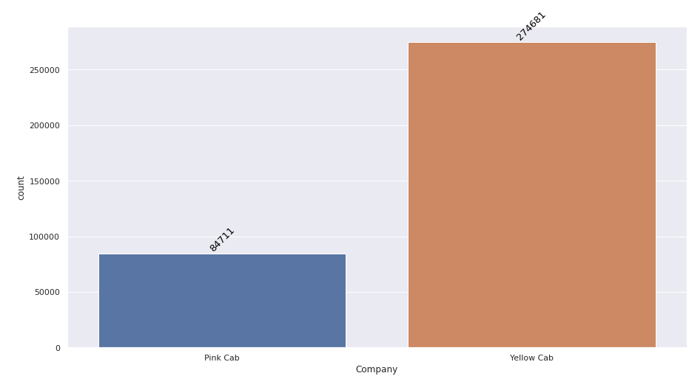
How often customers used both cabs (count of ride)?
Yellow cab has 274681 customers
Pink cab has 84711 customers
Based on the first investigation, yellow cab has more customers than pink cab.

Slide 9
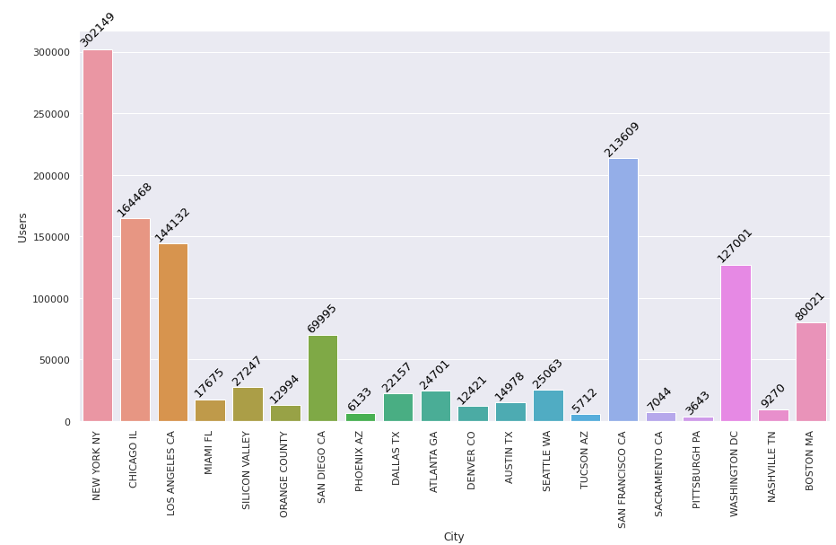
In which cities have more users ?
New York and San Francisco have more number of users followed by Chicago, Los Angeles, Washington.

Slide 10
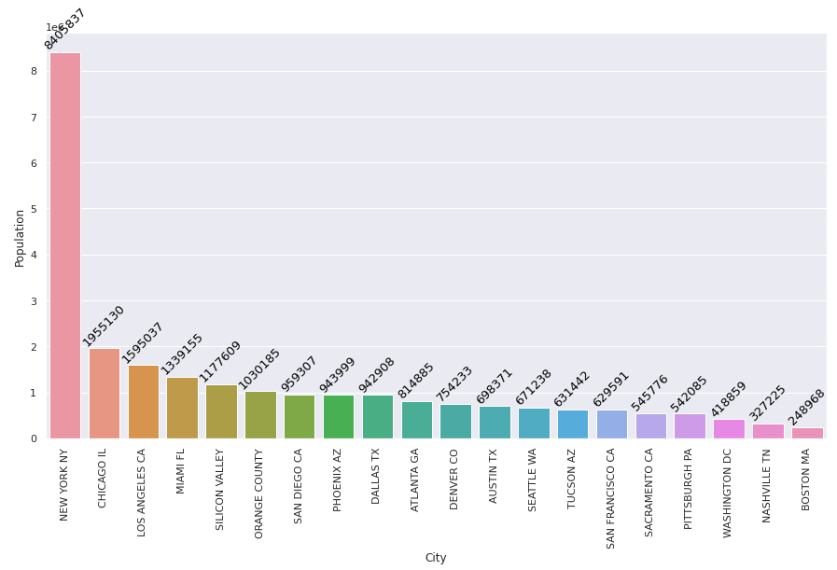
What is the Population of each cites ?
New York and Chicago are more populated countries followed by Los Angeles, Miami, Silicon Valley.

Slide 11
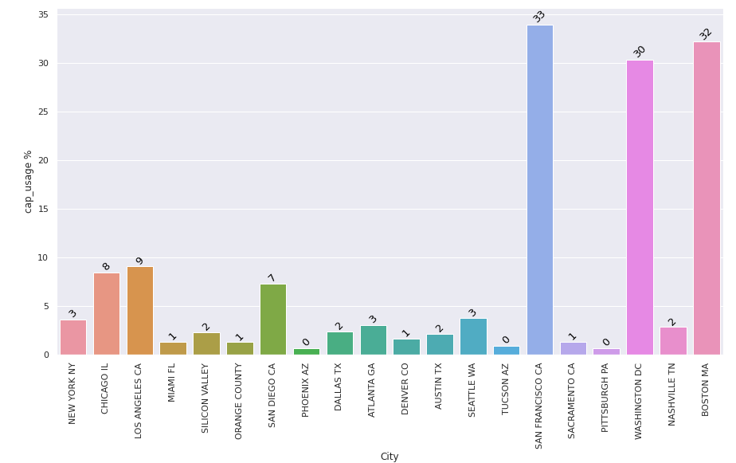
What is the percentage of users in each cities respective to the population?
In San Francisco 33 % of people using cab.
In Washington 30 % of people using cab.
In Boston 32 % of people using cab

Slide 12
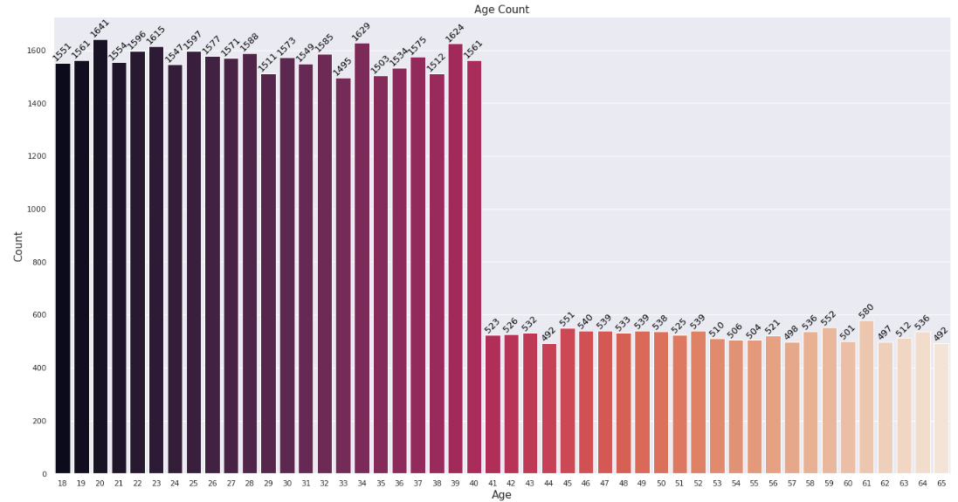
In which age category people using cab more often?
Younger people age from 18 to 40 are using cab more often.

Slide 13
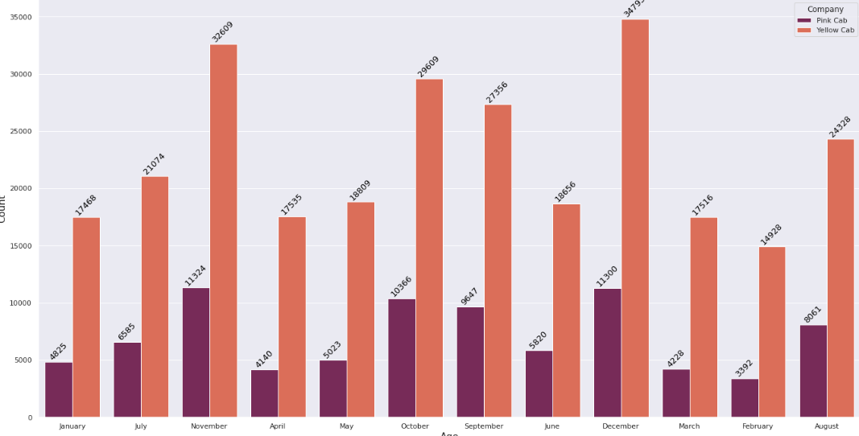
How many number of ride in both company by months
October, November, December months have more rides than other in both company.

Slide 14
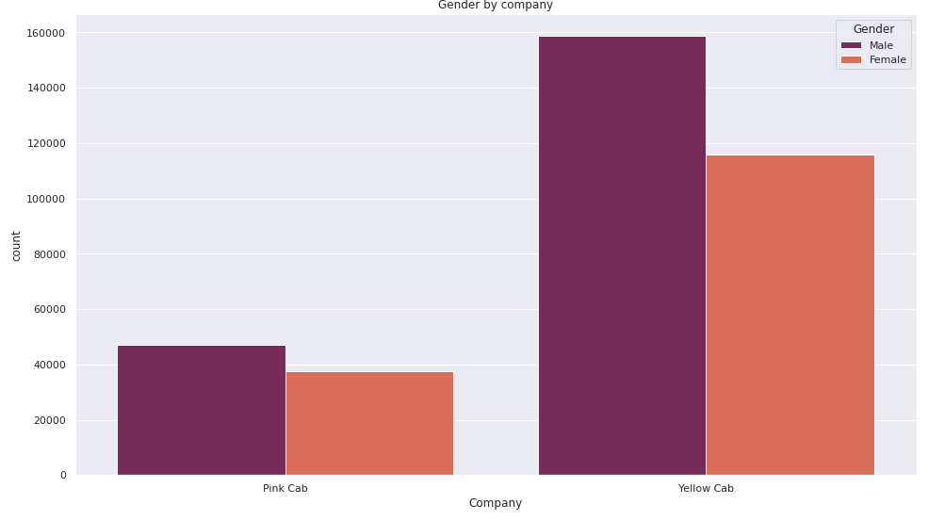
How many numbers of rides in both company by gender?
Male customers have the majority of number than female in both company

Slide 15
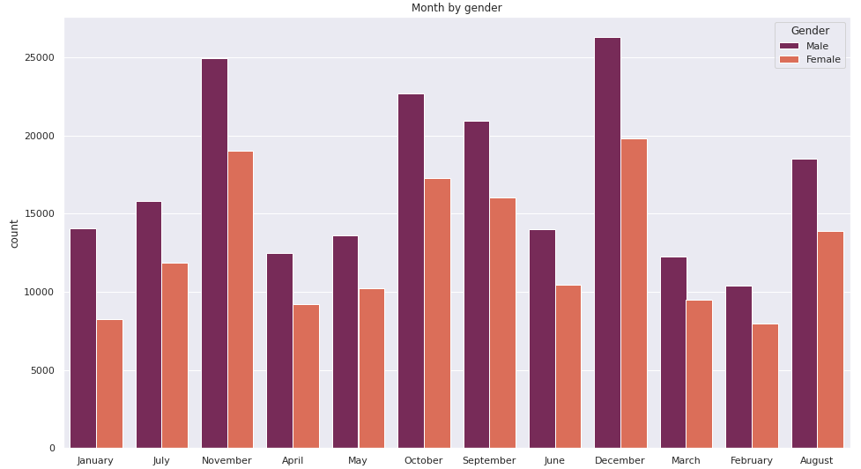
How many number of rides in every month by gender?
October, November, December have more rides in both genders.

Slide 16
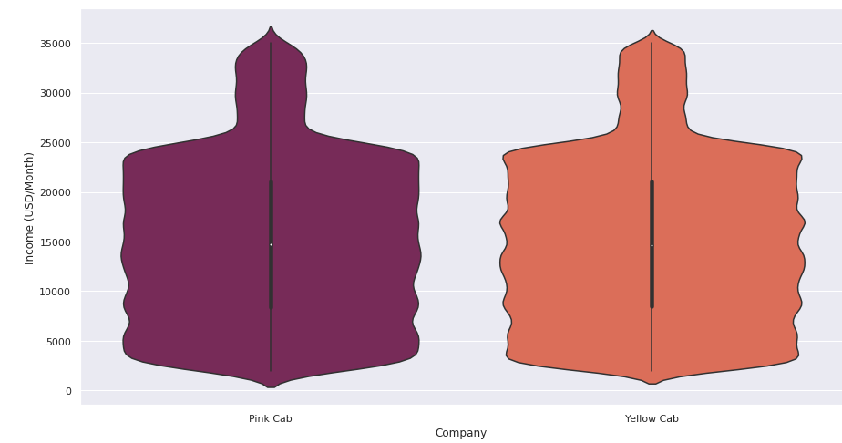
What is the average income of customer per month?
The average income of customers per month is 15000 USD for both company

Slide 17
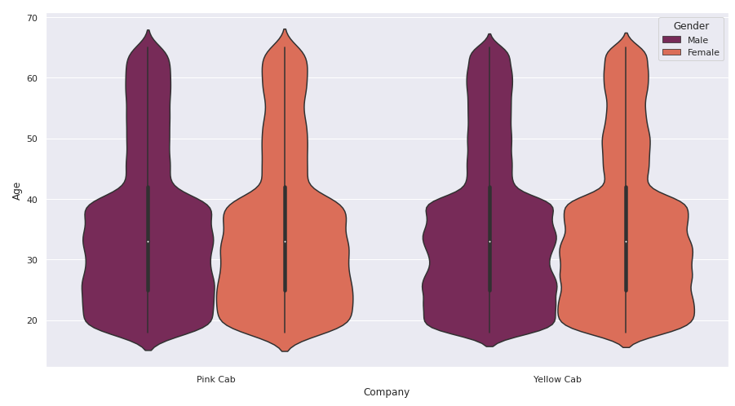
What is the average age of customers for both company?
The average age of customer for both company is 32

Slide 18
Hypothesis Testing

Slide 19
1. is population of city and usage of cap are co related with each other ?if P value is greater than 0.05, it is independent or else dependent
The p value for this question is less than 0.05. so, it indicates the population of city and cap usage of customers are co related with each other. thus, investing in the cities which high population is more benefit for investors.

Slide 20

2. is there price of cab is increase when more KMs are travelled ?
The price of cost is increased when people travel more KMs.

Slide 21

3. is High income persons are using car more often?
No, customers who earns more money are not travel more often. The p value for this questions is 0.08 as shown in below images.

Slide 22
4. is there gender making any impact of companies profit? ( Pink cab)
accept null hypothesis (Ho), there is no significant difference between gender for pink cabs profit. Thus, gender does not make any difference in making profits of company.

Slide 23
5. is there gender making any impact of companies profit? ( yellow cab)
accept alternative hypothesis (H1), there is significant difference between gender for yellow cabs profit. Thus, gender do make difference in profits of company.

Slide 24
6. Does age category making any difference in company’s profits? (pink and yellow cab)
For pink cab, it accept null hypothesis, there is no significant difference between age and profits.
For yellow cabs, it accept alternative hypothesis, there is significant difference between age and profits.

Slide 25
Thank You

