Slide 1

“ Money Transfer ”
Task - 4

Slide 2
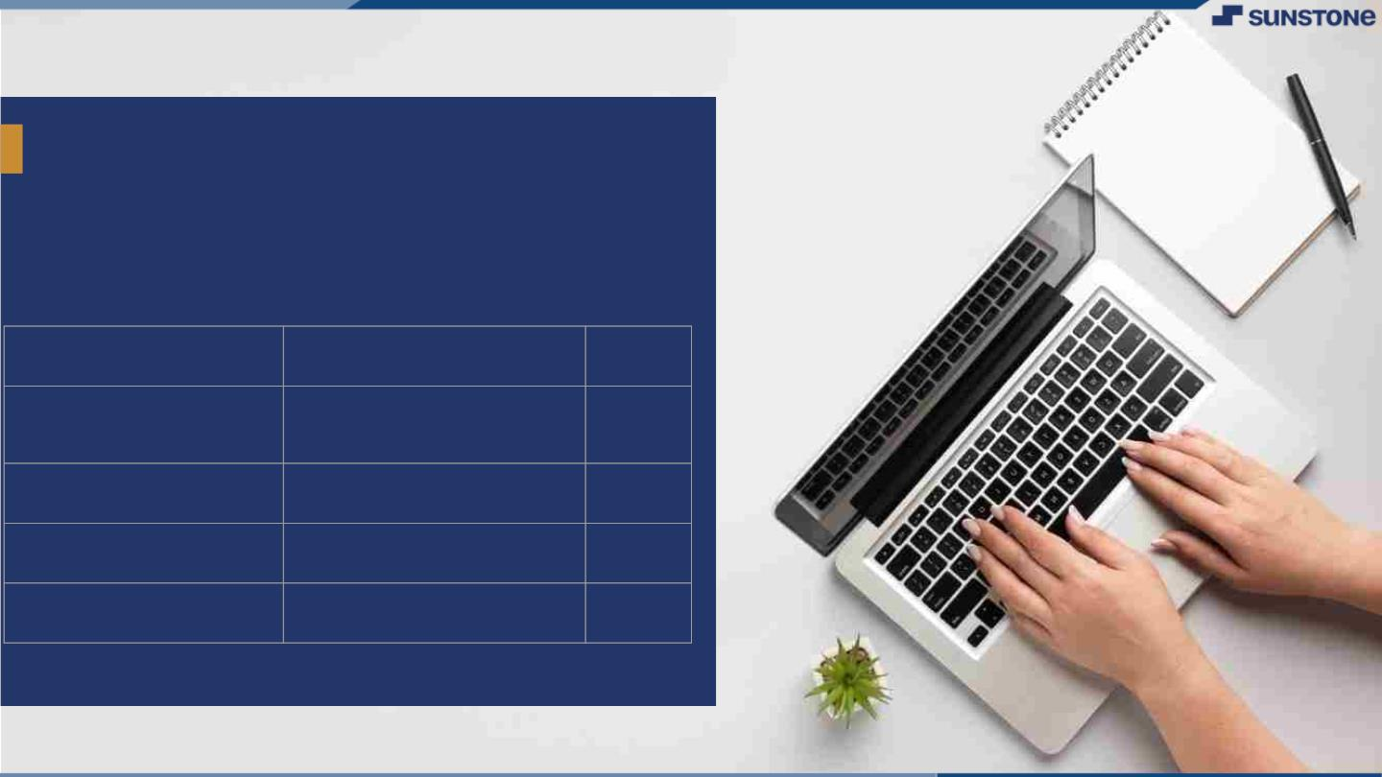
MoneyꢀTransfer
▪ MoneyꢀTransferꢀisꢀanꢀwebꢀapplicationꢀthatꢀisꢀusedꢀtoꢀ
transferꢀmoneyꢀfromꢀoneꢀaccountꢀtoꢀanotherꢀaccount.
▪ Itꢀcanꢀalsoꢀbeꢀusedꢀforꢀgettingꢀloanꢀfromꢀbank.
LMS Username
Name
Batch
2115a439
M.PRAGTHIYUMNAN A4
2115a415
2115a416
2115a429
K.GOKULRAJ
M.HARIHARAN
KAVIN KUMAR
A4
A4
A4

Slide 3

Taskꢀ4ꢀ::ꢀBackendꢀ(Moduleꢀ4)
Doꢀdatabaseꢀmodellingꢀandꢀcreateꢀmodels
▪ Designꢀschemaꢀforꢀallꢀtheꢀdataꢀtoꢀbeꢀstored
▪ Startꢀmongodbꢀlocalꢀserverꢀandꢀpointꢀtheꢀbackendꢀtoꢀtheꢀserver
▪ Createꢀmongooseꢀschemaꢀatꢀtheꢀbackend
▪ Runꢀtestꢀqueriesꢀtoꢀsetꢀupꢀtheꢀdatabase
CreateꢀVariousꢀAPIsꢀtoꢀensureꢀdataꢀflowꢀwithinꢀtheꢀwebsite
▪ Defineꢀallꢀtheꢀroutesꢀforꢀtheꢀbackend
▪ Addꢀauthenticationꢀmiddleware
▪ Addꢀcontrollersꢀforꢀallꢀtheꢀpathsꢀtoꢀhandleꢀapiꢀrequest
▪ CreateꢀEnvironmentꢀvariablesꢀforꢀallꢀauthenticationꢀkeys
▪ Note:ꢀAlwaysꢀhandleꢀallꢀpossibleꢀcasesꢀwithꢀtheꢀrequest
EvaluationꢀMetric:
100%ꢀCompletionꢀofꢀtheꢀaboveꢀtasks
Learningꢀoutcome
▪ UnderstandingꢀNosqlꢀdatabasesꢀmodeling
▪ Queryingꢀandꢀfilteringꢀmongodb
▪ Understandingꢀvariousꢀreqꢀmethods
▪ Gettingꢀfamiliarꢀwithꢀcookies
▪ Serverꢀsideꢀauthentication

Slide 4

Step-WiseꢀDescription
• Creating an account in mongo db .
• Getting the connection link from mongo db.
• Install mongo db and express in our local
computer and connecting to mongo db using
that link.
• Querying the mongo db database using queries.
Summaryꢀofꢀyourꢀtask
Creating a connection with the
NoSql Database MongoDB.

Slide 5

AssessmentꢀParameter
DesignꢀSchemaꢀforꢀdataꢀtoꢀbeꢀ
stored
Pointꢀallꢀroutesꢀwithꢀaꢀappropriateꢀ
controllersꢀtoꢀcontrolꢀrequestꢀandꢀresponse
Setꢀmongodbꢀserverꢀonꢀlocalhost
Check-List
Addꢀauthenticationꢀmiddlewareꢀtoꢀ
allꢀprotectedꢀroutes
Addꢀdummyꢀdataꢀwithꢀschemaꢀ
inꢀmongodbꢀserver
Filterꢀandꢀsantizeꢀallꢀtheꢀ
incomingꢀdataꢀinꢀhttpꢀrequests
Runꢀsomeꢀtestꢀqueriesꢀtoꢀtestꢀ
theꢀserver
Setꢀupꢀsecureꢀenvironmentꢀ
variablesꢀforꢀsecretꢀkeys

Slide 6

Submission Github
https://github.com/kavinkumar0/Moneytransfer

Slide 7


