Slide 1
EduSpace
Campus Facility Utilization Analysis & Optimization
U23AD491 — Data Science | Synthetic case study

Slide 2
Business Problem
Campus management needs visibility into bookings, actual occupancy, capacity and maintenance downtime.
Underuse and peak demand may coexist across rooms and time slots.
Business question: How are facilities used, and where can utilization be improved?
All records in this project are synthetic and should not be represented as real campus evidence.

Slide 3
Data & Method
Five connected datasets: bookings, facilities, occupancy, calendar and maintenance.
Data quality checks: missing occupancy, duplicate bookings, facility-name aliases, over-capacity readings and incomplete maintenance.
Python/Pandas for cleaning and integration; NumPy for derived metrics; Matplotlib for visualizations.
Excel workbook for summaries, charts and management-facing reporting.

Slide 4
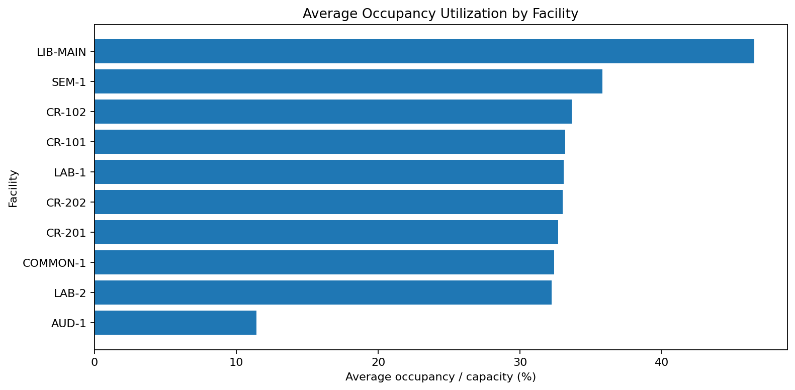
Facility Utilization
Compare average recorded occupancy with facility capacity. Investigate both low utilization and high demand before reallocating rooms.

Slide 5
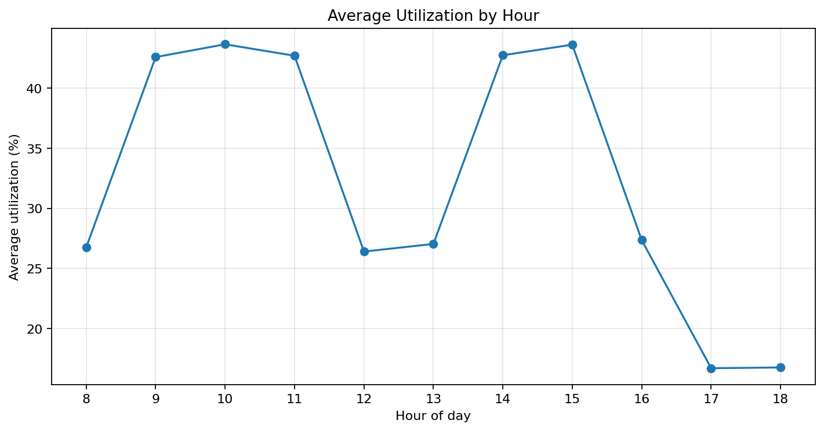
Peak-Time Analysis
Use hourly occupancy patterns to identify periods for timetable adjustments and demand balancing.

Slide 6
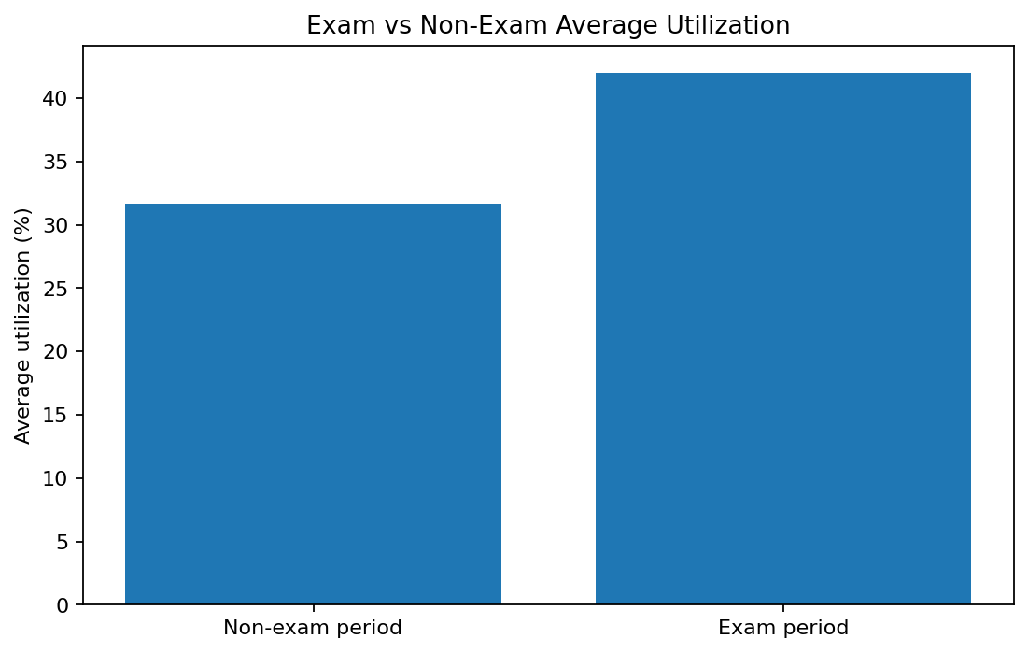
Exam-Period Comparison
Compare exam and non-exam periods. Ensure recommendations reflect the simulated calendar and occupancy assumptions.

Slide 7
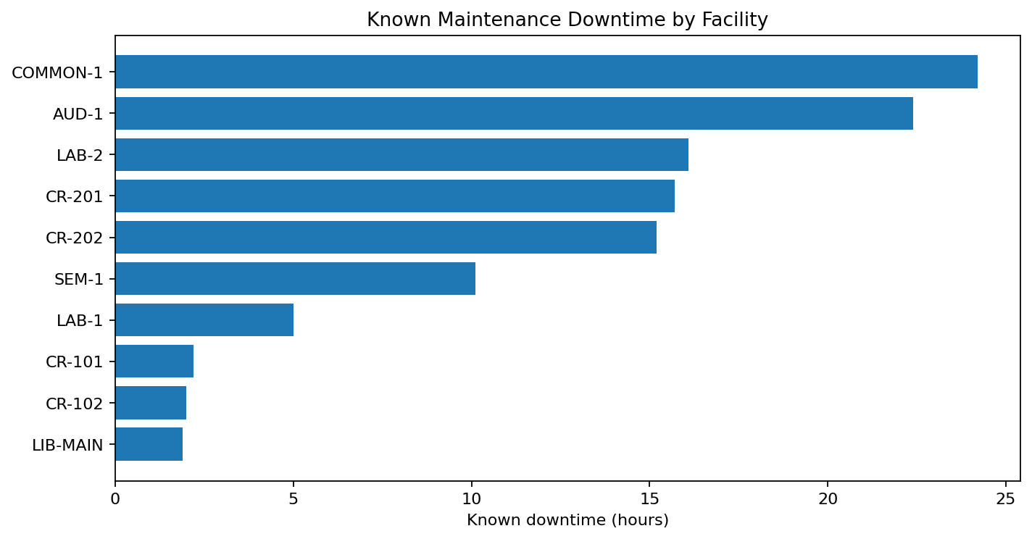
Maintenance Downtime
Prioritize complete maintenance records and schedule planned work during lower-demand periods where feasible.

Slide 8
Recommendations
Review timetables to move flexible sessions away from repeated peak periods.
Match room size to expected attendance while preserving suitable room type and equipment.
Investigate over-capacity readings rather than deleting them automatically.
Improve occupancy sensor coverage and maintenance record completeness.
Monitor utilization, peak occupancy, missed readings and downtime on a recurring basis.

Slide 9
Limitations & Next Steps
Synthetic data demonstrates an analytical workflow; findings are not real campus measurements.
Missing occupancy values are not imputed in the core analysis; averages use observed counts only.
Calendar blank events are interpreted as 'No Event' for this synthetic dataset.
Future work: validate with real campus data, define management-approved underuse thresholds and compare utilization by facility availability.

