Slide 1
Machine Learning(Uplift)
L-1 07/06/21

Slide 2
Introduction
Machine learning is the science of getting computers to act without being explicitly programmed. It is a branch of AI based on the idea that systems can learn from data, identify patterns and make decisions with minimal human intervention.
It is extensively being used in financial services, health care , governance, retail , transportation , Iot etc.

Slide 3
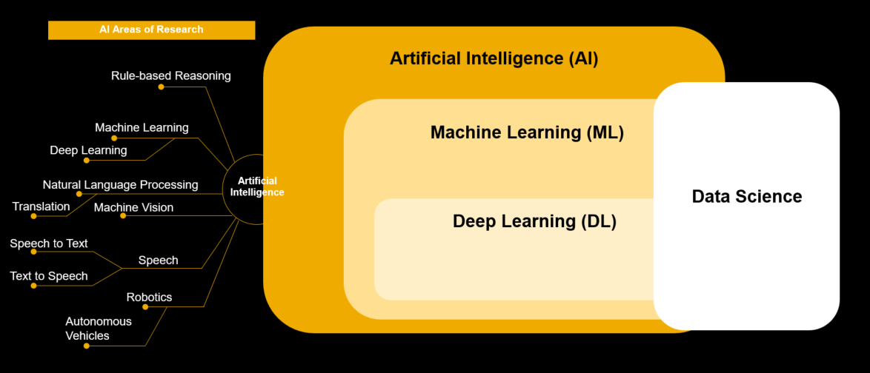

Slide 4
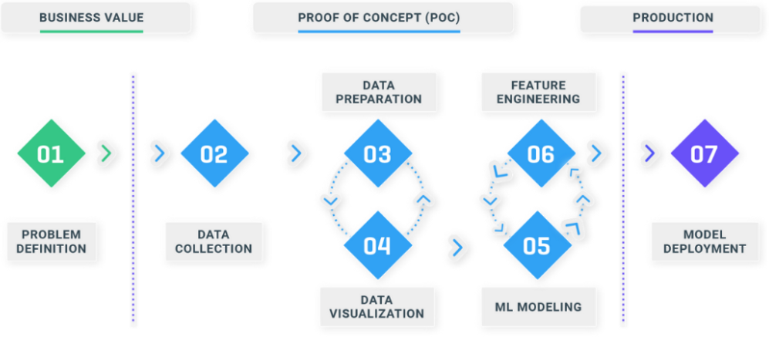
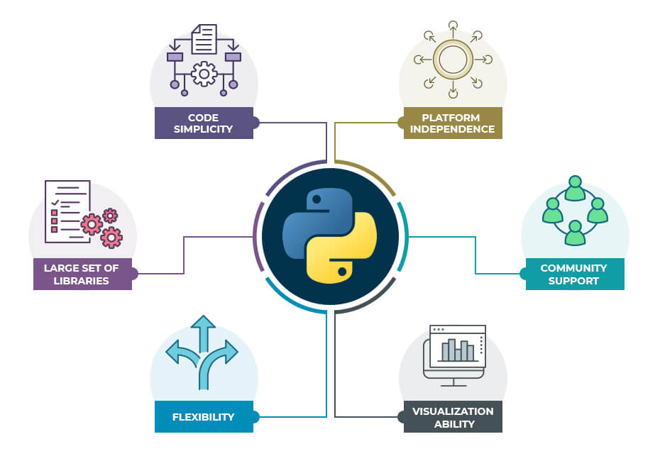
The Life Cycle of An Ml PROJECT & Why python?

Slide 5
Terms of Ml
Some Terminology of Machine Learning
Model: Also known as “hypothesis”, a machine learning model is the mathematical representation of a real-world process. A machine learning algorithm along with the training data builds a machine learning model.
Feature: A feature is a measurable property or parameter of the data-set.
Feature Vector: It is a set of multiple numeric features. We use it as an input to the machine learning model for training and prediction purposes.
Training: An algorithm takes a set of data known as “training data” as input. The learning algorithm finds patterns in the input data and trains the model for expected results (target). The output of the training process is the machine learning model.
Prediction: Once the machine learning model is ready, it can be fed with input data to provide a predicted output.
Target (Label): The value that the machine learning model has to predict is called the target or label.
Overfitting: When a massive amount of data trains a machine learning model, it tends to learn from the noise and inaccurate data entries. Here the model fails to characterise the data correctly.
Underfitting: It is the scenario when the model fails to decipher the underlying trend in the input data. It destroys the accuracy of the machine learning model. In simple terms, the model or the algorithm does not fit the data well enough.

Slide 6
THANK YOU

