Slide 1
Smart Attendance Pro
• Python-powered student check-in and reporting
• Tkinter • OpenCV LBPH • SQLite
• Local macOS desktop prototype
SMART ATTENDANCE PRO | COLLEGE DEMONSTRATION

Slide 2
Problem and objectives
• Reduce repetitive manual attendance entry
• Enroll consenting students using webcam face images
• Record one check-in per student per day
• Provide administrative access and downloadable reports
SMART ATTENDANCE PRO | COLLEGE DEMONSTRATION

Slide 3
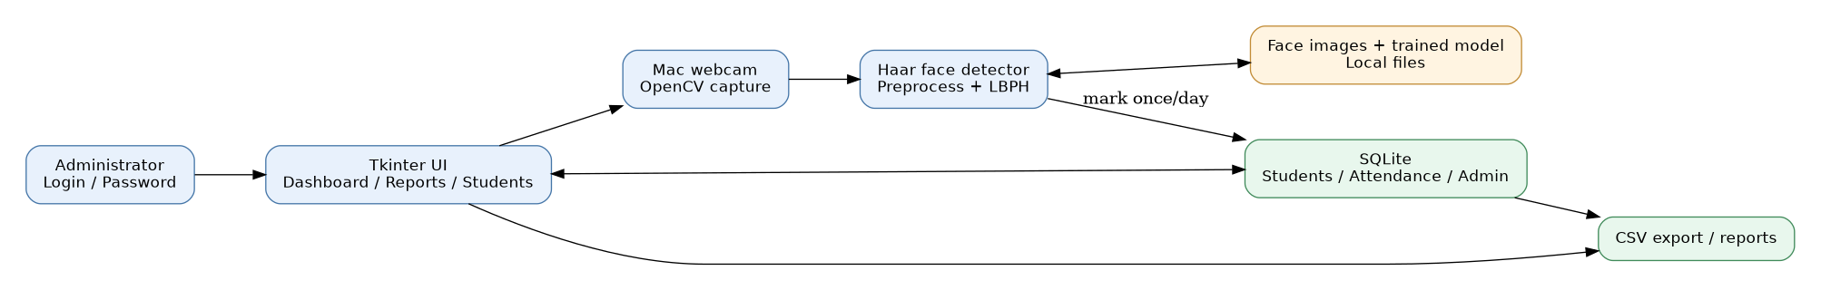
System architecture
SMART ATTENDANCE PRO | COLLEGE DEMONSTRATION

Slide 4
Features
• Administrator login and password changes
• Student registration and on-device face model
• Daily KPIs and seven-day attendance chart
• Daily/monthly date filters and CSV export
• Student deletion and retraining
SMART ATTENDANCE PRO | COLLEGE DEMONSTRATION

Slide 5
Recognition workflow
• Detect face using Haar cascade
• Resize and equalize each detected face crop
• Classify with OpenCV LBPH model
• Require a low-enough distance across 5 consecutive frames
• Save check-in using SQLite unique-per-day constraint
SMART ATTENDANCE PRO | COLLEGE DEMONSTRATION

Slide 6
Security and data
• Admin password: salted PBKDF2-HMAC-SHA256 hash
• Local SQLite database, sample images and model files
• Students and attendance linked by student ID
• Consent and limited data retention are required
SMART ATTENDANCE PRO | COLLEGE DEMONSTRATION

Slide 7
Live demonstration
• Create/login to admin account
• Register a consenting test student
• Run recognition and observe a check-in
• Verify duplicate protection and dashboard totals
• Filter dates and export CSV
SMART ATTENDANCE PRO | COLLEGE DEMONSTRATION

Slide 8
Testing and limitations
• Check accuracy across students and lighting conditions
• Unknown faces should not be automatically marked
• No anti-spoofing/liveness protection
• Daily “not marked” is not confirmed absence
• Human override and consent required in real deployment
SMART ATTENDANCE PRO | COLLEGE DEMONSTRATION

Slide 9
Future improvements
• Session/timetable-aware attendance
• Liveness detection or supervised confirmation
• Biometric accuracy evaluation and threshold calibration
• Encryption, audit history and role-based access
SMART ATTENDANCE PRO | COLLEGE DEMONSTRATION

Slide 10
Conclusion
• Python desktop app integrating computer vision, data and reporting
• Admin features and monthly attendance workflow
• Useful educational proof of concept—not a production attendance authority
SMART ATTENDANCE PRO | COLLEGE DEMONSTRATION

