Slide 1


Department of Computer Science and Engineering
24GEP31 - MINI PROJECT
REVIEW–1
SMART PARKING ALLOCATION SYSTEM
SDG 11 – Sustainable Cities & Communities | SDG 9 – Industry, Innovation & Infrastructure | SDG 13 – Climate Action
Team Members Details:
Mentor Details:

Slide 2
Problem Definition & Scope
Problem Definition:
Finding suitable parking spaces in busy areas is time-consuming and inefficient.
• Increased parking search time
• Unnecessary vehicle movement
• Traffic congestion
• Difficulty finding vehicle-compatible spaces
• Reservation conflicts / double booking
• Inefficient utilization of parking spaces
• No systematic waiting-request management
Scope:
Automated parking allocation and reservation based on vehicle type, availability, reservation time, travel time and request priority.
Target Users: Drivers, parking managers, institutions and campus administrators.

Slide 3
Objectives & Expected Outcomes
Objectives:-
1. Automated Parking Allocation – allocate the most suitable space based on compatibility and availability.
2. Conflict-Free Reservation – prevent overlapping bookings using interval checking.
3. Shortest Route Selection – use Dijkstra’s Algorithm to identify minimum travel time.
4. Waiting Queue Management – use Priority Queue when suitable spaces are unavailable.
Expected Outcomes:-
• Reduced parking search time
• Efficient parking-space utilization
• Faster systematic allocation
• Prevention of reservation conflicts
• Automatic waiting-list management

Slide 4
Technical Approach & Feasibility
Technology:-
Programming: Java
GUI: JavaFX
Database: SQLite / MySQL
Connectivity: JDBC
Java Concepts:-
OOP • Classes & Objects • Inheritance • Encapsulation • Abstraction • Polymorphism
Data Structures:-
HashMap → fast lookup
ArrayList → spaces & reservations
PriorityQueue → waiting requests
Graph → parking / road network
Algorithms:-
Dijkstra’s Algorithm → shortest travel time
Interval Overlap → reservation conflict detection
Allocation Algorithm → best-space selection

Slide 5
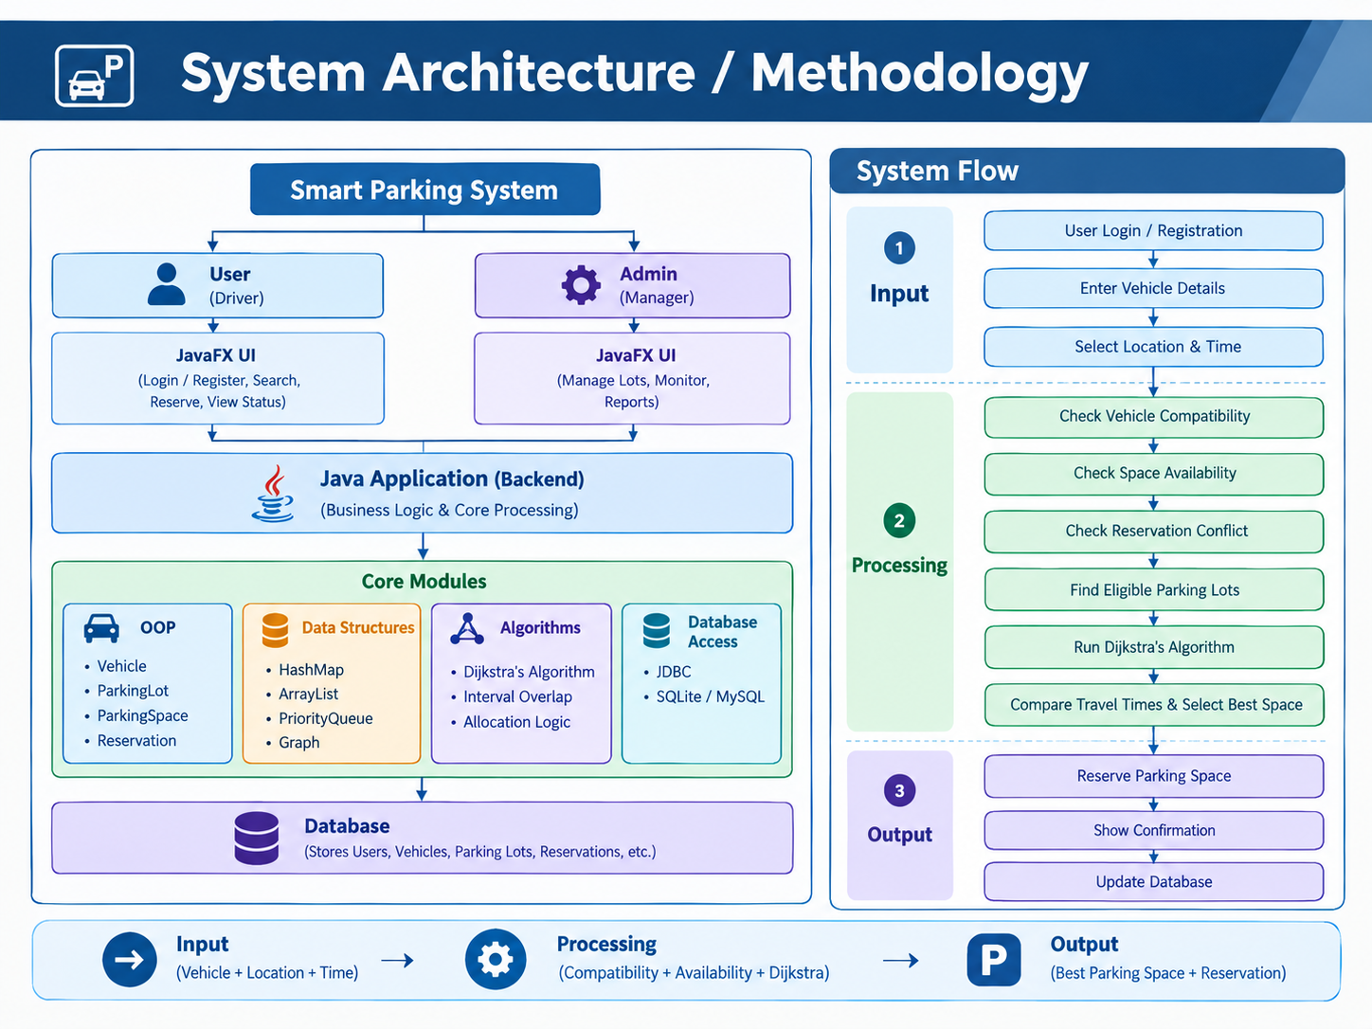
System Architecture / Methodology

Slide 6
Smart Allocation & Waiting Queue
Parking Allocation Process:-
Parking Request → Vehicle Compatibility → Space Availability → Reservation Conflict Check → Eligible Parking Lots → Dijkstra’s Algorithm → Compare Travel Times → Select Best Space → Reserve
If No Space Is Available
No Suitable Space → PriorityQueue → Waiting Requests → Space Becomes Free → Re-run Allocation → Allocate to Highest Priority
Example:
Lot A – 12 min
|
Lot B – 7 min ★ Selected
|
Lot C – 10 min
|
Result: Lot B → Space C205

Slide 7
Project Planning & Partial Implementation
Project Timeline:-
W1: Problem & requirements
W2: System design & UML
W3: Java OOP
W4: Data structures
W5: Graph & Dijkstra
W6: Database integration
W7: JavaFX interface
W8: Integration & testing
Partial Implementation:-
Completed / In Progress:
✓ Vehicle & parking-space classes
✓ Parking-lot structure
✓ Reservation model
✓ Compatibility & availability checking
✓ Graph representation
✓ Dijkstra logic
✓ Priority Queue structure
Pending: JavaFX GUI • Database integration • Reservation interface • Admin dashboard • Complete testing

Slide 8
Conclusion:-
The Smart Parking Allocation System provides an efficient and systematic approach to parking management using Java, Data Structures and Algorithms.
Key Outcomes:-
Smart Space Allocation – Selects the most suitable parking space.
Reduced Search Time – Finds parking using the shortest travel route.
Conflict-Free Reservations – Prevents overlapping bookings.
Efficient Waiting Queue – Manages requests when parking is unavailable.
Better Space Utilization – Improves the effective use of available parking.
Future Enhancements:-
Real-Time Parking Sensors
Mobile Application
Live Parking Availability
Digital Payment Integration
GPS-Based Navigation
THANK YOU

