Slide 1


Department of Computer Science and Engineering
24GEP31 - MINI PROJECT
REVIEW–1
SMART PARKING ALLOCATION SYSTEM
SDG 11 – Sustainable Cities & Communities
Team Members Details:
K Susidhar-25CSR314
N Sujith-25CSR309
G Suresh Krishna-25CSR313
Mentor Details:
Ms.V.Nandhini AP/ CSE

Slide 2
Problem Definition & Scope
  Problem Definition:-
    Finding suitable parking in busy areas is time-consuming and inefficient, leading to increased search time, unnecessary vehicle movement, and traffic congestion.
    Drivers may also struggle to find vehicle-compatible spaces, while reservation conflicts and double bookings can occur.
    In addition, poor space utilization and the absence of a systematic waiting-request system make parking management less efficient.
  Scope:-
    Automated parking allocation and reservation based on vehicle type, availability, reservation time, travel time and request priority.
    Target Users: Drivers, parking managers, institutions and campus administrators.

Slide 3
Objectives & Expected Outcomes
    Objectives:-
      The system aims to provide efficient and reliable parking management by automatically allocating compatible available spaces, preventing overlapping reservations through interval checking, selecting the shortest travel route using Dijkstra’s Algorithm, and managing unavailable-space requests through a Priority Queue based on priority and arrival order.
    Expected Outcomes:-
      • Reduced parking search time
      • Efficient parking-space utilization
      • Faster systematic allocation
      • Prevention of reservation conflicts
      • Automatic waiting-list management

Slide 4
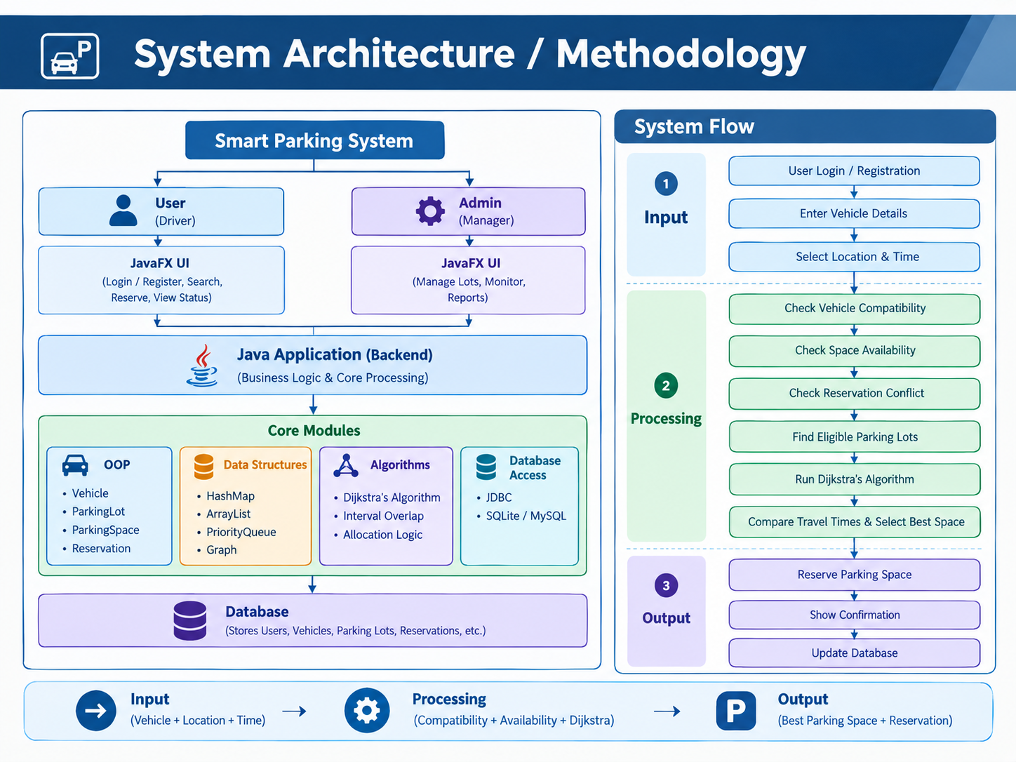
Technical Approach & Feasibility

Slide 5
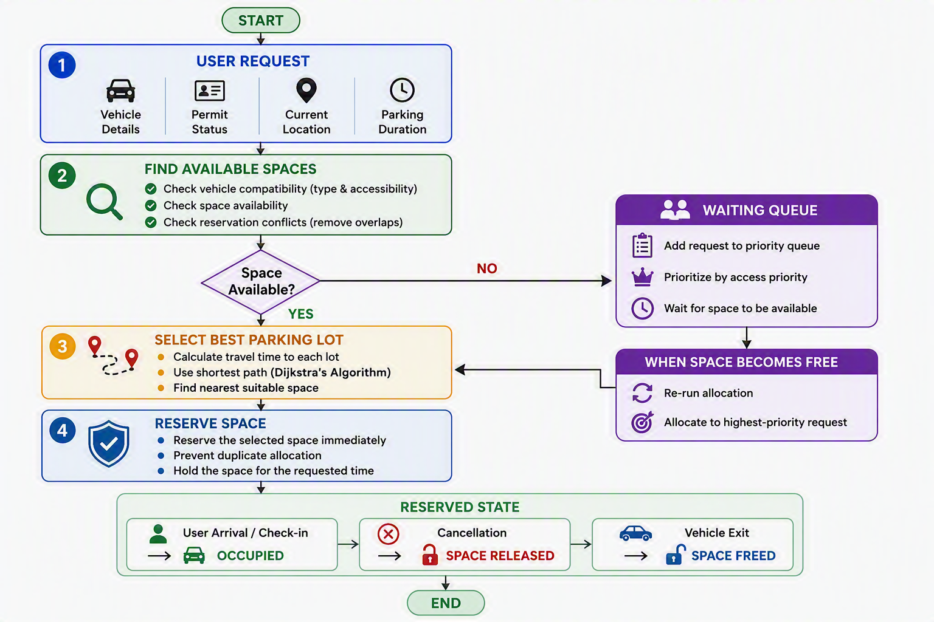
System Architecture / Methodology

Slide 6
Thank you

