Slide 1
INTEL ONE API CHALLENGE
Team Name: DATA DOCTORS
Problem Statement: Pothole Detection in Real-time Environment.
Team Details:
KAVIN V HARISH R

Slide 2
Problem statement:
Pothole Detection in Real-time Environment
Description:
Over the past few years, Sihao has seen exponential growth in the number of vehicles on the road. As a result, the increase in the number of vehicles on road gave rise to the number of road accidents. According to a study, one fatal road accident occurs every 5 minutes in the country, and 8 die on roads every hour. This has become a major concern in the country. One of the primary causes of these road accidents is the management and maintenance of the roads.
Potholes on roads can cause serious accidents, and any vehicle traveling at some decent speed can lose its track due to them. In the case of four-wheeler vehicles, potholes can cause severe damage to wheels and tires. More specifically, when it comes to two-wheelers like motorbikes, these vehicles are more prone to accidents due to potholes as the tendency to cause imbalance is very high and can lead to fatalities.
Concerned by the increasing number of accidents caused by potholes, the government of Sihao has started initiatives and campaigns to install cameras in the most accident-prone cities and capture the feed to detect the potholes. In this hackathon, as a Computer Vision Learner or Expert, you will apply image processing techniques to process the images and detect the potholes. This will assist the government to identify the extreme potholes depending on their size and handle them as the earliest.

Slide 3
Problem statement:
Expected Outcome:
Pothole Detection is to accurately identify the location and size of potholes in real-time using computer vision technology. R e s n e t is an object detection algorithm that uses a deep neural network to detect and classify objects in images or video streams.
Pothole Detection is detected using ResNet50 and DenseNet algorithm to improve road safety and reduce vehicle damage by enabling more efficient identification and repair of potholes.

Slide 4
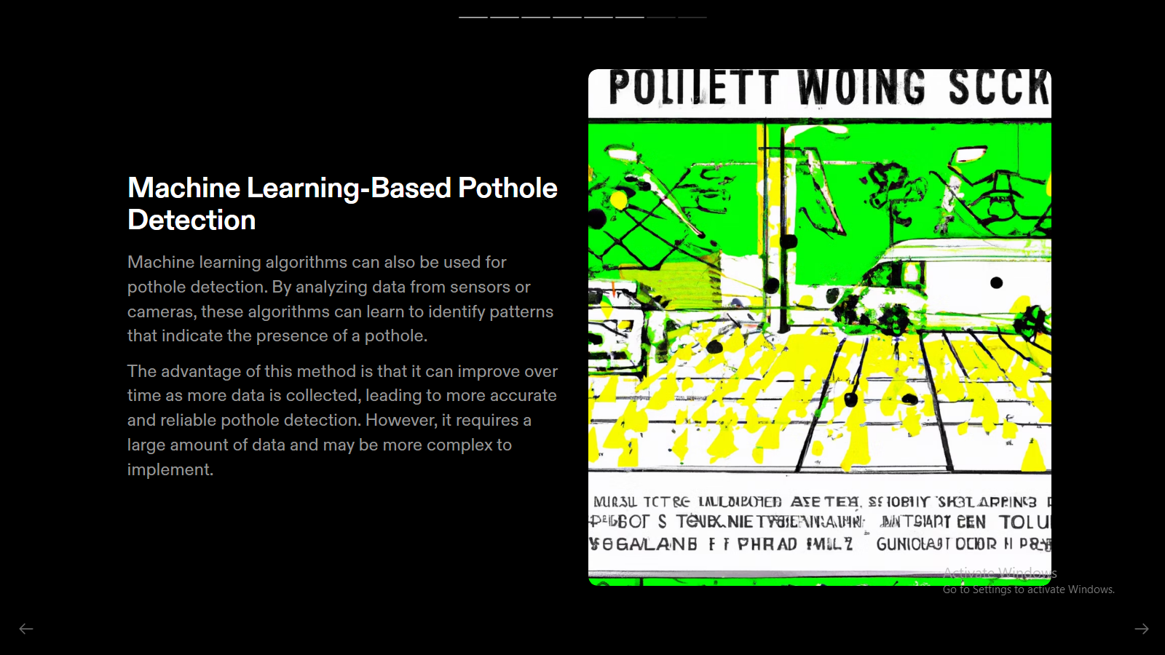

Slide 5
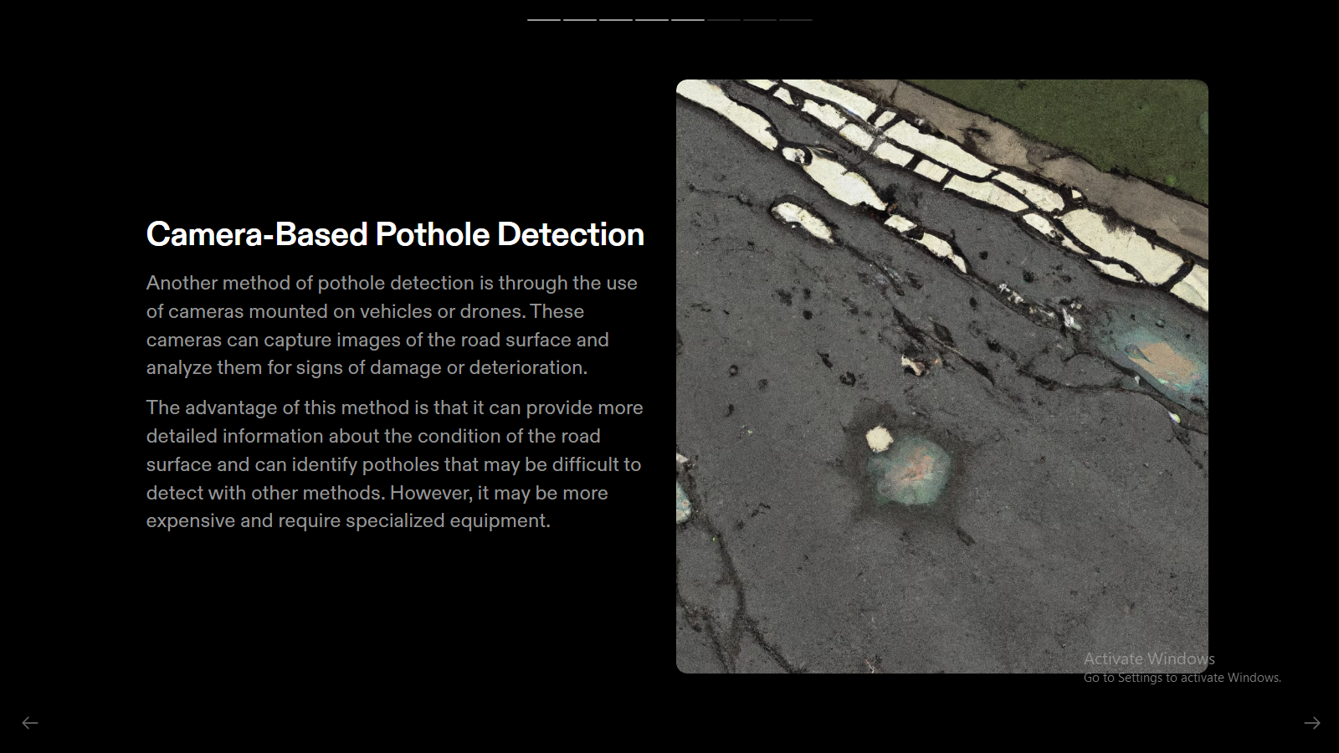

Slide 6
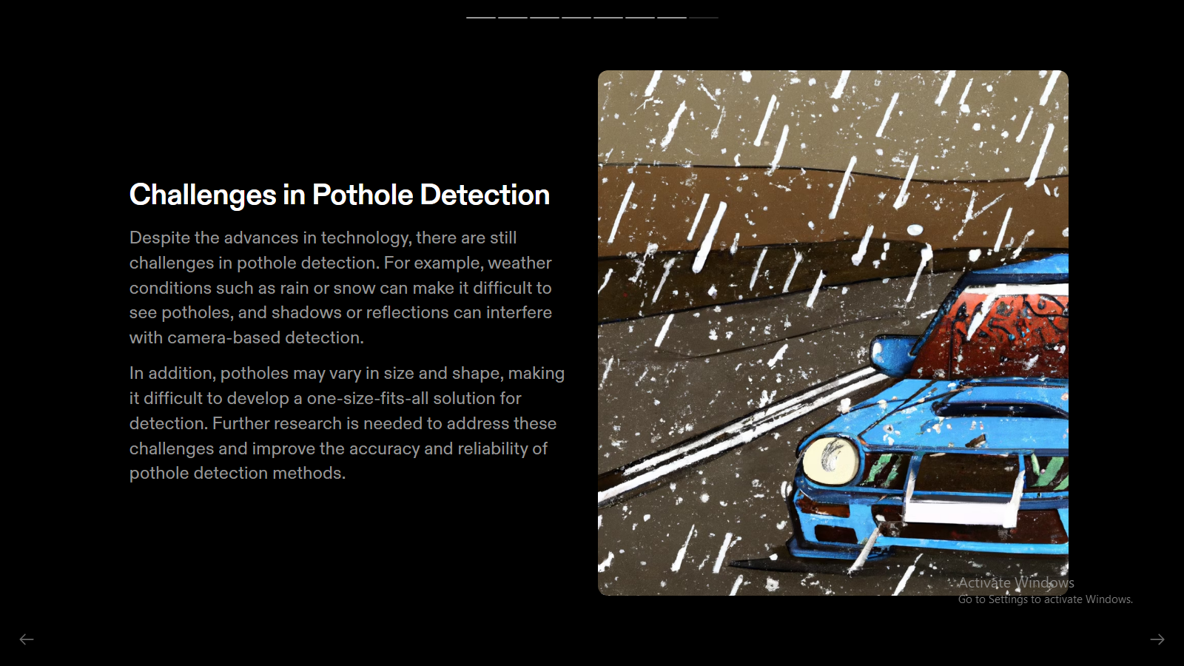

Slide 7
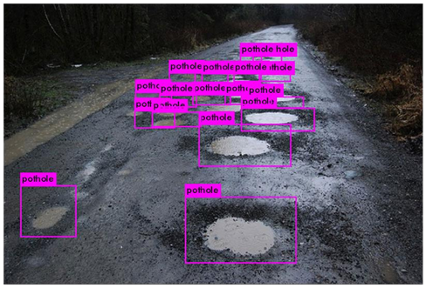
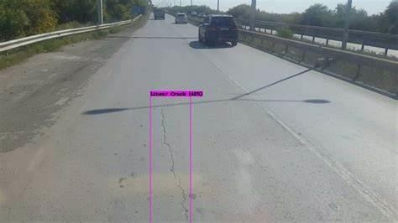
Output

Slide 8
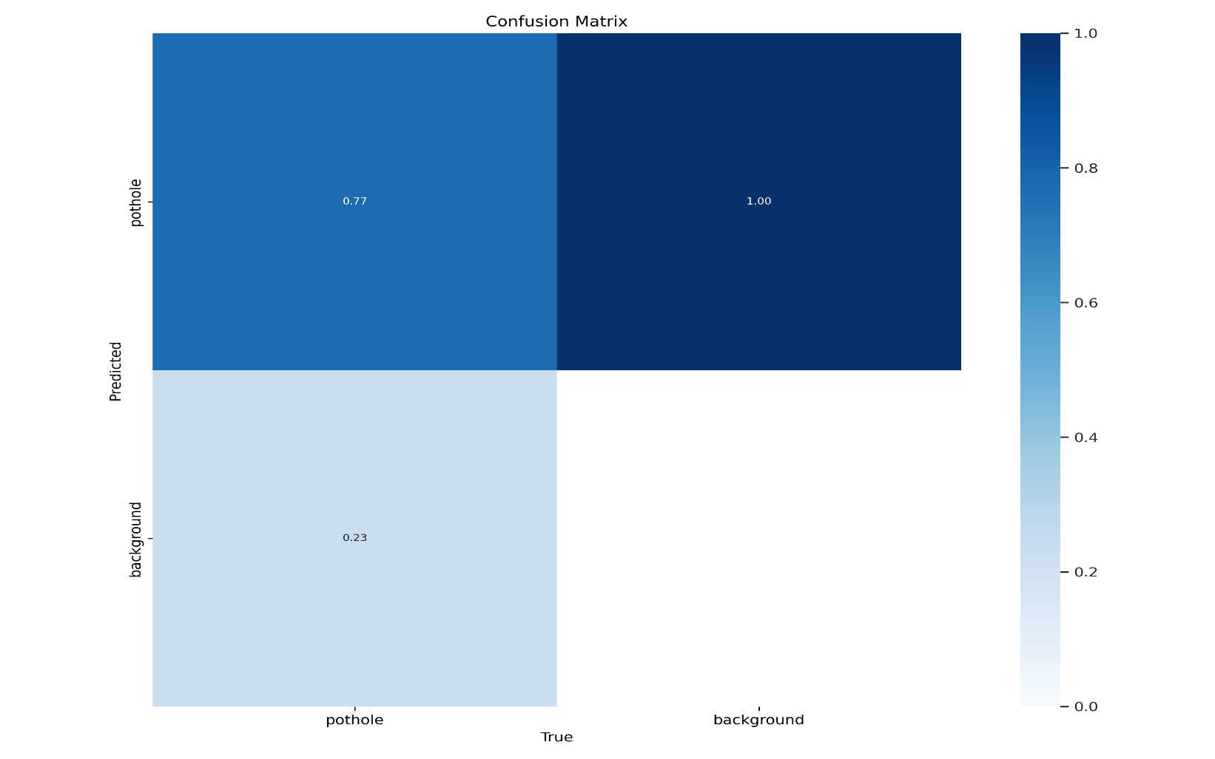
Confusion matrix

Slide 9
