Slide 1
DISTRIBUTED SYSTEM AND CLOUD COMPUTING
A NEW TRUST MANAGEMENT
ARCHITECHTURE FOR CLOUD
COMPUTING ENVIRONMENT
PRESENTED BY:
kaviram R
2021115332

Slide 2
INTRODUCTION
Briefly explain Cloud Computing and its benefits (elasticity, pay per use, location independence, etc.).Highlight the security, privacy, and trust concerns that limit cloud adoption.Introduce the paper's objective: Proposing a new trust management architecture to address these concerns.

Slide 3
PROPOSED SOLUTION
The Trust Management Architecture Introduce the three main components of the proposed architecture:
Cloud Service Registry and Discovery (CSRD) - a registry for CSPs with trust ratings.
Trust Calculator (TC) - calculates trust values for registered CSPs based on feedback.
Dynamic Trust Monitor (DTM) - monitors trust value fluctuations over time.

Slide 4
CLOUD SERVICE REGISTRY AND DISCOVERY (CSRD)
Cloud Service Registry and Discovery (CSRD)Explain CSRD's role as a central registry for cloud service providers (CSPs).
Mention how CSPs register with CSRD, providing details about their services.
Highlight how consumers can discover suitable CSPs by searching the registry based on their needs (service type, trust value).
Briefly explain how CSRD maintains a history of past trust values for each CSP, providing context for trust evaluation.

Slide 5
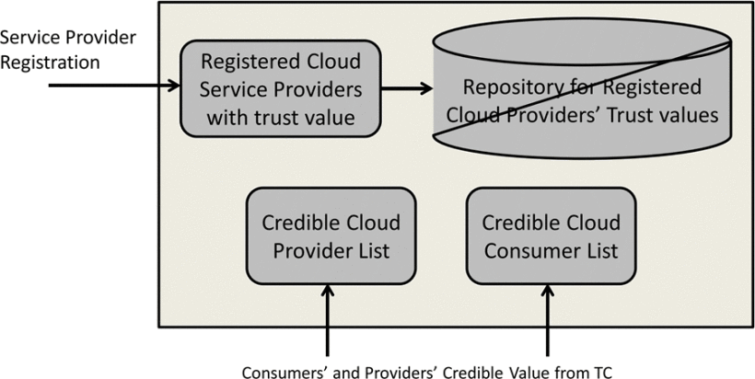

Slide 6
TRUST CALCULATOR – GAUGING Trust worthiness TC score providers
The Trust Calculator assigns a trust value to each registered cloud service provider (CSP).
Credible Feedback Matters: Trustworthiness is assessed based on feedback from credible sources.
This includes : Consumers who have used the service and report on factors like meeting Service Level Agreements (SLAs) and delivering good Quality of Service (QoS).
Focus on Reliability: The feedback considers how well a CSP adheres to its promises (SLAs) and the overall quality of the service it delivers (QoS).

Slide 7
TRUST CALCULATOR–CREDIBILITY MATTERS(OPTIONAL)
This slide can delve deeper into the concept of credibility score, explaining how it helps address unreliable feedback.
Explain how credibility score is calculated based on a provider's/consumer's experience (number and duration of services provided/consumed).
Mention that only feedback from credible sources (those with high credibility scores) is considered for calculating trust values, reducing the impact of biased or inaccurate feedback .

Slide 8
DYNAMIC TRUST MONITOR (DTM) Keeping Trust values UP-TO-DATE
Keeping Trust Dynamic Monitoring Trust Fluctuations:
The Dynamic Trust Monitor (DTM) continuously tracks changes in trust values assigned to cloud service providers (CSPs).
Trust is Evolving:
These changes reflect factors like new user experiences, variations in service quality, and a provider's adherence to SLAs over time.

Slide 9
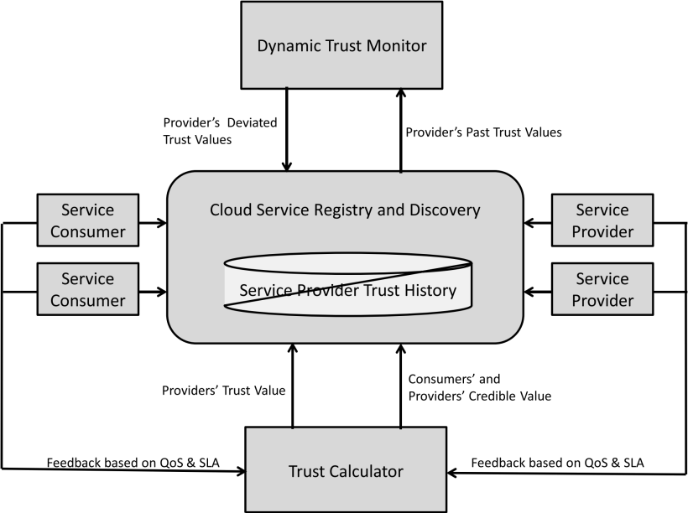

Slide 10
Alerts for Action:
DTM can trigger alerts for both consumers and providers:
Consumers are notified of potential risks associated with a declining trust value in a CSP.
Providers are notified of changes in their trust rating, prompting them to address any issues impacting their service quality.

Slide 11
CONCLUSION
Summarize the key takeaways of the proposed trust management architecture .
Reiterate how the model helps consumers choose reliable cloud service providers based on dynamic trust values.
Briefly mention the future work as stated in the paper (e.g., simulation and development of a complete trust management framework).

