Slide 1
AM5016 NUMERICAL METHODS IN BIOMEDICAL ENGINEERING
“Comparative Analysis of Numerical methods for cardiovascular Action potential modelling”
Arunachalam U – AM23M020
Dinesh Kumar M – AM23M022
Kaviyarasan P R – AM23M025
Pooja V – AM23D602

Slide 2
PROBLEM STATEMENT COMPARATIVE ANALYSIS OF NUMERICAL METHODS FOR CARDIOVASCULAR ACTION POTENTIAL MODELLING
Cardiovascular modelling is a critical area of research that plays a significant role in understanding the electrical activity of the heart. This project involves the numerical simulation of cardiac cell kinetics, specifically focusing on ion channel activity and action potential. Multiple numerical integration methods, including Euler, Explicit Runge-Kutta (RK4), Backward Euler, and Implicit RK4, are applied to study the behavior of the cardiac cell. The primary goal is to compare these methods in terms of accuracy, computational efficiency, and their impact on the simulation results. Additionally, the code investigates the sparsity pattern of the Jacobian matrix to understand the system's structural dependencies.

Slide 3
OBJECTIVES
Create a detailed cardiac myocyte action potential model in Simulink to accurately represent cardiac cell behavior.
Implement and validate the model for action potential generation and propagation, considering various conditions and scenarios.
Develop numerical solvers for both Implicit and Explicit methods, to simulate action potential dynamics.
Evaluate the efficiency, accuracy, and computational resource requirements of each numerical method to capture cardiovascular system behavior.
Present results graphically and discuss the impact of the findings on the choice of numerical methods for cardiovascular modeling and their relevance to research and clinical applications.

Slide 4
NOBLE MODEL
In 1962, Denis Noble published one of the first mathematical models of a cardiac cell. By adapting the equations of the original Hodgkin-Huxley squid axon model (1952), Noble described the long lasting action and pace-maker potentials of the Purkinje fibers of the heart.
The potassium-current equations differ from those of Hodgkin and Huxley in that the potassium ions are assumed to flow through two types of channel in the membrane.
But, it only includes one voltage gated inward current, I_{Na}. Calcium currents had not yet been discovered, but there was a clue in the model that something was missing. The only way the model could be made to work was to greatly extend the voltage range of the sodium current by reducing the voltage dependence of the sodium activation process.
In effect the sodium current was made to serve the function of both the sodium and the calcium channels as far as the plateau is concerned.

Slide 5
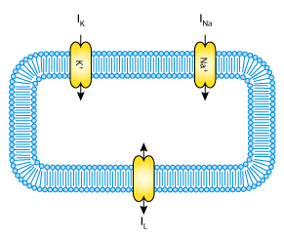

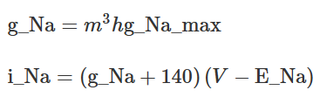
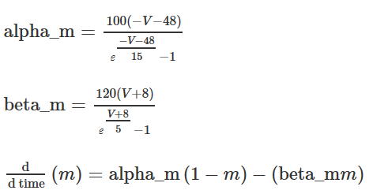
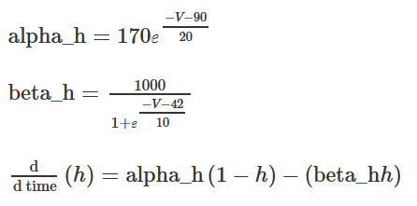
MODEL MATHEMATICS
Membrane Voltage
Sodium Channel
Sodium Channel - Gates

Slide 6
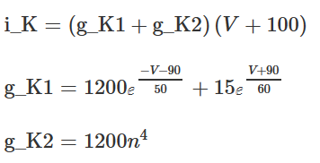
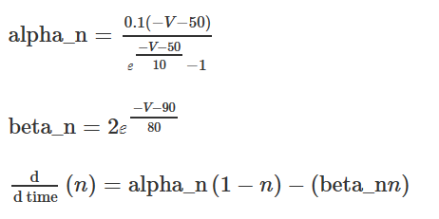

MODEL MATHEMATICS
Potassium Channel
Potassium Channel – Gates Leakage Current

Slide 7
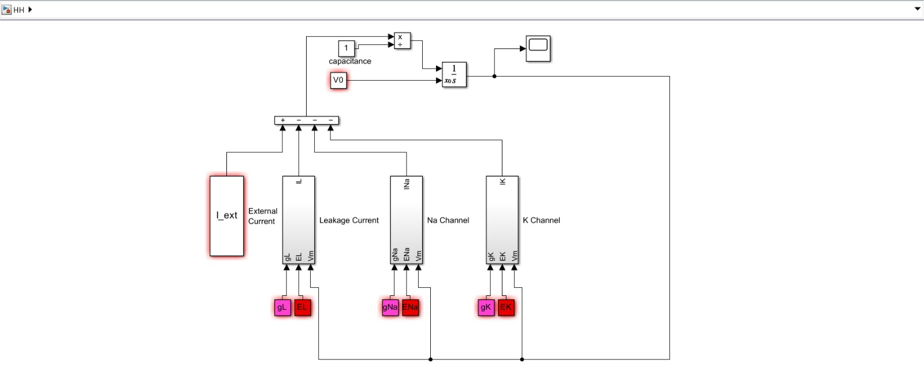
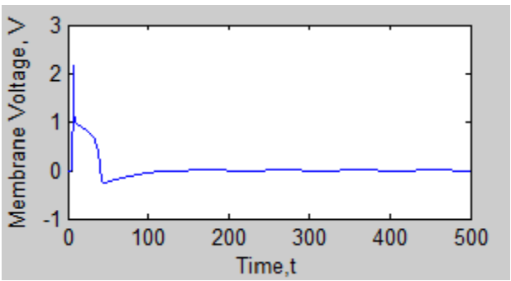
SIMULATION
Simulation Output
HH Model System

Slide 8
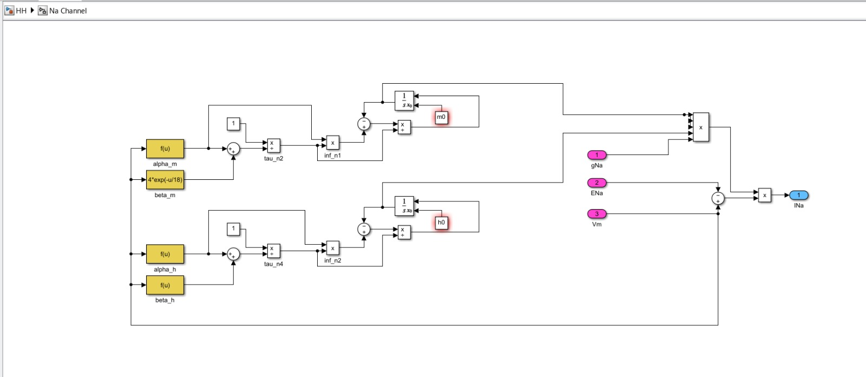
Sodium Channel Circuit

Slide 9
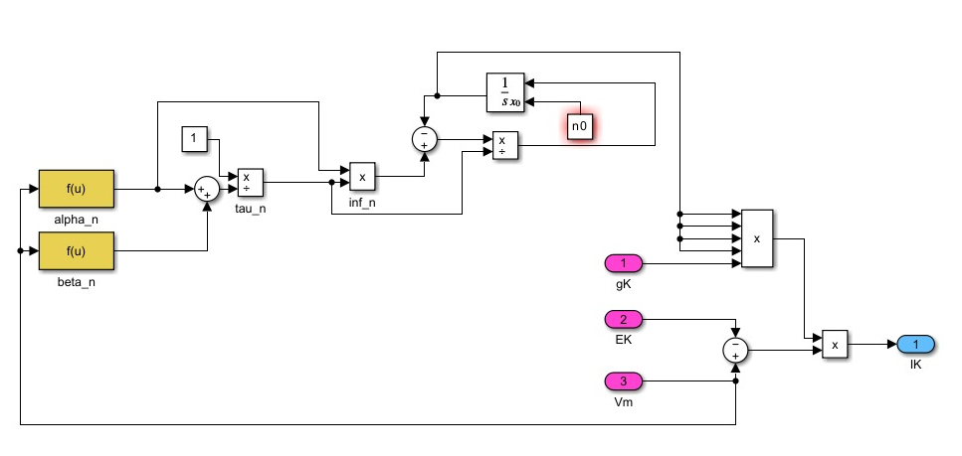
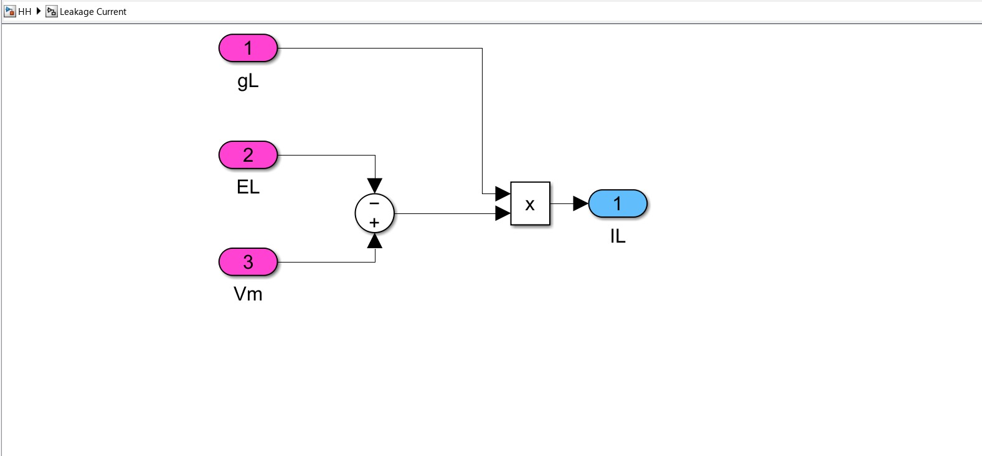
Potassium Channel Circuit
Leakage Current Circuit

Slide 10

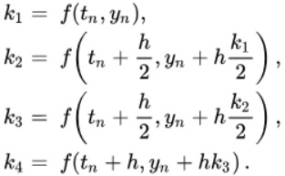
NUMERICAL METHODS
Forward Euler (FE)
Basic method for solving differential equations.
Simple and straightforward, but can be less accurate.
Explicit Runge-Kutta (ERK4)
A higher-order method providing improved accuracy.
More complex but suitable for precise simulations.

Slide 11

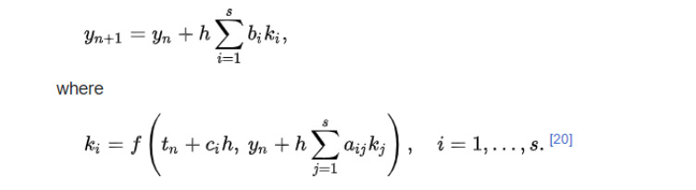
NUMERICAL METHODS
Backward Euler (BE)
Implicit method known for its stability.
Solves equations at future time points from past values.
Implicit Runge-Kutta (IRK4)
A blend of high accuracy and stability.
Useful for solving stiff problems.
LSODA
An adaptive numerical solver, adjusts step sizes automatically for efficient and accurate simulations. It's a versatile choice for a wide range of problems, making it a valuable tool in scientific research and modeling.

Slide 12
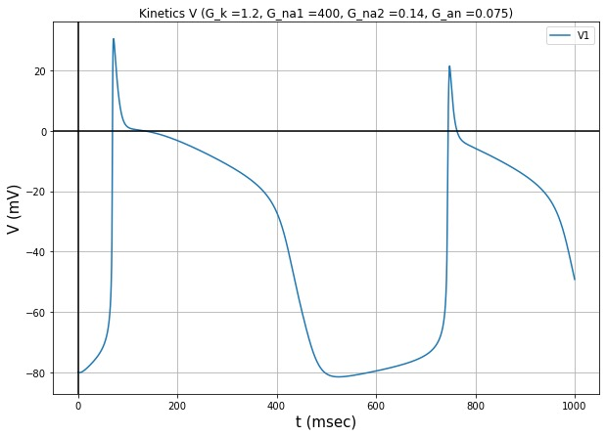
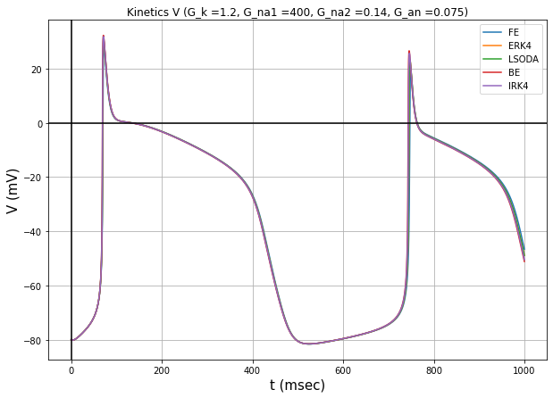
NOBLE MODEL – ACTION POTENTIAL

Slide 13
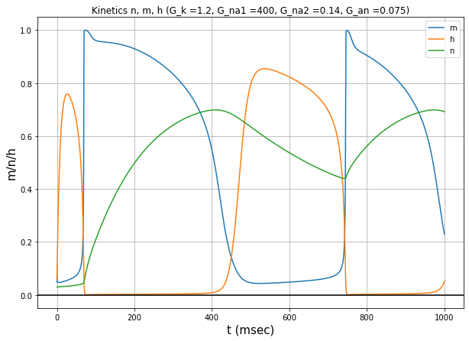
NOBLE MODEL – GATING VARIABLE ACTIVATION

Slide 14
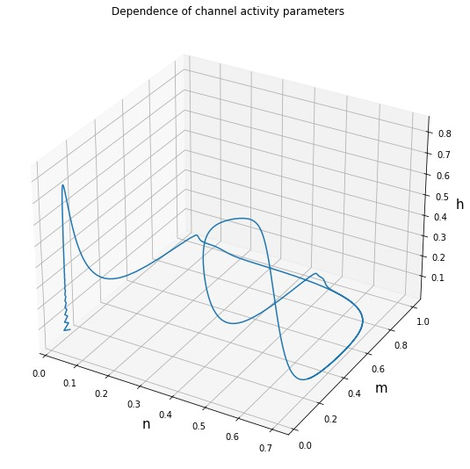
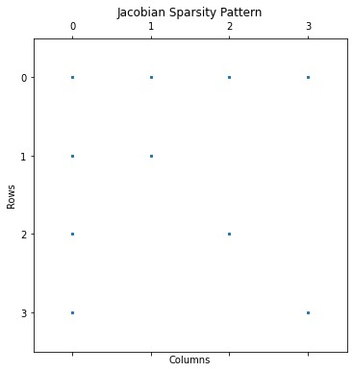
NOBLE MODEL
Dependence of Channel Activity Parameter
Jacobian Sparsity Matrix

Slide 15
OBSERVATIONS
Method | RMSE | Global RMSE | Computation Time
FE | 2.44 | 1.22 | 0.17 s
ERK4 | 0.65 | 0.33 | 0.70 s
LSODA | 0.66 | 0.33 | 0.20 s
BE | 1.97 | 0.98 | 1.78 s
IRK4 | 1.27 | 0.64 | 9.58 s

Slide 16
CONCLUSION
The results indicate that each method offers a unique balance between accuracy and computation time.
Explicit Runge-Kutta (ERK4) stands out as the most accurate method, making it suitable for precise simulations.
LSODA, with its efficient step size adaptation, provides a competitive alternative for scenarios where computational efficiency is a priority.
Implicit methods like Backward Euler (BE) and Implicit Runge-Kutta (IRK4) exhibit stability but require significantly more computational resources.
Overall, the choice of numerical method should be carefully considered based on the specific demands of the simulation, striking a balance between accuracy and efficiency.

Slide 17
REFERENCES
1) Noble D. (1962). A modification of the Hodgkin-Huxley equations applicable to Purkinje fibre action and pace-maker potentials. Journal of Physiology 160, 317-52.
2) Belhamadia, Y., 2010. Recent numerical methods in electrocardiology. New Development in Biomedical Engineering, pp.151-162.
3) A Historical Perspective on the Development of Models of Rhythm in the Heart Heart Rate and Rhythm, 2011 ISBN : 978-3-642-17574-9.
4) Spear, J.F., Horowitz, L.N., Hodess, A.B., MacVaugh 3rd, H. and Moore, E.N., 1979. Cellular electrophysiology of human myocardial infarction. 1. Abnormalities of cellular activation. Circulation, 59(2), pp.247-256.
5) Göktepe, S. and Kuhl, E., 2009. Computational modeling of cardiac electrophysiology: a novel finite element approach. International journal for numerical methods in engineering, 79(2), pp.156-178.

Slide 18
THANK YOU

