Slide 1
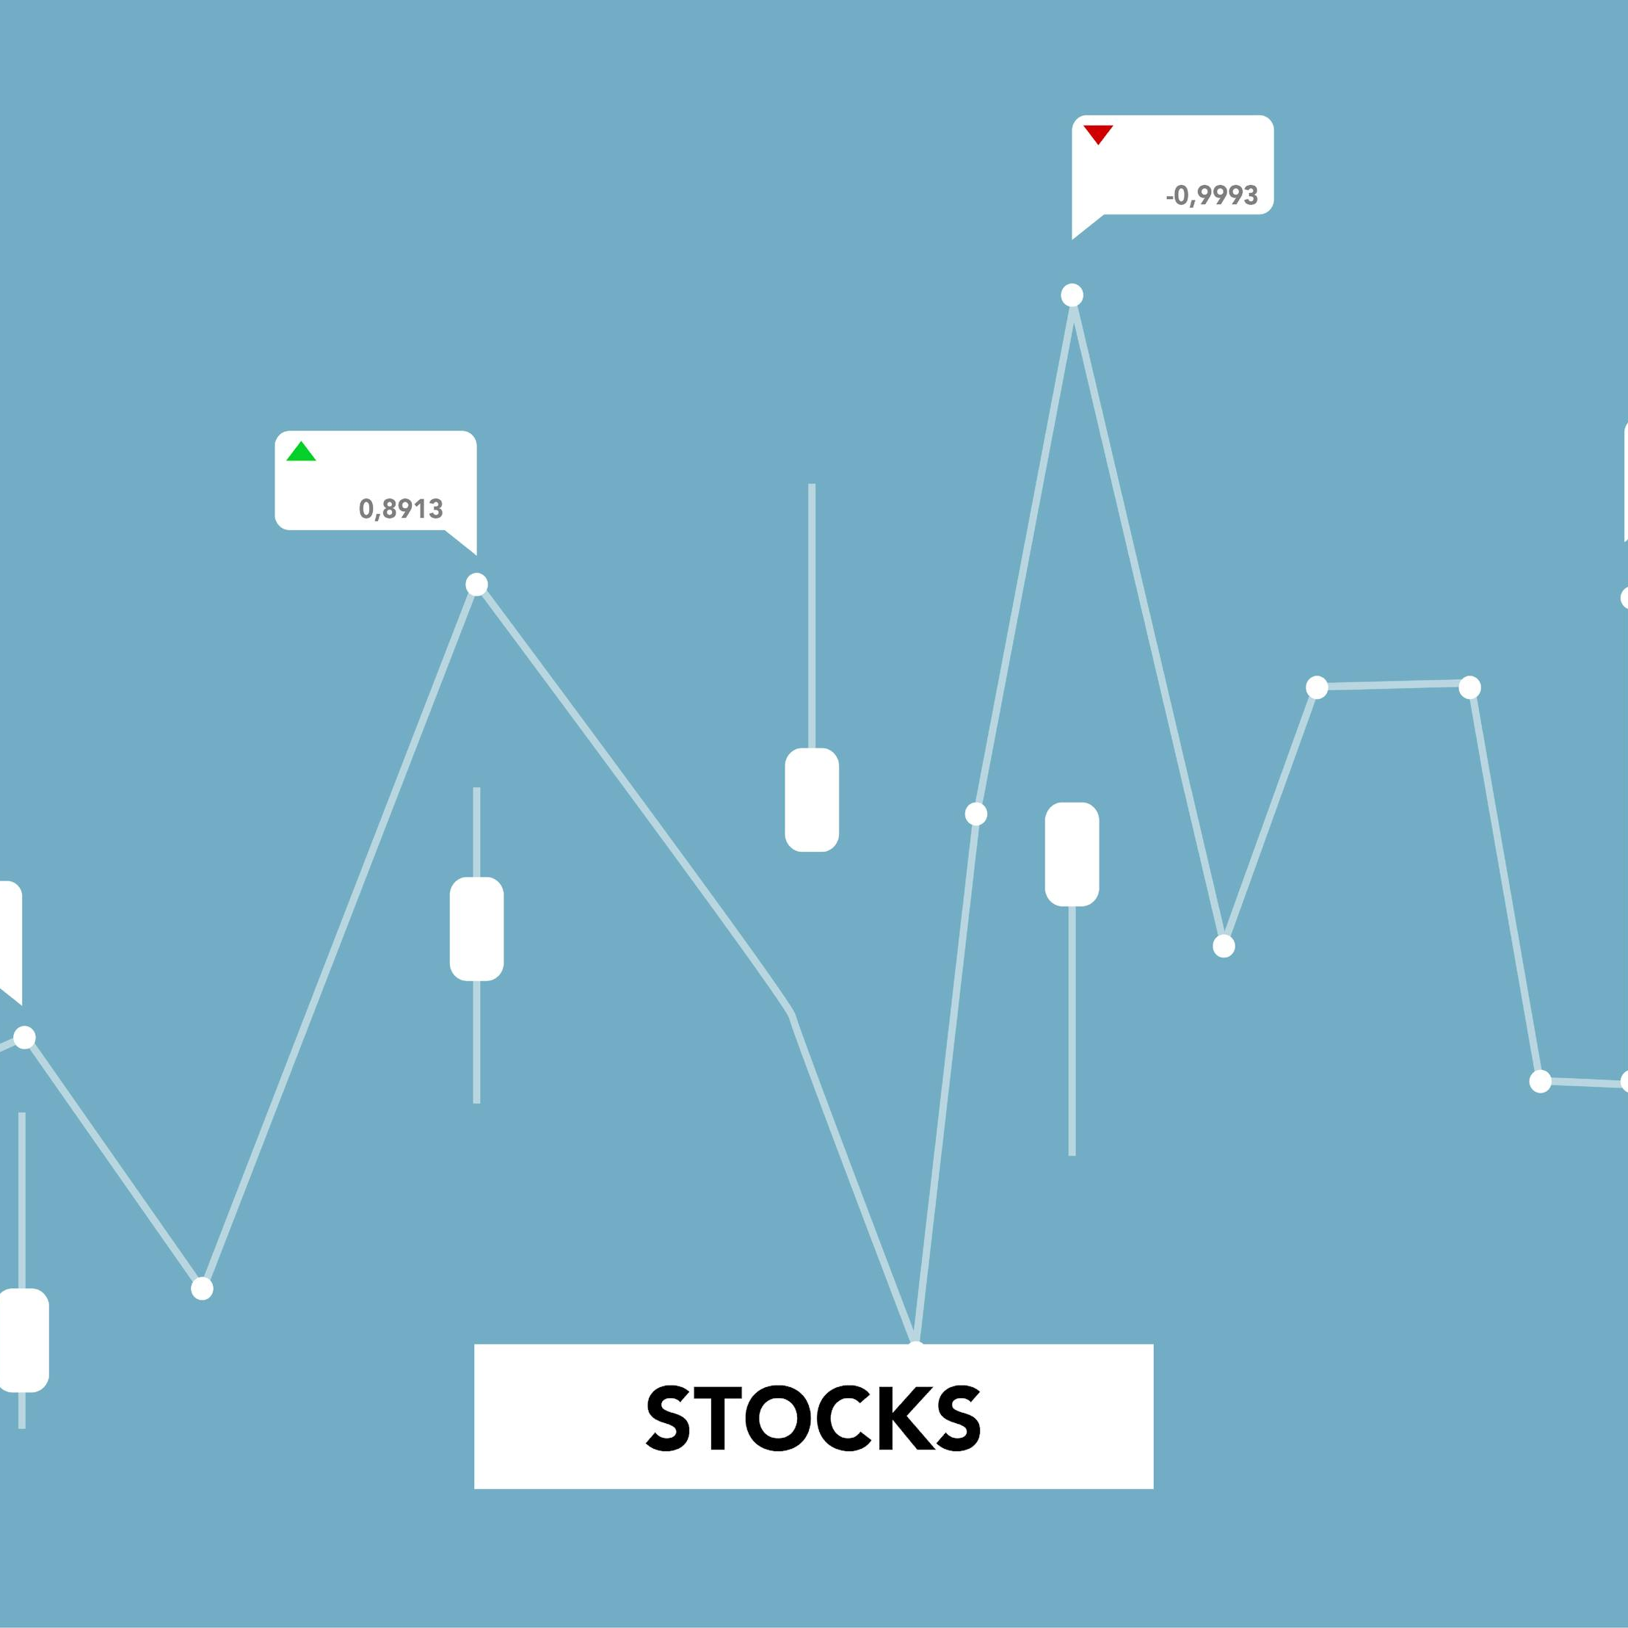
TradeTrack
- Stock tracking and portfolio management
Prepared by :
Name : Kavish Sunilkumar Patel
Enroll no. : 23002171310109
Batch: D1
Roll no. : 10
Date: 23rd August, 2025

Slide 2
Introduction
About TradeTrack: A platform designed for effortless stock tracking and portfolio management
Why TradeTrack?
Core working: Combines stock tracking, and data visualization to enhance investment decisions.
Investors often face challenges tracking multiple stocks, analyzing historical price data, and calculating investment performance.
TradeTrack fills this gap by providing a user-friendly solution.

Slide 3
Key features
User authentication
Price trends
watchlist
Portfolio
Live news
Transactions

Slide 4
Technology stack :
01
02
03
Python, javascript
- Coding languages
SQlite
- Database
Alpha Vantage API
- Real time information
1. Programming Languages : Python, JavaScript
2. Backend Framework : Django
3. Frontend library : React.js
4. CSS Framework : Tailwind CSS
5. Build tool : Vite
6. APIs : Alpha vantage API, finnhub API
7. database : SQlite

Slide 5
Future enhancements
01
03
02
04
Live Paper Trading
Secure User authentication
Add features to buy sell stocks
additional user details
Two factor authentication
Price alerts
Mobile app
for stocks reaching user-defined thresholds
An app version for better accessibility

Slide 6
Conclusion
TradeTrack is a comprehensive platform designed to simplify stock tracking and portfolio management
TradeTrack empowers users to make smarter investment decisions by combining technology, efficiency, and simplicity
Refrences
Live stock market data from :
- Alpha vantage API,
- Yahoo finance library ( yfinance ),
- finnhub api ( latest market news )

Slide 7
THANK YOU

