Slide 1
Capstone Project
ALY6110: Data Management and Big Data Final Project Presentation
Airbnb Analysis
Team-2
Team-9
Name
Kavish Shah
Tanusha Erupla

Slide 2
Dataset Overview
Dataset Taken:- Airbnb Listing in Australia
Dimension of dataset:- 18236 Records and 75 columns
Datatype:-
Numeric Values:- 44
Categorical Values:-31
Target Variable:- Availability_60

Slide 3
Introduction
Analyzed Airbnb dataset for Australia
Performed data wrangling, data imputation, exploratory data analysis, and data modeling for the dataset
Understood the different correlations between various variables in the dataset
Predicted the availability of Airbnb for 60 days in Australia.
Visualized various bar plots, heat maps, and scatter plots to understand the relation between price, availability, room type, and property type
Built decision tree, ridge regression, and random forest regressor to understand which model gives the most accuracy

Slide 4

Questions to Investigate
What is price distribution based on the availability of Airbnb for 60 days geographical-wise?
What is the number of Airbnb available in the Australian neighborhood?
What is the relationship between different neighborhoods and ratings based on price & room type?
What is the relationship between availability and price?
What is the relationship between availability and room type?
What is the correlation between features and target variables?
What features affect the availability of Airbnb for 60 days?

Slide 5
Data Cleaning
Removing
Removing unnecessary columns
Checking
Checking for N/A values
Splitting
Splitting the numeric and text data for analysis
Imputing
Imputing the N/A values with measures of central tendency.
Changing
Changing datatypes for necessary columns.

Slide 6
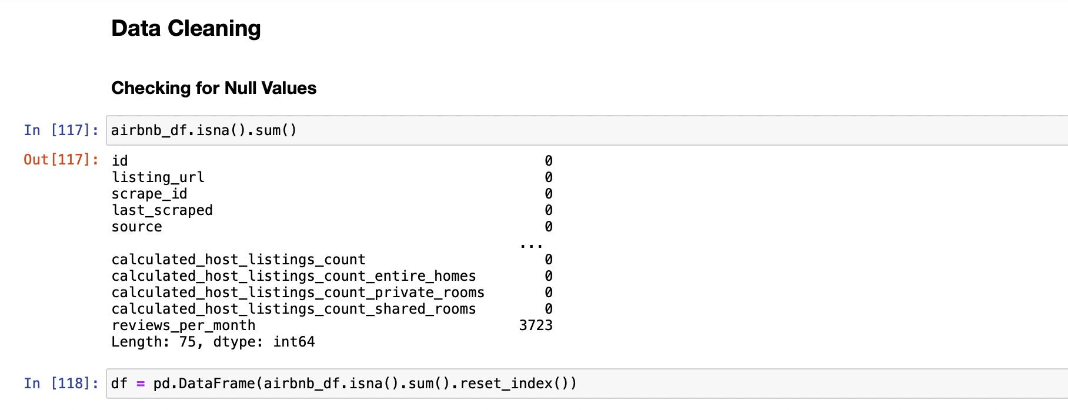
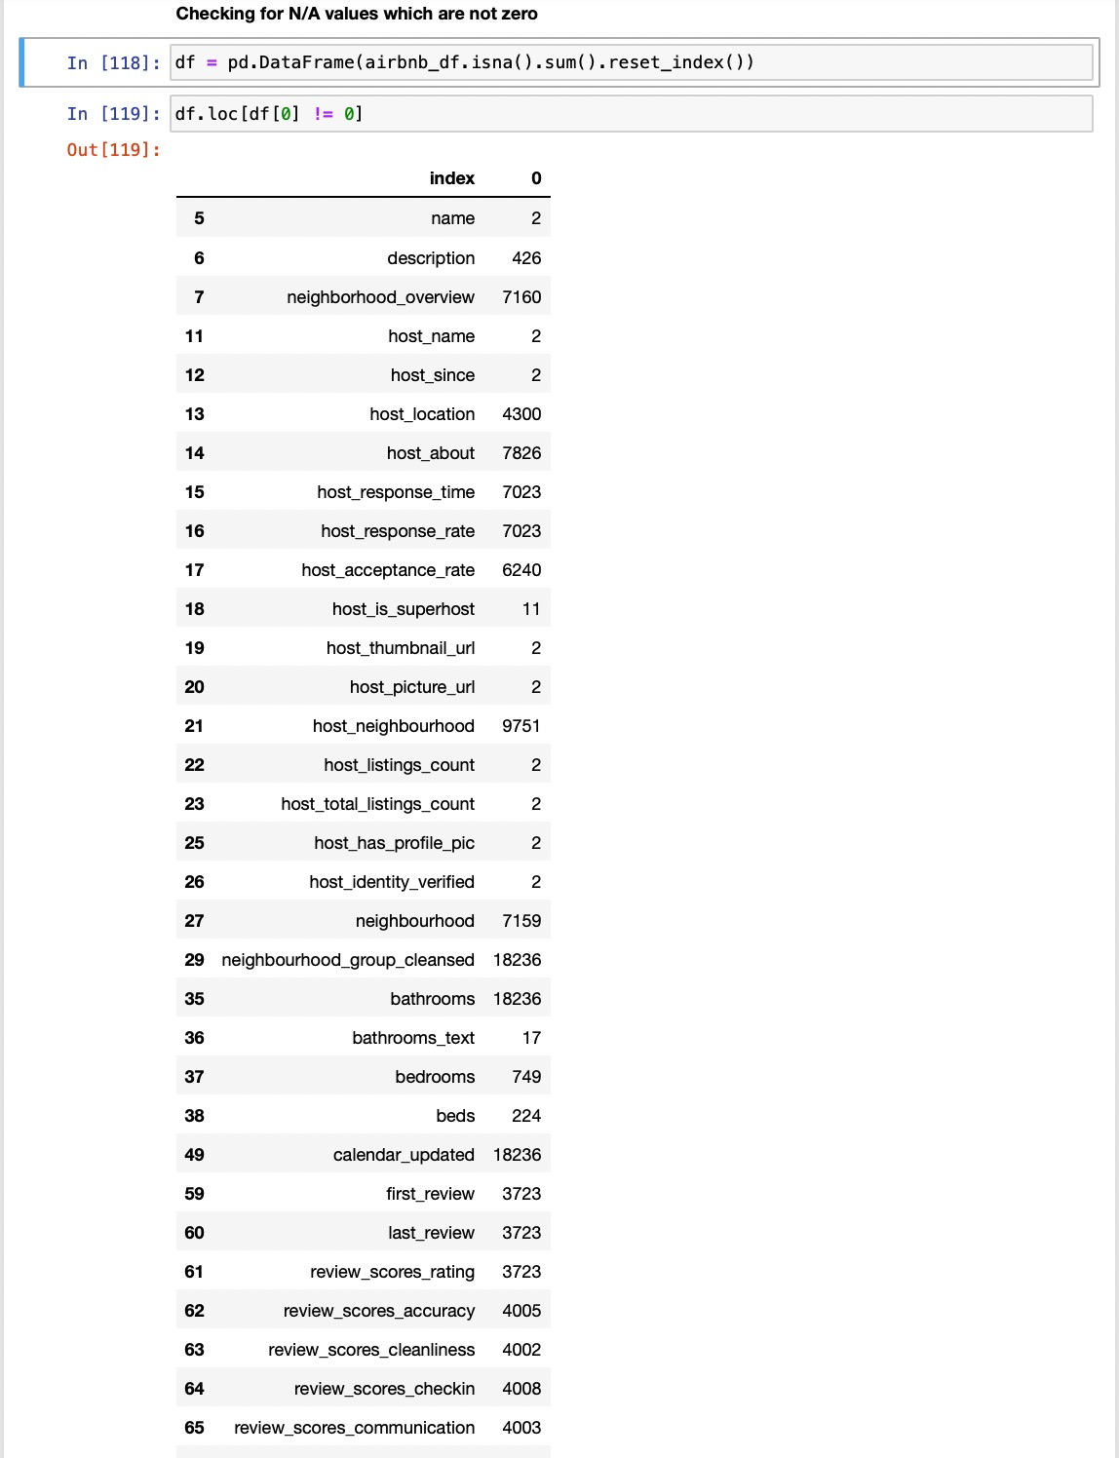
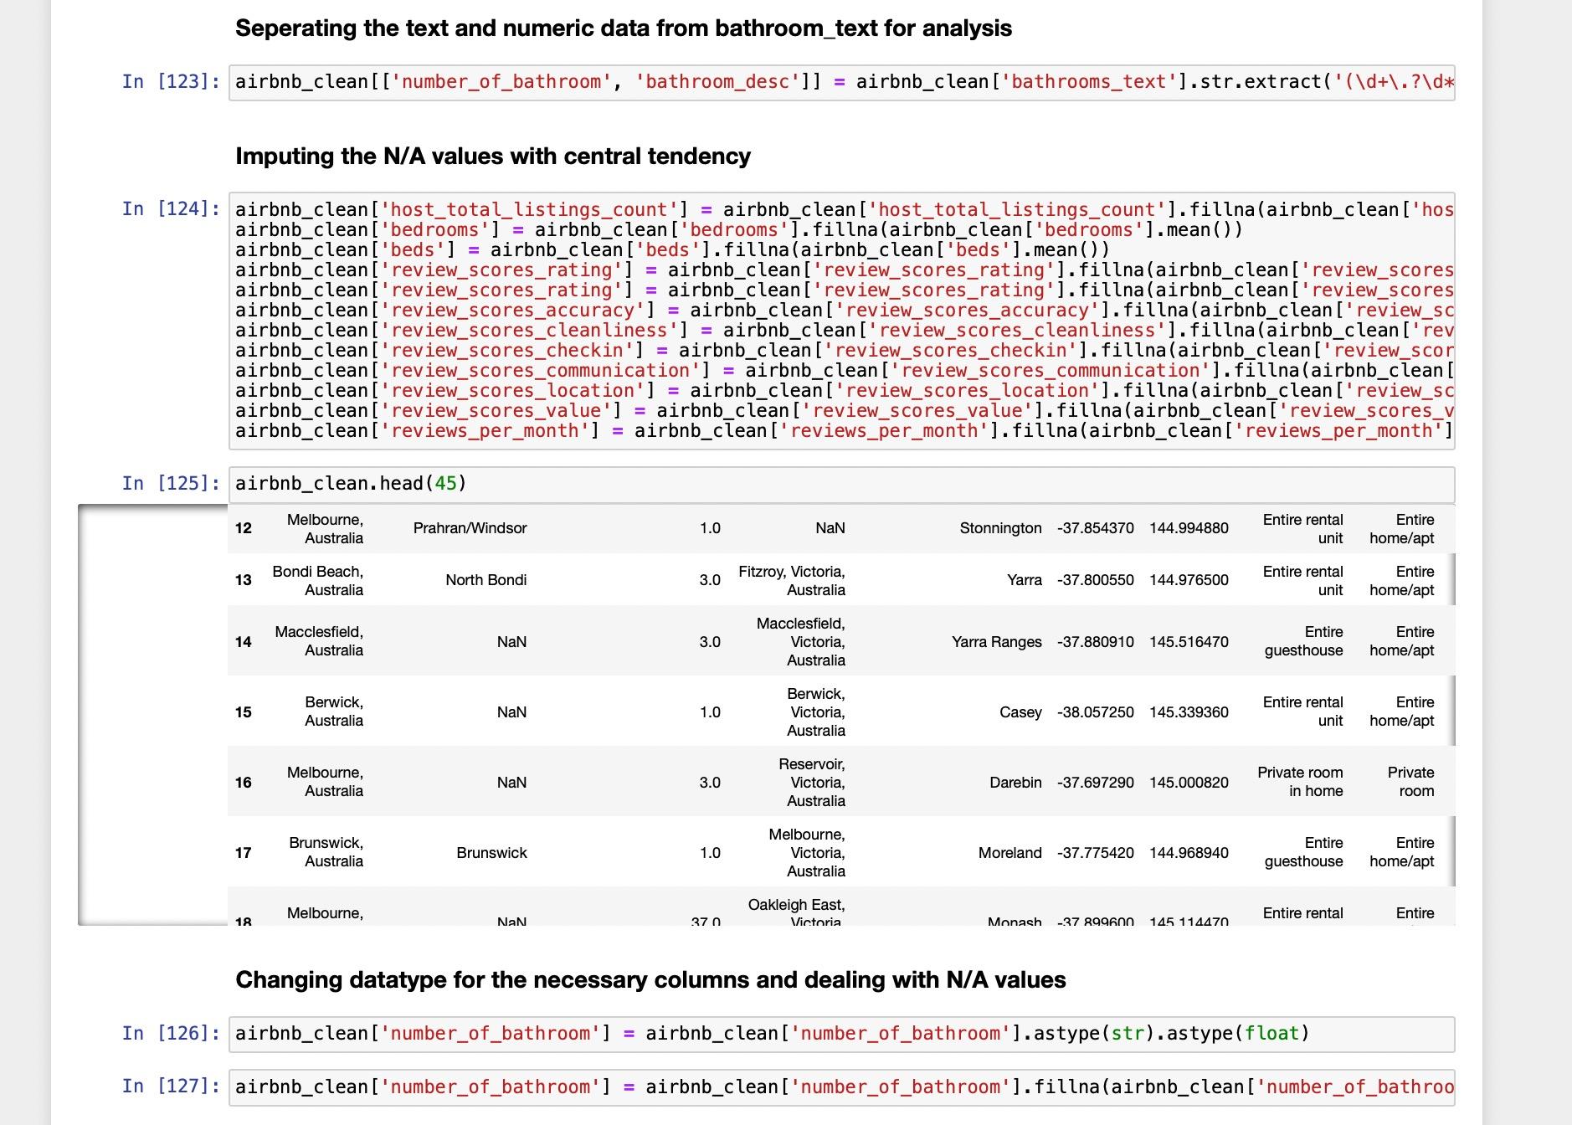
Snapshots of data cleaning

Slide 7
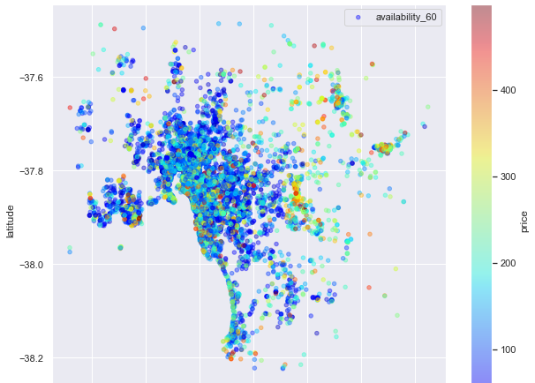
Exploratory data analysis
Price distribution based on the availability of Airbnb for 60 days geographical-wise

Slide 8
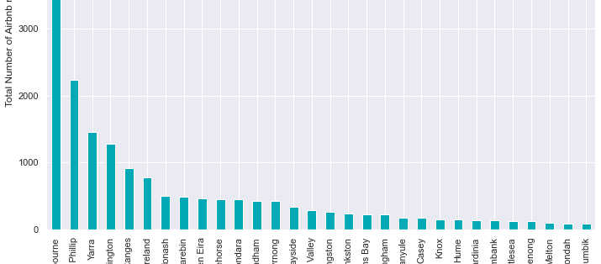
The number of Airbnb available in the Australian neighborhood

Slide 9
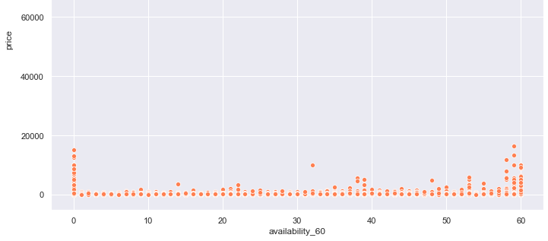
The relationship between availability and price

Slide 10
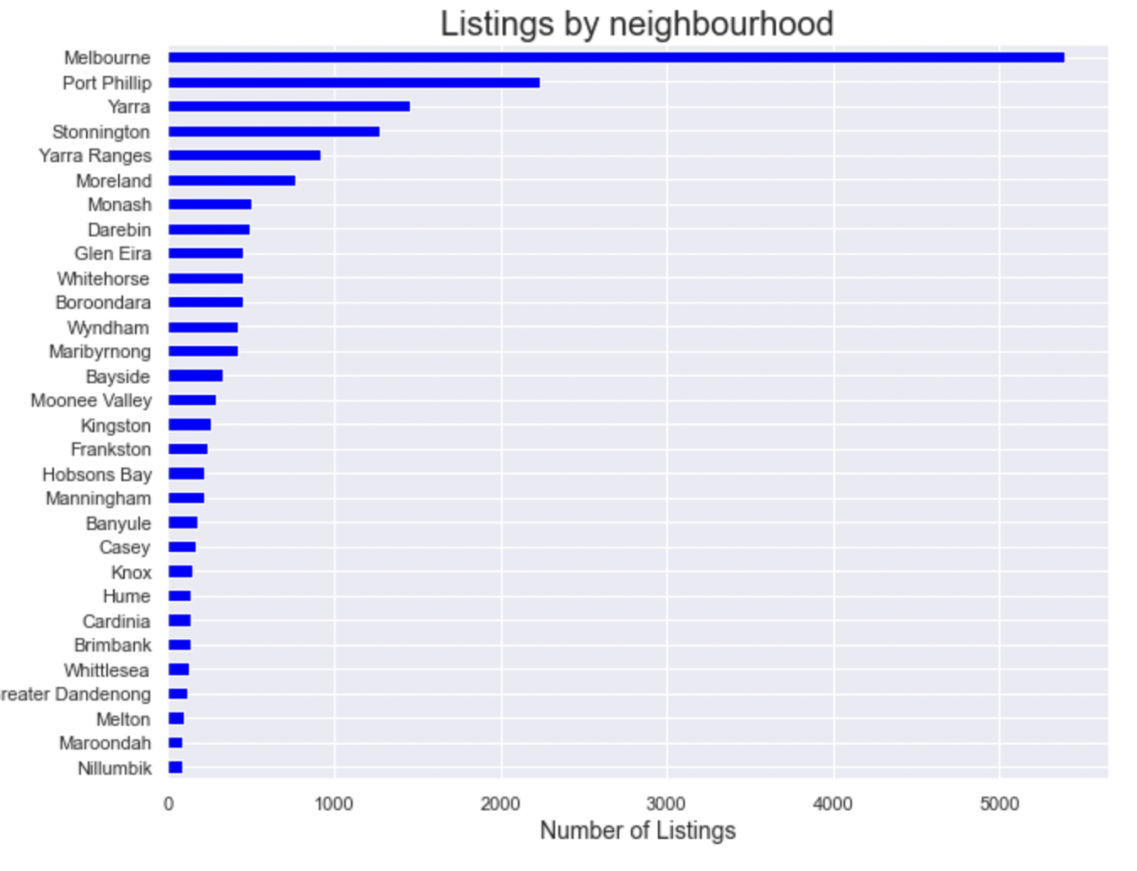
Listings by Neighborhood

Slide 11
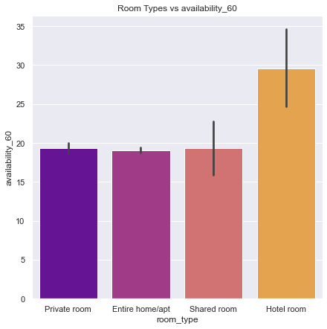
Distribution of room types based on availability

Slide 12
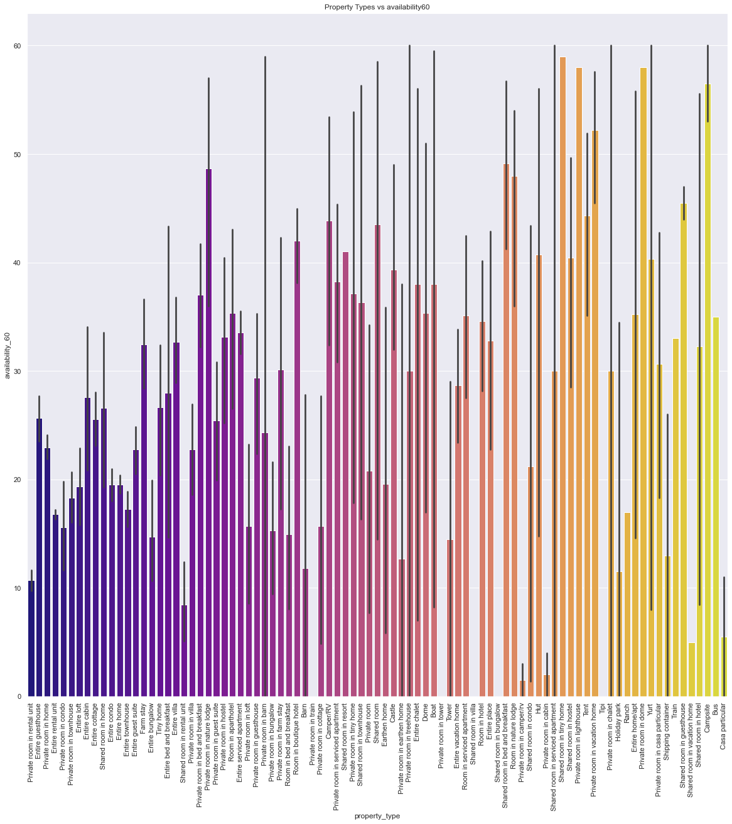
Availability by Neighborhood.

Slide 13
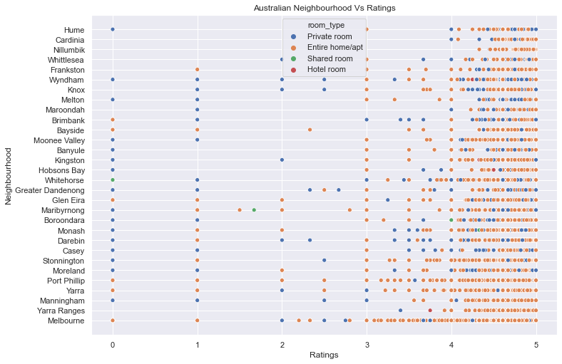
Ratings of different room type in different Australian cities

Slide 14
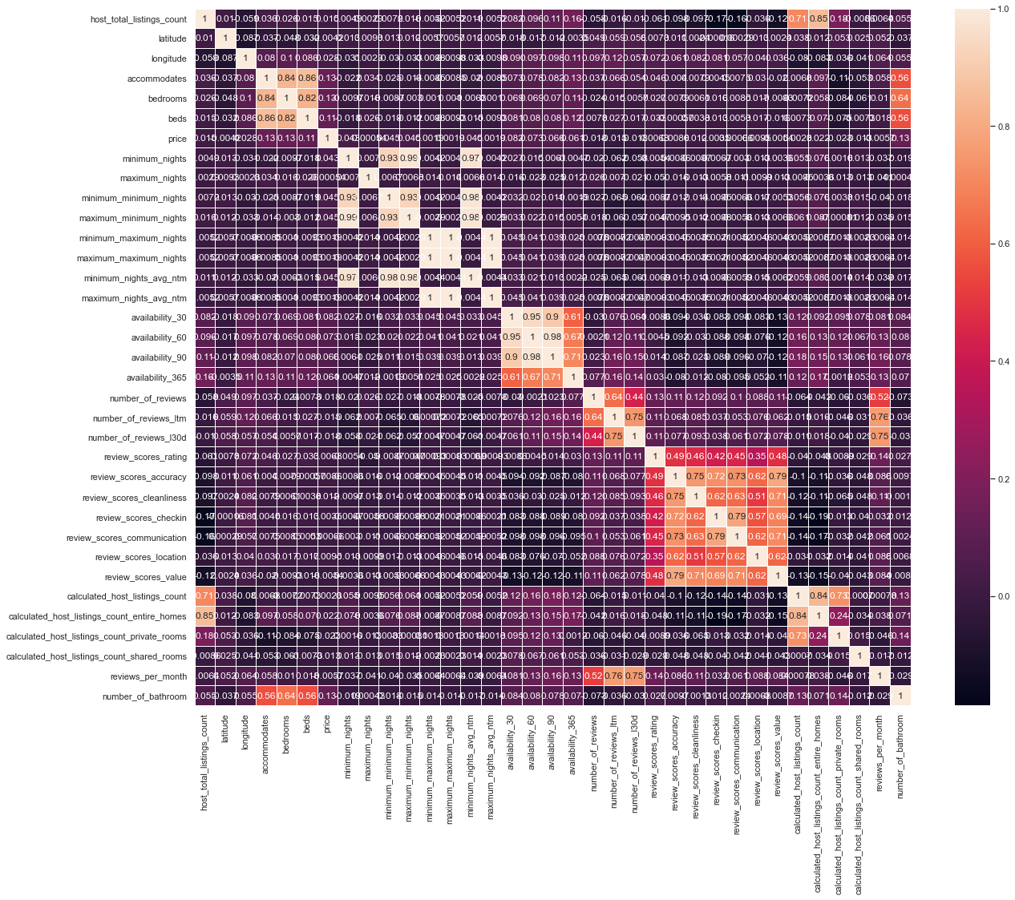
Correlation Matrix

Slide 15
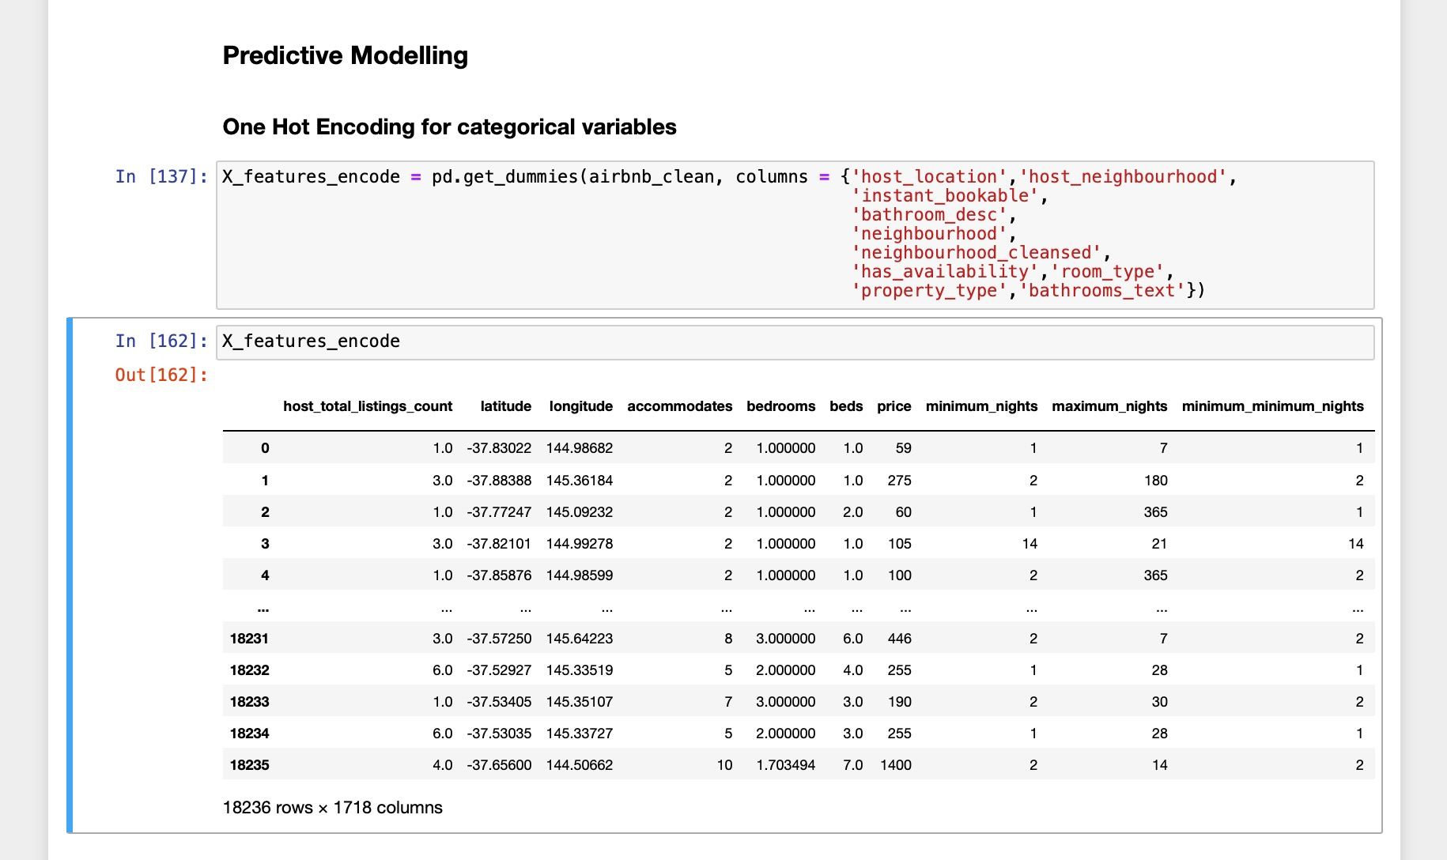
One Hot Encoding

Slide 16
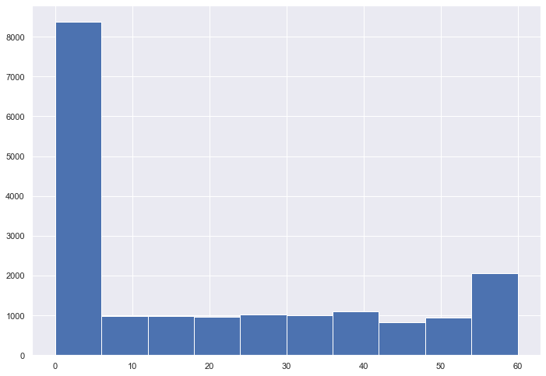
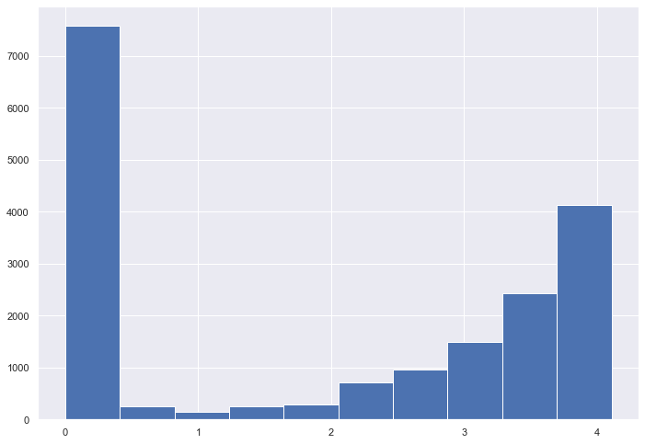
Checking for normalization of the target variable
Before Normalization
After Normalization using log function

Slide 17
Models
Predictive Models Used:-
Random Forest Regressor
Decision Tree Regressor
Ridge Regression

Slide 18
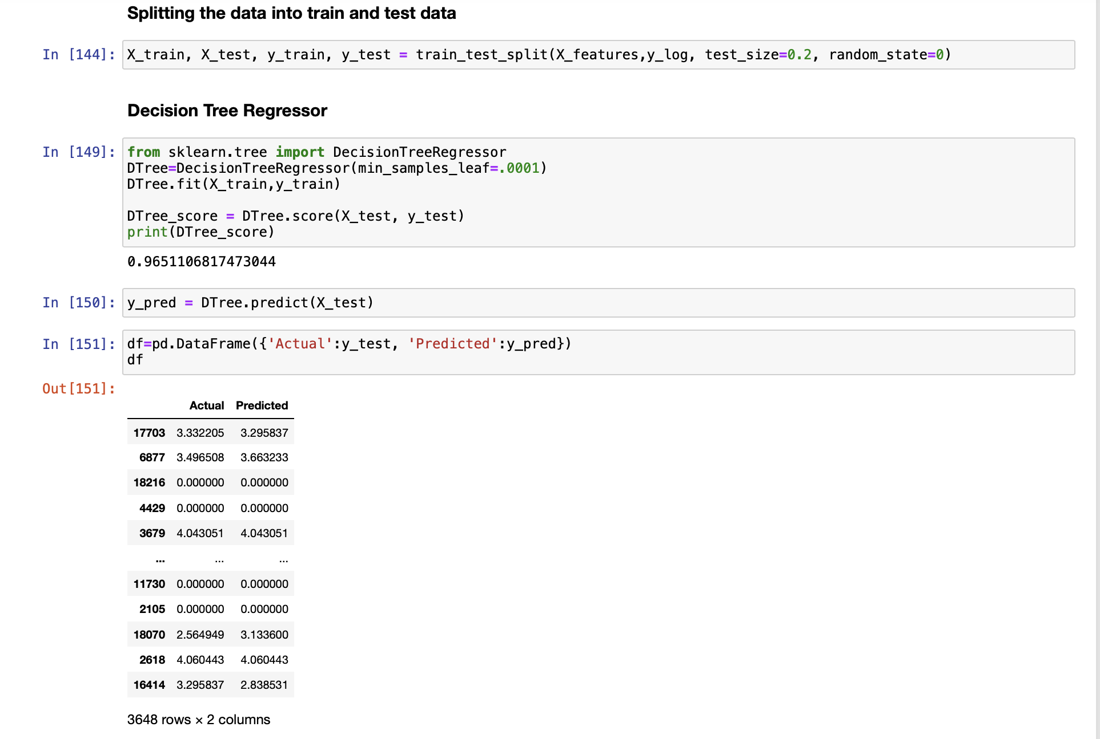
Decision Tree Regressor

Slide 19
Advantages
The decision tree model is simple to analyze, comprehend, and visualize and can be applied to classification and regression issues.
When compared to other methods, a decision tree's pre-processing involves less work and doesn't require data normalization.
It is also possible to implement the solution without scaling the data.
Disadvantages:
Decision trees cannot be used well with continuous numerical variables.
In comparison to other methods, the calculations required can also get sophisticated, and it takes more time to train the model.

Slide 20
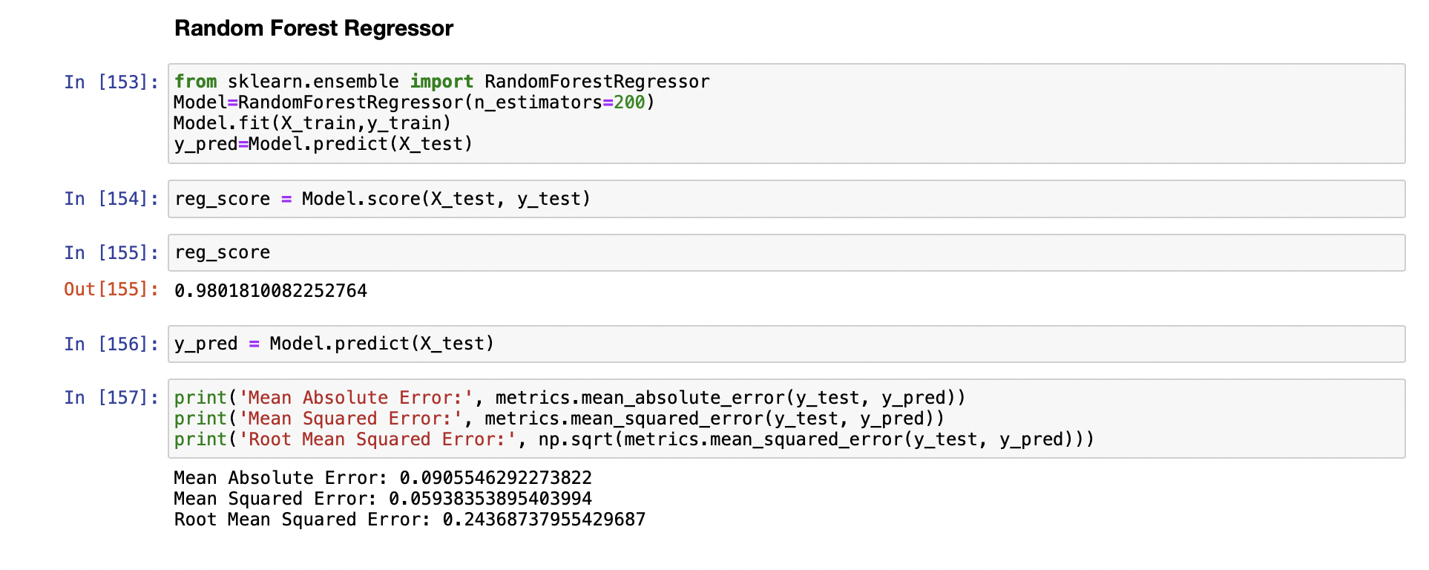
Random Forest Regressor

Slide 21
Random Forest Model
Random Forest Model is used to solve regression and classification problems.
It is suitable for situations when we have large dataset.
It involves many decision trees
It predicts the value by taking average of the mean
It predict values by taking into consideration the training data and predict the values of test data.
Training Data-80% Test Data-20%

Slide 22
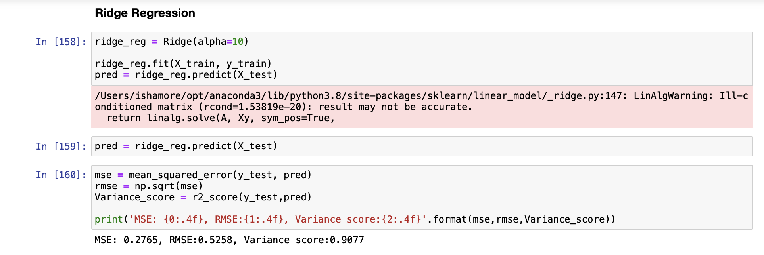
Ridge Regression Model

Slide 23
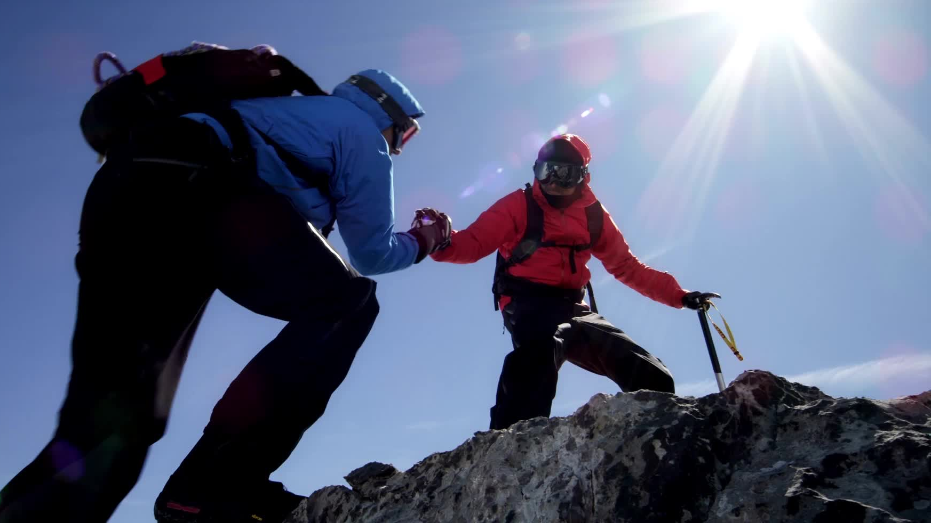
Advantages:
Avoids overfitting a model
The ridge estimator is preferably good at improving the least-squares estimate when there is multicollinearity.
Disadvantages:
They are unable to perform feature selection.

Slide 24
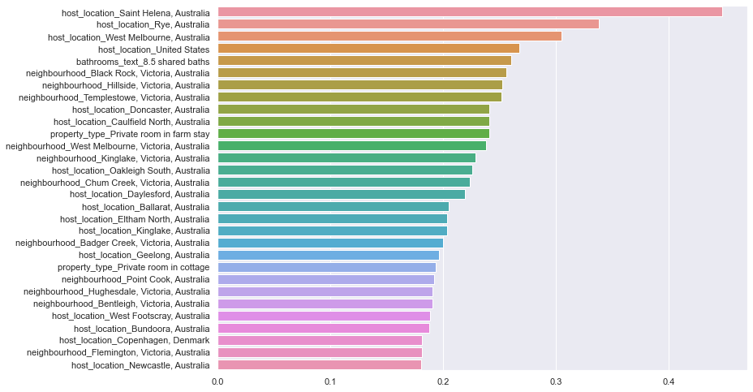

Slide 25
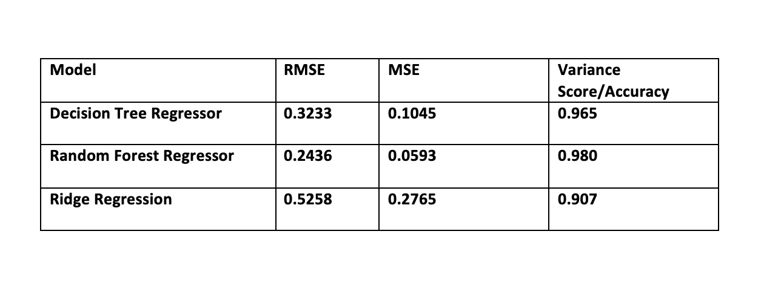
Comparison between Models

Slide 26
Conclusion
According to the above analysis, we can successfully conclude that the Random Forest Regressor worked the best and gave a variance score of 0.98 whereas the Ridge Regression model gave a variance score of 0.90. Hence the values predicted by Random Forest Regressor gave us close to accurate results. It is because the random forest uses many different sample in decision trees and that results in low variance.
It can be concluded that the predicted value of availability of Airbnb is closed to actual value.

Slide 27
Bibliography
Inside Airbnb adding data to the debate, http://insideairbnb.com/get-the-data.html
Towards Data, https://towardsdatascience.com/step-by-step-guide-building-a-prediction-model-in-python-ac441e8b9e8b
Scikit learn, https://scikit-learn.org/stable/modules/generated/sklearn.linear_model.LogisticRegression.html

