Slide 1
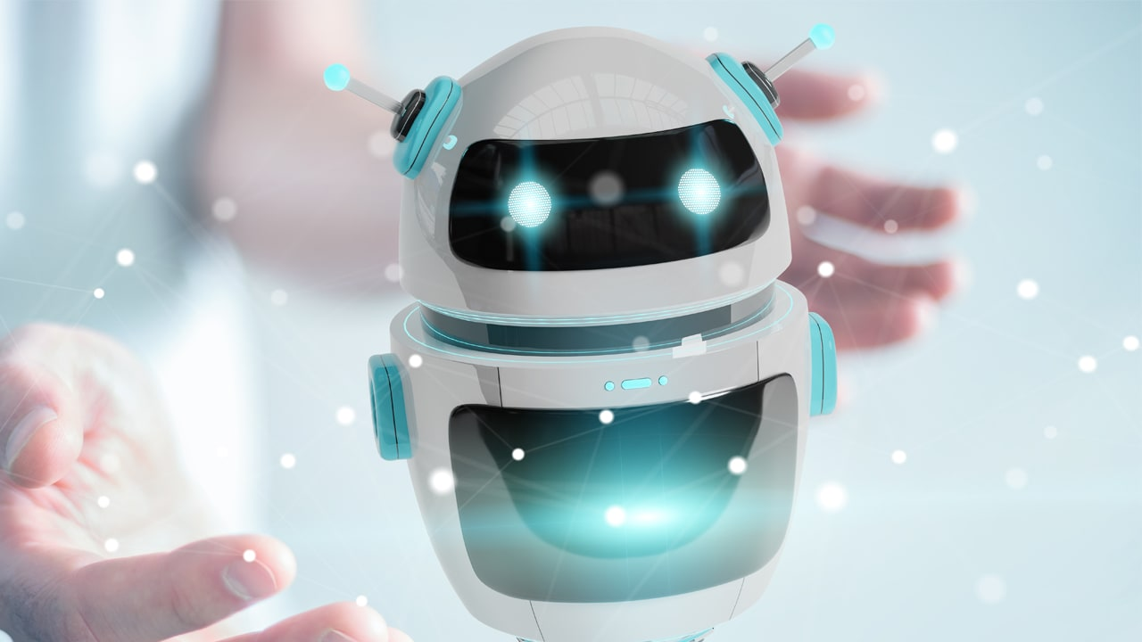
MSc Project
RecipeWhiz: A chatbot that recommends recipe based on available ingredients
Student Name – Kavish Chohan (kmc44)
1st Marker – Furqan Aziz (fa311)
2nd Marker – Paul Holmes (ph222)
This Photo by Unknown Author is licensed under CC BY-SA-NC

Slide 2

Motivation and Aim
Motivation
Problem of what to do with ingredients available.
Having multiple choice on which recipe to choose from.
Aim
Develop a chatbot that suggests recipes based on ingredients from a dataset having 0.5M+ dishes.
Having cost benefits due to reduction in food waste.

Slide 3

Phases of project
Project is divided in 3 key stages:
Dataset exploration & cleaning
Use of NLP & Model building
Integration of develop model with web application

Slide 4
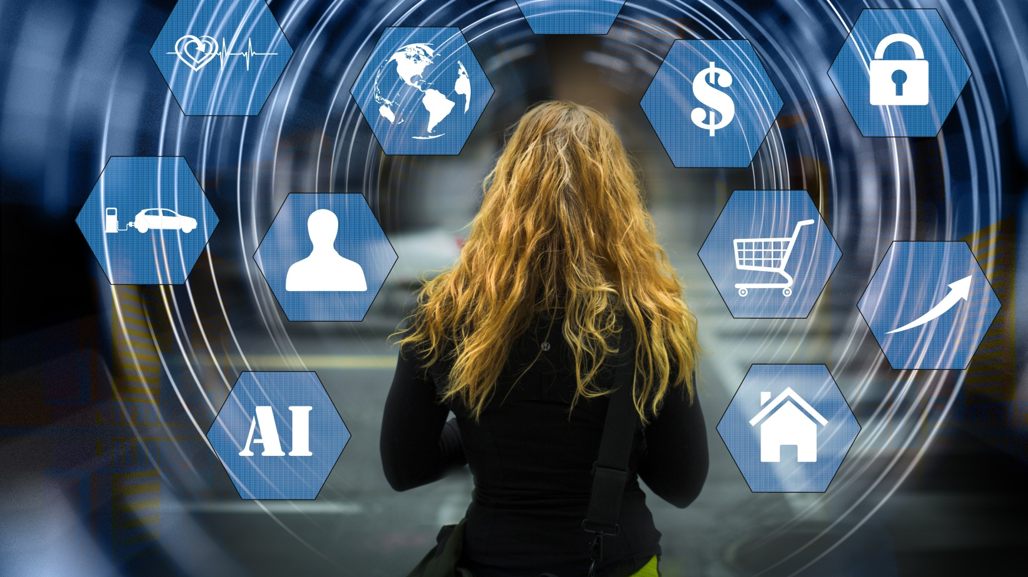
Technical specifications
Technologies involved:
Dataset | https://www.kaggle.com/datasets/irkaal/foodcom-recipes-and-reviews?resource=download
Programming Languages | Python HTML5 CSS3
Framework | Flask
Operating System | Windows 10 or later
IDE | Anaconda
Chat Agent | Eliza

Slide 5

Challenges involved
Key challenges involved in project:
Data collection & cleaning
Natural language processing
Model building & evaluation
Integration with flask

Slide 6
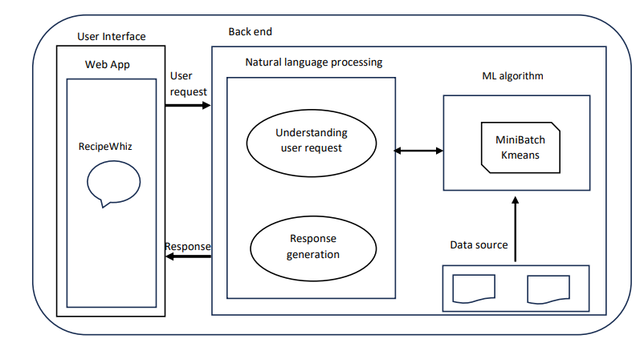
Architecture
Components:
Front End
Web app
Chatbot
Back end
Data source
NLP
ML Algorithm

Slide 7
IMPLEMENTATION
Implementation of chatbot is divided in 4 files namely:
data_clean.py : Consist of data cleaning operations on recipe.csv dataset.
classification.py : Consist of classification ml model (Logistic Regression).
clustering.py : Consist of clustering ml model (MiniBatchKMeans)
app.py : Consist of logic to embed chat agent, understand user input and provide response.

Slide 8
Future scope
Embedding AI to make an improved intent and responses.
Substitution suggestions for unavailable ingredients.
Adding accessibility features.
Enhanced model response rate with cloud deployment.

Slide 9
CONCLUSION
Objectives of the project including data cleaning, model training, recipe prediction, chatbot integration were achieved.
Comparison between two models was done.
Various NLP techniques like tokenization, vectorization and stopwords removal.
Learnings were achieved which includes using data cleaning techniques, model training, chatbot, using flask framework, chatbot development.
Enhancement to include more features, flexibility and security to make the chatbot more user centric were discussed.

Slide 10

Questions and Suggestions?

Slide 11

Time for demo

