Slide 1
Genesis Ideathon: Final Presentation
Team ID: GEN26-AOH-I011
Team Name: HACK ORBIT
Domain: Digital Technologies, AI & Cyber Security
Amrita Vishwa Vidyapeetham, Coimbatore Campus
Date: 11th October 2026

Slide 2
Presentation Outline
1
Problem Statement
7
Feasibility & Scalability
2
Problem Understanding
8
Cost for Product
3
Existing Gaps & Challenges
9
Use Cases
4
Our Proposed Solution
10
Impacts and Benefits
5
Technical Approach
11
Sustainable Development Goals
6
Innovation & Uniqueness
12
Individual Member Contribution

Slide 3
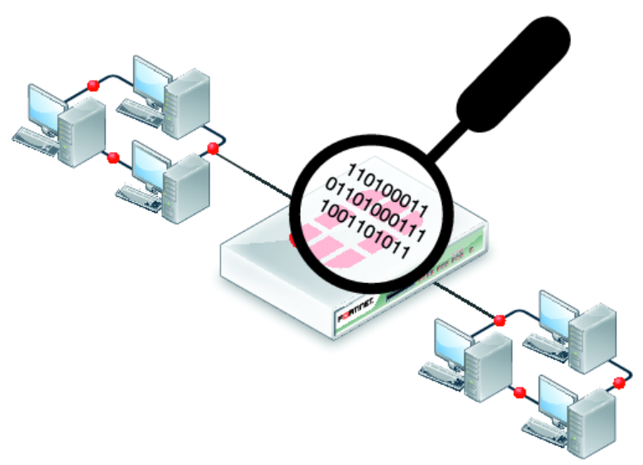
Problem Statement
Basic Network Packet Sniffer & Analyzer
Everything we do online is chopped into tiny packets. Today it is hard for beginners to see them. We want a free tool that catches those packets and shows who is talking to whom, in plain English – like a CCTV camera for your Wi-Fi.

Slide 4
Problem Understanding
Who experiences this problem?
Network admins, security analysts, students and developers – and also ISPs, teachers and anyone whose video call has ever frozen.
What causes the problem?
Packets are a wall of numbers. Most tools are made for experts and show raw data, not simple answers, and capture, analysis and charts live in separate tools.
How does it affect them?
Fixes take longer,
attacks slip by unnoticed,
bandwidth gets wasted and learners never see how networks really work.

Slide 5



Existing Gaps & Challenges
Wireshark
Powerful, but scary for beginners
Powerful tools are too complex: Wireshark throws hundreds of fields at a beginner, tcpdump is just text with no charts, and Snort / Suricata take real expertise to set up.
Simple or paid options fall short: ping / traceroute say something is wrong, not why. SolarWinds and PRTG are great but pricey and built for big firms.
Main challenge that remains unsolved: nobody offers a free, beginner-friendly tool that captures, explains, charts and warns, all in one place.
Snort / Suricata
Takes real expertise to set up
SolarWinds, PRTG
Great, but pricey and built for big firms

Slide 6
Technical Approach
Your devices
Capture engine
Analysis
Dashboard
Wi-Fi / Ethernet traffic on a small test network
Python + Scapy with Npcap / libpcap
TCP, UDP, ICMP, DNS filters; summaries; alert rules
Charts, alerts, export to CSV and PCAP
Packets are captured live, analysed and filtered, then shown on one dashboard with alerts and exports.
Tech Stack
Frontend: Dashboard with charts (Matplotlib)
Database: Pandas for analysis; CSV / PCAP export
Backend: Python + Scapy packet capture
AI/ML, APIs, or Hardware: Laptop (8 GB RAM), Npcap / libpcap

Slide 7
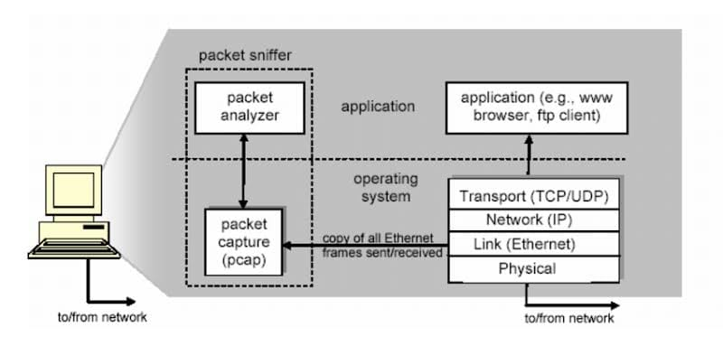
Our Proposed Solution
Core idea: a network packet sniffer and analyzer that catches live traffic and shows it on a clean dashboard – who, where, which protocol, how big.
How it works: live capture, then filters for TCP, UDP, ICMP and DNS, then summaries and charts, plus friendly alerts when it spots port scans or traffic spikes.
Main value to users: beginners can actually read their traffic, slow or broken networks get fixed faster, and results export to CSV and PCAP.

Slide 8
Innovation & Uniqueness
What is new or different? one tool that captures, explains, charts and warns, instead of juggling several separate tools.
Why is it suited to the problem? it shows traffic as simple answers, not raw data, so beginners, students and small teams can use it on a regular laptop.
Key differentiator: free and beginner-friendly, with built-in alerts for port scans and spikes – easy to use after one demo.

Slide 9
Feasibility & Scalability
Feasibility: a regular laptop with 8 GB RAM, free tools (Python, Scapy, Npcap / libpcap, Pandas, Matplotlib), a team of four and a faculty mentor. Wireshark is used to double-check our results.
Scalability: start on a small test network and a second device, then grow by adding more protocol filters and alert rules.
Risks: we capture only on networks we are allowed to monitor, and use sample packet files for demos.

Slide 10
Cost for Product (Optional)
Development or hardware cost: free software (Python, Scapy, Npcap / libpcap, Pandas, Matplotlib) on a laptop the team already has.
Hosting or maintenance cost: none expected – the tool runs on a local laptop.
Estimated total: minimal – no expensive software needed.

Slide 11
Use Cases
Use case 1: Network admin. Wi-Fi acts up – the admin sees which device and app is eating the bandwidth and fixes it quickly.
Use case 2: Security analyst. Port scans and traffic spikes are flagged by friendly alerts, so suspicious activity is caught early.
Use case 3: Student or teacher. Watch a network work live in the lab, with protocol charts and sample packet files, instead of just reading about it.

Slide 12
Impacts and Benefits
Benefit to target users: anyone can read their network traffic; problems get fixed faster and threats get caught earlier.
Social and economic impact: no expensive software needed, and learners pick up real networking and security skills.
Expected measurable outcome: filters and charts work, alerts fire, data exports to CSV and PCAP, and it beats doing it by hand.

Slide 13
Sustainable Development Goals (SDGs)
SDG Number | Target Number | Goal Name | Connection
SDG 4 | Target 4.4 | Quality Education | Students learn networking and security by seeing live traffic, building practical technical skills.
SDG 9 | Target 9.1 | Industry, Innovation and Infrastructure | Helps keep networks reliable and secure by catching slowdowns and threats early.

Slide 14
Individual Member Contribution
Member | Contribution or responsibility
Kavish Rahav D P | Team Lead & Backend Developer Builds the engine that catches packets and ties everything together
Karthikeyan K | Network & Security Analyst Works out what the traffic means and sets the alert rules
Ratchitha Kathiravan Vedhavalli | Frontend / UI Developer Designs the dashboard you actually see and use
Jeyanthan S | Tester & Documentation Lead Tests everything, checks it against Wireshark, writes it all up

Slide 15
Yukti ID
Yukti ID
[Enter Yukti ID]

