Slide 1
Foundations of Set Theory for Probability
U.B.E. Sasanka
Department of Agribusiness Management
1

Slide 2
ILO’s
To recap the basic concepts of set theory
To understand the importance of learning the concepts of set theory for applying in probability theory

Slide 3
Basic Definitions
Set - Collection of objects, usually denoted by capital letter
Member, element - Object in a set, usually denoted by lower case letter
Set Membership - a ∈ A denotes that a is an element of set A
Cardinality of a set - Number of elements in a set, denoted |S|

Slide 4
Basic definitions cont.
a∈A “a is an element of A”
“a is a member of A”
a∉A “a is not an element of A”
A = {a₁, a₂, …, a_{n}} “A contains…”
Order of elements is meaningless
It does not matter how often the same element is listed
We can usually denote a set S in writing by listing all of its elements in curly brackets:
  {a, b, c} is the set of whatever 3 objects are denoted by a, b, c.

Slide 5
Special/Standard Sets
N - set of natural numbers = {0,1,2,3,4, …}
P or Z+ - set of positive integers = {1,2,3,4, …}
Z - set of all integers, positive, negative and zero
R - set of all real numbers
Ø or {} - empty set
U - Universal set, set containing all elements under consideration

Slide 6
Set Builder Notation
Format: “such that”
{[element structure] | [necessary properties to be members]}
Examples:
Q = {m/n | m,n ∈ Z, n≠0}
  Q is set of all rational numbers
  Elements have structure m/n; must satisfy properties after the | to be set members.
{x ∈ R | x² = 1}
  {-1,1}

Slide 7
Set Equality
Sets A and B are equal if and only if they contain exactly the same elements.
Examples:
A = {9, 2, 7, -3}, B = {7, 9, -3, 2} :
A = B
A = {dog, cat, horse},
B = {cat, horse, squirrel, dog} :
A ≠ B
A = {dog, cat, horse},
B = {cat, horse, dog, dog} :
A = B

Slide 8
Subsets
A ⊆ B “A is a subset of B”
Examples:
A = {3, 9}, B = {5, 9, 1, 3}, A  B ?
true
A = {3, 3, 3, 9}, B = {5, 9, 1, 3}, A  B ?
true
A = {1, 2, 3}, B = {2, 3, 4}, A  B ?
false
What are super sets? Give 3 examples.
What are disjoint sets? Give 3 examples.

Slide 9
Subsets
Useful rules:
A = B ⇔ (A ⊆ B) ∧ (B ⊆ A)
(A ⊆ B) ∧ (B ⊆ C) ⇒ A ⊆ C (see Venn Diagram)
U
B
A
C

Slide 10
Cardinality of Sets
If a set S contains n distinct elements, n∈N,
we call S a finite set with cardinality n.
Examples:
A = {Mercedes, BMW, Porsche}, |A| = 3
B = {1, {2, 3}, {4, 5}, 6}
|B| = 4
C = 
|C| = 0
D = { xN | x  7000 }
|D| = 7001
E = { xN | x  7000 }
E is infinite!

Slide 11
Set Operations
Union: A∪B = {x | x∈A ∨ x∈B}
Example: A = {a, b}, B = {b, c, d}
A∪B = {a, b, c, d}
Intersection: A∩B = {x | x∈A ∧ x∈B}
Example: A = {a, b}, B = {b, c, d}
A∩B = {b}

Slide 12
Set Operations
Two sets are called disjoint if their intersection is empty, that is, they share no elements:
A∩B = ∅
The difference between two sets A and B contains exactly those elements of A that are not in B:
A-B = {x | x∈A ∧ x∉B}
Example: A = {a, b}, B = {b, c, d}, A-B = {a}

Slide 13
Set Operations
The complement of a set A contains exactly those elements under consideration that are not in A:
A^{c} or A/ = U-A
Example: U = N, B = {250, 251, 252, …}
B^{c} = {0, 1, 2, …, 248, 249}
What is power set operation? Give 1 example.

Slide 14
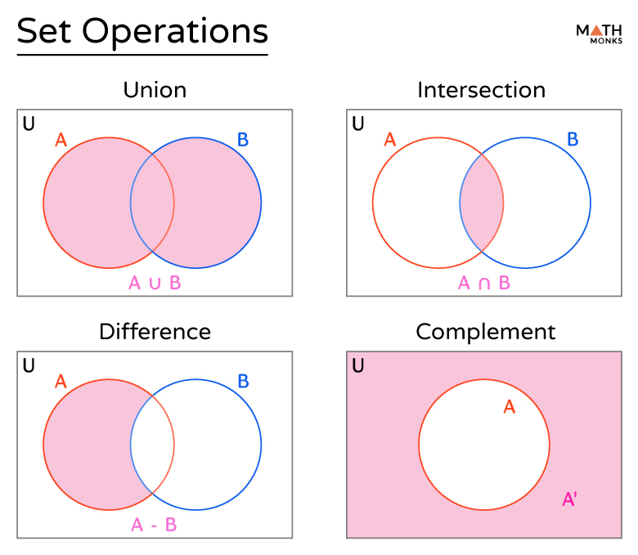
Set operations

Slide 15
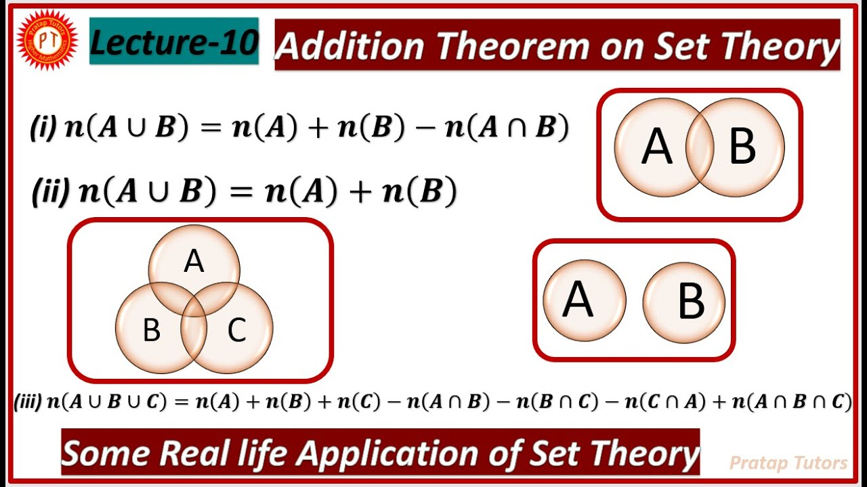
Addition theorem in set theory

Slide 16
Role of Set Theory in Probability
Probability theory is built on the language of set theory.
Sample space (Ω) represented as a set of all possible outcomes.
Events are subsets of the sample space.
Venn diagrams used to visualize relationships among events
Set operations (union, intersection, complement) describe event combinations
Provides a structured foundation for probability rules

Slide 17
Applications of Set Theory in Probability
Union (A ∪ B): Probability of A or B occurring → P(A∪B)=P(A)+P(B)−P(A∩B)
Intersection (A ∩ B): Probability of A and B occurring together
Complement (Aᶜ): Probability that event A does not occur → P(A^{c})=1−P(A)
Disjoint Sets: Events that cannot occur together → P(A∩B)=0
Mutually Exclusive Events: Special case of disjoint sets in probability
Partition of Sample Space: Breaking sample space into disjoint subsets for easier calculations
Basis for conditional probability and independence

Slide 18
Homework
Refresh your memory regarding permutations and combinations under different conditions.

Slide 19
Thank You

