Slide 1


GRRAS SOLUTIONS PVT. LTD.
A
Power Point Presentation
Submitted in complete fulfillment of the requirements for the Training
Of
IIIrd Year
Bachelor of Technology
In
Computer Science and Engineering
To
Department of Computer Science
TECHNO INDIA NJR INSTITUTE OF TECHNOLOGY
UDAIPUR (313001), RAJASTHAN
(Affiliated to Rajasthan Technical University [RTU], Kota)

Slide 2
Summer Training
May-June,2020
Project Title-
“Exam Book”
(Online Examination System)
Under the guidance of:
Mr. Sanjay Rathore

Slide 3
TABLE OF CONTENTS
TOPIC NAME | SLIDE NO.
Team Members | 4
Introduction | 5
Aim and Objectives | 6
Scope and purpose | 7
Brief Description | 8
Users of the system | 9-10
Technology used | 11
Procedure | 12
Functionality | 13-14
Advantages | 15
E-R Diagram | 16
Use case diagram | 17
Snapshots | 18-22
Conclusion | 23

Slide 4
TEAM MEMBERS
1) Anam Quazi
(Student IIIrd Year B.Tech Computer Science Engineering)
2) Kavish Lodha
(Student IIIrd Year B.Tech Computer Science Engineering)
3) Nupur Thakur
(Student IIIrd Year B.Tech Computer Science Engineering)

Slide 5
INTRODUCTION
This project is a real world application of all the skills
and knowledge that we have acquired from our
internship in MEAN stack development.
Since we all are amidst a global pandemic, it is our
duty, as students, to help other students stay connected
with their learning and this was the main motive
behind taking an online examination system as our
project.
Exam Book is a web application, which allows a
particular user or institute to create and conduct
examinations as well as join examinations via an online
environment. This can be done through the internet,
intranet and/or local area network environments.

Slide 6
AIM AND OBJECTIVES
Online examination will reduce the hectic job of
assessing the answers given by the candidate
manually.
Being an integrated online examination system, it
will reduce paper work.
It will allow the faculty to give additional time to
students with disabilities.
It will allow faculty to create tests and answer key.
The result will be shown immediately to the
participating students.
The web application can serve as an online
exam conducting platform for teachers, educational
institutions and organizations.

Slide 7
SCOPE AND PURPOSE
The online examination system can be used in
educational institutions as well as corporate world.
It can be used anywhere, anytime as it is a web based
application.
No restriction that examiner has to be present when the
candidate takes the test.
Designed to facilitate the administrator and the user.
Online Examination is designed for educational
institutes like schools, colleges and private institutes to
conduct logic tests of their students or employees on
regular basis.

Slide 8
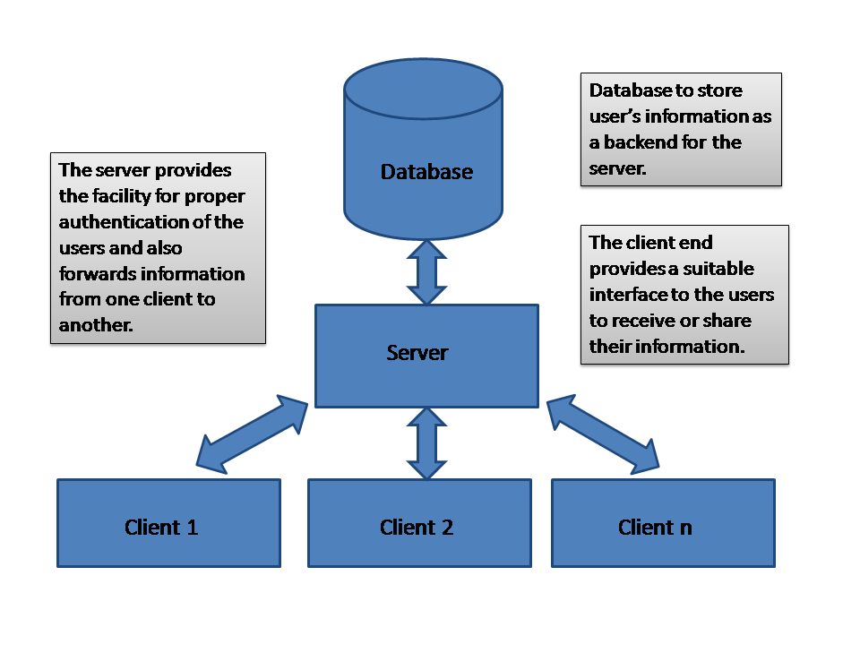
BRIEF DISCRIPTION
Basic Block Diagram

Slide 9
USERS OF THE SYSTEM
Administrators
Sign up
Login
Password
Taking backup of the database.
Add, view or delete exam details.
Edit or create the database.
Students
Sign up
Login
Password
Join exam
Exam Id
Exam password

Slide 10
Teachers
Sign up
Login
Password
Create exam
Exam Id
Exam name
Exam password
Exam time
Exam date
Exam duration
Educational Institutions and organizations
Sign up
Login
Create exam
Join exam

Slide 11
TECHNOLOGIES USED
FRONT END –
BACK END -
HTML 5
CSS 3
Bootstrap 4
JavaScript 1.8.5
jQuery 3.5.1
TypeScript 3.9.5
AngularJS 1.7.x
Node.js 14.4.0
JavaScript 1.8.
TypeScript3.9.5
FRAMEWORKS –
Angular 9
Express.js 4.17.1
TOOLS –
Visual Studio Code 1.4.6
DATABASE –
MongoDB 4.2.8

Slide 12
PROCEDURE
Examination process –
Login to the online examination system.
Create exam
Join exam
Submit
Result
The form of questions in test page –
Multiple choice questions
Four options
Only one correct answer

Slide 13
FUNCTIONALITY
STUDENT -
Requesting registration.
Logging into the system.
Edit user information.
Selecting the test.
Appearing for the examination.
Reviewing the given responses.
Access to the scores received.

Slide 14
ADMINISTRATOR -
Taking backup of the database.
Editing/ Deleting/ Creating the database.
Changing the password.
Logging into the system.
Accepting registrations of candidates.
Creating an exam.
Posting questions in the above test.
Marking correct answer within the given options.
Time limit of the exam if any.
Date and time of the exam.
Whether to randomize the questions.

Slide 15
ADVANTAGES
Physical presence at a given location is absolutely not
necessary.
No time is spent on evaluation.
Results are available instantly.
Exams can be easily accessed 24/7 over the open test
period.
Exams can be timed to allow Y minutes to answer X
number of questions.
Easy Accessibility
Available free of cost
Accuracy in checking the answer, calculating result.
User friendly
Secure because of authentication.
Online Exams – convenience, security and flexibility.

Slide 16
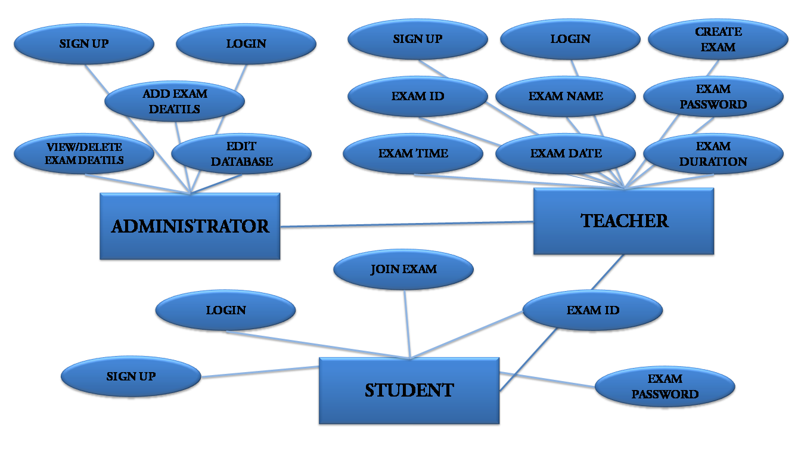
E-R DIAGRAM

Slide 17
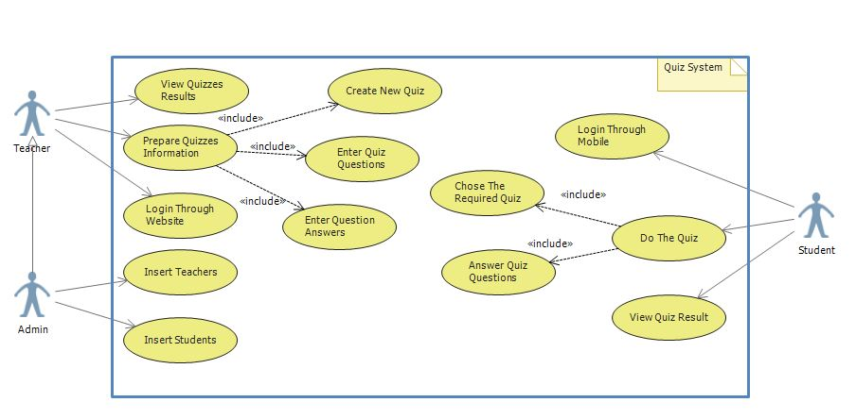
USE CASE DIAGRAM

Slide 18
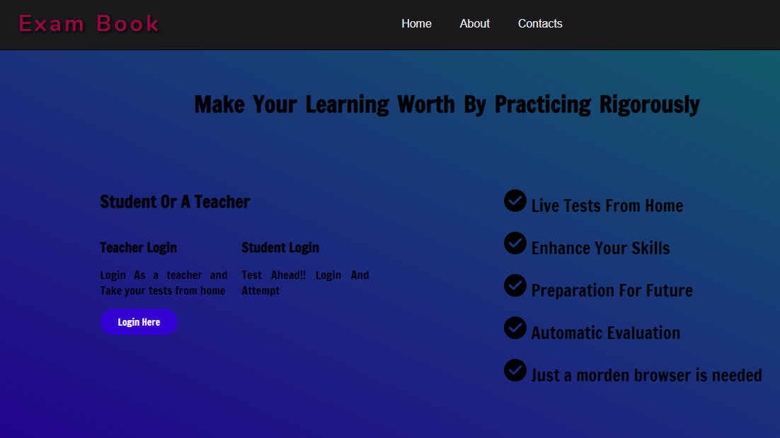
SNAPSHOTS
HOME PAGE -

Slide 19
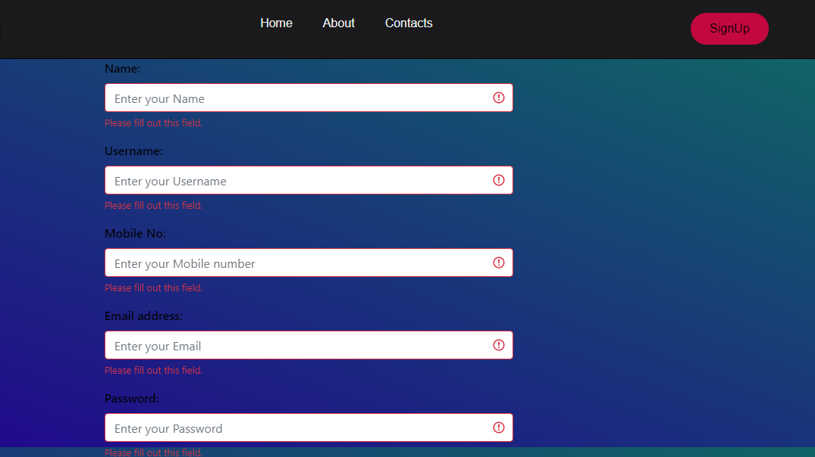
SIGN UP PAGE

Slide 20
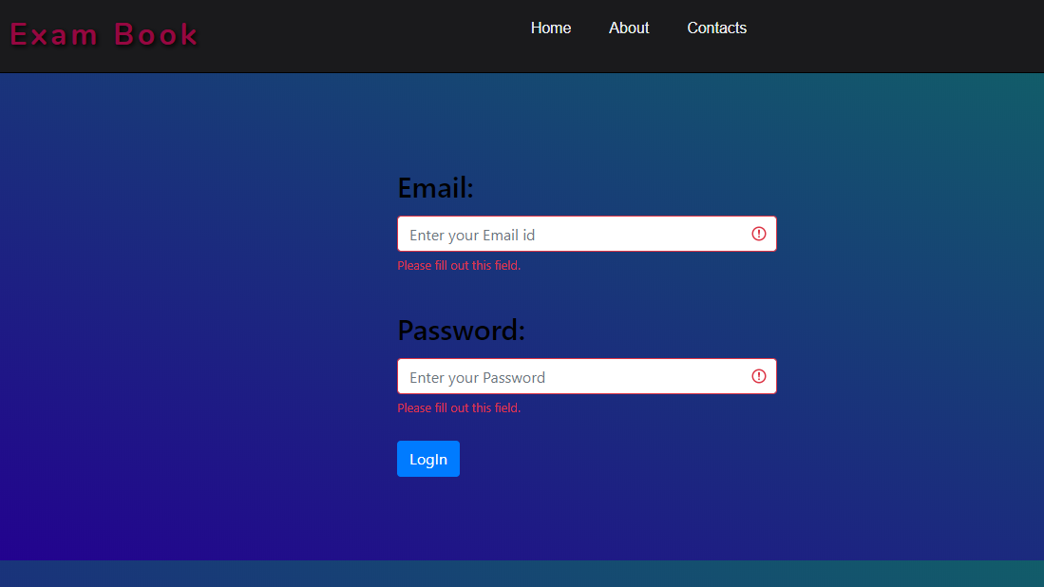
LOGIN PAGE

Slide 21
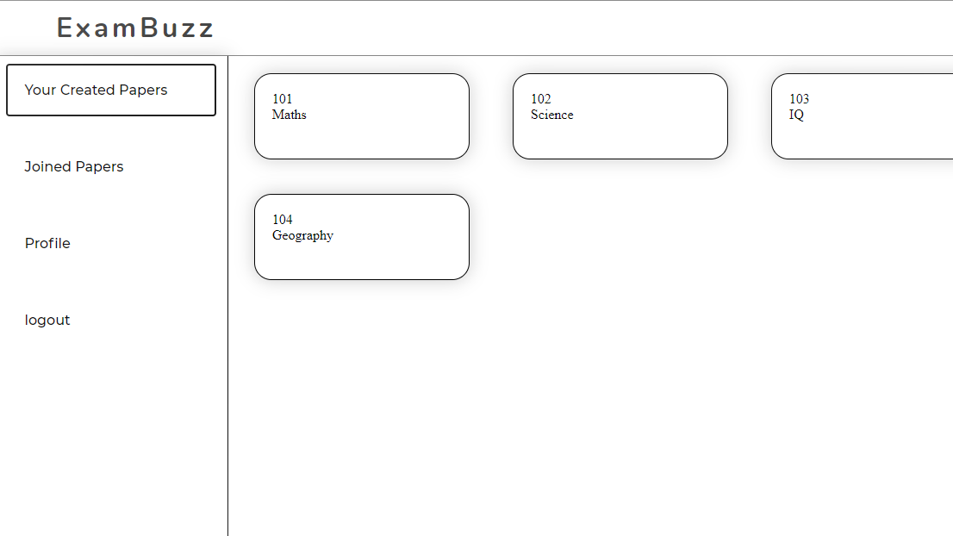

Slide 22
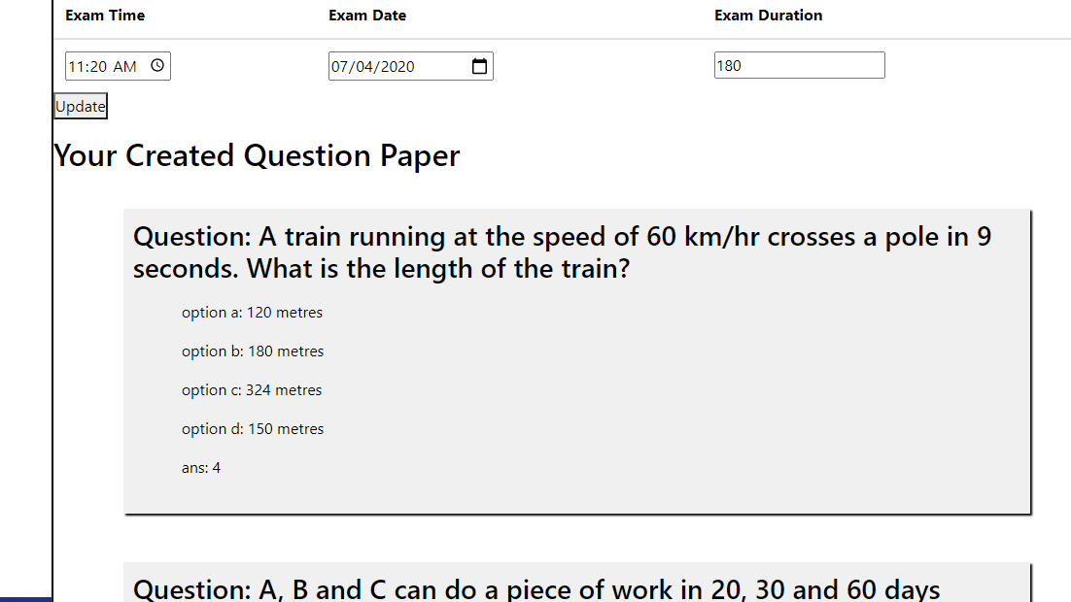
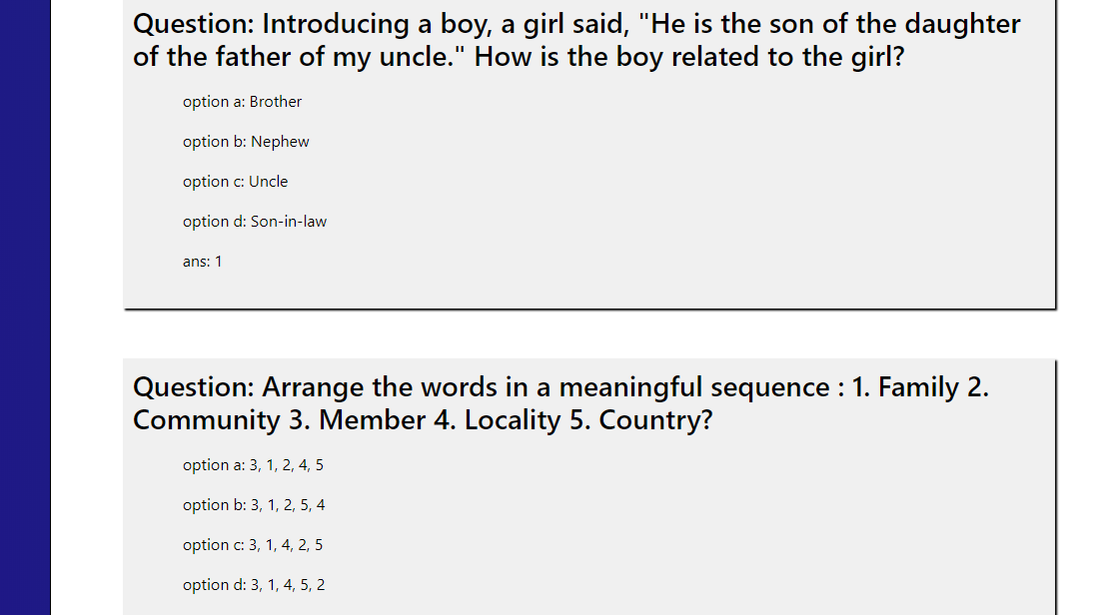

Slide 23
CONCLUSION
Exam Book is a web application. The key concept is to minimize the amount of paper and convert all types of documentation to digital form. This web application can help students, test their level of IQ and knowledge through joining exams in various subjects created by teachers and educational institutions. It is a helpful resource at the time of this pandemic. It can be observed that the information required can be obtained with ease and accuracy in the computerized system. The user with minimum knowledge about computer can be able to operate the system easily. The system also produces brief result required by the management.

Slide 24
THANK
YOU!

