Slide 1
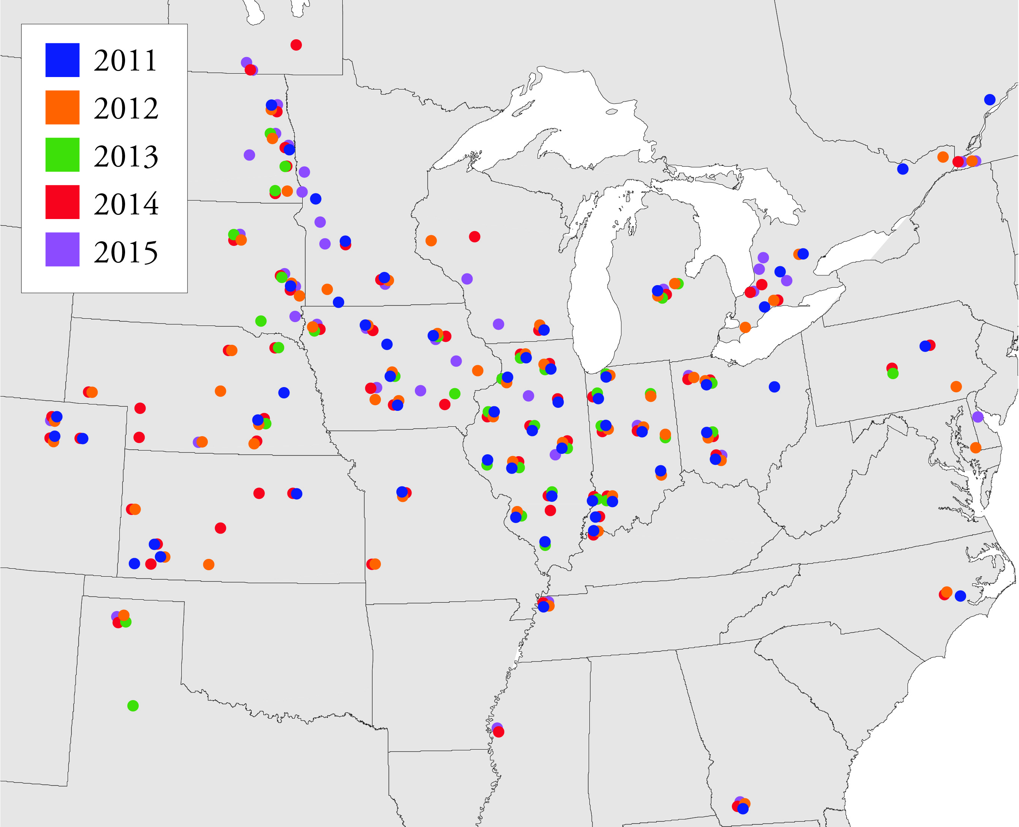
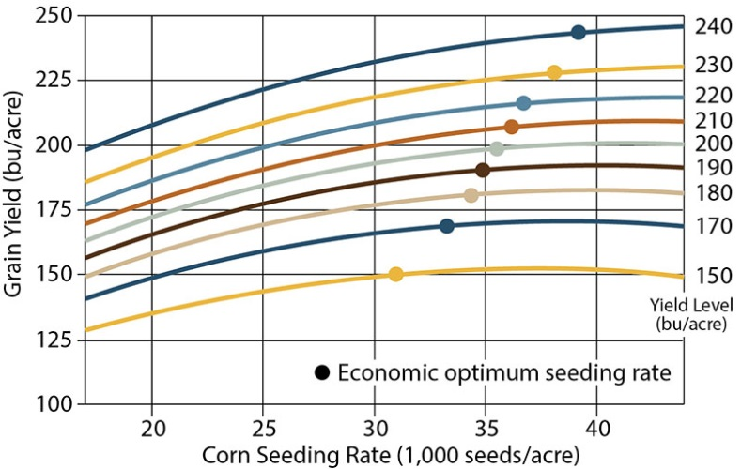
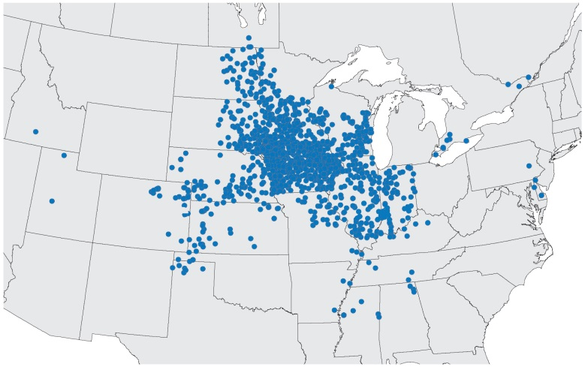
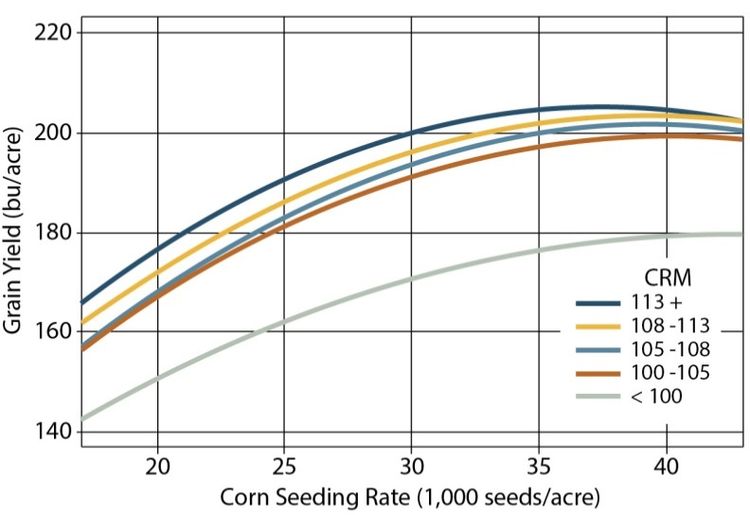
Corn Plant Population Research
DuPont Pioneer Research
Optimum Seeding Rate by Yield Level
Like previous Pioneer studies, the 2009 to 2015 trials across the U.S. and Canada show that corn hybrid response to plant population varies by yield level (Figure 3).
The seeding rate required to maximize yield increases as yield level increases.
The economic optimum seeding rate varies from about 31,000 seeds/acre for locations yielding 150 bu/acre to over 39,000 seeds/acre for yields of 240 bu/acre.
DuPont Pioneer has been conducting plant population studies with corn hybrids for over three decades.
Pioneer has conducted plant population research at over 260 locat-ions throughout the U.S. and Canada in the last 5 years (Figure 1).
Figure 1. DuPont Pioneer plant population test locations in North America, 2011-2015.
Figure 3. Corn yield response to population and optimum economic seeding rate by location yield level, 2009-2015.
Averaged across all hybrids tested. Economic optimums based on a corn rain price of $4.00/bu and a seed cost of $3.00 per 1,000 seeds; assumes % overplant to achieve target population.
DuPont Pioneer researchers target representative environments based on maturity zone, expected yield (high or low), specific stresses, and other unique location characteristics. Research trials are all conducted in 30-inch rows.
Additionally, hundreds of on-farm Pioneer® GrowingPoint® agronomy seeding rate trials are conducted each year comparing multiple corn products at up to four seeding rates at each location (Figure 2).
Optimum Seeding Rate by Hybrid Maturity
Previous research has shown that early maturity hybrids (<100 CRM) may require higher populations to maximize yield. Although this trend can still be detected when examining the response curves closely, it is a smaller difference than in the past (Figure 4).
Figure 2. Pioneer GrowingPoint agronomy on-farm seeding rate trials at 1378 locations in North America in 2015.
Growers can use the multi-year and multi-location results to identify the best potential planting rates specific to their hybrid, location, and management practices.
Figure 4. Yield response to plant population for corn hybrids from five maturity (CRM) ranges, 2009 to 2015. Averaged across all hybrids tested.
DuPont Pioneer Agronomy Sciences
®, ™, SM Trademarks and service marks of DuPont, Pioneer or their respective owners. © 2015, PHII
Pioneer® brand products are provided subject to the terms and conditions of purchase which are part of the labeling and purchase documents.

Slide 2
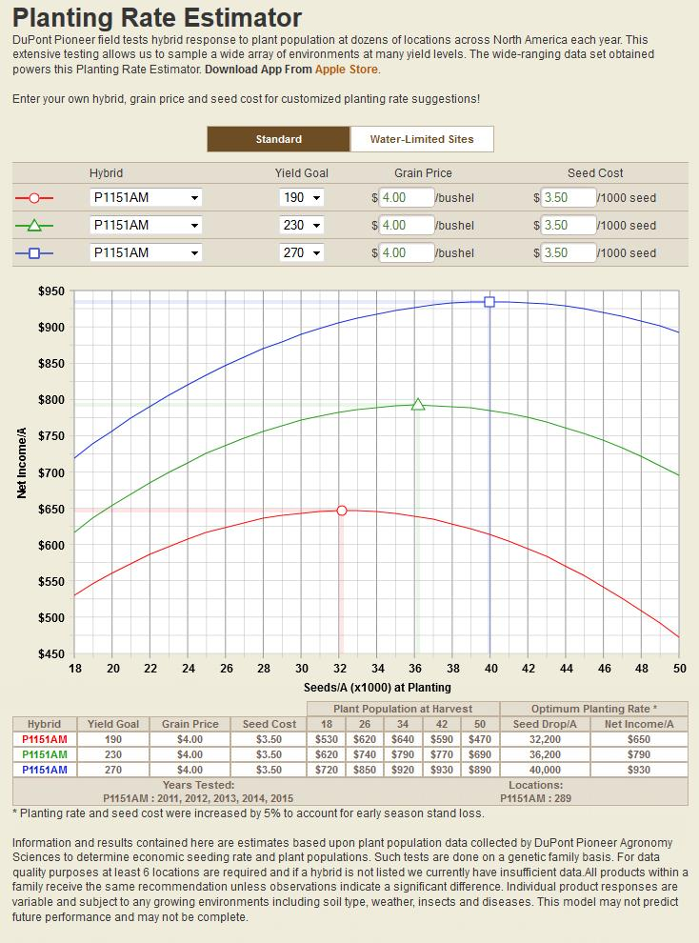
Planting Rate Estimator
Now it is possible to display plant population response curves at 10 bu/acre increments for all yield levels where there was a statistically significant response based on the available research data.
The yield levels available for display will vary among hybrids based on the available research data.
The 2016 Planting Rate Estimator features greater flexibility in customizing the graph display.
Previously, users could select corn grain price and seed cost to determine economic optimum seeding rates at different yield levels for a given hybrid.
Users can now display up to three response curves based on any combination of hybrids, yield levels, grain prices, and seed costs.
Users now have the option of selecting a “Water-Limited Sites” version of the planting rate estimator, which includes data from studies conducted in drought environments in the western U.S.
The DuPont Pioneer Planting Rate Estimator, available on www.pioneer.com and as a free mobile app, allows users to generate estimated optimum seeding rates for Pioneer® brand corn products based on data from Pioneer research and Pioneer® GrowingPoint® agronomy trials.
Enhanced Features for 2016
The 2016 version of the Planting Rate Estimator has several improvements compared to previous versions.
The most significant improvement is the ability to display population response curves for a greater range of yield levels, which provides greater utility for creating variable rate seeding prescriptions.
Previously, the Planting Rate Estimator displayed plant population responses for up to 3 yield levels: greater than 200 bu/acre, between 150 and 200 bu/acre, and less than 150 bu/acre.
View plant population responses from either standard or water-limited research sites.
Select and compare plant population responses based on hybrid, yield level, corn grain price, and seed cost.
Graph shows up to three plant population response curves with economic optimum seeding rates based on the criteria selected above. Results are displayed as net income/acre.
Tabular display of net income/acre at several seeding rates based on the criteria selected above and economic optimum seeding rates. Years of testing and number of testing locations for selected hybrid(s) shown below.
Growers should use the Planting Rate Estimator as an initial guide and work with your Pioneer sales professional for refinements based on local observations and on-farm trials.
Authors: Mark Jeschke and Gaurav Bhalla
The foregoing is provided for informational use only. Please contact your Pioneer sales professional for information and suggestions specific to your operation. Product performance is variable and depends on many factors such as moisture and heat stress, soil type, management practices and environmental stress as well as disease and pest pressures. Individual results may vary.

