Slide 1
Introduction to Web Analytics
Web analytics is the measurement, collection, analysis and reporting of internet data for purposes of understanding and optimizing web usage.
Web Analytics

Slide 2
What is web analytics?
What type of data can be collected from web site visits?
How can this data be collected?
What are the potential problems with collecting data?
What analysis can be done on this data?
Web Analytics

Slide 3
What information do you want about how your website is being used?
What data can you collect from your website?
How can you analyse the data?
Can this give you the information you want?
Web Analytics

Slide 4
Blurb........
........”Google Analytics is the enterprise-class web analytics solution that gives you rich insights into your website traffic and marketing effectiveness. [..]you [can]see and analyze your traffic data in an entirely new way. With Google Analytics, you're more prepared to write better-targeted ads, strengthen your marketing initiatives and create higher converting websites. ....
Web Analytics

Slide 5
Aim
improve online results, whatever they are...
Web Analytics

Slide 6
What kind of information can you find out?
How people find your site :
  What search engine do they use?
  What search terms do they use?
  What sites refer visitors to my site?
How people navigate your site
  What content are they most interested in?
  Where do people drop out of the site?
Web Analytics

Slide 7
What kind of information can you find out?
How people become customers
What part of my web site is most effective at generating sales?
What are the conversion rates (number of sales) based on traffic from different sites?
Where are the customers located?
Web Analytics

Slide 8
Metrics for Measuring web performance
Metrics:
  It is a good idea to identify metrics which you can track to access if your web site is working.
  Which metrics are suitable depends on the nature of the site:
    eCommerce, Social Networking
  Generally trends will be more interesting than absolute numbers.
Web Analytics

Slide 9
Examples of metrics
Conversion Rate:
  Did visitors do what you wanted them to do?
  Buy something, download a catalogue, join your mailing list, watch a video ?
Average order size (for e-commerce).
  Average time spent per visit for other types of site.
Abandonment Rate
  Number of shopping carts abandoned.
  Number of registrations not completed.
Content Rating by visitors.
Web Analytics

Slide 10
Exercise
What metrics do you think the college could uses for our college web site?
Web Analytics

Slide 11
Remember all of this is complex information.
Need to consider whether you can collect the data to generate this information.
Web Analytics

Slide 12
How is data collected?
Server logs
  Script Based Tracking
Web Analytics

Slide 13
Server logs
These are log files which contain a history of activity on a web server.
  Data saved generally includes:
    IP address of the client
    User name if logging on is necessary.
    Date and Time
    Page of file requested
    Number of bytes returned,
    Browser the client used
    URL of page which contains the link
    Any cookies.
    Any errors
Web Analytics

Slide 14
Problems with Server Logs
You want to be able to track at a user level.
  If they need to register and log on then great, if not you need to use IP addresses or cookies neither of which give an exact correspondence to individuals.
  Can also use cookies.
You don’t count views of pages which are cached.
  A cached page is a copy of a web page used to reduce traffic. Normally stored locally on your own machine or on an intermediate server.
  There is no activity on a web server when a cached page is viewed.
Requests from search engine bots can distort figures.
Web Analytics

Slide 15
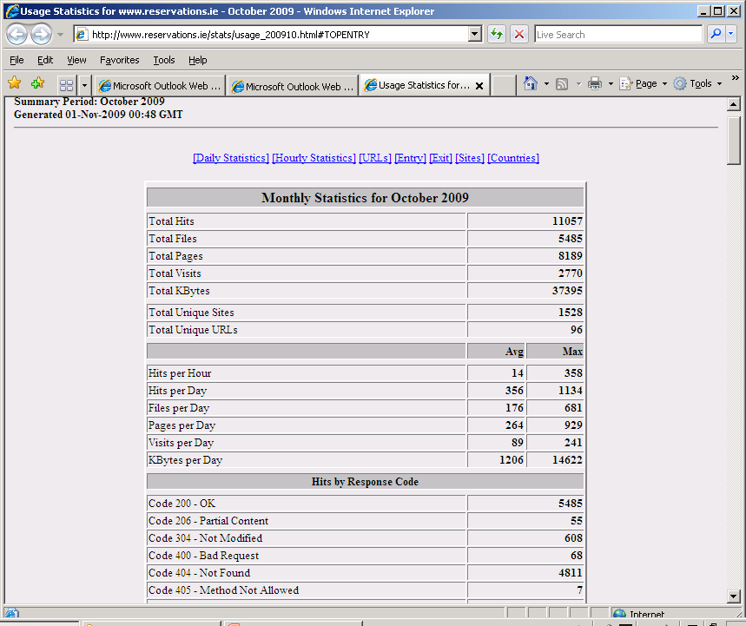
Web Analytics

Slide 16
Script Based Tracking
Some code (normally Java script) is added to each page.
This code can collect additional information and send it back to the server.
  for example: Information about the screen size, partial form completion.
The page tagging service manages the process of assigning cookies to visitors.
Page tagging can report on events which do not involve a request to the web server
  Eg. such as interactions within Flash movies or partial form completion
The technology is usually provided as part of a hosted solution and website owners can access real time reports online without needing any additional hardware or software in-house.
Web Analytics

Slide 17
Problems with Script Based Tracking
Some clients may disable cookies or JavaScript.
JavaScript needs to be added to every page you track.
With a hosted solution you are tied to the company you use.
  You may not have access to the raw data;
  You may not own your raw data.
Web Analytics

Slide 18
An Aside: Cookies
A cookie is a small piece of data which a web server can place on your computer.
It is returned without change to the web server.
Two types:
  Persistent:
    Last until some set expiry data (e.g. 6 months)
  Session
    Last until browser is shut or 30 minutes of inactivity (with that web server).
Cookies are tied to the computer and the browser. What does this mean on a college site?
Web Analytics

Slide 19
Measurement: Basic Units
Hits:
  A single request for any item on your web site.
  A single page load can result in many hits.
Page Hits or page views
  A request for a page.
  Unique page view: Number of visits during which a page was viewed.
Downloads
Bytes
  Useful for measuring bandwidth needed.
http://www.summary.net/manual/tutorial/lesson1-1.html
Web Analytics

Slide 20
More measurement
Visitors
  Great if they have to log on.
  If not use a visitor cookie.
  Like to separate new (no cookie) and repeat visitors.
Unique IP Address
  Problem because IP addresses are dynamic.
Session or Visit
  A series of consecutive accesses from a given user bounded by inactivity.
  A session ends when a user shuts their browser or is inactive for 30 minutes.
  Can use session cookies to track this.
Web Analytics

Slide 21
Measuring Time
Can compare time stamps to calculate how long visitors spent on:
  Your site
  A page
Web Analytics

Slide 22
Traffic Sources
Nice to know what is driving traffic to your site:
  Direct Traffic
    Comes from a bookmark or by typing a URL
  Referral Traffic
    Comes from links on other sites.
  Search Engine
    Comes from a search engine.
Web Analytics

Slide 23
Data Quality Problems
As with all BI may have problems with data quality.
Need to be aware of issues.
  Some users will not allow you to use cookies.
  Bots can distort the true figures of visitors.
  Cookies are tied to the computer and the browser so number of visitors based on cookies will be an overestimate.
  Users may delete cookies.
Web Analytics

Slide 24
Other Potential Problems
People may shut down browsers, or have more than one browser open.
If you have a repeat visitor who buys something which traffic source gets credit for the referral.
Web Analytics

Slide 25
Analysis
Need to get beyond basic statistics in order to understand the data.
May need to analyse data based on different dimensions.
  E.g. data accessed, geographic region, total spend, traffic type, browser used, new verus repeat visitors.
May use external data in order to interpret the data.
  E.g. Any external marketing campaigns.
Web Analytics

Slide 26
Analysis
If you have goals or metrics defined before analysis starts it is easier to get meaningful reports.
E.g.
  Define a “successful visit”, then you can analyse traffic sources to see which ones lead to successful visits.
Web Analytics

Slide 27
Some potential confusion
The hotel problem
  Unique visitors for each day in a month do not add up to the same total as the unique visitors for that month.
New Visitors + Repeat Visitors may not equal the total number of visitors.
Web Analytics

Slide 28
Reporting
If you use server log analysis then you can buy tools which will help.
With script based tracking the reporting tools are provided by the external company.
Can include: Custom reports, dashboards, score cards, graphing, heat maps, personalised emails
Web Analytics

Slide 29
Type of Information Visualised on Dashboards/Scorecards
larger trends
details in context
conversion rates in areas –”heat maps”– show value of areas to business
Which adwords drive traffic – informed keyword-buying decisions
search ad clicks, cost conversion rate, revenue per click, roi margin
Web Analytics

Slide 30
Website content optimisation
site overlay – click and conversion info – how do design and layout affect bottom line?
–effect on conversion of e.g. different entrance pages for visitors
design better pages and combine with correct keywords
optimisation of navigation : simplify checkout so visitors become customers (where do dropouts go?)
Web Analytics

Slide 31
Understanding
It helps if you know what you want to report on before you start the analysis.
E.g. what does conversion mean for you.
A funnel is a set of pages or steps you expect a visitor to follow on their way to a conversion;
  E.g. the check out process.
  Can get data on where users exit the funnel.
Web Analytics

Slide 32
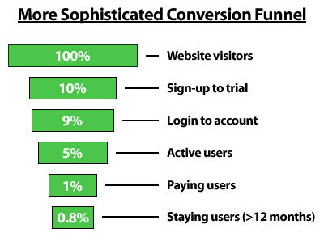
Funnel
Web Analytics

Slide 33
Optimisation
Optimisation is where you act on what you have learned.
  E.g. what key words give you the best ROI.
  Identify where users fall out of the funnel.
  Experiment:
    Offer different versions for pages to see which has the higher conversion.
Web Analytics

Slide 34
Case Study Questions
What type of site is each of the above?
What were the company’s goals in using Google Analytics?
What type of information did they get and how did they use it?
What type of data was analysed to provide the above information?
What actions were taken/ results were achieved?
Web Analytics

Slide 35
Case Study : Huffington Post
Online publisher
8 million unique users
fifth most popular news and commentary site on the Internet as measured by web links, (Technorati)
HuffPost features news, opinion, and links to various other news sources.
Web Analytics

Slide 36
What were the company’s goals in using Google Analytics?
GOAL/RESULT : “to keep existing viewers coming back for more and to increase our readership,"
Web Analytics

Slide 37
What type of information did they get?
Analysis : With filters, Berry can separate subsections of the site -- entertainment, politics, and business -- and track visitors to each section.
  Which pages and content draw and hold the most viewers.
  Traffic spikes for news items
  outbound clicks to show how much traffic the HuffPost generates for other sites
  Unique visitors and bounce rates
Web Analytics

Slide 38
....and how did they use it (actions)
To customize the site accordingly.
shape our feature stories or Quick Read columns
share any changes with everyone on staff to create more targeted, relevant content and attract more viewers
Web Analytics

Slide 39
What type of data was analysed to provide the above information?
DATA
site performance data – number of visitors
unique visitors
new visitors
returning visitors,
clicks on areas on a page
bounce rates
conversion rates
Web Analytics

Slide 40
Some further reading
A tutorial from a web analysis company which offers log file analyser software.
Google’s on-line tutorials on Google Analytics
Overview of web analytics
Example of the analysis of a web log file
Web Analytics

