Slide 1
CLIENT KNOWLEDGE TRANSFER
PostgreSQL 18
High-Availability Platform
Architecture, Ansible deployment, testing and operations
UAT and Production
Bayshore PostgreSQL HA Project | 24 August 2026
Notes:
[Sources]
- ansible-pg-ha/POSTGRESQL_HA_KNOWLEDGE_TRANSFER_GUIDE.docx
[/Sources]

Slide 2
KNOWLEDGE TRANSFER
What this session enables
By the end, the client team can explain, deploy, test and operate the platform safely.
01
Understand the platform
Application path, database roles, routing failover and backup ownership
02
Navigate the repository
Inventories, variables, playbooks, roles, Vault and execution order
03
Run the deployment
Bootstrap keys, validate inputs, deploy UAT or Production, and verify
04
Prove availability
Read-only health checks plus approved routing and database failover tests
05
Operate day to day
Use Ansible-server pg_autoctl, systemd, routing and monitoring commands
02
Notes:
[Sources]
- ansible-pg-ha/POSTGRESQL_HA_KNOWLEDGE_TRANSFER_GUIDE.docx
[/Sources]

Slide 3
KNOWLEDGE TRANSFER
One design, two environment inventories
The same playbooks deploy UAT and Production; inventory and group variables supply the differences.
UAT
PRODUCTION
inventories/uat_hosts.ini
inventories/prod_hosts.ini
Cluster subnet
192.168.129.0/24
Cluster subnet
192.168.128.0/24
Database VIP
192.168.129.110
Database VIP
192.168.128.139
Application clients
192.168.24.0/24
Application clients
192.168.4.0/24
Managed nodes
U05 / U06 / U07 • U03 / U04
Managed nodes
P01 / P02 / P03 • PGB P01 / P02
Backup owner
Rubrik
Backup owner
Rubrik
03
Notes:
[Sources]
- ansible-pg-ha/inventories/uat_hosts.ini
- ansible-pg-ha/inventories/prod_hosts.ini
- ansible-pg-ha/group_vars/uat.yml
- ansible-pg-ha/group_vars/prod.yml
[/Sources]

Slide 4
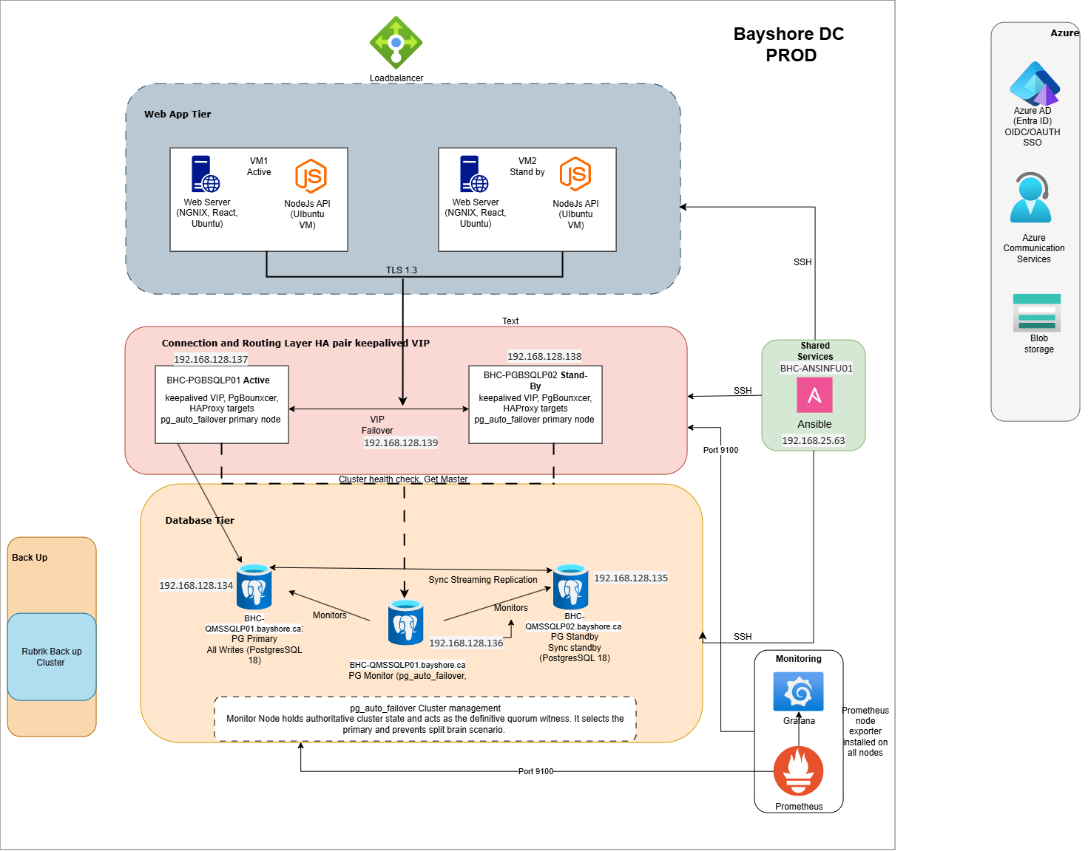
KNOWLEDGE TRANSFER
Platform architecture
04
Notes:
[Sources]
- ansible-pg-ha/POSTGRESQL_HA_KNOWLEDGE_TRANSFER_GUIDE.docx
[/Sources]

Slide 5
KNOWLEDGE TRANSFER
Every application connection follows one controlled path
Applications use the VIP; they never choose a database node directly.
1
2
3
4
5
Application
›
Keepalived
›
HAProxy
›
PgBouncer
›
PostgreSQL
VIP :5432
VIP owner
Primary-aware check
Transaction pool
Writable primary
05
Notes:
[Sources]
- ansible-pg-ha/roles/keepalived_haproxy
- ansible-pg-ha/roles/pgbouncer
- ansible-pg-ha/POSTGRESQL_HA_KNOWLEDGE_TRANSFER_GUIDE.docx
[/Sources]

Slide 6
KNOWLEDGE TRANSFER
Database and routing failover are independent
One changes the writable database; the other changes the VIP owner.
DATABASE LAYER
ROUTING LAYER
•
pg_auto_failover monitor decides roles
•
Keepalived owns the VIP on one router
•
Standby is promoted after primary failure
•
HAProxy health is tracked by Keepalived
•
Returning node rejoins as secondary
•
Peer acquires VIP when owner fails
•
Never use pg_ctl promote manually
•
Preferred router reclaims VIP after recovery
06
Notes:
[Sources]
- ansible-pg-ha/SYSTEM_ARCHITECTURE_AND_RECOVERY.md
- ansible-pg-ha/roles/pg_auto_failover
- ansible-pg-ha/roles/keepalived_haproxy
[/Sources]

Slide 7
KNOWLEDGE TRANSFER
The repository separates environment data from reusable roles
site.yml sequences the platform; inventories and group_vars select UAT or Production.
FOUNDATION
ansible-pg-ha/
├─ inventories/
├─ group_vars/
├─ roles/
├─ bootstrap.yml
├─ site.yml
└─ tests/
push_ssh_keys • ufw_firewall • os_tuning • storage_lvm
DATABASE
pg_auto_failover • database_bootstrap • backup provider cleanup
ROUTING
pgbouncer • keepalived_haproxy
VISIBILITY
monitoring_agents • health and failover tests
07
Notes:
[Sources]
- ansible-pg-ha/CODEBASE_ARCHITECTURE.md
- ansible-pg-ha/site.yml
- ansible-pg-ha/roles
[/Sources]

Slide 8
KNOWLEDGE TRANSFER
Deployment follows a guarded sequence
Run from the Linux Ansible control server; do not limit the first full deployment.
1
Bootstrap
Push the controller public key with --ask-pass
2
Validate
Inventory graph, Vault, syntax, disks, mounts and interface
3
Deploy
Select UAT or Production inventory and run site.yml
4
Verify
Health suite, pg_autoctl state, VIP, SQL path and exporters
Production: keep storage_lvm_enabled=false when LVM, XFS, mounts and /etc/fstab are already provisioned.
08
Notes:
[Sources]
- ansible-pg-ha/DEPLOYMENT_HOWTO.md
- ansible-pg-ha/OPERATOR_RUNBOOK.md
- ansible-pg-ha/site.yml
[/Sources]

Slide 9
KNOWLEDGE TRANSFER
UAT and Production use the same deployment command pattern
Change only the selected inventory; keep Vault and evidence handling consistent.
UAT
ansible-playbook -i inventories/uat_hosts.ini site.yml \
--ask-vault-pass | tee "uat-deployment-$(date +%F-%H%M).log"
PRODUCTION
ansible-playbook -i inventories/prod_hosts.ini site.yml \
--skip-tags storage -e storage_lvm_enabled=false \
--ask-vault-pass | tee "prod-deployment-$(date +%F-%H%M).log"
First full deployment: avoid --limit because monitor → initial primary → standby sequencing matters.
09
Notes:
[Sources]
- ansible-pg-ha/DEPLOYMENT_HOWTO.md
- ansible-pg-ha/POSTGRESQL_HA_KNOWLEDGE_TRANSFER_GUIDE.docx
[/Sources]

Slide 10
KNOWLEDGE TRANSFER
Testing progresses from read-only health to controlled failover
Disruptive tests require an approved window and the correct typed confirmation.
READ-ONLY HEALTH
Services, Chrony, UFW, mounts, exporters, SQL through VIP
bash tests/run_health.sh --ask-vault-pass
ROUTING FAILOVER
Moves VIP to peer, proves SQL, restores preferred owner
bash tests/run_routing_failover.sh --ask-vault-pass
DATABASE SWITCHOVER
Monitor-coordinated role exchange and SQL validation
bash tests/run_db_failover.sh --ask-vault-pass
CLIENT HA/DR
Baseline, routing, database, restoration and evidence bundle
bash tests/run_client_dr_failover.sh --ask-vault-pass
10
Notes:
[Sources]
- ansible-pg-ha/tests/README.md
- ansible-pg-ha/CLIENT_DR_FAILOVER_TEST_RUNBOOK.md
[/Sources]

Slide 11
KNOWLEDGE TRANSFER
A successful test proves the entire service path
Passing Ansible output alone is not enough; validate the cluster, routing and client experience.
✓
failed=0 and unreachable=0 for all targeted hosts
✓
SQL through the VIP returns pg_is_in_recovery() = false
✓
Chrony reports normal synchronization on every node
✓
Required exporters respond from approved monitoring sources
✓
pg_autoctl shows one writable primary and one stable secondary
✓
Rubrik backup evidence is verified separately
✓
Exactly one routing node owns the database VIP
11
Notes:
[Sources]
- ansible-pg-ha/tests/README.md
- ansible-pg-ha/POSTGRESQL_HA_KNOWLEDGE_TRANSFER_GUIDE.docx
[/Sources]

Slide 12
KNOWLEDGE TRANSFER
Use the monitor as the source of truth
Run pg_autoctl commands from the Ansible server rather than inferring roles from inventory names.
SHOW STATE
ansible db_monitor -i "$INVENTORY" -b --become-user postgres -m command \
-a "pg_autoctl show state --pgdata /pgdata/pgroot/data"
CHECK LOCAL CONFIGURATION
ansible db_cluster -i "$INVENTORY" -b --become-user postgres -m command \
-a "pg_autoctl config check --pgdata /pgdata/pgroot/data"
WATCH TRANSITIONS
watch -n 2 "ansible '$DB_MONITOR' -i '$INVENTORY' -b --become-user postgres \
-m command -a 'pg_autoctl show state --pgdata /pgdata/pgroot/data'"
Controlled: pg_autoctl perform switchover must run only in an approved maintenance window.
12
Notes:
[Sources]
- ansible-pg-ha/POSTGRESQL_HA_KNOWLEDGE_TRANSFER_GUIDE.docx
- ansible-pg-ha/OPERATOR_RUNBOOK.md
[/Sources]

Slide 13
KNOWLEDGE TRANSFER
Six quick checks explain most operational incidents
Run them with the selected inventory before changing service state.
SERVICE
DATABASE
systemctl status pg_autoctl --no-pager
pg_isready -h /var/run/postgresql -p 5432
Monitor and both data nodes
Local PostgreSQL readiness
ROUTING
VIP
systemctl status pgbouncer haproxy keepalived
ip -brief -4 address show dev <interface>
Both routing nodes
Exactly one VIP owner
TIME
FIREWALL
chronyc tracking && chronyc sources
sudo ufw status verbose
Normal leap status and active source
Incoming deny and approved role rules
13
Notes:
[Sources]
- ansible-pg-ha/OPERATOR_RUNBOOK.md
- ansible-pg-ha/POSTGRESQL_HA_KNOWLEDGE_TRANSFER_GUIDE.docx
[/Sources]

Slide 14
KNOWLEDGE TRANSFER
Rubrik owns backup and recovery; legacy monitor archiving stays off
The retained /pgdata/WalArchive area is rollback storage, not a concurrent backup path.
CURRENT DESIGN
OPERATOR RULE
•
Rubrik provides the approved base backup and recovery points
Do not run the legacy monitor SSH WAL archive at the same time as Rubrik-managed archiving.
•
Ansible validates that the legacy archive-wal command is absent
•
Restore evidence is generated by an isolated Rubrik recovery exercise
Backup success is proven in Rubrik—not by Ansible health output alone.
14
Notes:
[Sources]
- ansible-pg-ha/RUBRIK_WAL_CUTOVER_AND_DR_RUNBOOK.md
- ansible-pg-ha/SYSTEM_ARCHITECTURE_AND_RECOVERY.md
[/Sources]

Slide 15
KNOWLEDGE TRANSFER
The client team is ready when it can operate without guesswork
Use the repository as the control plane and the monitor as the authority for database roles.
✓
Select and prove the correct UAT or Production inventory
✓
Identify the current primary and the current VIP owner
✓
Run the read-only health suite and interpret failures
✓
Explain which tests require a maintenance window
✓
Locate detailed recovery and Rubrik runbooks before an incident
Questions, ownership confirmation and open actions
15
Notes:
[Sources]
- ansible-pg-ha/POSTGRESQL_HA_KNOWLEDGE_TRANSFER_GUIDE.docx
- ansible-pg-ha/SYSTEM_ARCHITECTURE_AND_RECOVERY.md
[/Sources]

