Slide 1
The Request Response Cycle

Slide 2
Simple Letter Writing
Imagine you’re writing to a Friend. The process would look something like this:
Write a letter
Specify your Friend’s address
Drop the letter in your mailbox
The letter goes through the postal system and arrives at your Friend’s mailbox

Slide 3
Simple Letter Writing
Your Friend then goes through a very similar set of steps:
Read your letter and write a response
Specify your address
Drop their letter in their mailbox
The letter goes through the postal system and arrives at your mailbox

Slide 4
Analogy
You are the Client
Your Friend is the Server
Your letter is the Request
Your Friend’s letter is the Response
The postal system, the thing responsible for ensuring your letters are delivered, is The Internet
HTTP is the language you write in so that your penpal can understand you. You may write in English because you know you both understand English.

Slide 5
Client and Server
The basis of all web interactions is someone asking for information, and receiving information.
In order to ask for and receive any information, we need two players - the asker and the producer. In basic web interactions, the ‘asker’ is a client and the ‘producer’ is a server.
Clients send Requests to Servers asking for some kind of information. Upon receiving a Request, Servers send Responses back to the Client.
In the web development world, a client is a web browser, not an individual person.
The person using the browser is referred to as a user.

Slide 6
Sockets
Sockets and the socket API are used to send messages across a network.
They provide a form of inter-process communication (IPC).
The network can be a logical, local network to the computer, or one that’s physically connected to an external network, with its own connections to other networks.

Slide 7
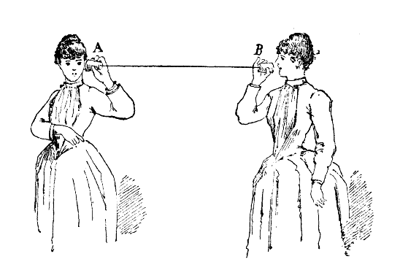
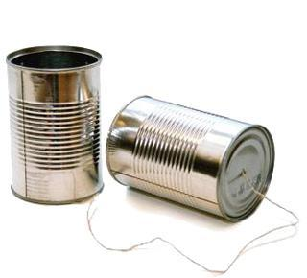

Slide 8

TCP Connections / Sockets
“In computer networking, an Internet socket or network socket is an endpoint of a bidirectional inter-process communication flow across an Internet Protocol-based computer network, such as the Internet.”
Application
Process
Application
Process
Internet
http://en.wikipedia.org/wiki/Internet_socket

Slide 9
Port Numbers
A port is an application-specific or process-specific software communications endpoint
It allows multiple networked applications to coexist on the same server
There is a list of well-known port numbers

Slide 10
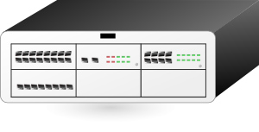

TCP Port Numbers
www.dj4e.com
74.208.28.177
Incoming E-Mail
25
Login
23
blah blah blah blah
Web Server (HTTP)
80
Web Server (HTTPS)
443
Personal Mail Box
109
Personal Mail Box
110

Slide 11
Uniform Resource Locator
http://data.pr4e.org/page1.htm
protocol
host
document

Slide 12
TCP v/s UDP
You’re going to create a socket object using socket.socket(), specifying the socket type as socket.SOCK_STREAM. When you do that, the default protocol that’s used is the Transmission Control Protocol (TCP).
Why should you use TCP? The Transmission Control Protocol (TCP):
Is reliable: Packets dropped in the network are detected and retransmitted by the sender.
Has in-order data delivery: Data is read by your application in the order it was written by the sender.

Slide 13
TCP v/s UDP
In contrast, User Datagram Protocol (UDP) sockets created with socket.SOCK_DGRAM aren’t reliable, and data read by the receiver can be out-of-order from the sender’s writes.
Although UDP isn’t ideal for sending an email, viewing a webpage, or downloading a file, it is largely preferred for real-time communications like broadcast or multitask network transmission.

Slide 14
Python Socket Module
socket()
.bind()
.listen()
.accept()
.connect()
.send()
.recv()
.close()
.gethostname()

Slide 15
.socket
Is like opening a file handle

Slide 16
.bind
The bind() method of Python's socket class assigns an IP address and a port number to a socket instance.
The bind() method is used when a socket needs to be made a server socket.
As server programs listen on published ports, it is required that a port and the IP address to be assigned explicitly to a server socket.
For client programs, it is not required to bind the socket explicitly to a port. The kernel of the operating system takes care of assigning the source IP and a temporary port number.
The client socket can use the connect() method, after the socket creation is complete to contact the server socket.

Slide 17
.listen
Calling listen() makes a socket ready for accepting connections.
The listen() method should be called before calling the accept() method on the server socket.

Slide 18
.accept
The accept() method of Python's socket class, accepts an incoming connection request from a TCP client.
The accept() method is called on a TCP based server socket.

Slide 19
.connect
Used to connect with a server by passing IP address and port number

Slide 20
.send
The send()method of Python's socket class is used to send data from one socket to another socket.
The send()method can only be used with a connected socket. That is, send() can be used only with a TCP based socket and it can not be used with UDP socket.
The send() method can be used to send data from a TCP based client socket to a TCP based client-connected socket at the server side and vice versa.
The data sent should be in bytes format. String data can be converted to bytes by using the encode() method of string class.

Slide 21
.sentto
The method sendto() of the Python's socket class, is used to send datagrams to a UDP socket.
The communication could be from either side. It could be from client to server or from the server to client.
For sendto() to be used, the socket should not be in already connected state.

Slide 22
.recvfrom
The recvfrom() method Python's socket class, reads a number of bytes sent from an UDP socket.
Like sendto(), the recvfrom() method as well is to be called on a UDP socket.
Unlike sendto(), the method recvfrom() does not take an IP address and port as a parameter.
The recvfrom() method can be used with an UDP server to receive data from a UDP client or it can be used with an UDP client to receive data from a UDP server.

Slide 23
.gethostname
The Python function socket.gethostname() returns the host name of the current system under which the Python interpreter is executed.

Slide 24
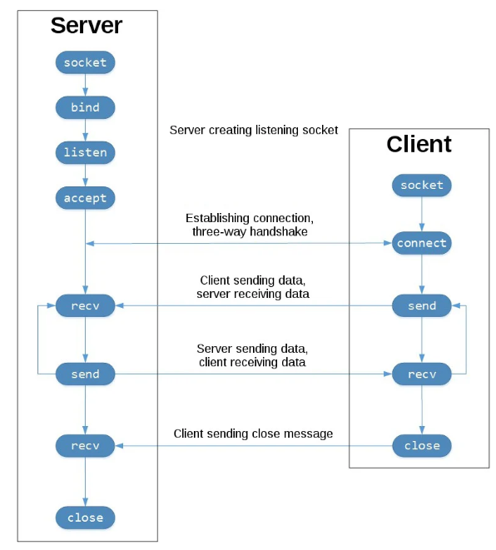
TCP Client Server Flow

Slide 25
Internet
The Internet is the network between devices that allows clients and servers to exchange this information.

Slide 26
HTTP (HyperText Transfer Protocol)
HTTP is a set of rules for how this exchange of information happens. Clients and Servers adhere to these rules to ensure that they understand each other’s Requests and Responses.

Slide 27
HTTP Request Response Cycle
You open your browser, the Client, and type in a web address
The browser takes this address and builds an HTTP Request. It addresses it to the Server
The Request is handed off to your Internet Service Provider (ISP) and they send it through the Internet, mostly a series of wires and fiber optic cables, to the Server
The Server reads the Request. It knows how to read it because it is formatted as an HTTP Request.
The Server generates an HTTP Response to that Request.
The server hands the Response off to their ISP and it goes through the internet to arrive at your computer.
Your browser reads the Response. It knows how to read it because it is formatted as an HTTP Response.
Your browser displays the data on your machine.

