Slide 1
Secure data hiding in images using Steganography
CAPSTONE PROJECT
Presented By: Kavita Prajapati
Student Name : Kavita Prajapati
College Name & Department : Sabarmati University MCA

Slide 2
OUTLINE
Problem Statement
Technology used
Wow factor
End users
Result
Conclusion
Git-hub Link

Slide 3
Problem Statement
GUI-based easy-to-use steganography tool that allows users to encrypt and decrypt messages with a simple click
The tool ensures secure communication by embedding confidential information within images, making it difficult for unauthorized parties to detect or retrieve the hidden data.
It is designed to be accessible for both technical and non-technical users, offering a seamless encryption process without requiring deep cryptographic knowledge.

Slide 4
Technology used
Python
Cryptography Library
Tkinter (for GUI)

Slide 5
Wow factors
One-click encryption & decryption
User-friendly graphical interface
Secure message hiding in images

Slide 6
End users
Customers who require secure message transmission
Out internship mentors

Slide 7
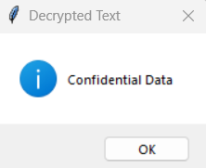
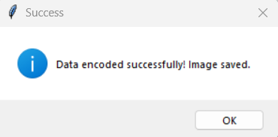
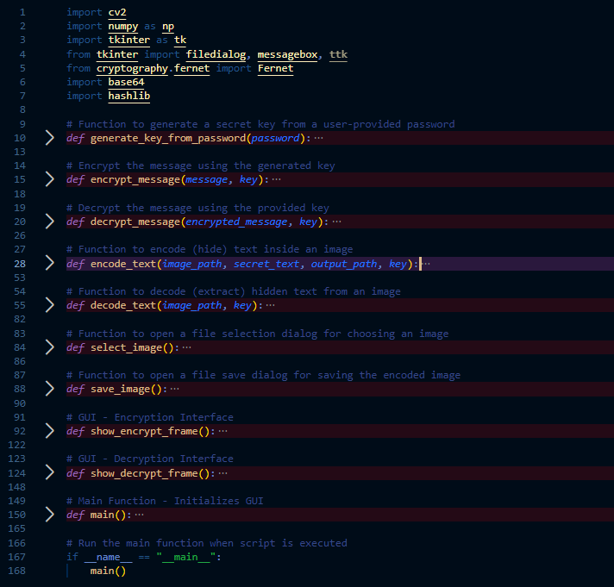
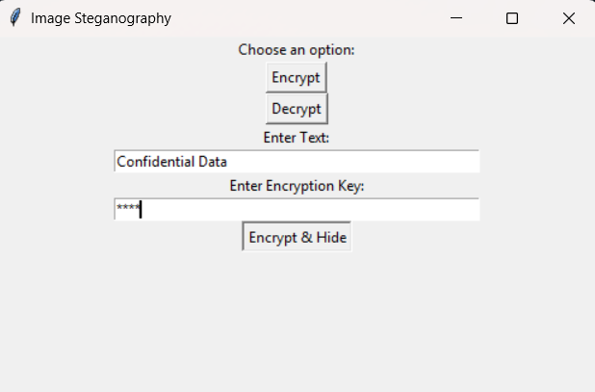
Results

Slide 8
Conclusion
The project successfully provides a user-friendly GUI for secure message encryption and decryption using steganography techniques

Slide 9
GitHub Link
https://github.com/kavita1208/Steganography.git

Slide 10
THANK YOU

