Slide 1
Hadoop

Slide 2
What is Big Data?
Big Data = very large amount of data that is too big, too fast, or too complex for normal computers (like Excel or a single database) to handle.
Think of:
WhatsApp messages
Instagram photos & reels
Amazon orders
All this together = Big Data

Slide 3
The 3 V’s of Big Data
Volume – Huge amount of data
Facebook → petabytes of photos
Velocity – Speed of data
Live tweets, stock prices, GPS tracking
Variety – Different types
Text, image, video, audio, logs
If data has these → it’s Big Data

Slide 4
Real-life example
Netflix
Netflix collects:
What you watch
When you pause
What you skip
Device used
Big Data helps Netflix:
Recommend shows
Decide which series to produce
Improve streaming quality

Slide 5
What is Hadoop
Hadoop is a framework to store and process very large data (Big Data) across many computers.
One laptop can’t handle TBs or PBs of data Hadoop splits the data + work across many machines and finishes the job faster.
unlimited storage
horizontally unlimited scalability i.e. no limit of max number of slave nodes
supports parallel processing with the help of replica

Slide 6
Where Hadoop is used
Log processing (Netflix, Amazon)
Clickstream analysis
Banking transactions
Telecom call data
IoT sensor data
Social media analytics

Slide 7
Components of Hadoop Architecture
Hadoop Architecture Mainly consists of 3 components:
HDFS (Hadoop Distributed File System)
YARN (Yet Another Resource Negotiator)
MapReduce

Slide 8
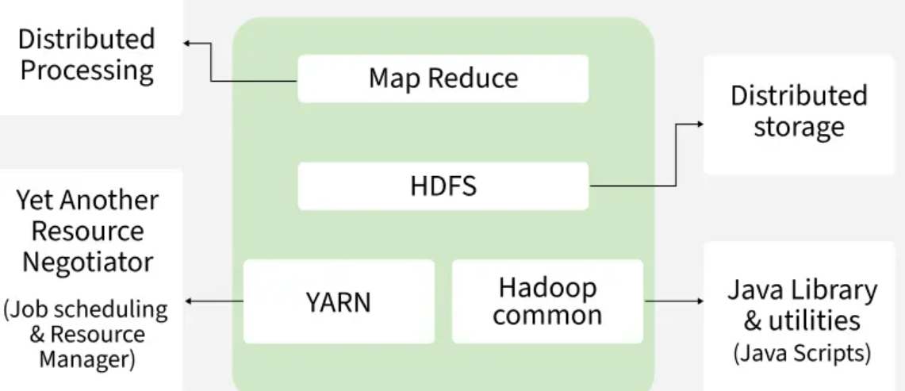
Hadoop Architecture

Slide 9
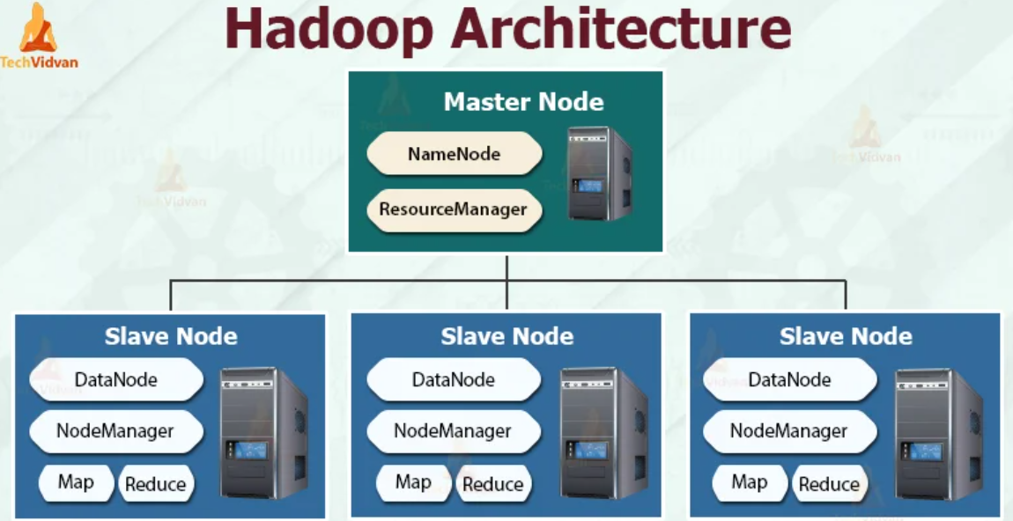

Slide 10
Core components of Hadoop
HDFS (Storage layer)
HDFS = Hadoop Distributed File System
Stores big files by breaking them into blocks
Spreads blocks across multiple machines
Keeps multiple copies (replicas)
Example:
100 GB file
→ split into 128 MB blocks
→ stored across 10 machines
→ 3 replicas each
If one machine fails → data still safe

Slide 11
MapReduce (Processing layer – old but foundational)
MapReduce = programming model for parallel processing
Two phases:
Map → process chunks of data
Reduce → combine results
Example: Word Count:
Map: hello → 1
Map: hello → 1
Reduce: hello → 2
MapReduce is slow for modern use cases Mostly replaced by Spark

Slide 12
Cloudera
Cloudera is a company that provides a big data platform used to store, process, and analyze large amounts of data, especially in enterprise environments.
Cloudera = A managed Hadoop ecosystem It helps you run tools like Hadoop, Spark, Hive, etc. easily without setting everything up manually.

Slide 13
Cloudera Data Platform
Cloudera offers a platform called CDP
This platform includes:
HDFS → Storage (big data file system)
YARN → Resource management
Hive → SQL on big data
Spark → Fast data processing
Impala → Fast SQL queries
Hue → Web UI to run queries
Oozie → Workflow scheduling

Slide 14
HDFS Commands
1. List files in HDFS
hdfs dfs -ls /
hdfs dfs -ls /user/cloudera
2. Create directory in HDFS
hdfs dfs -mkdir /user/cloudera/testdir
hdfs dfs -mkdir -p /user/cloudera/data/input

Slide 15
Cont…
4. Delete files/directories
hdfs dfs -rm /user/cloudera/test.txt
Delete directory:
hdfs dfs -rm -r /user/cloudera/testdir
5. Move/Rename file
hdfs dfs -mv /user/cloudera/test.txt /user/cloudera/newname.txt

Slide 16
6. Upload file (Local → HDFS)
hdfs dfs -put test.txt /user/cloudera/
7. Download file (HDFS → Local)
hdfs dfs -get /user/cloudera/test.txt
8. Copy file inside HDFS
hdfs dfs -cp /user/cloudera/test.txt /user/cloudera/test_copy.txt

Slide 17
Big Data Architecture
Data Source
↓
HDFS / Data Lake (store data)
↓
Spark (process data)
↓
Analytics / ML
↓
Dashboard / App

Slide 18
In detail
CSV file
↓
Copied to HDFS
↓
HDFS splits into blocks
↓
Spark reads blocks in parallel
↓
Spark creates DataFrame
↓
Transformations (filter, groupBy, ML, etc.)
↓
Result stored back to HDFS / shown / sent to DB

Slide 19
What is Apache Hive?
Hive allows you to work with data stored in Hadoop (HDFS) using a language called HiveQL (similar to SQL).
👉 Think of it like this: Instead of writing complex MapReduce programs, you just write:
SELECT count(*) FROM logs;
Hive internally converts it into MapReduce jobs.
Apache Hive is a data warehouse system built on top of Hadoop that helps you query and analyze large datasets using SQL-like language instead of writing Java MapReduce code.

Slide 20
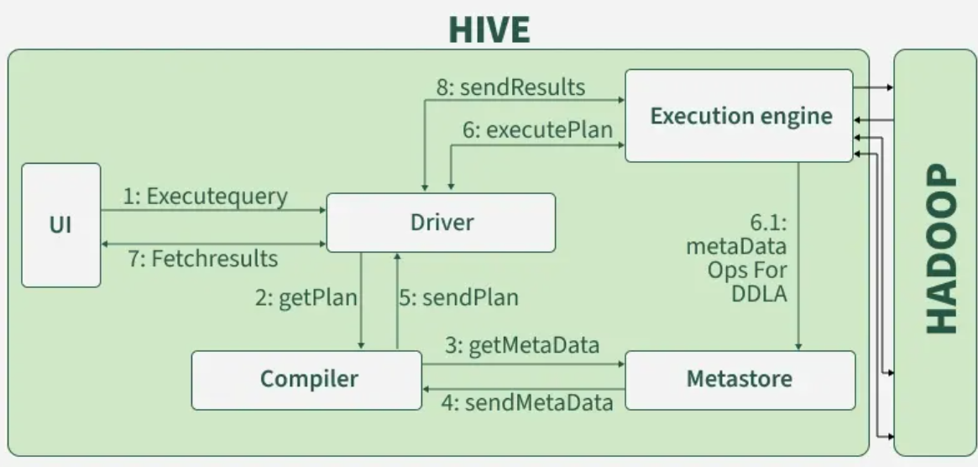
Hive Architecture

Slide 21
Hive Architecture (Simple Flow)
User writes query (HiveQL)
Query goes to Driver
Compiler converts it into execution plan
Execution engine runs using:
MapReduce
Data is read from:
HDFS
Results returned to user

Slide 22
Steps
🔹 Step 1: Create Table (each line as a string)
CREATE TABLE users(
id INT,
name STRING
)
ROW FORMAT DELIMITED
FIELDS TERMINATED BY ‘,’
STORED AS TEXTFILE;
🔹 Step 2: Load File from HDFS
LOAD DATA INPATH '/user/cloudera/user.csv' INTO TABLE users;
🔹 Step 3: Display the number of users
Select count(*) from users;

Slide 23
Iceberg
Using Apache Iceberg with Hadoop is a great next step after HDFS + Hive because it solves real problems like updates, deletes, schema evolution, and fast queries.
Iceberg is a table format that sits on top of Apache Hadoop HDFS.
Think like this:
HDFS → stores files
Hive → reads tables (but limited updates)
Iceberg → modern table layer with ACID + versioning

Slide 24
Why Iceberg is needed
Problems with Hive tables:
❌ No proper UPDATE/DELETE
❌ Slow queries on large data
❌ Schema change is risky
Iceberg solves:
✅ ACID transactions
✅ Time travel (see old data)
✅ Fast queries (metadata pruning)
✅ Works with Spark, Hive, Flink

Slide 25
Steps
1️⃣ Start Spark with Iceberg support
spark-shell \ --packages org.apache.iceberg:iceberg-spark-runtime-3.3_2.12:1.4.2
2️⃣ Create Iceberg Table
CREATE TABLE local.db.customer_iceberg ( customer_id INT, name STRING, city STRING, income INT ) USING iceberg;
This table is stored in HDFS internally

Slide 26
Cont…
3️⃣ Insert Data
INSERT INTO local.db.customer_iceberg VALUES (1, 'Ravi', 'Chennai', 50000), (2, 'Anita', 'Bangalore', 60000);
4️⃣ Query Data
SELECT * FROM local.db.customer_iceberg;
5️⃣ Update (This is where Iceberg shines)
UPDATE local.db.customer_iceberg SET income = 70000 WHERE customer_id = 1;
👉 Not possible easily in Hive, but Iceberg supports it
6️⃣ Delete
DELETE FROM local.db.customer_iceberg WHERE customer_id = 2;

Slide 27
Apache Spark
Apache Spark is a fast, distributed data processing engine used to process large datasets.
In simple terms:
It reads data from sources like HDFS, processes it quickly (in memory), and gives results.
Why Spark is popular
Compared to traditional Hadoop MapReduce:
Much faster (in-memory processing)
Supports real-time streaming
Easy integration with HDFS, Hive, Kafka
Supports SQL, Machine Learning, Graph processing

Slide 28
Where Spark fits in your project
Data (CSV / JSON / Streaming) ↓ HDFS (Storage) ↓ Spark (Processing Engine) ↓ Output (Console / HDFS / Dashboard)
Spark does NOT store data permanently It processes data stored in HDFS

Slide 29
Test.py
from pyspark.sql import SparkSession spark = SparkSession.builder.appName("Demo").getOrCreate() df = spark.read.csv(“/user/cloudera/customer.csv", header=True, inferSchema=True) df.show() # Reads data from HDFS and displays it
df.filter(df.income > 50000).show()
Runs the file using : spark-submit test.py

Slide 30
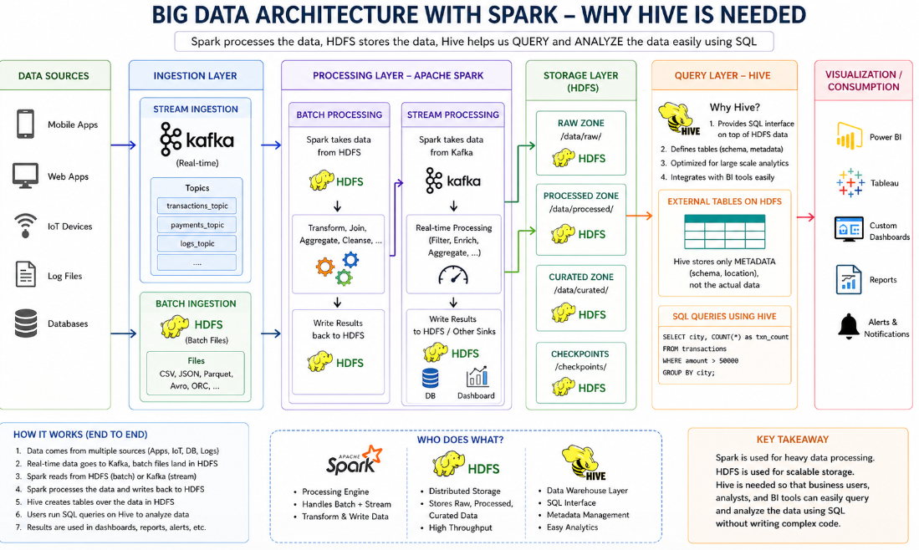
Everything together

Slide 31
Spark output integration with ML
Raw Data (HDFS / Streaming) ↓ Spark Processing (clean, join, filter) ↓ Feature Data (final DataFrame) ↓ Machine Learning Model ↓ Predictions / Insights
Spark prepares clean, structured data ML uses that data to predict or classify

Slide 32
Display spark output to dashboard
✅ STEP 1: Save Spark output to Hive table
df.write.mode("overwrite").saveAsTable("customer_summary")
✅ STEP 2: Verify in Hive
SELECT * FROM customer_summary;
✅ STEP 3: Open Dashboard Tool in Cloudera
SELECT city, COUNT(*) FROM customer_summary GROUP BY city;
Then click:
“Chart”
Choose Bar / Pie

Slide 33
How to handle Real Time Data
Create file1.csv
1,Ravi,Chennai,50000 2,Anita,Bangalore,70000
Upload:
hdfs dfs -mkdir /user/stream_data hdfs dfs -put file1.csv /user/stream_data/
After 10 seconds → create file2.csv
3,Kiran,Hyderabad,60000 4,Meena,Chennai,65000
hdfs dfs -put file2.csv /user/stream_data/
Notes:
IMPORTANT RULE
Spark will ONLY read new files It will NOT reread old files

