Slide 1
JUnit

Slide 2
Module design
Provide the cheat sheet
Introduce the use case
JUnit Overview
JUnit Configuration
JUnit Annotations
Execution of test cases
Assertions
Display use case
S/W Requirements
IDE :Eclipse
Java : version 8
JUnit: version 5.4.2

Slide 3
Introduce the Use Case on JUnit

Slide 4
Presenting the Use case on JUnit
Write the JUnit test cases for Bank Customer Management System.
Write the test case to make sure the Customer class object gets created successfully.
Write the test cases to validate customer name, phone number, email id and account type.

Slide 5
Junit Overview

Slide 6

Junit Overview
JUnit is a unit testing framework for the Java programming language.
JUnit has been important in the development of test-driven development, and is one of a family of unit testing frameworks.
JUnit 5 aims to adapt java 8 style of coding and several other features like lambda expression, that’s why java 8 is required to create and execute tests in JUnit 5.
JUnit latest version is 5.4.2 released on April 2019.

Slide 7
JUnit Configuration and Test Case execution

Slide 8
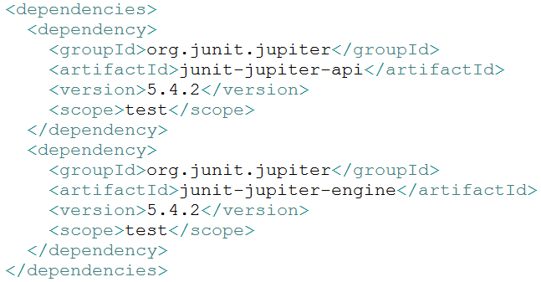
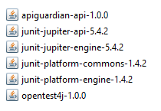
How to configure JUnit in eclipse
Add these dependencies to POM file.
Add the required JUnit jar files in eclipse build path.
Notes:
The junit-jupiter-api (version 5.4.2). This dependency provides the public API for writing tests and extensions.
The junit-jupiter-engine (version 5.4.2). This dependency contains the implementation of the JUnit Jupiter test engine that runs our unit tests.

Slide 9
Annotations

Slide 10
Test LifeCycle
In JUnit 5, test lifecycle is driven by 4 primary annotations i.e. @BeforeAll, @BeforeEach, @AfterEach and @AfterAll. Along with it, each test method must be marked with @Test annotation.
@BeforeAll
@BeforeEach
@Test
@AfterEach
@AfterAll

Slide 11
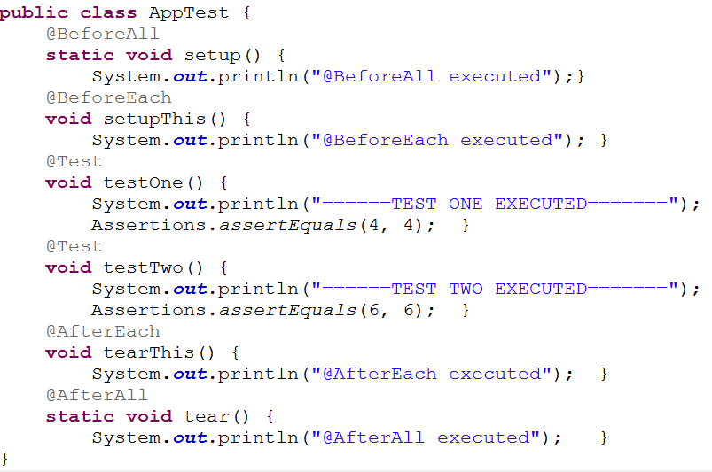
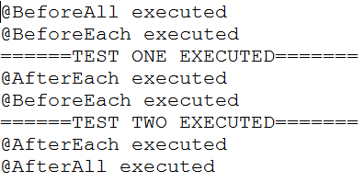
Test LifeCycle Demo

Slide 12
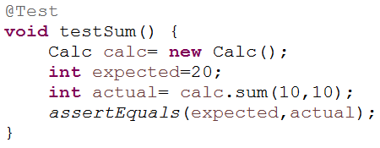
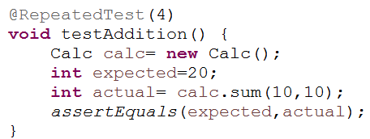
@Test
@Test: Denotes that a method is a test method.
@RepeatedTest: It enables to write repeatable test templates which could be run multiple times. The frequency can be configured as parameter to @RepeatedTest annotation.
.

Slide 13
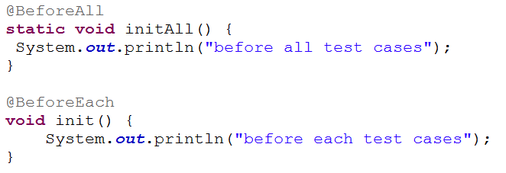
@BeforeEach and @BeforeAll
@BeforeEach: Denotes that the annotated method should be executed before each @Test, @RepeatedTest, @ParameterizedTest,.
@BeforeAll: Denotes that the annotated method should be executed before all @Test, @RepeatedTest, @ParameterizedTest,.

Slide 14
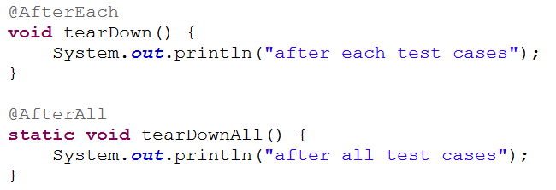
@AfterEach and @AfterAll
@AfterEach: Denotes that the annotated method should be executed after each @Test, @RepeatedTest, @ParameterizedTest,.
@AfterAll: Denotes that the annotated method should be executed after all @Test, @RepeatedTest, @ParameterizedTest,.

Slide 15
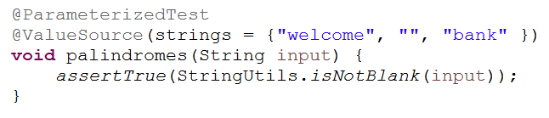
@ParametrizedTest
@ParametrizedTest : Denotes that a method is a parameterized test. This makes it possible to run a test multiple times with different arguments.
In addition, you must declare at least one source that will provide the arguments for each invocation and then consume the arguments in the test method.
@ValueSource is one of the simplest possible sources. It lets you specify a single array of literal values and can only be used for providing a single argument per parameterized test invocation.
The following types of literal values are supported by @ValueSource.
short
byte
int
long
float
double
char
java.lang.String
java.lang.Class

Slide 16
Assertions

Slide 17
Assertions
Assertions help in validating the expected output with actual output of a testcase. All JUnit Jupiter assertions are static methods in the org.junit.jupiter.api.Assertions class.
Few important methods are below:
void assertEquals(String expected, String actual): Checks that two primitives/objects are equal.
void assertTrue(boolean condition): Checks that a condition is true.
void assertFalse(boolean condition): Checks that a condition is false.
void assertNotNull(Object object): Checks that an object isn't null.
void assertNull(Object object): Checks that an object is null.
void assertSame(object1, object2): The assertSame() method tests if two object references point to the same object.
void assertNotSame(object1, object2): The assertNotSame() method tests if two object references do not point to the same object.
void assertArrayEquals(expectedArray, resultArray);:The assertArrayEquals() method will test whether two arrays are equal to each other.

Slide 18
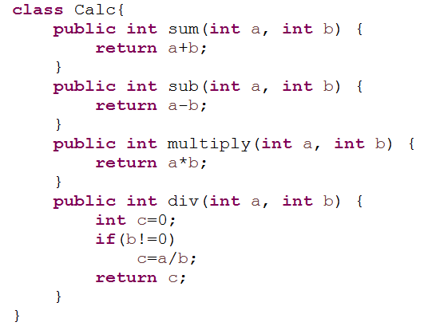
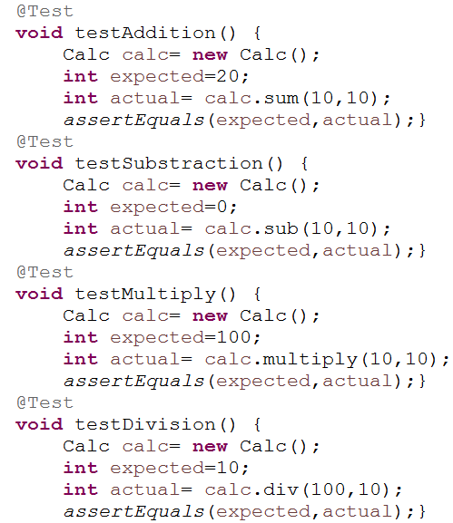
Calculator Test Cases

Slide 19
Test Cases execution

Slide 20
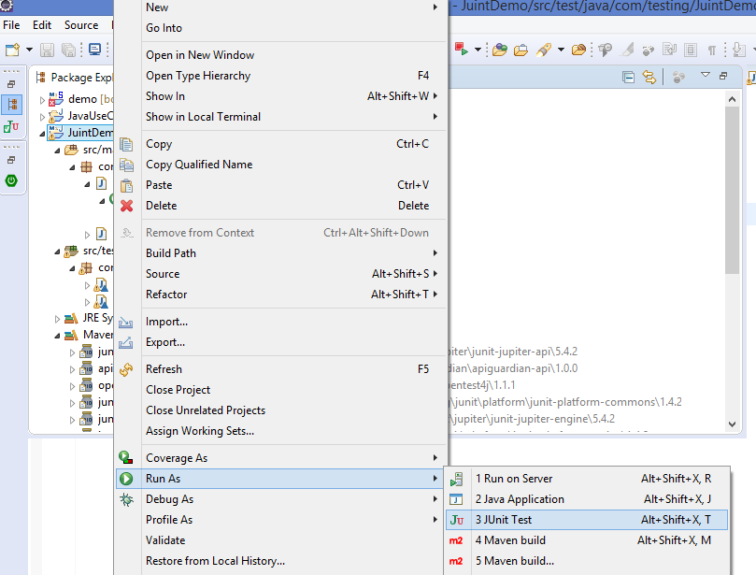
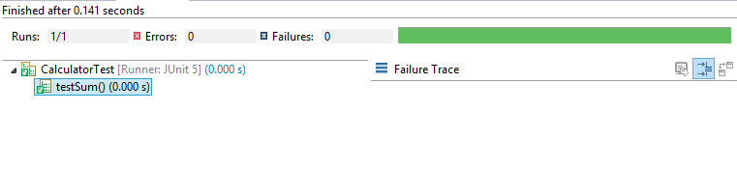
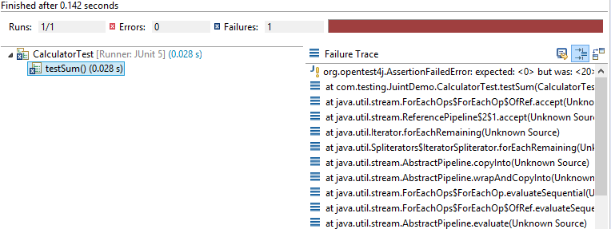
How to execute the JUnit test cases
Successful test case
Failed test case

Slide 21
Let us work on use case on JUnit

Slide 22
Presenting the Use case on JUnit
Write the JUnit test cases for Bank Customer Management System.
Write the test case to make sure the Customer class object gets created successfully.
Write the test cases to validate customer name, phone number, email id and account type.

Slide 23
Thank You

