Slide 1
Java

Slide 2
Java Module Design
Module 1 : Java Basics
Module 2 : OOP’s Programming
Introduce the Use Case to be completed
Module 3 : Exception Handling
Module 4 : Collection Framework
S/W Requirements
Module 5 : JDBC
IDE : Eclipse
SDK: JDK 8

Slide 3
Introducing the use case

Slide 4
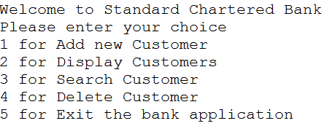
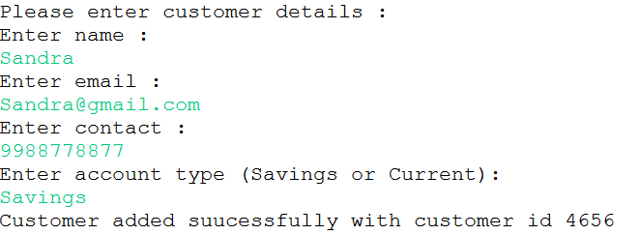
Bank Customer Management System
Display the menu to user
Create the customer class having fields cutsomerid as int, name as string, mailid as string contact as string and account type as string.
If user enters 1 , please provide the details. On valid entries these details should be added into the database with auto generated customerid.

Slide 5

Bank Customer Management System …
While adding the customer, make sure admin provides valid entries like name can only have alphabets, email should be valid one , contact no should have 10 digits and account type can be either Savings or current. If any one of the condition fails, the customer should not be added in the database and display the appropriate error message.
If user enters 2 , display all existing customer details using collection.
If user enters 3 , display the matched customer details.
If user enters 4 , delete the matched customer details.
If user enters 5, exit the application.

Slide 6
Module 1: Java Basics

Slide 7
Module 1 : Java Basics Design
What is java
Platform Independence
JDK, JRE, JVM
Typecasting
Data Types and Variable Declaration
Hello World Program
Operators
Control Statements
Array

Slide 8
What is Java

Slide 9

Java
Java is one of the most popular and widely used programming language and platform. A platform is an environment that helps to develop and run programs written in any programming language.
Java is a general-purpose programming language that is class-based, object-oriented (although not a pure OO language, as it contains primitive types)
It is intended to let application developers write once, run anywhere (WORA), meaning that compiled Java code can run on all platforms that support Java without the need for recompilation.
Java was originally developed by James Gosling at Sun Microsystems (which has since been acquired by Oracle) and released in 1995 as a core component of Sun Microsystems' Java platform.
The latest version is Java 12, released in March 2019.
Notes:
Java applications are typically compiled to bytecode that can run on any Java virtual machine (JVM) regardless of the underlying computer architecture.
Java is fast, reliable and secure. From desktop to web applications, scientific supercomputers to gaming consoles, cell phones to the Internet, Java is used in every nook and corner.

Slide 10
Java Features
Dynamic
Distributed
Multithreaded
Object Oriented
Java
Simple
High Performance
Secure
Interpreted
Portable
Platform Independent
Robust
Architecture Neutral

Slide 11
Java as Platform Independent
Java source code (*.java)
Platform independent language means once compiled you can execute the program on any platform (OS).
The Java compiler converts the source code to bytecode, which is an intermediate Language.
The bytecode generated is a non-executable code and needs an interpreter to execute on a machine. This interpreter is the JVM and thus the Bytecode is executed by the JVM.
Java is platform independent but JVM is platform dependent.
Java Compiler
Java Byte Code (*.class)
JVM
Machine Code

Slide 12
JDK, JRE and JVM
JRE and JDK come as installer while JVM is bundled with them.
The JDK also called Java Development Kit is a superset of the JRE, and contains everything that is in the JRE, plus tools such as the compilers and debuggers necessary for developing applets and applications.
The Java Runtime Environment (JRE) provides the libraries, the Java Virtual Machine, and other components to run applets and applications written in the Java programming language. JRE does not contain tools and utilities such as compilers or debuggers for developing applets and applications.
Java Virtual Machine(JVM ) is platform dependent and it interprets the Byte Code in to specific Machine language of the platform.
Development Tools like compiler, debugger
Set of libraries+ components
JVM
JRE
JDK

Slide 13
Hello World Program

Slide 14
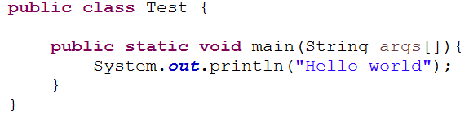
Hello World Program
Array of string data types
No need to create the object to call this method
Starting point of java program
This statement prints “Hello World” on screen
Method does not return anything

Slide 15
Data Types and variable declaration

Slide 16
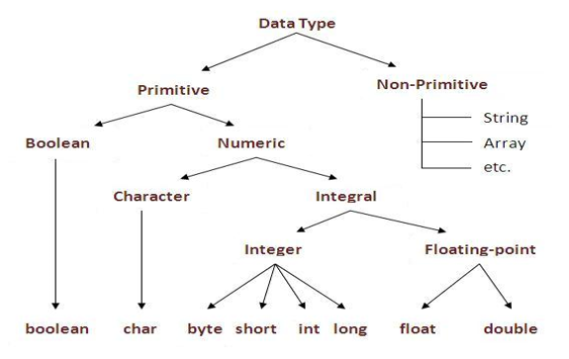

Data Types
Java language has a rich implementation of data types. Data types specify size and the type of values that can be stored in an identifier.
In java, data types are classified into two categories :
Primitive Data type
Non-Primitive Data type
Notes:
https://code4coding.com/datatype-and-variables-in-javaprogramming-language/

Slide 17
Variable Declaration
A variable is the name given to a memory location. It is the basic unit of storage in a program.
The value stored in a variable can be changed during program execution.
A variable is only a name given to a memory location so all the operations done on the variable effects that memory location.
In Java, all the variables must be declared before use.
Example:
int age=20;
boolean flag = false;
double amount= 2548.78;
String s= “Hello World”;

Slide 18
Typecasting

Slide 19
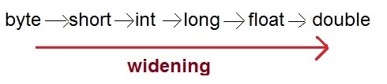

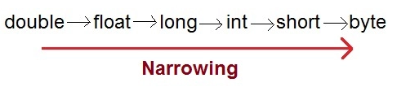

Typecasting
Assigning a value of one type to a variable of another type is known as Type Casting.
In Java, type casting is classified into two types,
Widening Casting(Implicit or automatic):
the two types are compatible
the target type is larger than the source type
Narrowing Casting(Explicitly done):
When you are assigning a larger type value to a variable of smaller type, then you need to perform explicit type casting.

Slide 20
Operators

Slide 21
Operators
Java provides a rich set of the operator (different type)to manipulate variables. We can divide all the Java operators into the following groups:
Arithmetic Operators : +, -, *, /, %
Assignment Operators : =, +=, -=, *=, /=, %=, &=, |=, ^=
Relational Operators : >, <, ==, >= , <= , !=
Unary Operator : ++, --, !
Logical Operators : &&, ||, !
Bitwise Operator : &, |, =, ^, >>, <<
Ternary Operator: ?:

Slide 22
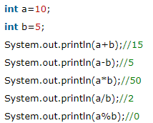
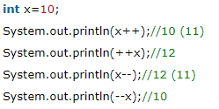
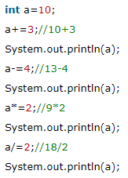
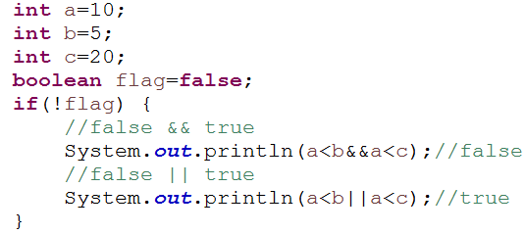

Operators with examples
Unary operators
Arithmetic operators
Ternary operator
Assignment operators
Relational and Logical operators

Slide 23
Control Statements

Slide 24
Control Statements
If else
Conditional Statements
nested if
switch
for
Control Statements
Iteration Statements
while
do while
Jump Statements
break
continue

Slide 25
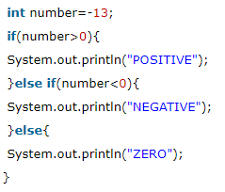
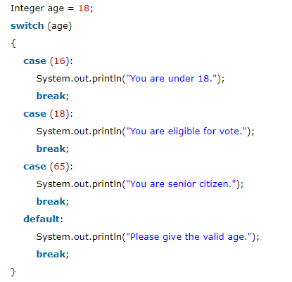
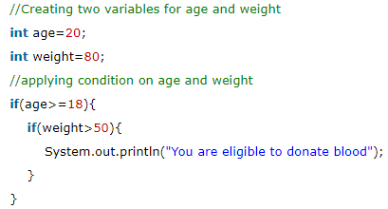
Conditional Statements
if-else
switch
Nested if

Slide 26
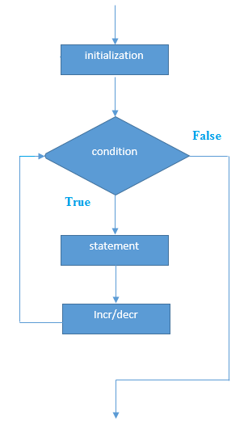
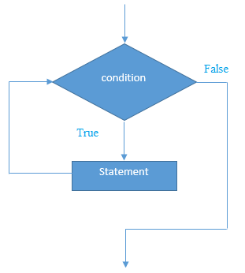
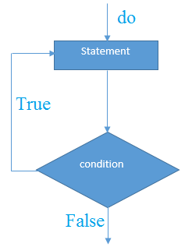
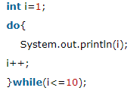
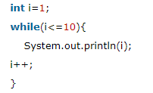

Iteration Statements
while loop
do while loop
for loop

Slide 27
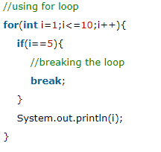
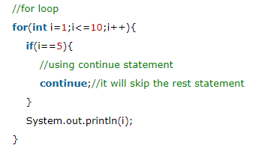
Jump Statements
break:
When a break statement is encountered inside a loop, the loop is immediately terminated and the program control resumes at the next statement following the loop.
The Java break is used to break loop or switch statement.
continue:
The continue statement is used in loop control structure when you need to jump to the next iteration of the loop immediately. It can be used with for loop or while loop.
The Java continue statement is used to continue the loop.

Slide 28
Array

Slide 29
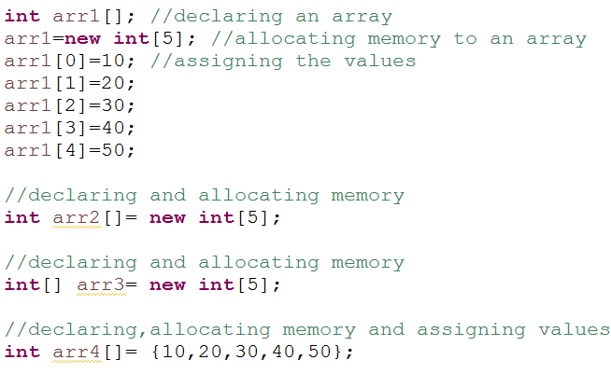
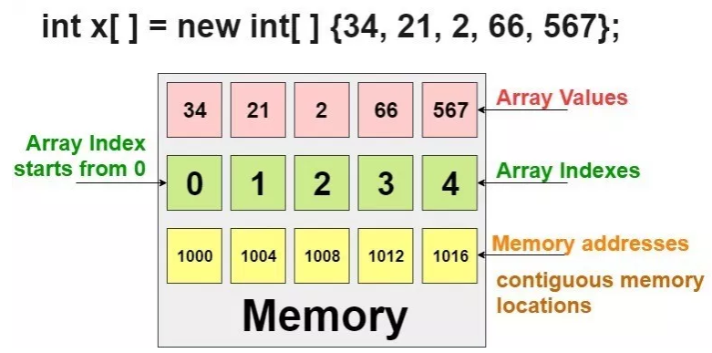
Array
Array in Java are a group of like-typed variables that are referred to by a common name. Array is a collection of homogenous elements that have contiguous memory location.
The size of an array must be specified by an int value and not long or short.
Array can contain primitive data types as well as objects of a class depending on the definition of array.
In case of primitive data types, the actual values are stored in contiguous memory locations.
In case of objects of a class, the actual objects are stored in heap area.

Slide 30
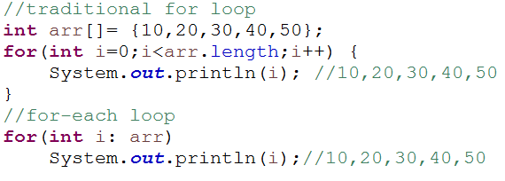
Iteration of an array
To iterate an array, we use for loop or for-each loop also.
The for-each loop is introduced in Java5. It is mainly used to traverse array or collection elements.
The advantage of for-each loop is that it eliminates the possibility of bugs and makes the code more readable.

Slide 31
Module 1 Hands-on

Slide 32
Module 1 Hands-on
Write a program to display table of 10.
Write a program to display Fibonacci series of 10 numbers (0,0,1,1,2,3,5,8,13,21).
Write a program to check whether a given number is odd or even.
Write a program to find largest of two numbers.
Write a java program to create an array of numbers and display the original array in sorted order.
Write a java program to create an array of numbers and display the original array in reverse order.

Slide 33
Module 2: OOP’s programming

Slide 34
Module 2 : OOP’s programming design
Introduce the Module 2 Use case
Class and Object
UML Class Diagram
Class and object creation
this and super keyword
Constructor and Methods
Types of variables
Inheritance
Association, Aggregation and Composition
Polymorphism
Encapsulation
Abstraction
final and static keyword
String and String Methods
StringBuffer Class

Slide 35
Presenting the use case

Slide 36
Bank Customer Management System
Create the UML class diagram for customer.
Display the menu to user.
Create the customer class having fields cutsomerid as int, name as string, mailid as string contact as string and account type as string.
If user enters 1 , please provide the details. On valid entries these details should be added into the array with auto generated customerid.

Slide 37
Bank Customer Management System …
If user enters 2 , display all existing customer details.
If user enters 3 , display the matched customer details.
If user enters 5, exit the application.

Slide 38
Class and Object

Slide 39
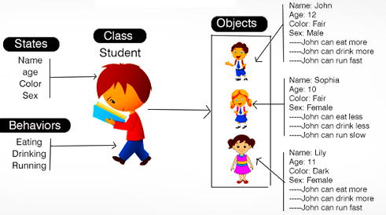
Class and Object
Class is a template or blueprint from which objects are created.
Class is a logical entity. It can’t be physical.
Any entity that has state and behaviour is known as an object. For example: chair, pen, table, keyboard, bike, software etc. It can be physical and logical.
state: represents data (value) of an object.
behavior: represents the behavior (functionality) of an object such as eating, drinking etc.

Slide 40
Constructor and Method

Slide 41
Constructor
Constructors are used to initialize the object’s state. Like methods, a constructor also contains collection of statements(i.e. instructions) that are executed at time of Object creation.
Constructors are used to assign values to the instance variables at the time of object creation, either explicitly done by the programmer or by Java itself (default constructor).
Each time an object is created using new() keyword at least one constructor (it could be default constructor) is invoked to assign initial values to the data members of the same class.
There are two type of constructor in Java:
No-argument constructor : A constructor is called "Default Constructor" when it doesn't have any parameter.
Parametrized constructor : A constructor which has a specific number of parameters is called a parameterized constructor.

Slide 42
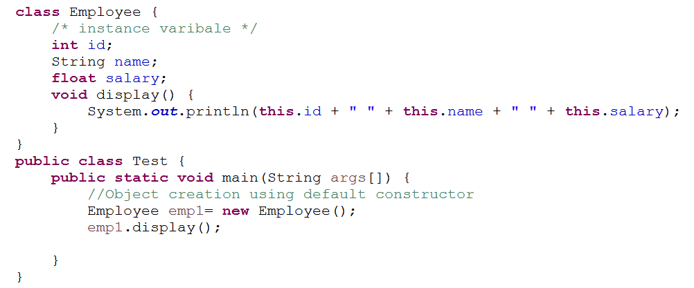

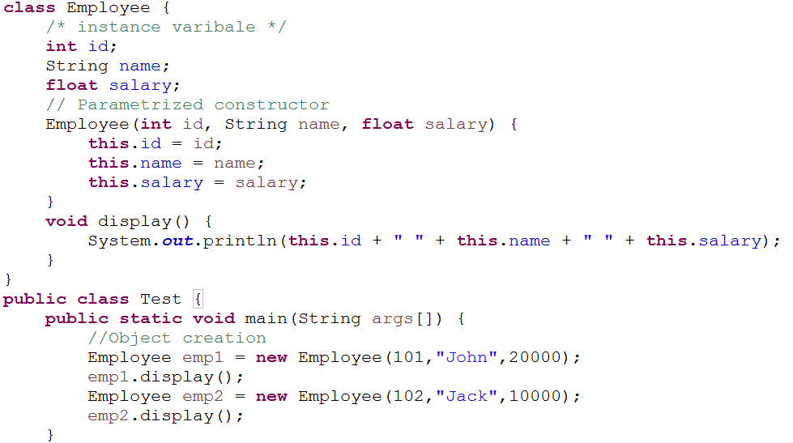

Default and Parametrized Constructor example
Default Constructor Output
Parametrized Constructor Output

Slide 43
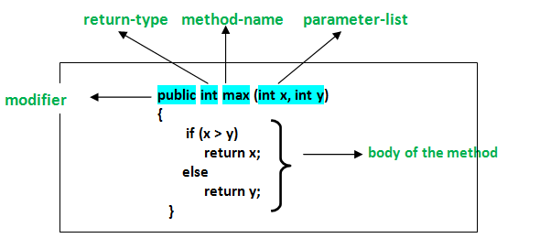
Method in java
A method is a collection of statements that perform some specific task and return result to the caller.
A method can perform some specific task without returning anything.
Methods allow us to reuse the code without retyping the code.

Slide 44
Constructor vs method
Java Constructor | Java Method
A constructor is used to initialize the state of an object. | A method is used to expose the behavior of an object.
A constructor must not have a return type. | A method must have a return type.
The constructor is invoked implicitly. | The method is invoked explicitly.
The Java compiler provides a default constructor if you don't have any constructor in a class. | The method is not provided by the compiler in any case.
The constructor name must be same as the class name. | The method name may or may not be same as the class name.
Constructor overloading is supported. | Method overloading is supported.

Slide 45
this

Slide 46
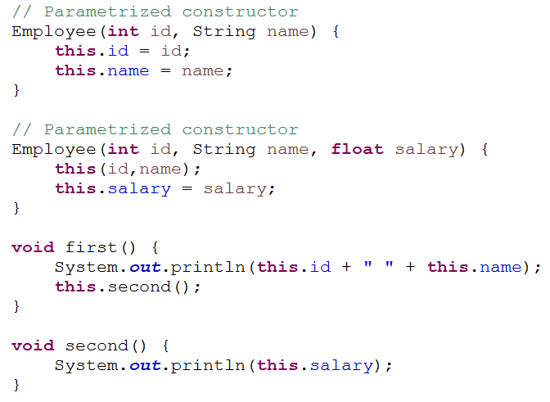
this keyword
There can be a lot of usage of java this keyword. In java, this is a reference variable that refers to the current object.
Here is given the 6 usage of java this keyword.
this can be used to refer current class instance variable.
this() can be used to invoke current class constructor.
this can be used to invoke current class method (implicitly)

Slide 47
Class and Object creation

Slide 48
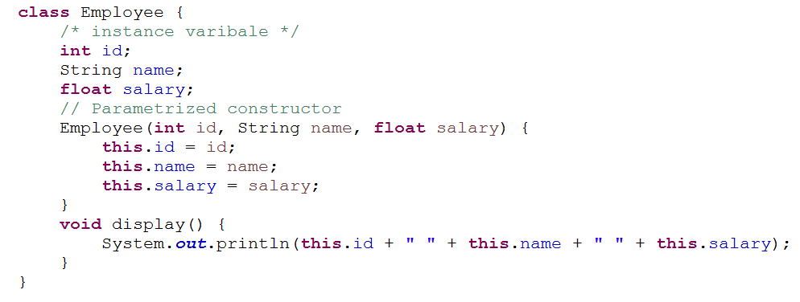
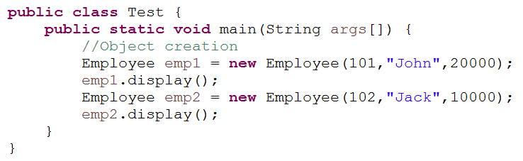
Class and object creation
Output
Employee class
main class creates the objects

Slide 49
How the objects gets stored
emp2
emp1
102
Jack
10000
Objects
Reference variables (to access the objects in heap)
101
John
20000
Stack Memory
Heap Memory

Slide 50
Types of variables

Slide 51
Types of variables
There are three types of variables in Java:
Local Variables : declared inside the method
Instance Variables : declared inside the class but outside the method
Static Variables : known as class variables and they can not be local

Slide 52
Variables
Local Variables :
A variable defined within a block or method or constructor is called local variable. These variables are created when the block in entered or the function is called and destroyed after exiting from the block or when the call returns from the function.
The scope of these variables exists only within the block in which the variable is declared. i.e. we can access these variable only within that block.
Initialization of Local Variable is Mandatory.
Instance Variables:
Instance variables are non-static variables and are declared in a class outside any method, constructor or block. As instance variables are declared in a class, these variables are created when an object of the class is created and destroyed when the object is destroyed.
Unlike local variables, we may use access specifiers for instance variables. If we do not specify any access specifier then the default access specifier will be used.
Initialization of Instance Variable is not Mandatory.
Instance Variable can be accessed only by creating objects.
Static Variables:
We will see in upcoming slides
Notes:
These variables are declared similarly as instance variables, the difference is that static variables are declared using the static keyword within a class outside any method constructor or block.
Unlike instance variables, we can only have one copy of a static variable per class irrespective of how many objects we create.
Static variables are created at start of program execution and destroyed automatically when execution ends.
Initialization of Static Variable is not Mandatory.
If we access the static variable like Instance variable (through object), compiler will show the warning message and it wont halt the program. Compiler will replace the object name to class name automatically.
If we access the static variable without classname, Compiler will automatically append the class name.

Slide 53
UML class diagram

Slide 54
UML Class Diagram
Class Name
Employee
Fields with access indicators and data types
-empid:int
-name:String
-project:String
Methods with access indicators, parameter types and return types
+getName():String
+setName(name:string):void
+getProject():String
Minus (-) for Private
Plus (+) for Public
Pound (#) for Protected
Employee class

Slide 55
How to take user input

Slide 56
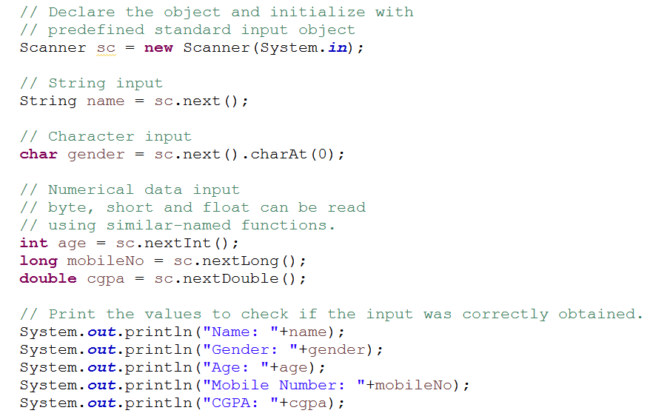
Scanner
Scanner is a class in java.util package used for obtaining the input of the primitive types like int, double, etc. and strings. It is the easiest way to take user input in a Java program.
It has different set of methods for different data types like next(for String), nextInt( for int)

Slide 57
Let us create class and object for the use case

Slide 58
Use Case on class and object creation
Create the UML class diagram for customer class.
Let us create the customer class having fields cutsomerid as int, name as string, mailid as string contact as string and account type as string.
Create 3 customer class objects using parametrized constructor and insert them into an array of customers.
Finally iterate the array and display all customer objects.

Slide 59
Inheritance

Slide 60
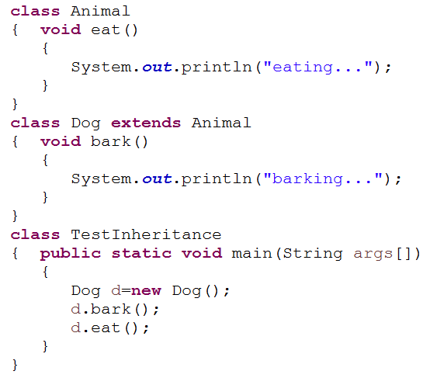

Inheritance
It is the mechanism in java by which one class is allow to inherit the features(fields and methods) of another class. The idea behind inheritance in java is that you can create new classes that are built upon existing classes.
When you inherit from an existing class, you can reuse methods and fields of parent class, and you can add new methods and fields also.
The class which inherits the properties of other is known as subclass (derived class, child class) and the class whose properties are inherited is known as superclass (base class, parent class).
Output

Slide 61
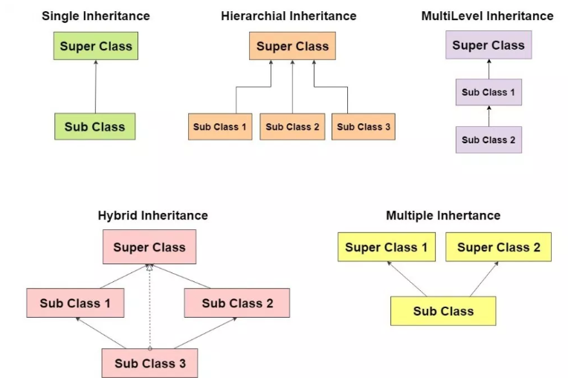
Types of Inheritance
Supported using interfaces

Slide 62
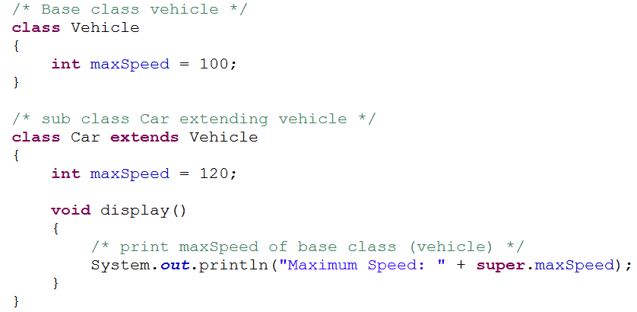
super keyword
The super keyword in java is used to refer parent class data members.
Using “super” keyword, you can access fields, constructor or methods of super class.
Fields
Constructor
Method
Fields
Constructor
Method
super
Parent class
Child class

Slide 63
Association vs Aggregation vs Composition

Slide 64
Association vs Aggregation vs Composition
Association
Association refers to the relationship between multiple objects. It refers to how objects are related to each other and how they are using each other's functionality.
Association can be one-to-one, one-to-many, many-to-one, many-to-many.
Composition and Aggregation are the two forms of association.
Aggregation
Composition

Slide 65
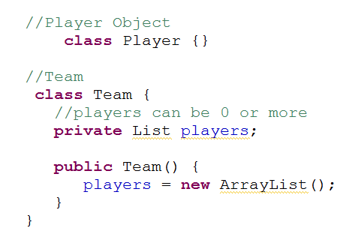
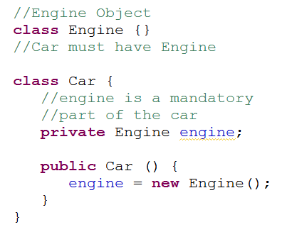
Aggregation vs Composition
Aggregation
Properties | Aggregation | Composition
Dependency | An association is said to be aggregation if both Objects can exist independently. For example, a Team object and a Player object. The team contains multiple players but a player can exist without a team. | An association is said to composition if an Object owns another object and another object cannot exist without the owner object. Example: Car and Engine. Here Car object contains the engine and engine cannot exist without Car.
Type of Relationship | “has-a” | “part-of”
Type of association | Weak association | Strong association
Composition

Slide 66
Encapsulation

Slide 67

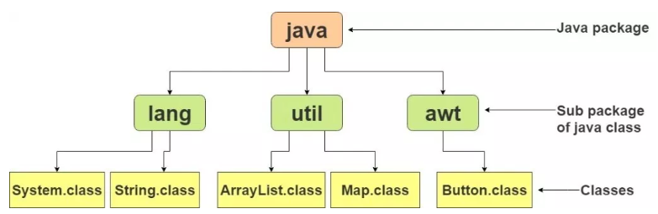
Packages
Package in java as the name suggests is a pack(group) of classes, interfaces and other packages. They can be considered as data encapsulation (or data-hiding). Packages are used for below points:
Preventing naming conflicts. For example there can be two classes with name Employee in two packages, college.staff.cse.Employee and college.staff.ee.Employee
Providing controlled access: protected and default have package level access control. A protected member is accessible by classes in the same package and its subclasses. A default member (without any access specifier) is accessible by classes in the same package only.
There are two types of packages : In-built (java.util, java.lang etc.) and User Defined.
Syntax to access the classes, interfaces inside the package:
In-Built Packages

Slide 68
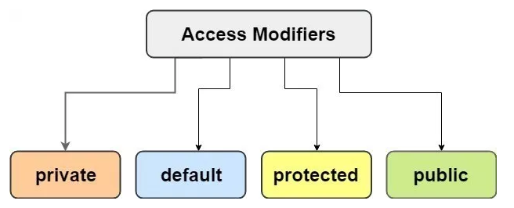
Access Modifiers
Access modifiers in java specify the scope of a class, constructor , variable , method or data member. There are four types of access modifiers available in java:
Private
Default – No keyword required
Protected
Public
Access Modifier | Within class | Within package | Outside package by subclass only | Outside package
Private | Y | N | N | N
Default | Y | Y | N | N
Protected | Y | Y | Y | N
Public | Y | Y | Y | Y

Slide 69
Let us implement encapsulation

Slide 70
Encapsulation implementation
Make all the customer fields as private. Write getter and setters for customer class for all fields.
Create customer objects using setter methods.
Display the array of customer objects.

Slide 71
Abstraction

Slide 72

Abstraction
Data Abstraction can be defined as the process of identifying only the required characteristics of an object ignoring the irrelevant details. Example: An ATM machine.
Abstraction can be achieved in two ways:
Abstract Class
Interface

Slide 73
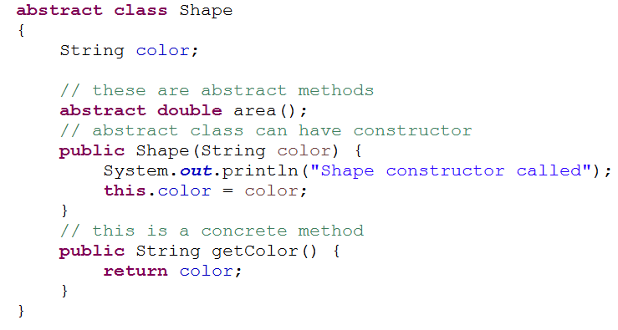
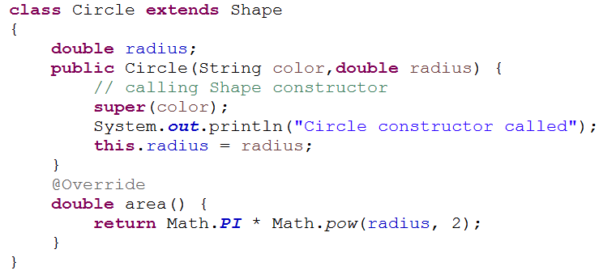
Abstract Class
An abstract class is a class that is declared with abstract keyword.
An abstract class can never be instantiated. If a class is declared as abstract then the sole purpose is for the class to be extended.
A class cannot be both abstract and final. (since a final class cannot be extended).
An abstract method is a method that is declared without an implementation.
Notes:
An abstract class may or may not have all abstract methods. Some of them can be concrete methods
An abstract method is a method that is declared without an implementation.
A method defined abstract must always be redefined in the subclass, thus making overriding compulsory OR either make subclass itself abstract.
Any class that contains one or more abstract methods must also be declared with abstract keyword.
There can be no object of an abstract class. That is, an abstract class can not be directly instantiated with the new operator.
An abstract class can have parametrized constructors and default constructor is always present in an abstract class.

Slide 74
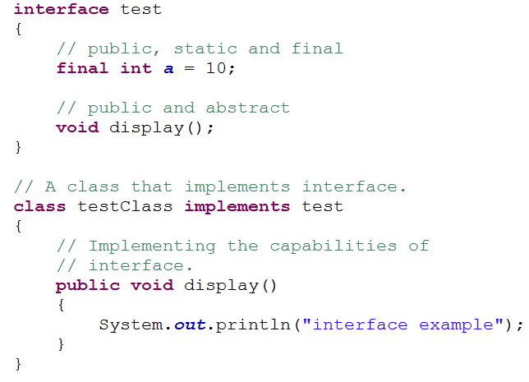
Interface
Like a class, an interface can have methods and variables.
All the methods are public and abstract. And all the fields are public, static, and final.
Interfaces specify what a class must do and not how. It is the blueprint of the class.
If a class implements an interface and does not provide method bodies for all functions specified in the interface, then class must be declared abstract.
We can’t create instance(interface can’t be instantiated) of interface but we can make reference of it that refers to the Object of its implementing class.
A class can implement more than one interface.
Notes:
New features added in interfaces in JDK 9 From Java 9 onwards, interfaces can contain following also
Static methods
Private methods
Private Static methods

Slide 75
Polymorphism

Slide 76
Polymorphism
Polymorphism refers to the ability of OOPs programming languages to differentiate between entities with the same name efficiently. It can be achieved in two ways.
Static binding is done during compile-time while dynamic binding is done during run-time.
private, final , static methods and variables use static binding and bonded by compiler while overridden methods are bonded during runtime based upon type of runtime object
Polymorphism
Compile Time Polymorphism
(Static or early binding)
Runtime Polymorphism
(Dynamic or late binding)

Slide 77
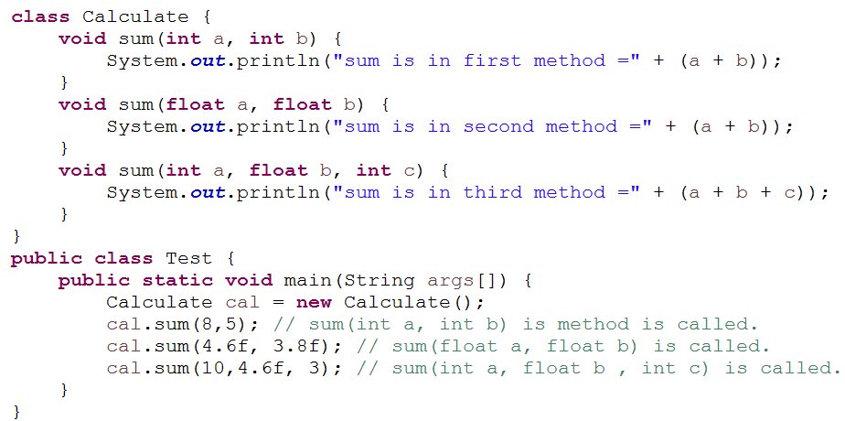

Compile Time Polymorphism (Method Overloading)
Method overloading is one of the ways in which Java supports Compile Time Polymorphism.
Two or more method in a class have same name but different parameters.
Overloading always occur in the same class(unlike method overriding).
Method overloading can be done by changing number of arguments or by changing the data type of arguments.
If two or more method have same name and same parameter list but differs in return type are not said to be overloaded method
Overloaded method can have different access modifiers.
Code Snippet
Output

Slide 78
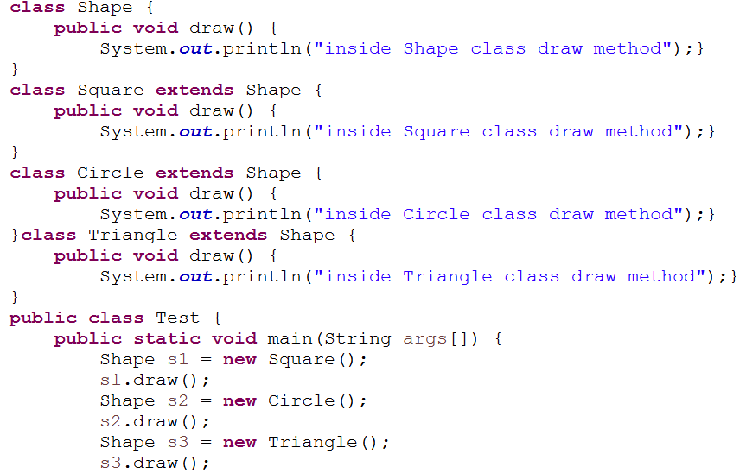
Runtime Polymorphism (Method Overriding )
Method overriding is one of the ways in which Java supports Runtime Polymorphism. It is the mechanism by which a call to an overridden method is resolved at run time, rather than compile time.
When an overridden method is called through a superclass reference, Java determines which version(superclass/subclasses) of that method is to be executed based upon the type of the object being referred to at the time the call occurs. Thus, this determination is made at run time.
At run-time, it depends on the type of the object being referred to (not the type of the reference variable) that determines which version of an overridden method will be executed
A superclass reference variable can refer to a subclass object. This is also known as upcasting. Java uses this fact to resolve calls to overridden methods at run time.

Slide 79

Method Overriding Diagram
draw()
Shape class
extends
extends
extends
draw()
draw()
draw()
Code Snippet
Square class
Circle class
Triangle class
Output

Slide 80
Method Overloading vs Method Overriding
Method Overloading | Method Overriding
Parameter must be different and name must be same. | Both name and parameter must be same.
Compile time polymorphism. | Runtime polymorphism.
Increase readability of code. | Increase reusability of code.
Access specifier can be changed. | Access specifier cannot be more restrictive than original method(can be less restrictive).

Slide 81
Keywords: final, static

Slide 82


final keyword
The final keyword in java is used to restrict the user. The java final keyword can be used in many context. Final can be:
final variable
Stop value change
final method
Prevent method overriding
final class
Prevent inheritance

Slide 83
static keyword
The static keyword in Java is used for memory management mainly. We can apply java static keyword with variables, methods, blocks and nested class. The static keyword belongs to the class than an instance of the class.
The static can be:
Variable (also known as a class variable) : shared to all objects
Method (also known as a class method) : no need to create object to call method and static methods can not be overridden because static method is bound to class whereas method overriding is associated with object i.e. at runtime.
Block : used to initialize the static data member and executed before the main method gets executed.

Slide 84

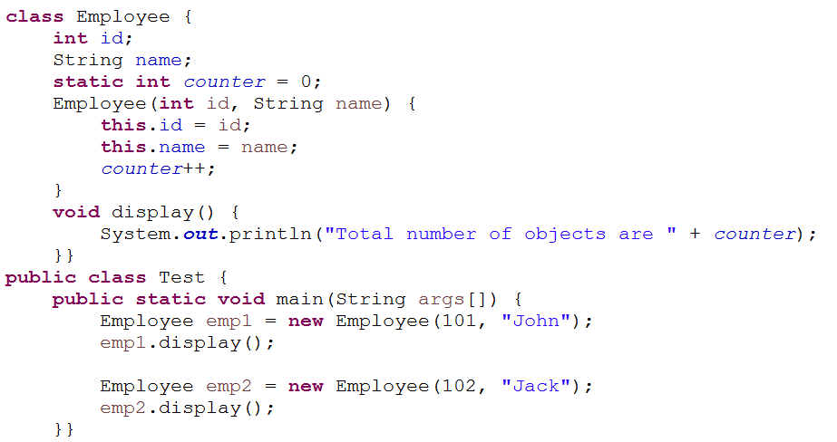

static variable
static variable (class variable)
Common property for all objects
Output
Notes:
These variables are declared similarly as instance variables, the difference is that static variables are declared using the static keyword within a class outside any method constructor or block.
Unlike instance variables, we can only have one copy of a static variable per class irrespective of how many objects we create.
Static variables are created at start of program execution and destroyed automatically when execution ends.
Initialization of Static Variable is not Mandatory.
If we access the static variable like Instance variable (through object), compiler will show the warning message and it wont halt the program. Compiler will replace the object name to class name automatically.
If we access the static variable without classname, Compiler will automatically append the class name.

Slide 85
How static variable gets stored in heap
101
John
Counter=2 (initially 0 , then to 1 and finally to 2)
Object1
102
Jack
Object2
Heap memory

Slide 86
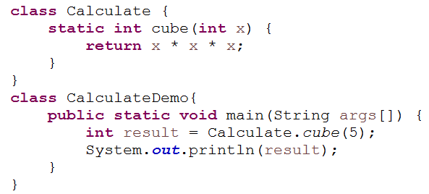
static method
static method (class method)
No need to create object to call static method

Slide 87
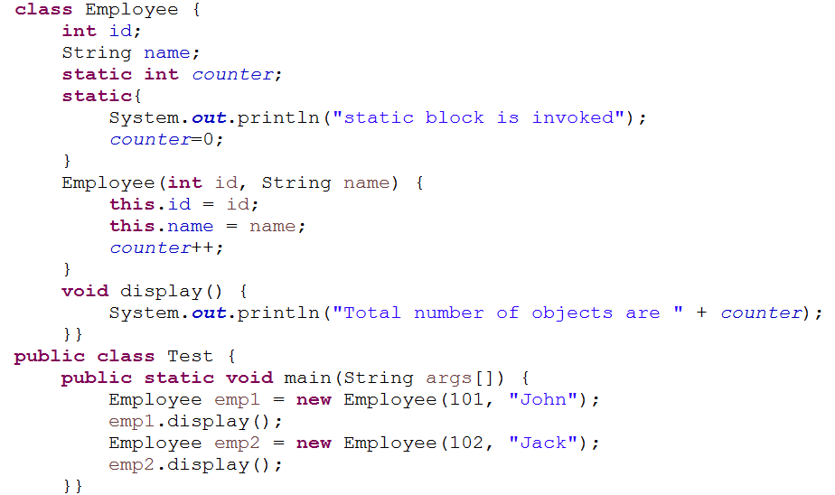
static block
Initialize the static members and executed before main method
static block

Slide 88
String

Slide 89
String
String is an object that represents a sequence of characters. The java.lang.String class is used to create a string object. String objects are immutable (Once you create you can not change it.)
There are two ways to create String object:
By string literal:
String s=“Welcome”; (creates one string in constant pool area if not found else it will point to same string )
By new keyword:
String s= new String(“Welcome”); (creates one string in constant pool area and one object in heap area)

Slide 90
How String gets stored
String s1= “A”
String s2= “A”
s1.equals(s2)=>true
s1==s2=> true
s3.equals(s4)=>true
s3==s4=> false
//equals method
compares the
content of strings
whereas == compares
the memory
references of variables
A
String s3= new String(“A”);
A
b
String s4= new String(“A”);
A
a
String s5=“a”;
Constant pool area
b
String s6=new String(“b”);
Heap area

Slide 91
String Methods
Method | Description | Code
char charAt(int index) | returns char value for the particular index | “company”.charAt(2) =>”m”
int length() | returns string length | “company”.length() => 7
String substring(int beginIndex) | returns substring for given begin index. | “company”.substring(2)=> “mpany”
String substring(int beginIndex, int endIndex) | returns substring for given begin index and end index. | “company”.substring(2,5)=> ”mpa”
boolean contains(CharSequence s) | returns true or false after matching the sequence of char value. | “company”.contains(“mp”)=> true
static String equalsIgnoreCase(String another) | compares another string. It doesn't check case. | “company”.equalsIgnoreCase(“COMpANy”)=> true
boolean equals(Object another) | checks the equality of string with the given object. | “company”.equals(“Company”)=>false

Slide 92
String Methods cont…
Method | Description | code
boolean isEmpty() | checks if string is empty. | “”.isEmpty()=> true
String concat(String str) | concatenates the specified string. | “company”.concat(“ name”)=> “company name”
String replace(char old, char new) | replaces all occurrences of the specified char value. | “company”.replace(“com”,”tom”)=> “tompany”
int indexOf(String str) | returns the specified char value index. | “company”.indexOf(“m”)=>2
String toLowerCase() | returns a string in lowercase. | “company”.toLowerCase()=>”company”
String toUpperCase() | returns a string in uppercase. | “company”.toUpperCase()=>”COMPANY”
String trim() | removes beginning and ending spaces of this string. | “ company”.trim() =>”company”
boolean matches(String regex) | Returns true if it matches with regex | “company”.matches(“[a-z]+”) => true
String[] split(String str) | Returns an array of strings after match of given expression | “company:name”.split(“:”)=>[“company”,”name”]

Slide 93
Regular Expression Pattern and Quantifiers
Pattern | Description
[0-9] | Find any of the digits between the brackets
[A-Z] | Find any of the characters (capital letters) between the brackets
[0-9a-z] | Find any of the alphanumeric characters between the brackets
(x|y) | Find any of the alternatives separated with |
Example 1: To check name field can only have alphabets.
The pattern can be :
/^[A-Za-z]+$/ or
“^[A-Za-z]+$”
/^[a-z]+$/i (case insensitive)
Example 2: To check contact field can only have numbers of 10 digits.
The pattern can be :
/^[7-9]{1}[0-9]{9}$/ or
“^[7-9]{1}[0-9]{9}$”
Quantifier | Description
[0-9]+ | Matches any string that contains at least one digit
[0-9]* | Matches any string that contains zero or more occurrences of n
[0-9]? | Matches any string that contains zero or one occurrences of n
[0-9]{3} | Matches any string that contains exactly 3 occurrences of n
[0,9]{3,6} | Matches any string that contains minimum 3 occurrences of n and max 6 occurrences

Slide 94

StringBuffer
A string buffer is like a String, but mutable i.e. can be modified.
It contains some particular sequence of characters, but the length and content of the sequence can be changed through in-built methods.
Every string buffer has a capacity , the default capacity is 16 chars.

Slide 95
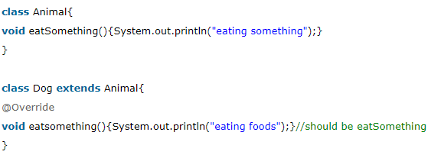
Annotations
Java Annotation is a tag that represents the metadata i.e. attached with class, interface, methods or fields to indicate some additional information which can be used by java compiler and JVM.
Annotations in java are used to provide additional information.
Built-In Java Annotations used in java code
@Override :
@SuppressWarnings
@Deprecated

Slide 96
Annotations in detail
@Override annotation assures that the subclass method is overriding the parent class method. If it is not so, compile time error occurs. Sometimes, we does the silly mistake such as spelling mistakes etc. So, it is better to mark @Override annotation that provides assurance that method is overridden.
@SuppressWarnings annotation: is used to suppress warnings issued by the compiler.
@Deprecated annotation : It marks that this method is deprecated so compiler prints warning. It informs user that it may be removed in the future versions. So, it is better not to use such methods.

Slide 97
Let us work on use case

Slide 98
Bank Customer Management System
Display the menu to user.
If user enters 1 , please provide the details. On valid entries these details should be added into the array with auto generated customerid.

Slide 99
Bank Customer Management System …
If user enters 2 , display all existing customer details.
If user enters 3 , display the matched customer details.
If user enters 5, exit the application.

Slide 100
Exception Handling

Slide 101
Module 3 : Exception Handling Design
Introduce the Module 3 Use Case
What is Exception
Common Scenarios of Exception
try, catch and finally keyword
Types of Exceptions
Hierarchy of Exception Classes
Exception Propagation
Multi catch block
throw vs throws
Custom exceptions

Slide 102
Presenting the use case

Slide 103

Bank Customer Management System
While adding the customer, make sure admin provides valid entries like name can only have alphabets, email should be valid one , contact no should have 10 digits and account type can be either Savings or current.
If any one of the condition fails, the customer should not be added in the array and display the appropriate error message using custom exceptions.
Only for valid entries, it should be added in array.
While taking the input from the user to search a customer using customer id, make sure it has to be an integer else display the appropriate error message using custom exceptions.

Slide 104
What is an Exception

Slide 105
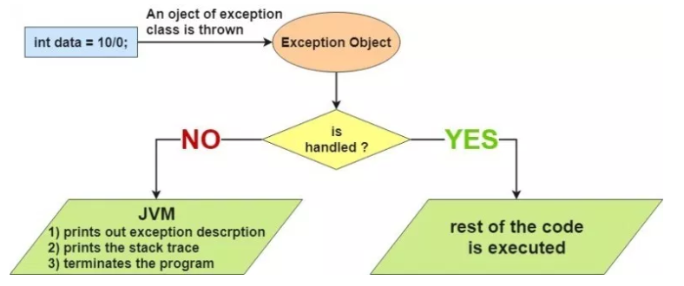
What is Exception and Exception Handling
What is an Exception?
An exception is an unwanted or unexpected event, which occurs during the execution of a program i.e. at run time, that disrupts the normal flow of the program’s instructions. It is an object which is thrown at runtime.
What is exception handling?
Exception Handling is a mechanism to handle runtime errors such as Arithmetic, ClassNotFound, IO, SQL etc. So it is a way to provide a proper structure when an exception occurs such that the program execution is not affected.
Exception Handling is mainly used to handle the checked exceptions. If there occurs any unchecked exception such as NullPointerException, it is programmer’s fault that he is not performing check up before the code being used.
Notes:
https://simplesnippets.tech/exception-handling-in-java-part-1/

Slide 106

Common Scenarios of exceptions:
Scenario where ArithmeticException occurs : If we divide any number by zero, there occurs an ArithmeticException.
Scenario where NullPointerException occurs : If we have null value in any variable, performing any operation by the variable occurs a NullPointerException.
Scenario where NumberFormatException occurs: The wrong formatting of any value, may occur NumberFormatException.
Scenario where ArrayIndexOutOfBoundsException occurs: If you are inserting any value in the wrong index, it would result ArrayIndexOutOfBoundsException.

Slide 107
Hierarchy of Java Exception classes
Object
Throwable
Exception
Error
Checked Exception
Unchecked Exception
StackOverFlowError
IOException
ArithmeticException
VirtualMachineError
SQLException
NullPointerException
OutOfMemoryError
ClassNotFoundException
IndexOutOfBoundsException
Notes:
All exception and errors types are sub classes of class Throwable, which is base class of hierarchy.One branch is headed by Exception. This class is used for exceptional conditions that user programs should catch. NullPointerException is an example of such an exception.Another branch,Error are used by the Java run-time system(JVM) to indicate errors having to do with the run-time environment itself(JRE). StackOverflowError is an example of such an error.
There are basically 3 types of exceptions/abnormal conditions –
Checked Exceptions
Unchecked Exceptions
Errors

Slide 108
Types of Exceptions
There are basically 3 types of exceptions/abnormal conditions –
Checked Exceptions: The classes that extend Throwable class except RuntimeException and Error are known as checked exceptions e.g.IOException, SQLException etc. Checked exceptions are checked at compile-time.
Unchecked Exceptions: The classes that extend RuntimeException are known as unchecked exceptions e.g. ArithmeticException, NullPointerException, ArrayIndexOutOfBoundsException etc. Unchecked exceptions are not checked at compile-time rather they are checked at runtime.
Errors: Error is irrecoverable e.g. OutOfMemoryError, VirtualMachineError, AssertionError etc.
Notes:
All exception and errors types are sub classes of class Throwable, which is base class of hierarchy.One branch is headed by Exception. This class is used for exceptional conditions that user programs should catch. NullPointerException is an example of such an exception.Another branch,Error are used by the Java run-time system(JVM) to indicate errors having to do with the run-time environment itself(JRE). StackOverflowError is an example of such an error.
There are basically 3 types of exceptions/abnormal conditions –
Checked Exceptions
Unchecked Exceptions
Errors

Slide 109
Java Exception Handling Keywords
There are 5 keywords used in java exception handling.
try
catch
finally
throw
throws

Slide 110
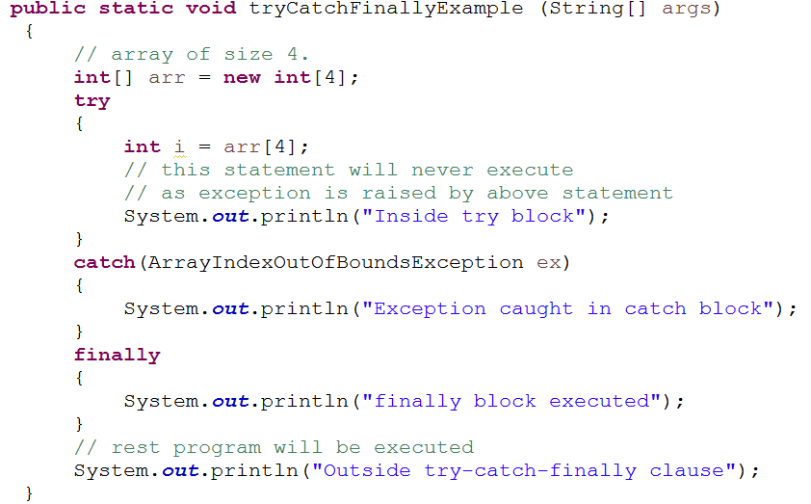

try, catch and finally Syntax
Output
Code Snippet

Slide 111
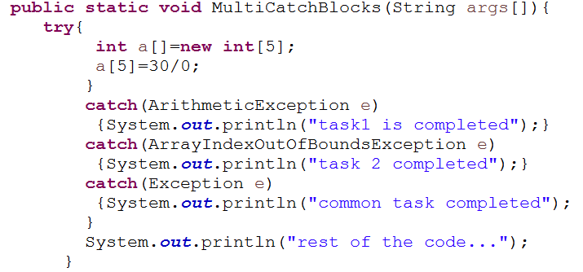

Multi Catch Block
Output
Code Snippet
Notes:
All catch blocks must be ordered from most specific to most general i.e. catch for ArithmeticException must come before catch for Exception.
Some Important points to remember –
If you don’t handle exception, before terminating the program, JVM executes finally block(if any).
For each try block there can be zero or more catch blocks, but only one finally block.
At a time only one Exception is occurred and at a time only one catch block is executed.
All catch blocks must be ordered from most specific to most general i.e. catch for ArithmeticException must come before catch for Exception.

Slide 112

Exception Propagation
An exception is first thrown from the top of the stack and if it is not caught, it drops down the call stack to the previous method, If not caught there, the exception again drops down to the previous method, and so on until they are caught or until they reach the very bottom of the call stack. This is called exception propagation.
It happens only for checked exception.
Notes:
https://simplesnippets.tech/throw-throws-in-java-exception-handling-part-3/

Slide 113

Throw and Throws Keyword
The Java throw keyword is used to explicitly throw an exception. The throw keyword is mainly used to throw custom exception (Checked).
The Java throws keyword is used to declare an exception. It gives an information to the programmer that there may occur an exception so it is better for the programmer to provide the exception handling code so that normal flow can be maintained.

Slide 114
Throw vs Throws
No. | throw | throws
1. | Java throw keyword is used to explicitly throw an exception. | Java throws keyword is used to declare an exception.
2. | Throw is followed by an instance. | Throws is followed by class.
3. | Throw is used within the method. | Throws is used with the method signature.
4. | You cannot throw multiple exceptions. | You can declare multiple exceptions e.g. public void method()throws IOException,SQLException.

Slide 115


Custom Exception
Custom Exception
Create a new class whose name should endwith Exception like InvalidAgeException. This is a convention to differentiate an exception class from regular ones.
Make the class extends one of the exceptions which are subtypes of the java.lang.Exception class.
Generally, a custom exception class always extends directly from the Exception class so that you will make it a checked exception.
Create a constructor with a String parameter which is the detail message of the exception. In this constructor, simply call the super constructor and pass the message.
Code Snippet
Output

Slide 116
Let us work on use case

Slide 117
Bank Customer Management System
While adding the customer, make sure admin provides valid entries like name can only have alphabets, email should be valid one , contact no should have 10 digits and account type can be either Savings or current.
If any one of the condition fails, the customer should not be added in the array and display the appropriate error message using custom exceptions.
Only for valid entries, it should be added in array.
While taking the input from the user to search a customer using customer id, make sure it has to be an integer else display the appropriate error message using custom exceptions.

Slide 118
Collection Framework

Slide 119
Module 4 : Collection Framework
Introduce the Module 4 Use Case
Wrapper Class
Hierarchy of Collection Framework
Overview of Collection Framework
Collection
List
Set
Map

Slide 120
Introducing the use case

Slide 121
Bank Customer Management System
Convert array into ArrayList and make the corresponding code changes.
If user enters 4 , delete the matched customer details.

Slide 122
Wrapper Class

Slide 123


Wrapper Class
Wrapper classes in java provides the mechanism to convert primitive into object and object into primitive.
Since J2SE 5.0, autoboxing and unboxing feature converts primitive into object and object into primitive automatically. The automatic conversion of primitive into object is known as autoboxing and vice-versa unboxing.
Primitive Data Types
Wrapper Class

Slide 124
Collection Framework

Slide 125
Overview of Collection Framework
The Java collections framework is a set of classes and interfaces that implement commonly reusable collection data structures.
Although referred to as a framework, it works in a manner of a library. The collections framework provides both interfaces that define various collections and classes that implement them.
Java Collection framework provides many interfaces (Set, List, Queue, Deque) and classes (ArrayList, Vector, LinkedList, PriorityQueue, HashSet, LinkedHashSet, TreeSet).

Slide 126
Collection Framework Hierarchy
Collection
Set
List
Queue
Map
ArrayList
PriorityQueue
HashMap
HashSet
LinkedHashSet
LinkedList
Deque
LinkedHashMap
SortedSet
Vector
ArrayQueue
SortedMap
TreeSet
TreeMap
Interface
Class
extends
implements

Slide 127
Collection
The Collection interface is the foundation upon which the collections framework is built. It declares the core methods that all collections will have.
Some of the methods of Collection interface are Boolean add ( Object obj), Boolean addAll ( Collection c), void clear(), etc. which are implemented by all the subclasses of Collection interface.
Method | Description | Code
boolean add(Object obj) | Adds obj to the invoking collection. Returns true if obj was added to the collection. Returns false if the collection does not allow duplicates. | Collection collection = new HashSet(); collection.add(“value”);
boolean contains(Object obj) | Returns true if obj is an element of the invoking collection. Otherwise, returns false. | collection.contains(“test”);=>false
boolean remove(Object obj) | Removes one instance of obj from the invoking collection. Returns true if the element was removed. Otherwise, returns false. | collection.remove(“value”); => value
int size( ) | Returns the number of elements held in the invoking collection. | collection.size() => 0
boolean isEmpty( ) | Returns true if the invoking collection is empty. Otherwise, returns false. | Collection.isEmpty() => true
Iterator iterator( ) | Returns an iterator for the invoking collection. | Collection.iterator()

Slide 128


List Interface
A List is an ordered Collection (sometimes called a sequence). Lists may contain duplicate elements.
List interface is implemented by the classes ArrayList, LinkedList, Vector, and Stack.
ArrayList: Implemented as a single linked list.
LinkedList: Implemented as a double linked list.
Vector: Almost identical to ArrayList, and the difference is that Vector is synchronized. Because of this, it has an overhead than ArrayList.
Code Snippet
Output
Notes:
In addition to the operations inherited from Collection, the List interface includes operations for the following:
Positional access — manipulates elements based on their numerical position in the list. This includes methods such as get, set, add, addAll, and remove.
Search — searches for a specified object in the list and returns its numerical position. Search methods include indexOf and lastIndexOf.
Iteration — extends Iterator semantics to take advantage of the list's sequential nature. The listIterator methods provide this behavior.

Slide 129




Set Interface
A Set is an unordered Collection that cannot contain duplicate elements.
Set interface is implemented by the classes HashSet, LinkedHashSet and TreeSet.
HashSet: Unordered Collection with no duplicates
LinkedHashSet: Ordered Collection with no duplicates
TreeSet: Sorted Collection with no duplicates
Code Snippet
HashSet Output
LinkedHashSet Output
TreeSet Output

Slide 130




Map Interface
A Map is an object which maps keys to values. A map cannot contain duplicate keys and each key can map to at most one value
Map interface is implemented by the classes HashMap, LinkedHashMap and TreeMap.
HashMap: Unordered with no duplicate keys.
LinkedHashMap: Ordered with no duplicate keys.
TreeMap: Sorted keys with no duplicate keys
Code Snippet
HashMap Output
LinkedHashMap Output
TreeMap Output

Slide 131
Let us work on use case

Slide 132
Bank Customer Management System
Convert array into ArrayList and make the corresponding code changes.
If user enters 4 , delete the matched customer details.

Slide 133
JDBC

Slide 134
Module 5 : JDBC
Introduce the Module 5 Use case
What is JDBC
Core JDBC Components
Connection
Steps for JDBC program
JDBC Driver and Type of JDBC Drivers
Statement
PreparedStatement
ResultSet

Slide 135
Introducing the use case

Slide 136
Bank Customer Management System.
Persist the customer data into tables using JDBC.
Save the customer details into database as and when new customer gets added.
Delete the customer details from database as and when admin requests to delete any customer.

Slide 137

JDBC
The Java JDBC API (Java Database Connectivity) enables Java applications to connect to relational databases like MySQL, PostgreSQL, MS SQL Server, Oracle, H2 Database etc. The JDBC API makes it possible to query and update relational databases, as well as call stored procedures, and obtain meta data about the database. The Java JDBC API is part of the core Java SE SDK, making JDBC available to all Java applications that want to use it.
Here is a list of popular open source and commercial relational databases which have JDBC drivers so you can use them from Java:
H2Database
MariaDB
PostgreSQL
My SQL
Derby
Microsoft SQL Server
Oracle
PostgreSQL driver
Java Application
JDBC
API
Oracle driver
Sybase driver

Slide 138
Core JDBC Components
The JDBC API consists of the following core parts:
JDBC Drivers: A JDBC driver is a collection of Java classes that enables you to connect to a certain database. For instance, MySQL will have its own JDBC driver. A JDBC driver implements a lot of the JDBC interfaces. When your code uses a given JDBC driver, it actually just uses the standard JDBC interfaces. The concrete JDBC driver used is hidden behind the JDBC interfaces. Thus you can plugin a new JDBC driver without your code noticing it.
Connections: Once a JDBC driver is loaded and initialized, you need to connect to the database. You do so by obtaining a connection to the database via the JDBC API and the loaded driver. All communication with the database happens via a connection. An application can have more than one connection open to a database at a time. This is actually very common.
Statements: A statement is what you use to execute queries and updates against the database. There are a few different types of statements like PreparedStatement, CallableStatement you can use. Each statement corresponds to a single query or update.
Result Sets : When you perform a query against the database you get back a ResultSet . You can then traverse this ResultSet to read the result of the query.

Slide 139


JDBC Steps
Register Driver
Get Connection
Create Statement
Execute Query
Close connection

Slide 140
Connection
A Connection is the session between java application and database. The Connection interface is a factory of Statement, PreparedStatement.
Commonly Used methods are:
public Statement createStatement(): creates a statement object that can be used to execute SQL queries.
public PrepareStatement prepareSatement(String sql): creates a prepare statement object that can be used to execute SQL queries.
public void setAutoCommit(boolean status): is used to set the commit status.By default it is true.
public void commit(): saves the changes made since the previous commit/rollback permanent.
public void rollback(): Drops all changes made since the previous commit/rollback.
public void close(): closes the connection and Releases a JDBC resources immediately.

Slide 141

Statement
The Statement interface provides methods to execute queries with the database. The statement interface is a factory of ResultSet i.e. it provides factory method to get the object of ResultSet.
The commonly used methods are:
public ResultSet executeQuery(String sql): is used to execute SELECT query. It returns the object of ResultSet.
public int executeUpdate(String sql): is used to execute specified query, it may be insert, update, delete etc.
public boolean execute(String sql): is used to execute queries that may return multiple results.

Slide 142

PreparedStatement
The PreparedStatement interface is a subinterface of Statement. It is used to execute parameterized query.
The performance of the application will be faster if you use PreparedStatement interface because query is compiled only once.
The commonly used methods are:
public ResultSet executeQuery(): is used to execute SELECT query. It returns the object of ResultSet.
public int executeUpdate(): is used to execute specified query, it may be insert, update, delete etc.
public boolean execute(): is used to execute queries that may return multiple results.

Slide 143

ResultSet
The object of ResultSet maintains a cursor pointing to a row of a table. Initially, cursor points to before the first row.
The commonly used methods are:
public boolean next(): is used to move the cursor to the one row next from the current position.
public boolean previous(): is used to move the cursor to the one row previous from the current position.
public int getInt(int columnIndex): is used to return the data of specified column index of the current row as int.
public int getInt(String columnName): is used to return the data of specified column name of the current row as int.

Slide 144
Let us work on use case

Slide 145
Bank Customer Management System
Persist the customer data into table using JDBC.
Save the customer details into database as and when new customer gets added.
Delete the customer details from database as and when admin requests to delete any customer.

Slide 146
Thank You

Slide 147
Appendix

Slide 148




Types of JDBC Driver
There are four different JDBC driver types. Today most of the drivers are Type 4. These driver types are:
Type 1: JDBC-ODBC bridge JDBC driver
Type 2: Java + Native code JDBC driver
Type 3: All Java + Middleware translation JDBC driver
Type 4: All Java JDBC driver.
Notes:
http://tutorials.jenkov.com/jdbc/driver-types.html

