Slide 1
B.TECH IN CSE
“Supply Chain Delivery Risk Prediction”
RAI TECHNOLOGY UNIVERSITY
BANGALURU
Presented By: Submitted To:
KAVITA P Mr. Abhishek S
RTU24101CS050 Project Guide

Slide 2
CONTENT
Introduction
Problem Statement
Literature Survey
Proposed Solution and Methodology
Solution Development
Scalability& Performance analysis
Conclusion

Slide 3
INTRODUCTION
Reliable delivery performance is central to business operations across e-commerce, logistics, and warehousing. Late deliveries erode customer satisfaction, increase operational cost, and force businesses into reactive damage control after the fact. As order volumes grow and supply chains span multiple regions, shipping modes, and warehouses, predicting delivery risk before an order is dispatched becomes essential for maintaining customer trust and controlling cost.

Slide 4
PROBLEM STATEMENT
Conventional delivery-tracking systems often flag risk only after a delay has already occurred, leaving little room for preventive action. These systems are reactive by design: alerts arrive once the delay is already in progress, corrective action comes too late, and staff rely on manual judgement and informal rules of thumb rather than data-driven prediction. As a result, the customer is typically informed only after the delivery promise has already been broken.

Slide 5
LITERATURE SURVEY
Ensemble Methods: Bagging
Breiman (2001) introduced Random Forests, an ensemble of decision trees trained on bootstrapped samples with random feature subsets, showing that averaging many de-correlated trees reduces variance and improves generalization compared to a single decision tree.
Ensemble Methods: Boosting
Friedman (2001) proposed Gradient Boosting, which builds trees sequentially, with each new tree fitted to the residual errors of the previous ensemble, often achieving higher accuracy at the cost of longer training time and greater sensitivity to overfitting on small datasets.

Slide 6
PROPOSED SOLOUTION AND METHODOLOGY
Data preprocessing and feature preparation.
Predict late-delivery risk before dispatch.
Compare three ML models.
Evaluate model performance.
Use the best model for prediction.

Slide 7
SOLUTION DEVELOPMENT
The solution was implemented in Python using scikit-learn pipelines, so that identical preprocessing is applied consistently across training, testing, and future predictions. The core stages are data loading, preprocessing, model training for all three algorithms, and evaluation.

Slide 8
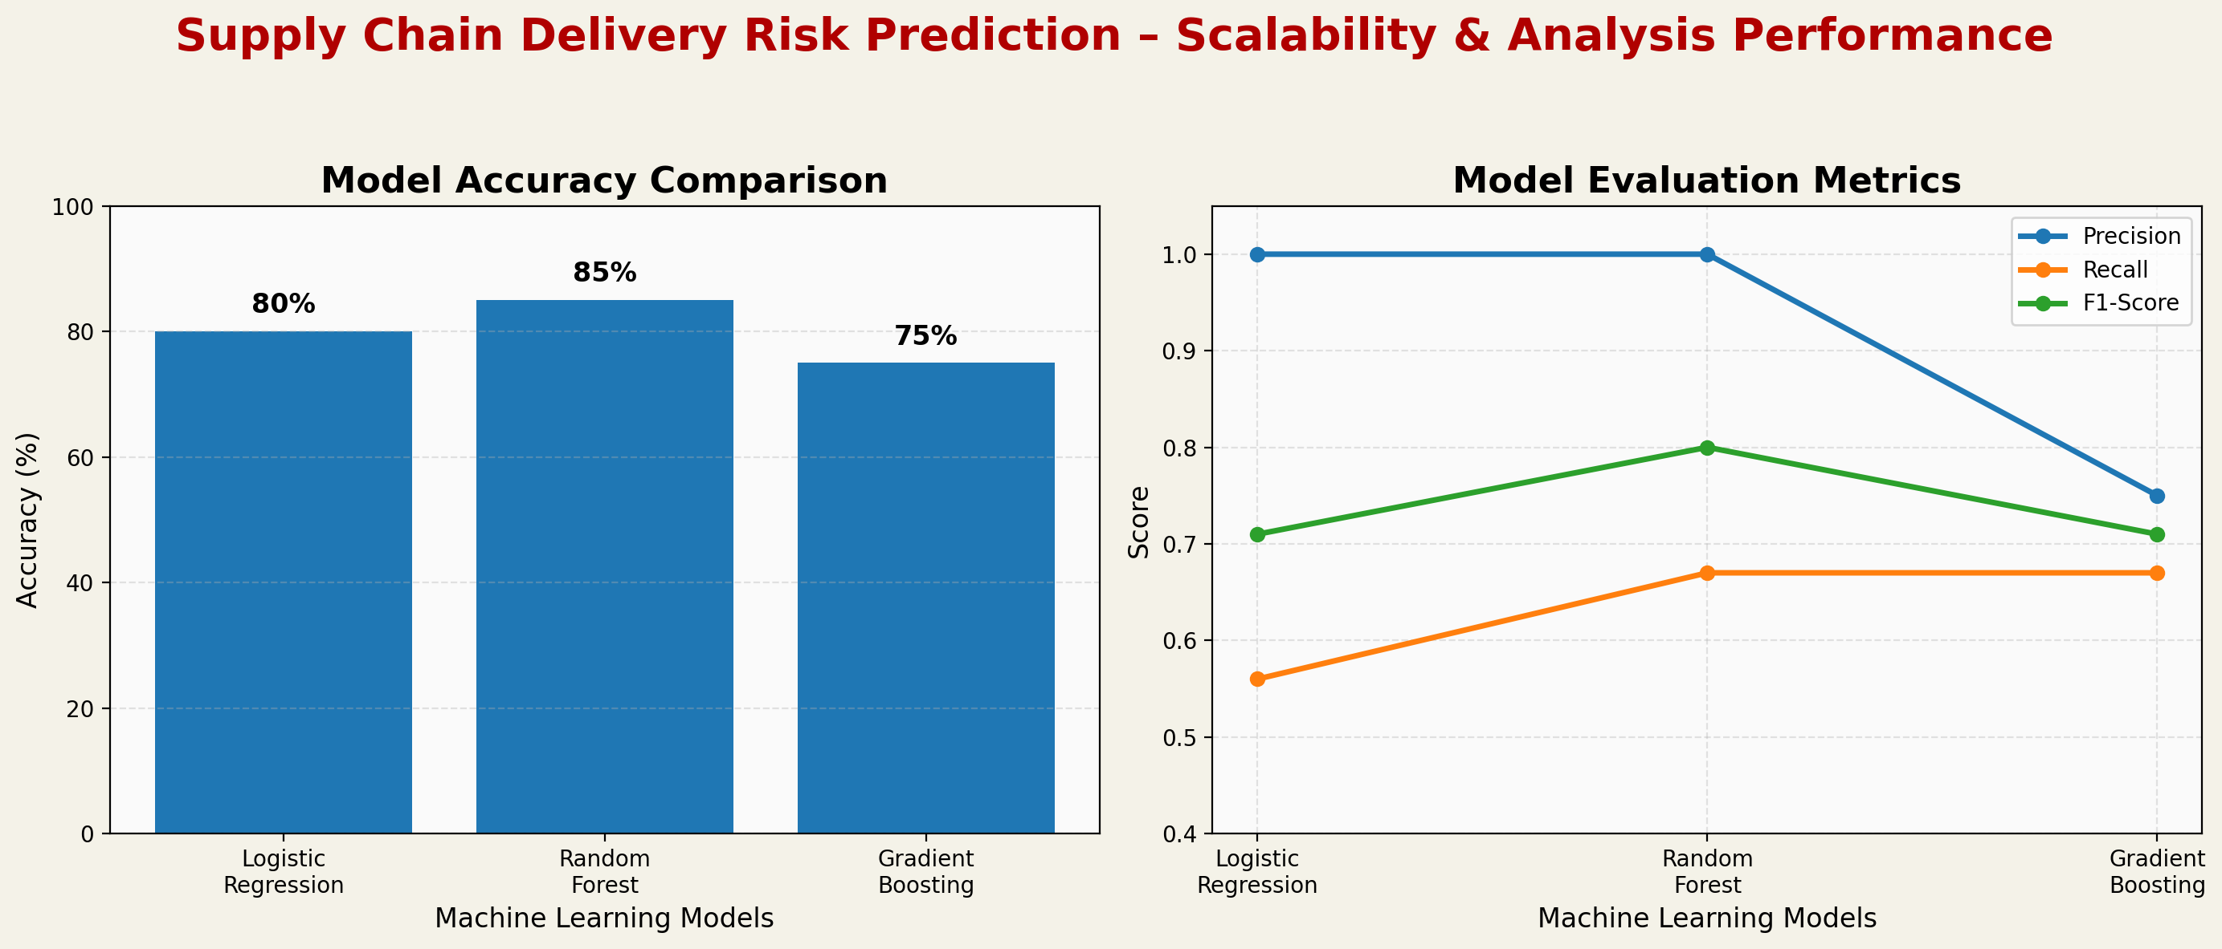

Slide 9
SCALABILITY & ANALYSIS PERFORMANCE
Query Performance Under Increasing Data Load
Model | Accuracy | Precision | Recall | F1-Score
Logistic Regression | 80.0% | 1.00 | 0.56 | 0.71
Random Forest | 85.0% | 1.00 | 0.67 | 0.80
Gradient Boosting | 75.0% | 0.75 | 0.67 | 0.71

Slide 10
CONCLUSION
The project successfully predicts late delivery risk using machine learning. Among the three models, Random Forest achieved the highest accuracy of 85% and an F1-score of 0.80. The system can help identify risky deliveries before dispatch and support better decision-making in supply chain operations.

Slide 11
Thank you all

