Slide 1
By Kavita Malviya
Applied Data Science Capstone
IBM Data Science Professional Certificate

Slide 2
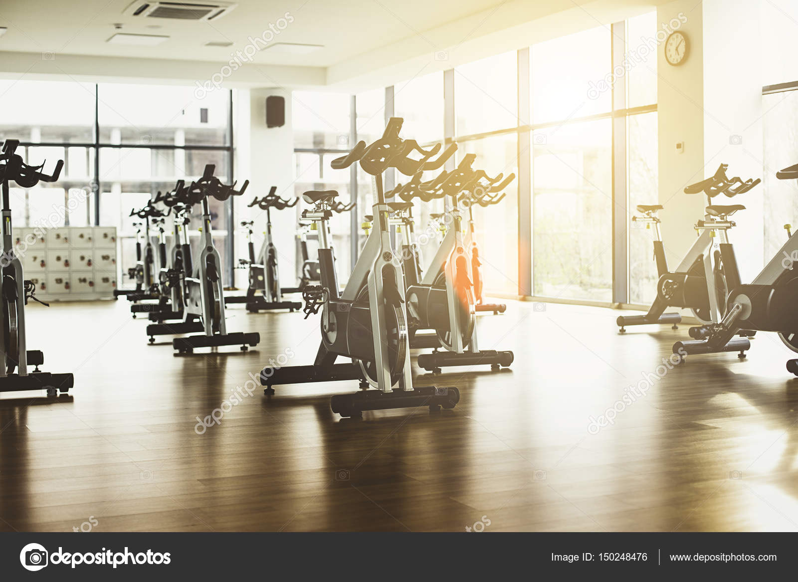
Recommending best location for Fitness Center :

Slide 3
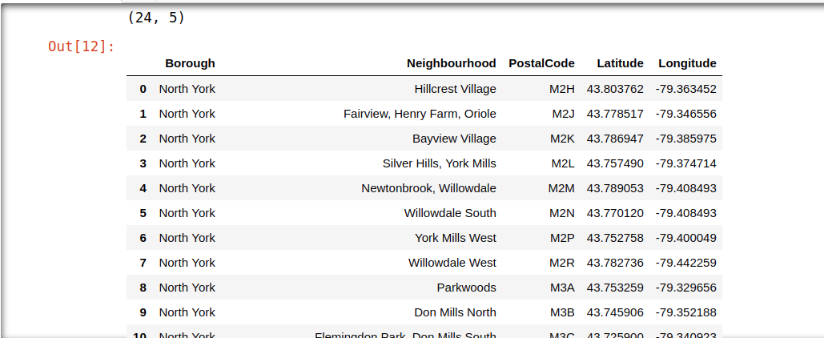
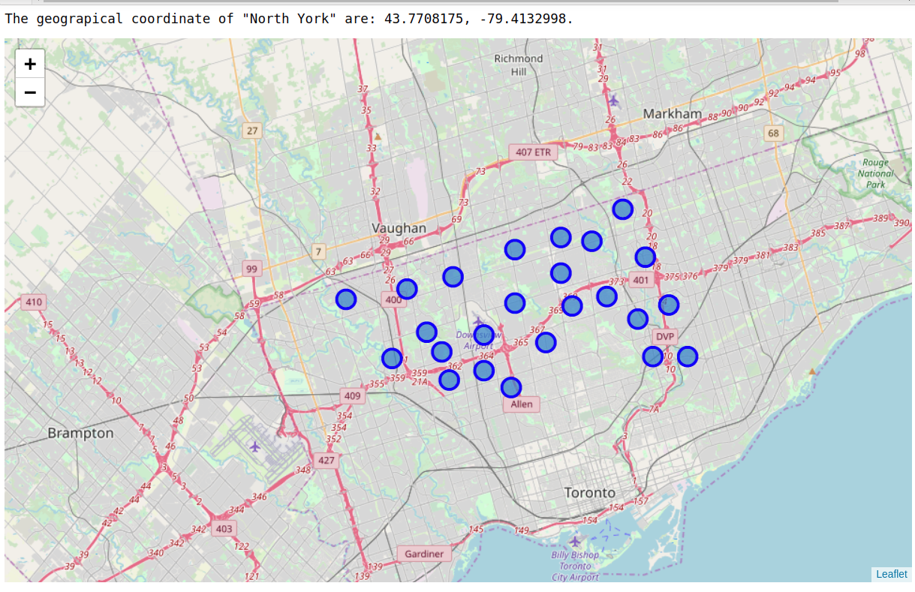
Methodology and Discussion:
Exploring Neighborhoods of "North York":
We will use Postal Codes of different regions inside North York to find the list of neighborhoods. We will essentially obtain our information from https://en.hwikipedia.org/wiki/List_of_postal_codes_of_Canada:_M and then process the table inside this site. Images from data frames and also from maps will be provided in the presentation. Here we only present our strategy and how we got the mission accomplished.

Slide 4
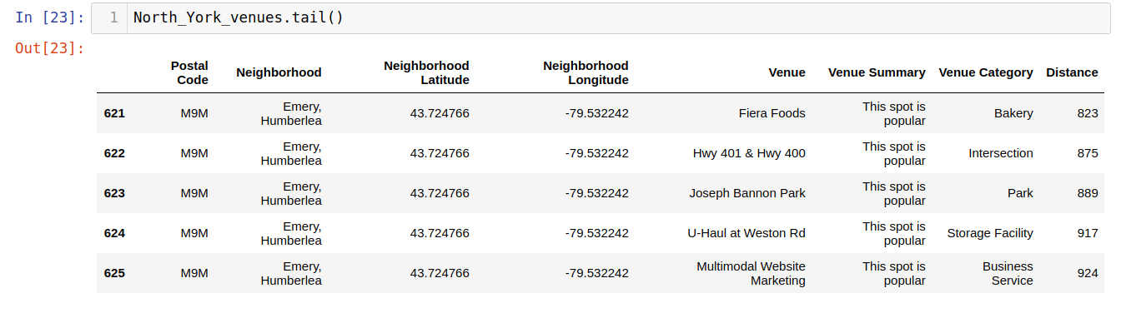
Methodology and Discussion:
Processing the Retrieved Data and Creating a Data Frame for All the Venue:
When the data is completely gathered, we will perform processing on that raw data to find our desirable features for each venue. Our main feature is the category of that venue. After this stage, the column "Venue's Category" will be One-hot encoded and different venues will have different feature-columns.

Slide 5
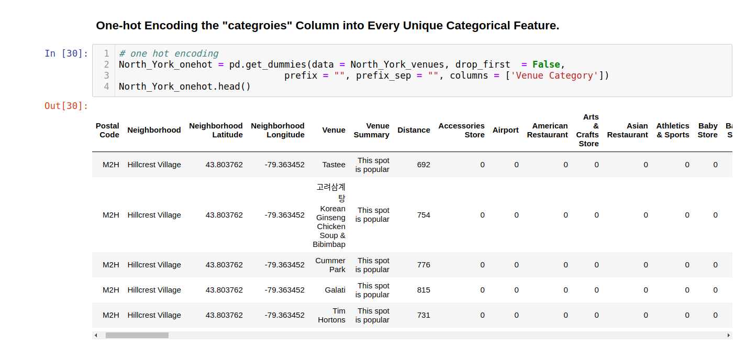
Methodology and Discussion:
We will set few Benchmarks for the City and the locality in which opening a fitness center would be successful This assumption is made for simplicity and due to not having a very detailed data set about different venues.
Now, the data set is fully ready to be used for machine learning (and statistical analysis) purposes.

Slide 6
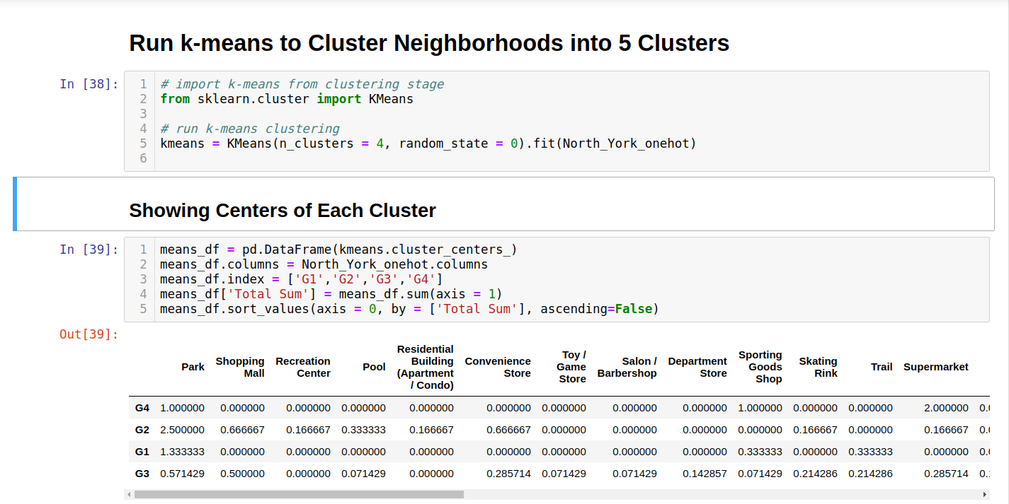
Applying Machine Learning Techniques (K-Means Clustering)
Here we cluster neighborhoods via K-means clustering method. We think that 4 clusters is enough and can cover the complexity of our problem. After clustering we will update our data set and create a column representing the group for each neighborhood.

Slide 7
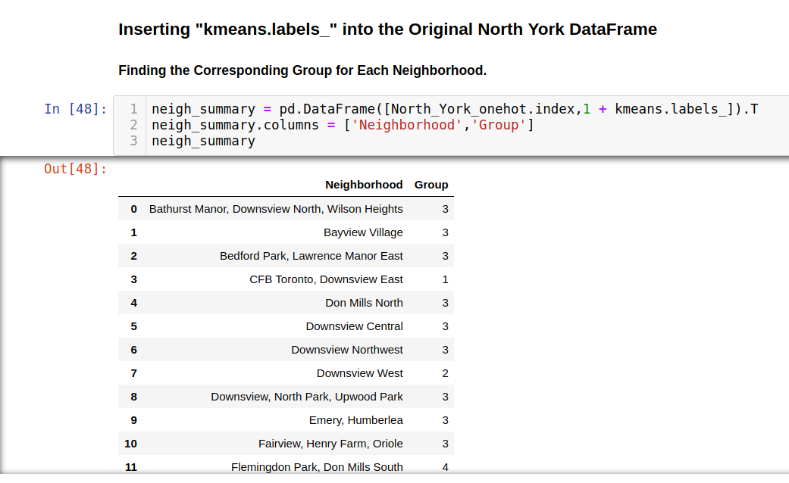
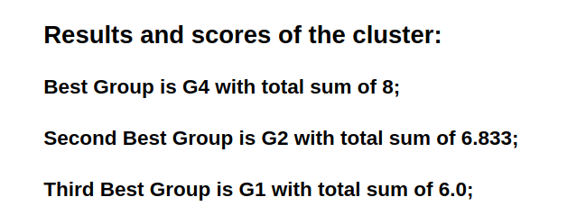
Decision Making and Reporting Results:
Now,on the basis of centers of clusters and compare them from their "Total Sum”. The group which its center has the highest "Total Sum" will be our best recommendation to the person. This algorithm although is pretty straightforward yet is strongly powerful.

Slide 8
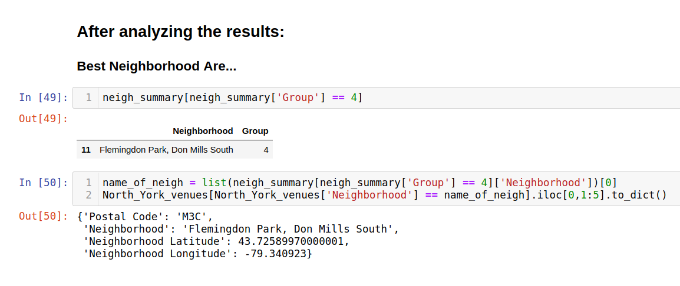
Results :
Based on this analysis, the best recommended neighborhood will be cluster G4:
{'Postal Code': 'M3C',
'Neighborhood': 'Flemingdon Park, Don Mills South',
'Neighborhood Latitude': 43.72589970000001,
'Neighborhood Longitude': -79.340923}

Slide 9
Conclusion :
After analyzing the cluster we came to the conclusion that “Flemingdon Park, Don Mills South” is a best place in North York borough to set a fitness center to get good growth in the business.
Thank You

