Slide 1
Chapter 13
Chemical Equilibrium

Slide 2
Etymology of equilibrium:
Equilibrium comes from the latin aequi, meaning equal, and libra, meaning balance.
Credit to Adam Alexic
Copyright © Cengage Learning. All rights reserved
Notes:
Nod to Adam Alexic, equal, balance, staying the same.

Slide 3
Equilibrium Is:
Macroscopically static
Microscopically dynamic
Copyright © Cengage Learning. All rights reserved
Notes:
Throwback to kinetic theory.

Slide 4
Chemical Equilibrium
Every reaction has a forward and a reverse reaction.
Concentrations reach levels where the rate of the forward reaction equals the rate of the reverse reaction.
N₂(g) + 3H₂(g) 2NH₃(g)
Copyright © Cengage Learning. All rights reserved

Slide 5
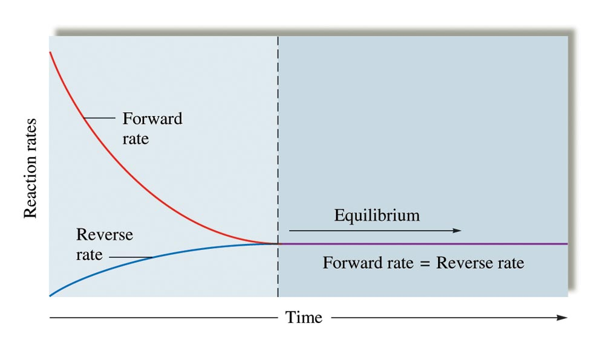
The Changes with Time in the Rates of Forward and Reverse Reactions
Copyright © Cengage Learning. All rights reserved

Slide 6
Chemical Equilibrium
The state where the concentrations of all reactants and products remain constant with time.
On the molecular level, there is frantic activity. Equilibrium is not static, but is a highly dynamic situation.
Copyright © Cengage Learning. All rights reserved

Slide 7
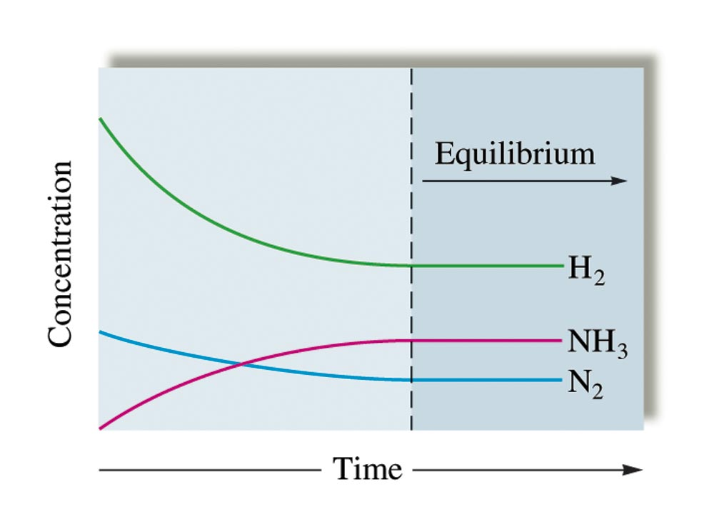
Changes in Concentration
N₂(g) + 3H₂(g) 2NH₃(g)
Copyright © Cengage Learning. All rights reserved

Slide 8

Concept Check
Consider an equilibrium mixture in a closed vessel reacting according to the equation:
H₂O(g) + CO(g) H₂(g) + CO₂(g)
You add more H₂O(g) to the flask. How does the concentration of each chemical compare to its original concentration after equilibrium is reestablished? Justify your answer.
Copyright © Cengage Learning. All rights reserved
Notes:
The concentrations of each product will increase, the concentration of CO will decrease, and the concentration of water will be higher than the original equilibrium concentration, but lower than the initial total amount.
Students may have many different answers (hydrogen goes up, but carbon dioxide in unchanged, etc.) Let them talk about this for a while – do not go over the answer until each group of students has come up with an explanation. This question also sets up LeChâtelier’s principle for later.

Slide 9
Concept Check
Consider an equilibrium mixture in a closed vessel reacting according to the equation:
H₂O(g) + CO(g) H₂(g) + CO₂(g)
You add more H₂ to the flask. How does the concentration of each chemical compare to its original concentration after equilibrium is reestablished? Justify your answer.
Copyright © Cengage Learning. All rights reserved
Notes:
This is the opposite scenario of the previous slide. The concentrations of water and CO will increase. The concentration of carbon dioxide decreases and the concentration of hydrogen will be higher than the original equilibrium concentration, but lower than the initial total amount.

Slide 10
Consider the following reaction at equilibrium:
jA + kB lC + mD
A, B, C, and D = chemical species.
Square brackets = concentrations of species at equilibrium.
j, k, l, and m = coefficients in the balanced equation.
K = equilibrium constant (given without units).
[C]
l
[D]
m
K
=
[A]
j
[B]
k
Copyright © Cengage Learning. All rights reserved

Slide 11
Conclusions About the Equilibrium Expression
Equilibrium expression for a reaction is the reciprocal of that for the reaction written in reverse.
When balanced equation for a reaction is multiplied by a factor of n, the equilibrium expression for the new reaction is the original expression raised to the nth power; thus K_{new} = (K_{original})^{n}.
K values are usually written without units.
Copyright © Cengage Learning. All rights reserved

Slide 12
K always has the same value at a given temperature regardless of the amounts of reactants or products that are present initially.
For a reaction, at a given temperature, there are many equilibrium positions but only one value for K.
  Equilibrium position is a set of equilibrium concentrations.
Copyright © Cengage Learning. All rights reserved

Slide 13
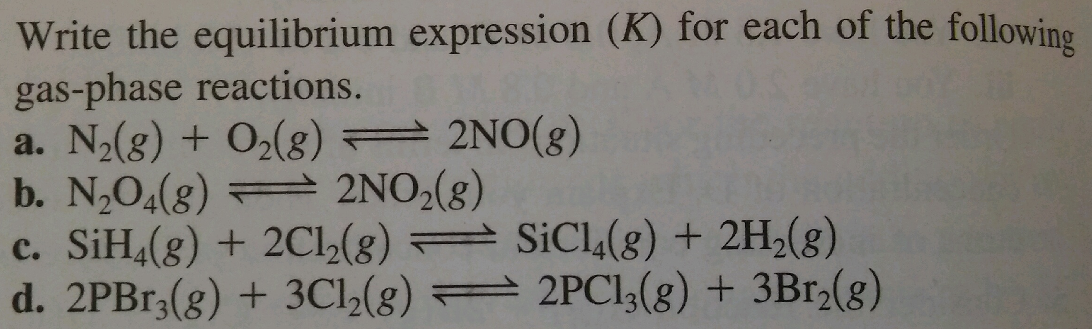
Copyright © Cengage Learning. All rights reserved
Notes:
White boards

Slide 14
K involves concentrations.
K_{p} involves pressures.
Copyright © Cengage Learning. All rights reserved

Slide 15
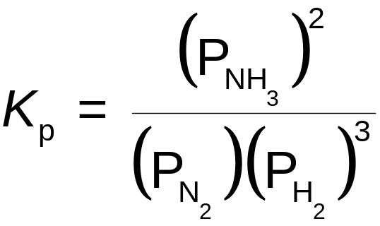
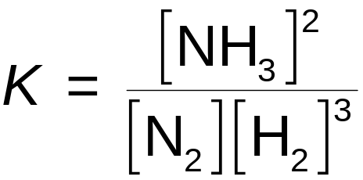
Example
N₂(g) + 3H₂(g) 2NH₃(g)
Copyright © Cengage Learning. All rights reserved

Slide 16
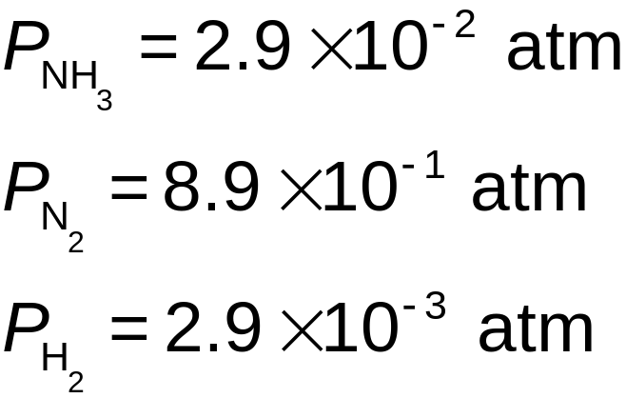
Example
N₂(g) + 3H₂(g) 2NH₃(g)
Equilibrium pressures at a certain temperature:
Copyright © Cengage Learning. All rights reserved

Slide 17
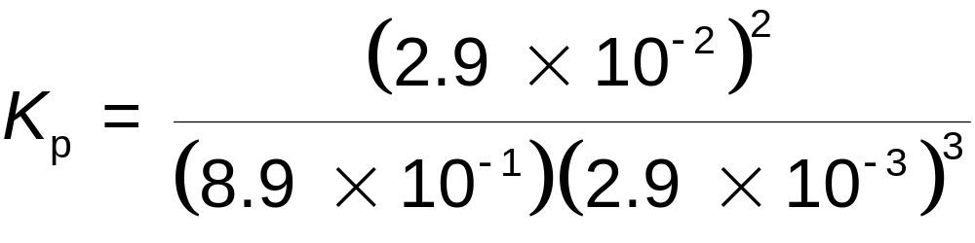
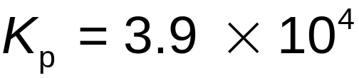
Example
N₂(g) + 3H₂(g) 2NH₃(g)
Copyright © Cengage Learning. All rights reserved

Slide 18
The Relationship Between K and K_{p}
K_{p} = K(RT)^{Δn}
Δn = sum of the coefficients of the gaseous products minus the sum of the coefficients of the gaseous reactants.
R = 0.08206 L·atm/mol·K
T = temperature (in kelvin)
Copyright © Cengage Learning. All rights reserved

Slide 19
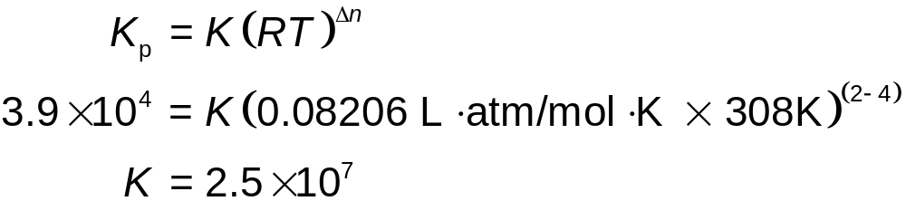
Example
N₂(g) + 3H₂(g) 2NH₃(g)
Using the value of K_{p} (3.9 × 10⁴) from the previous example, calculate the value of K at 35°C.
Copyright © Cengage Learning. All rights reserved

Slide 20
Homogeneous Equilibria
Homogeneous equilibria – involve the same phase:
N₂(g) + 3H₂(g) 2NH₃(g)
HCN(aq) H⁺(aq) + CN⁻(aq)
Copyright © Cengage Learning. All rights reserved

Slide 21
Heterogeneous Equilibria
Heterogeneous equilibria – involve more than one phase:
2KClO₃(s) 2KCl(s) + 3O₂(g)
2H₂O(l) 2H₂(g) + O₂(g)
Copyright © Cengage Learning. All rights reserved

Slide 22
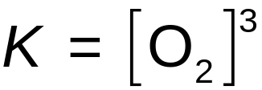
The position of a heterogeneous equilibrium does not depend on the amounts of pure solids or liquids present.
  The concentrations of pure liquids and solids are constant.
  2KClO₃(s) 2KCl(s) + 3O₂(g)
Copyright © Cengage Learning. All rights reserved

Slide 23
The Extent of a Reaction
A value of K much larger than 1 means that at equilibrium the reaction system will consist of mostly products – the equilibrium lies to the right.
  Reaction goes essentially to completion.
Copyright © Cengage Learning. All rights reserved

Slide 24
The Extent of a Reaction
A very small value of K means that the system at equilibrium will consist of mostly reactants – the equilibrium position is far to the left.
  Reaction does not occur to any significant extent.
Copyright © Cengage Learning. All rights reserved

Slide 25
Concept Check
If the equilibrium lies to the right, the value for K is __________.
large (or >1)
If the equilibrium lies to the left, the value for K is ___________.
small (or <1)
Copyright © Cengage Learning. All rights reserved
Notes:
Large (or >1); small (or < 1)

Slide 26
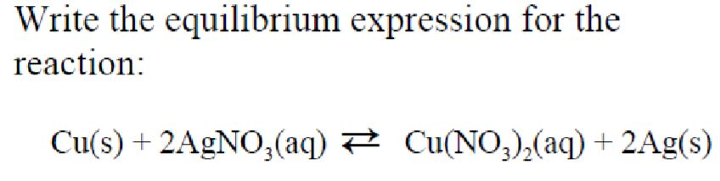
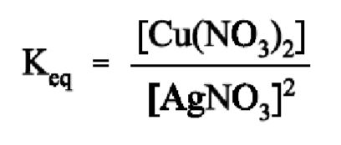
Example 1
Copyright © Cengage Learning. All rights reserved

Slide 27
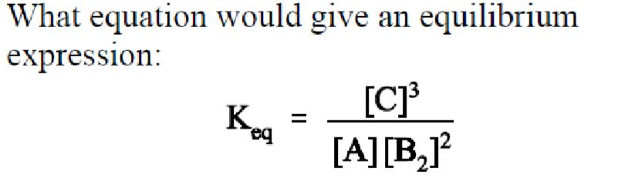

Example 2
Copyright © Cengage Learning. All rights reserved

Slide 28
Example 3
For the following reversible reaction K=6.7x10^5.
Which is the most abundant species
Answer: NH₃ because k >> 1 so the equilibrium lies far to the right
N₂(g) + 3H₂(g) 2NH₃(g)
Copyright © Cengage Learning. All rights reserved

Slide 29
Reaction Quotient, Q
Apply the law of mass action using initial concentrations instead of equilibrium concentrations.
Copyright © Cengage Learning. All rights reserved

Slide 30
Reaction Quotient, Q
Q = K; The system is at equilibrium. No shift will occur.
Q > K; The system shifts to the left.
  Consuming products and forming reactants, until equilibrium is achieved.
Q < K; The system shifts to the right.
  Consuming reactants and forming products, to attain equilibrium.
Copyright © Cengage Learning. All rights reserved

Slide 31

Exercise
Consider the reaction represented by the equation:
Fe³⁺(aq) + SCN⁻(aq) FeSCN²⁺(aq)
Trial #1:
6.00 M Fe³⁺(aq) and 10.0 M SCN⁻(aq) are mixed at a certain temperature and at equilibrium the concentration of FeSCN²⁺(aq) is 4.00 M.
What is the value for the equilibrium constant for this reaction?
Copyright © Cengage Learning. All rights reserved
Notes:
Note: Use the red box animation to assist in explaining how to solve the problem.

Slide 32
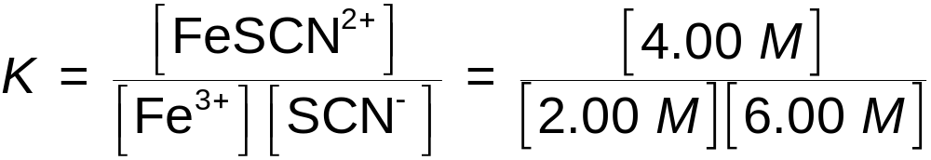
Set up ICE Table
Fe³⁺(aq) + SCN–(aq) FeSCN²⁺(aq)
Initial 6.00 10.00 0.00
Change – 4.00 – 4.00 +4.00
Equilibrium 2.00 6.00 4.00
K = 0.333
Copyright © Cengage Learning. All rights reserved
Notes:
The value for K is 0.333.

Slide 33
Exercise
Consider the reaction represented by the equation: Fe³⁺(aq) + SCN⁻(aq) FeSCN²⁺(aq)
Trial #2:
  Initial: 10.0 M Fe³⁺(aq) and 8.00 M SCN⁻(aq) (same temperature as Trial #1)
  Equilibrium: ? M FeSCN²⁺(aq)
Copyright © Cengage Learning. All rights reserved
Notes:
The answer for Trial #2 is 5.00 M. The students can solve this with the quadratic but it is not necessary. The numbers have been chosen to be relatively easy to solve (trial and error works well and will only take a short period of time). Tell the students the problems will not always have numbers like these, so take the time to understand what is going on (so the math doesn’t “get in the way”). Have the students write ICE tables for these.

Slide 34
Exercise
Copyright © Cengage Learning. All rights reserved
Notes:
The answer for Trial #3 is 3.00 M. The students can solve this with the quadratic but it is not necessary. The numbers have been chosen to by relatively easy to solve (trial and error works well and will only take a short period of time). Tell the students the problems will not always have numbers like these, so take the time to understand what is going on (so the math doesn’t “get in the way”). Have the students write ICE tables for these.

Slide 35
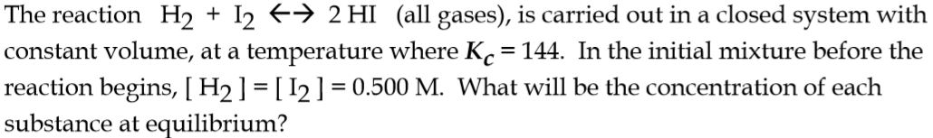
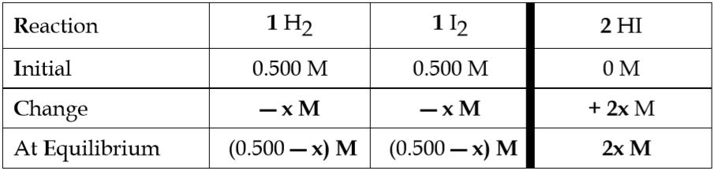
Exercise
Copyright © Cengage Learning. All rights reserved
Notes:
The answer for Trial #3 is 3.00 M. The students can solve this with the quadratic but it is not necessary. The numbers have been chosen to by relatively easy to solve (trial and error works well and will only take a short period of time). Tell the students the problems will not always have numbers like these, so take the time to understand what is going on (so the math doesn’t “get in the way”). Have the students write ICE tables for these.

Slide 36
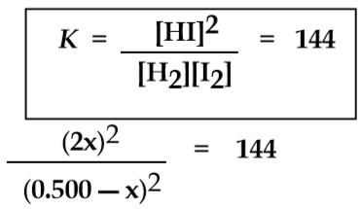
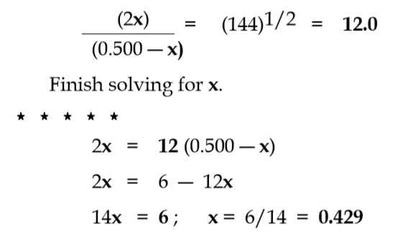
Exercise
Copyright © Cengage Learning. All rights reserved
Notes:
The answer for Trial #3 is 3.00 M. The students can solve this with the quadratic but it is not necessary. The numbers have been chosen to by relatively easy to solve (trial and error works well and will only take a short period of time). Tell the students the problems will not always have numbers like these, so take the time to understand what is going on (so the math doesn’t “get in the way”). Have the students write ICE tables for these.

Slide 37
Solving Equilibrium Problems
Write the balanced equation for the reaction.
Write the equilibrium expression.
List the initial concentrations.
Calculate Q, and determine the direction of the shift to equilibrium.
Copyright © Cengage Learning. All rights reserved

Slide 38
Solving Equilibrium Problems
5) Define the change needed to reach equilibrium, and define the equilibrium concentrations by applying the change to the initial concentrations.
Substitute the equilibrium concentrations into the equilibrium expression, and solve for the unknown.
Check your calculated equilibrium concentrations by making sure they give the correct value of K.
Copyright © Cengage Learning. All rights reserved

Slide 39
Exercise
Consider the reaction represented by the equation:
Fe³⁺(aq) + SCN⁻(aq) FeSCN²⁺(aq)
Fe³⁺ SCN⁻ FeSCN²⁺
Trial #1 9.00 M 5.00 M 1.00 M
Trial #2 3.00 M 2.00 M 5.00 M
Trial #3 2.00 M 9.00 M 6.00 M
Find the equilibrium concentrations for all species.
Copyright © Cengage Learning. All rights reserved

Slide 40
Exercise (Answer)
Trial #1: [Fe³⁺] = 6.00 M; [SCN⁻] = 2.00 M; [FeSCN²⁺] = 4.00 M
Trial #2: [Fe³⁺] = 4.00 M; [SCN⁻] = 3.00 M; [FeSCN²⁺] = 4.00 M
Trial #3: [Fe³⁺] = 2.00 M; [SCN⁻] = 9.00 M; [FeSCN²⁺] = 6.00 M
Copyright © Cengage Learning. All rights reserved
Notes:
Trial #1: [Fe³⁺] = 6.00 M; [SCN⁻] = 2.00 M; [FeSCN²⁺] = 4.00 M
Trial #2: [Fe³⁺] = 4.00 M; [SCN⁻] = 3.00 M; [FeSCN²⁺] = 4.00 M
Trial #3: [Fe³⁺] = 2.00 M; [SCN⁻] = 9.00 M; [FeSCN²⁺] = 6.00 M
This problem will provide a good discussion of Q vs. K. Trial #1 proceeds to the right to reach equilibrium, Trial #2 proceeds to the left, and Trial #3 is at equilibrium. Watch for students setting up an ICE chart without thinking about which direction the reaction must proceed initially. Be prepared for some discussion about the fact that in the Change row we can have a “-x” on the right side and a “+x” on the left side and still use the same expression for K. Use this so that students can think about the direction the reaction must proceed initially so that they needed memorize a relationship between Q and K.
The students can solve this with the quadratic but it is not necessary. The numbers have been chosen to be relatively easy to solve. Tell the students the problems will not always have numbers like these, so take the time to understand what is going on (so the math doesn’t “get in the way”).

Slide 41
Concept Check
A 1.00 mol sample of N₂O₄(g) is placed in a 10.0 L vessel and allowed to reach equilibrium according to the equation:
N₂O₄(g) 2NO₂(g)
K = 4.00 x 10⁻⁴
Calculate the equilibrium concentrations of: N₂O₄(g) and NO₂(g).
Copyright © Cengage Learning. All rights reserved
Notes:
Concentration of N₂O₄ = 0.097 M
Concentration of NO₂ = 6.32 x 10⁻³ M
(without quadratic)
or
Concentration of N₂O₄ = 0.094 M
Concentration of NO₂ = 6.22 x 10⁻³ M
(with quadratic)
Use this problem to discuss the 5% allowable error (so we can assume x is negligible). Make sure the students understand we are NOT saying x is equal to zero but that x is negligible. This is a subtle but very important point.
Note: Use the red box animation to assist in explaining how to solve the problem.

Slide 42
Exercise
Concentration of N₂O₄ = 0.097 M
Concentration of NO₂ = 6.32 x 10-3 M
Copyright © Cengage Learning. All rights reserved
Notes:
The answer for Trial #3 is 3.00 M. The students can solve this with the quadratic but it is not necessary. The numbers have been chosen to by relatively easy to solve (trial and error works well and will only take a short period of time). Tell the students the problems will not always have numbers like these, so take the time to understand what is going on (so the math doesn’t “get in the way”). Have the students write ICE tables for these.

Slide 43
If a change is imposed on a system at equilibrium, the position of the equilibrium will shift in a direction that tends to reduce that change.
Copyright © Cengage Learning. All rights reserved

Slide 44
Effects of Changes on the System
Concentration: The system will shift away from the added component. If a component is removed, the opposite effect occurs.
2. Temperature: K will change depending upon the temperature (endothermic – energy is a reactant; exothermic – energy is a product).
Copyright © Cengage Learning. All rights reserved

Slide 45
Effects of Changes on the System
Pressure:
  The system will shift away from the added gaseous component. If a component is removed, the opposite effect occurs.
  Addition of inert gas does not affect the equilibrium position.
  Decreasing the volume shifts the equilibrium toward the side with fewer moles of gas.
Copyright © Cengage Learning. All rights reserved

Slide 46

Copyright © Cengage Learning. All rights reserved

Slide 47

Equilibrium Decomposition of N₂O₄
Copyright © Cengage Learning. All rights reserved

Slide 48
Concept Check
A 2.0 mol sample of ammonia is introduced into a 1.00 L container. At a certain temperature, the ammonia partially dissociates according to the equation:
NH₃(g) N₂(g) + H₂(g)
At equilibrium 1.00 mol of ammonia remains.
Calculate the value for K.
K = 1.69
Copyright © Cengage Learning. All rights reserved
Notes:
K = 1.69
This answer assumes the students have balanced the equation with relative coefficients of 2:1:3.
Note: Use the red box animation to assist in explaining how to solve the problem.

