Slide 1
Chapter 16
Solubility and Complex Ion Equilibria

Slide 2
16.1 Solubility Equilibria and the Solubility Product
16.2 Precipitation and Qualitative Analysis
16.3 Equilibria Involving Complex Ions
Copyright © Cengage Learning. All rights reserved

Slide 3
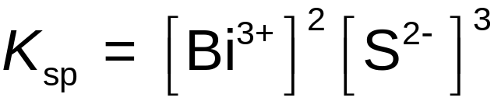
Solubility Equilibria
Solubility product (K_{sp}) – equilibrium constant; has only one value for a given solid at a given temperature.
Solubility – an equilibrium position.
Bi₂S₃(s) 2Bi³⁺(aq) + 3S^{2–}(aq)
Copyright © Cengage Learning. All rights reserved

Slide 4

Exercise
Calculate the solubility of silver chloride (AgCl) in pure water. K_{sp} = 1.6 × 10^{–10}
1.3×10⁻⁵ M
Calculate the solubility of silver phosphate (Ag₃PO₄) in pure water. K_{sp} = 1.8 × 10^{–18}
1.6×10⁻⁵ M
Copyright © Cengage Learning. All rights reserved
Notes:
a) 1.3×10⁻⁵ M
b) 1.6×10⁻⁵ M

Slide 5

Concept Check
In comparing several salts at a given temperature, does a higher K_{sp} value always mean a higher solubility?
Explain. If yes, explain and verify. If no, provide a counter-example.
No
Copyright © Cengage Learning. All rights reserved
Notes:
No. In order to relate K_{sp} values to solubility directly, the salts must contain the same number of ions. For example, for a binary salt, K_{sp} = s² (s = solubility); for a ternary salt, K_{sp} = 4s³.

Slide 6
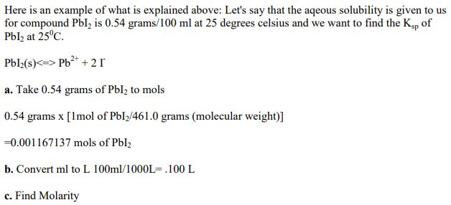
Exercise
Copyright © Cengage Learning. All rights reserved
Notes:
a) 1.3×10⁻⁵ M
b) 1.6×10⁻⁵ M

Slide 7
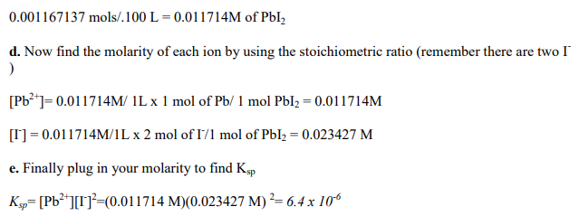
Exercise
Copyright © Cengage Learning. All rights reserved
Notes:
a) 1.3×10⁻⁵ M
b) 1.6×10⁻⁵ M

Slide 8
Concept Check
How does the solubility of silver chloride in water compare to that of silver chloride in an acidic solution (made by adding nitric acid to the solution)?
Explain.
The solubilities are the same.
Copyright © Cengage Learning. All rights reserved
Notes:
The solubilities are the same. Since HCl is a strong acid, it is completely dissociated in water.
There are no common ions between AgCl and HNO₃.

Slide 9
Concept Check
How does the K_{sp} of silver phosphate in water compare to that of silver phosphate in an acidic solution (made by adding nitric acid to the solution)?
Explain.
The K_{sp} values are the same.
Copyright © Cengage Learning. All rights reserved
Notes:
The K_{sp} values are the same (assuming the temperature is constant).

Slide 10
Concept Check
How does the solubility of silver phosphate in water compare to that of silver phosphate in an acidic solution (made by adding nitric acid to the solution)?
Explain. (hint: phosphate acts as a base)
The silver phosphate is more soluble in an acidic solution.
Copyright © Cengage Learning. All rights reserved
Notes:
The silver phosphate is more soluble in an acidic solution. This is because the phosphate ion is a relatively good base and will react with the proton from the acid (essentially to completion). The phosphate ion does not react nearly as well with water. This is an example of the effect of LeChâtelier's principle on the position of the solubility equilibrium.

Slide 11
Exercise
Calculate the solubility of AgCl in:
K_{sp} = 1.6 × 10^{–10}
100.0 mL of 4.00 x 10⁻³ M calcium chloride.
  2.0×10⁻⁸ M
100.0 mL of 4.00 x 10⁻³ M calcium nitrate.
  1.3×10⁻⁵ M
Copyright © Cengage Learning. All rights reserved
Notes:
a) 2.0×10⁻⁸ M Note: [Cl⁻] in CaCl₂ is twice the [CaCl₂] given. 100.0 mL is not used in the calculation.
b) 1.3×10⁻⁵ M

Slide 12
Precipitation (Mixing Two Solutions of Ions)
Q > K_{sp}; precipitation occurs and will continue until the concentrations are reduced to the point that they satisfy K_{sp}.
Q < K_{sp}; no precipitation occurs.
Copyright © Cengage Learning. All rights reserved

Slide 13
Selective Precipitation (Mixtures of Metal Ions)
Use a reagent whose anion forms a precipitate with only one or a few of the metal ions in the mixture.
Example:
  Solution contains Ba²⁺ and Ag⁺ ions.
  Adding NaCl will form a precipitate with Ag⁺ (AgCl), while still leaving Ba²⁺ in solution.
Copyright © Cengage Learning. All rights reserved

Slide 14
Separation of Cu²⁺ and Hg²⁺ from Ni²⁺ and Mn²⁺ using H₂S
At a low pH, [S^{2–}] is relatively low and only the very insoluble HgS and CuS precipitate.
When OH– is added to lower [H⁺], the value of [S^{2–}] increases, and MnS and NiS precipitate.
Copyright © Cengage Learning. All rights reserved

Slide 15
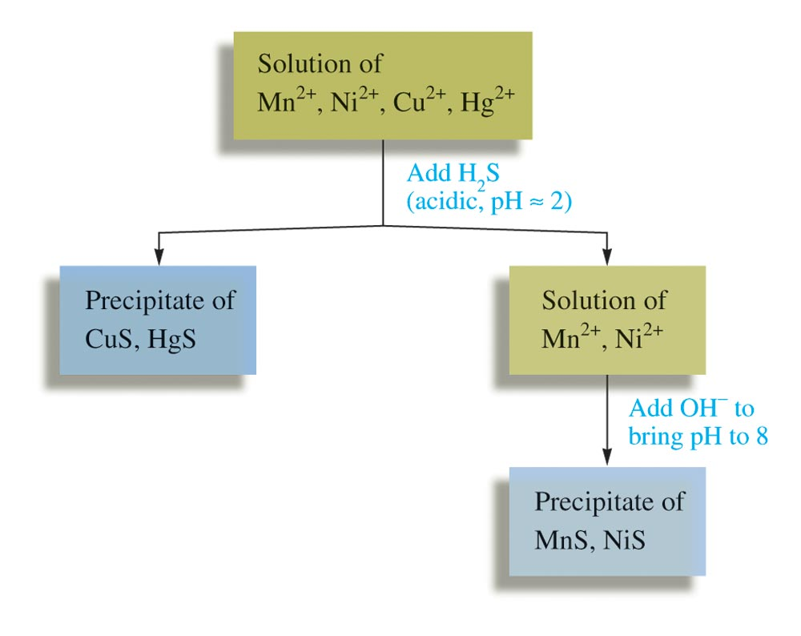
Separation of Cu²⁺ and Hg²⁺ from Ni²⁺ and Mn²⁺ using H₂S
Copyright © Cengage Learning. All rights reserved

Slide 16
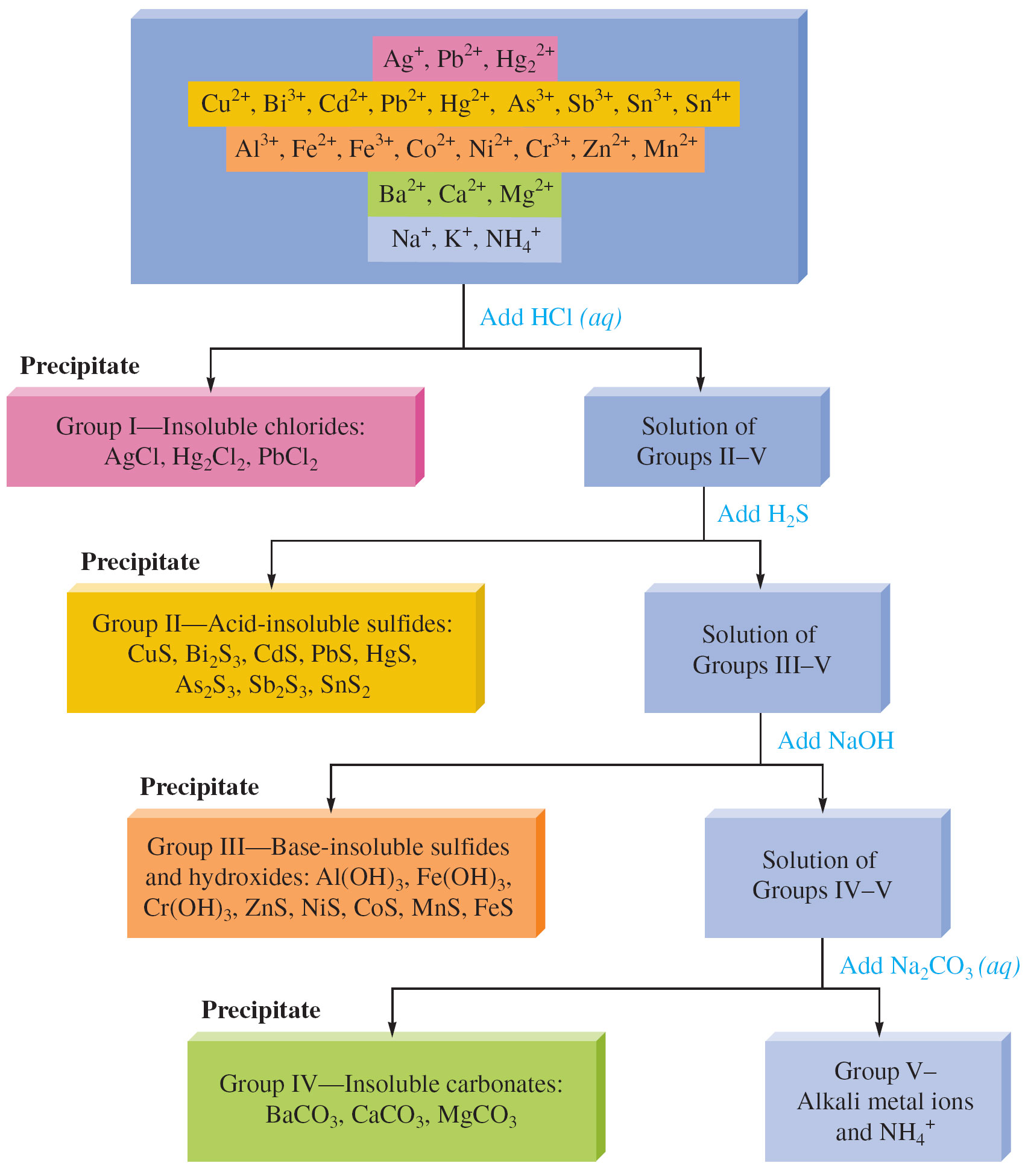
Separating the Common Cations by Selective Precipitation
Copyright © Cengage Learning. All rights reserved

Slide 17
Complex Ion Equilibria
Charged species consisting of a metal ion surrounded by ligands.
  Ligand: Lewis base
Formation (stability) constant.
  Equilibrium constant for each step of the formation of a complex ion by the addition of an individual ligand to a metal ion or complex ion in aqueous solution.
Copyright © Cengage Learning. All rights reserved

Slide 18
Complex Ion Equilibria
Be²⁺(aq) + F–(aq) BeF⁺(aq) K₁ = 7.9 x 10⁴
BeF⁺(aq) + F–(aq) BeF₂(aq) K₂ = 5.8 x 10³
BeF₂(aq) + F–(aq) BeF₃– (aq) K₃ = 6.1 x 10²
BeF₃– (aq) + F–(aq) BeF₄^{2–} (aq) K₄ = 2.7 x 10¹
Copyright © Cengage Learning. All rights reserved

Slide 19
Complex Ions and Solubility
Two strategies for dissolving a water–insoluble ionic solid.
  If the anion of the solid is a good base, the solubility is greatly increased by acidifying the solution.
  In cases where the anion is not sufficiently basic, the ionic solid often can be dissolved in a solution containing a ligand that forms stable complex ions with its cation.
Copyright © Cengage Learning. All rights reserved

Slide 20
Concept Check
Calculate the solubility of silver chloride in 10.0 M ammonia given the following information:
K_{sp} (AgCl) = 1.6 x 10^{–10}
Ag⁺ + NH₃ AgNH₃⁺ K = 2.1 x 10³
AgNH₃⁺ + NH₃ Ag(NH₃)₂⁺ K = 8.2 x 10³
0.48 M
Calculate the concentration of NH₃ in the final equilibrium mixture.
9.0 M
Copyright © Cengage Learning. All rights reserved
Notes:
a) 0.48 M
b) 9.0 M
This problem is discussed at length in the text.

