Slide 1
Machine Learning
An Introduction for students in Grades 3-8

Slide 2
A Mysterious Box
Input
?
Output

Slide 3
?
Red
?
Blue
?
Red
?
Blue
Box 1

Slide 4
?
Box 1

Slide 5
?
6
?
4
?
4
?
3
Box 2

Slide 6
?
Box 2

Slide 7
?
Drive
?
Stop
?
Stop
?
Drive
Box 3

Slide 8
?
Box 3

Slide 9
What is machine learning?
Machine learning is a way to automatically create a new box, given a bunch of examples
Input
Output

Slide 10
What is machine learning?
By automatically, we mean without a human

Slide 11
How good is Machine Learning?
Input
Output
A good next chess move
Pieces on a chess board

Slide 12
?
Drive
?
Stop
?
Stop
?
Drive

Slide 13
How does it work?
At the moment, Deep Learning works best
Layer 1
Layer 2
Layer 3
Output
Person
Fully Connected

Slide 14
Each layer is doing something very simple, but stacking multiple layers together can solve hard problems
Like a game of 20 questions where each simple question reveals more information
Input
Output
Residual

Slide 15
What happens in one layer?
In each layer, we draw the best line
Best Line

Slide 16
How do we get the best line?
If a mistake on an example, we move the line a better direction
This change in direction is called a gradient and this process is called training

Slide 17
Why do we need multiple layers?

Slide 18
Learning by Mistakes

Slide 19
Fun with gradients
If we have many layers, the gradients become more interesting
We can even add the gradient to the image for a fun result

Slide 20
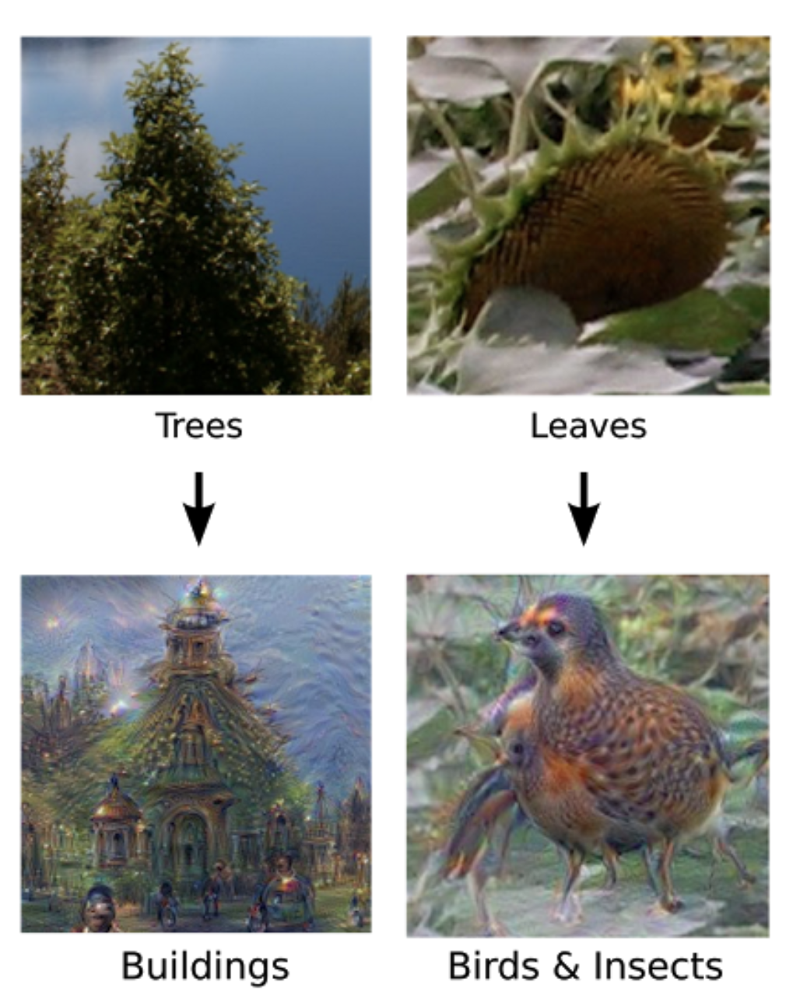

Slide 21
If we keep repeating this process…

