Slide 1
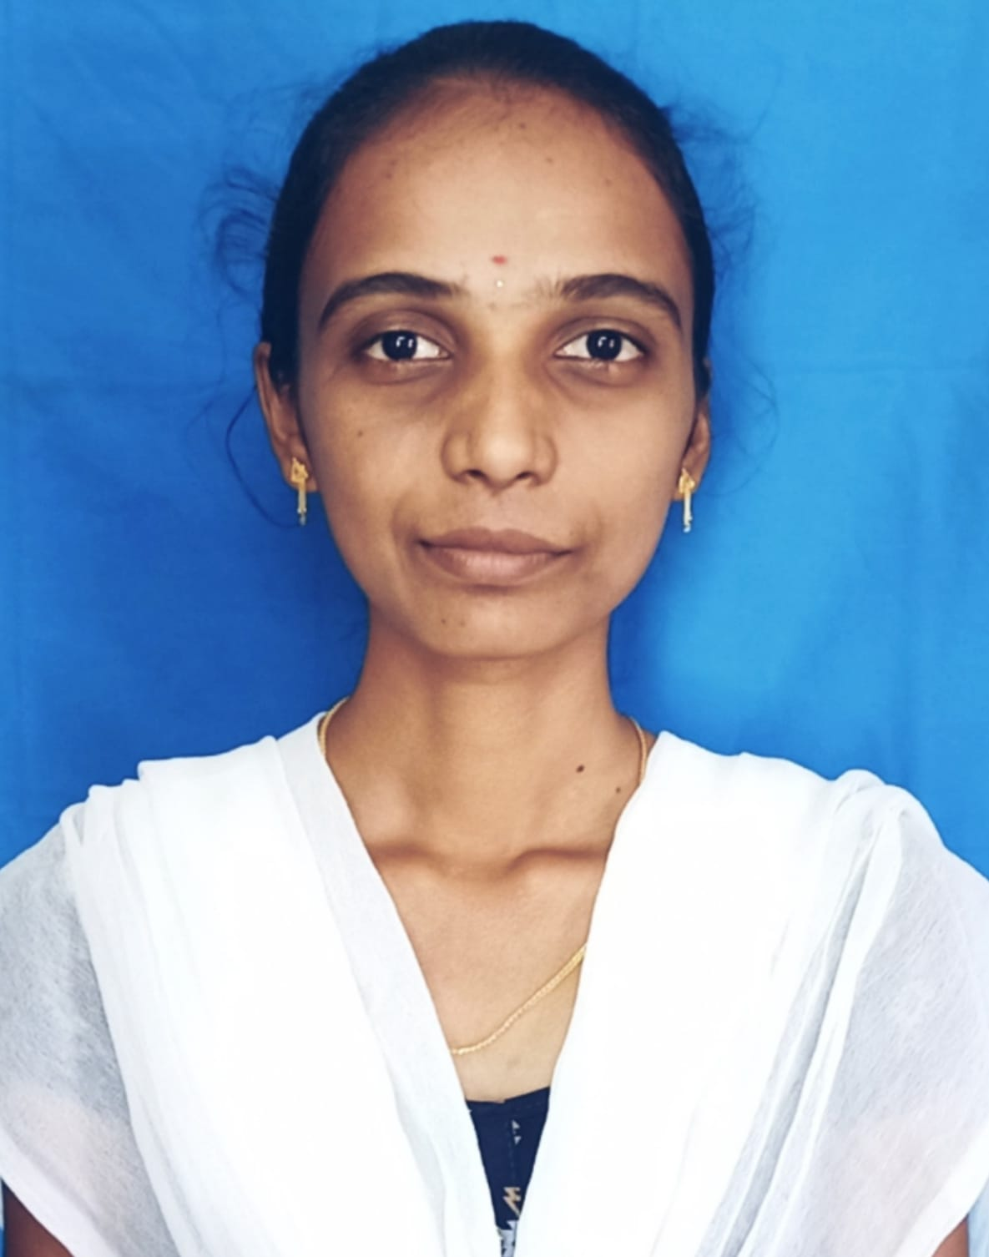


KAVITHA NAGAM
Bachelor of Engineering
Electrical & Electronics : 2017- 2021
Skills Apigee
Java 8 /J2EE
Spring Boot
Spring MVC
JPA CRUD
Bootstrap
Backend
Spring Boot
Hibernate
REST-API
Database
SQL database – MySQL,
Postgres SQL
Web Technologies
HTML5
CSS3
JavaScript
Bootstrap
AddOns
Maven
Postman
Additional Details
Leadership
Good Communication Skills
Team management
Analyst/Software Engineer
Hyderabad
Kavitha.nagam@capgemini.com
+91 7997166788
A4
Full Stack Developer
Hands on experience in developing web pages using HTML5, CSS3, Object Oriented Java script, ES6, JSON, XML.
Eager to work in a team of dedicated people and serve a key role in the enhancement and development of the project.
Has working knowledge on AngularJS , Java Development using Spring framework on an intermediate level.
Software Engineer who is Strong in design and integration with intuitive problem-solving skills. Passionate about implementing and launching new projects.
Payment Wallet Application
Completed end to end case study of Payment Wallet Application with the help of Spring boot and Postgre SQL database, Angular framework used for user interface.
Designed Static and Dynamic Web Pages
Payment wallet application will provide online services to the customers in order to transfer money ,pay bills, store amount in their wallet etc.
Developed website with HTML5 and CSS3 along with Angular framework to make website interactive and colorful.
Check out my work on GitHub & Video Profile

