Slide 1
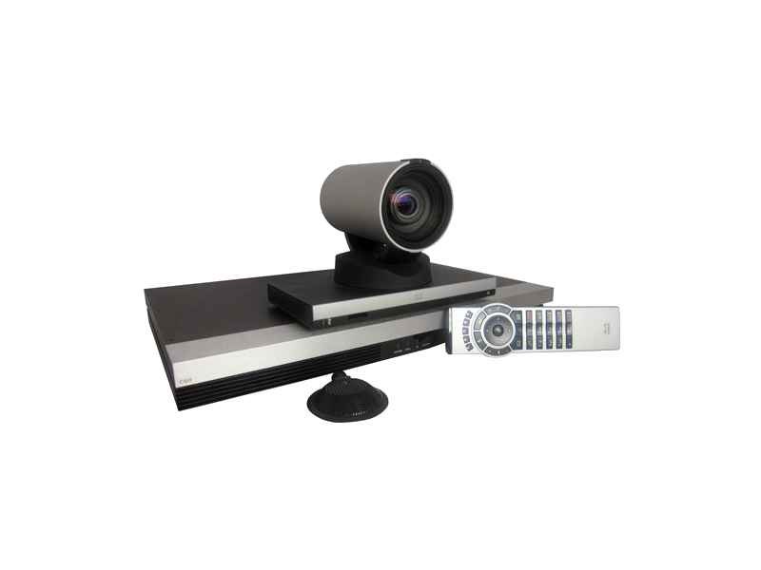
CODEC-ENCODING CAMERA
PAIRING MECHANISM

Slide 2
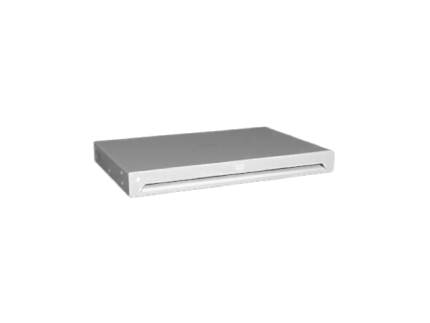
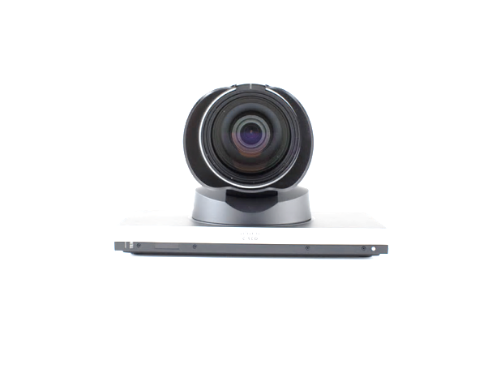
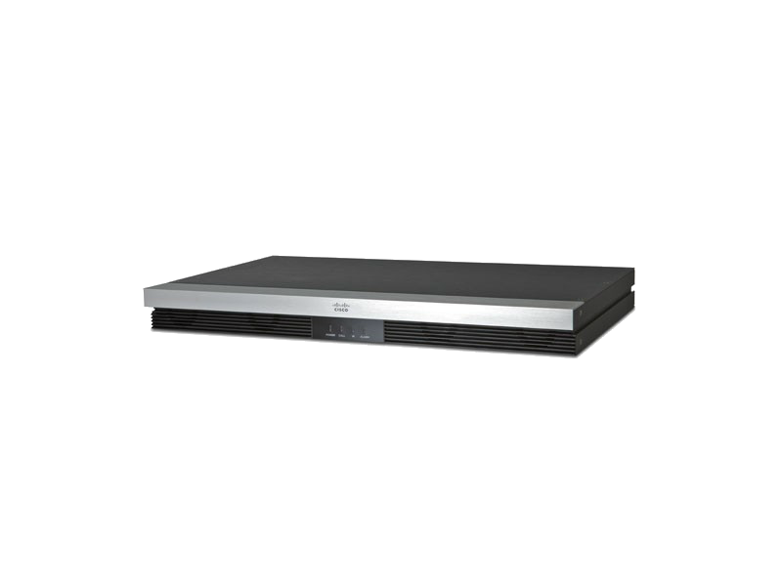
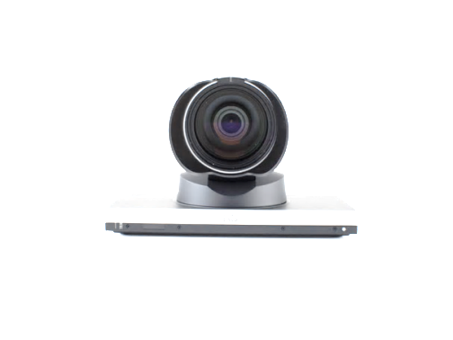





Codec
Experience
`
We solve the problem of pairing in our Encoding Camera using proximity detection.
We use a smartphone application for Configuration and Pairing between Cameras and Codec.
Smartphone
Application
PAIRING EXPERIENCE
Notes:
Wireless? – Done
We do not want to specify anything yet. – Done
Mention smartphone and codec. Like the next slide. - Done

Slide 3

Out of the Box Experience
Codec
Experience
CONFIGURE
Once configured the pairing can be done only on the secondary channel.
PAIR
USE in Call
Smartphone
Application
PAIRING EXPERIENCE
Notes:
Add that we don’t even need to connect to the network. – When do we need to connect anyway? (Confirm First) (Please mention once configured the pairing can be done only on the secondary channel)
Configuring. – (I don’t remember why we wrote this 😐 ) (These two points are taken care of in the Configure page Slide 8) As such it’s a very neat slide I wouldn’t want many changes here
Admin configuration. - (I don’t remember why we wrote this 😐 )

Slide 4

L.E.D. States
UNCONFIGURED
UNPAIRED
PAIRED
Encoding Camera
We define three states a camera can be in:
UNCONFIGURED
PAIRED
UNPAIRED
UNCONFIGURED
In this state the encoding camera does not have the required Configuration settings to function. i.e. network settings, etc.
UNPAIRED
In this state the encoding camera is capable of functioning but is not aware of the codec it needs to cater to
RESET Switch
Can be used to reset the camera to unpaired state or factory reset
PAIRED
In this state the camera is paired with a codec and may or may not be streaming depending on the call status.
PAIRING EXPERIENCE
Notes:
Add reset switch. – Done( Can be used to reset the camera to unpaired state or factory reset)
Remove the smartphone from this slide. - Done
Check the verbosity. Add points.

Slide 5



Configuring an Encoding Camera
CONFIGURE CAMERA
PROXIMITY APP
START PAIRING
CONFIGURE CAMERA
EDIT PAIRING
START PAIRING
EDIT PAIRING
PAIRING EXPERIENCE
Notes:
Remove the text. Add the codec to the display. In all subsequent slides too. - Done

Slide 6
Configuring an Encoding Camera
CONFIGURE CAMERA
PROXIMITY APP
Find Camera
CONFIGURE CAMERA
Find Camera
When Find Camera is clicked the App/Codec starts scanning for non-configured cameras by sending out Beacons
PAIRING EXPERIENCE
Notes:
Mention the beacons. – Just add a Text box below the Codec “When Find Camera is clicked the App/Codec starts scanning for non-configured cameras by sending out Beacons”

Slide 7

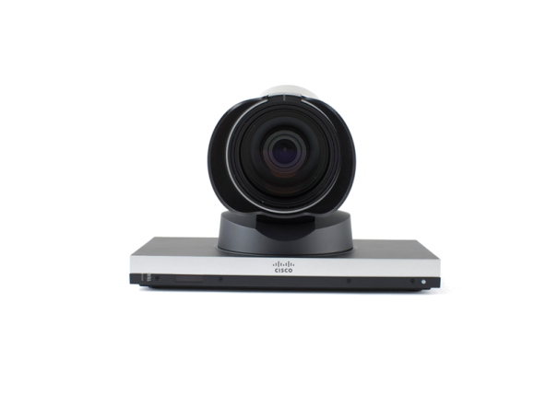
Configuring an Encoding Camera
Configuring an Encoding Camera
CONFIGURE CAMERA
PROXIMITY APP
PROXIMITY APP
Camera 1
Camera 3
CONFIGURE CAMERA
Camera 2
Camera 4
Camera 1
Camera 2
Camera 3
Camera 4
PAIRING EXPERIENCE
Notes:
UNCONFIGURED as well as previously CONFIGURED + PAIRED maybe. – Nothing to do in this

Slide 8
Configuring an Encoding Camera
CONFIGURE CAMERA 1
Alias
Wi-Fi Password
PROXIMITY APP
Wi-Fi SSID
Static IP Address
Blink L.E.D.
Auto Configure
CONFIGURE CAMERA 1
Alias
Wi-Fi SSID
Wi-Fi Password
Static IP Address
Blink L.E.D.
Auto Configure
PAIRING EXPERIENCE
Notes:
Remove the Text. Restate the cloud action and logic. The cloud logic comes when the pairing action begins. Auto configure instead of cisco cloud. – Done CHANGED IT TO CAMERA 1 just to tell that we are configuring a particular camera

Slide 9
Pairing Encoding Cameras
CONFIGURE CAMERA
PROXIMITY APP
START PAIRING
EDIT PAIRING
CONFIGURE CAMERA
START PAIRING
EDIT PAIRING
PAIRING EXPERIENCE
Notes:
Add the multiple codec scenario listed on the application. – Where to do this? (This is taken Care in the Next slide) OR Taken care in the next slide . Flow of slides will take care Or may be after clicking START PAIRING/ EDIT PAIRING WE SHOW a slide that lets us select PARTICULAR CODEC (List down codec 1, codec 2) and then we show the next slide.

Slide 10
Pairing Encoding Cameras
CHOSE CODEC
PROXIMITY APP
Codec 1
Codec 2
CHOSE CODEC
Codec 1
Codec 2
PAIRING EXPERIENCE
Notes:
Add the multiple codec scenario listed on the application. – Where to do this? (This is taken Care in the Next slide) OR Taken care in the next slide . Flow of slides will take care Or may be after clicking START PAIRING/ EDIT PAIRING WE SHOW a slide that lets us select PARTICULAR CODEC (List down codec 1, codec 2) and then we show the next slide.

Slide 11
Pairing Encoding Cameras
START PAIRING
PROXIMITY APP
Camera 1
BLINK LED
Codec 1
START PAIRING
Camera 2
BLINK LED
Camera 3
BLINK LED
Camera 1
BLINK LED
Camera 2
BLINK LED
Camera 3
BLINK LED
Codec 1
PAIRING EXPERIENCE

Slide 12
Pairing Encoding Cameras
START PAIRING
PROXIMITY APP
Camera 1
BLINK LED
Codec 1
START PAIRING
Camera 2
BLINK LED
Camera 3
BLINK LED
Camera 1
BLINK LED
Camera 2
BLINK LED
Camera 3
BLINK LED
Codec 1
Camera 2
PAIRING EXPERIENCE

Slide 13
Pairing Encoding Cameras
CONFIGURE CAMERA
PROXIMITY APP
START PAIRING
EDIT PAIRING
CONFIGURE CAMERA
START PAIRING
EDIT PAIRING
PAIRING EXPERIENCE
Notes:
Add the multiple codec scenario listed on the application. – Where to do this? Taken care in the next slide . Flow of slides will take care Or may be after clicking START PAIRING/ EDIT PAIRING WE SHOW a slide that lets us select PARTICULAR CODEC (List down codec 1, codec 2) and then we show the next slide. This should be done for start pairing as well. (Only on smartphone)

Slide 14
Pairing Encoding Cameras
CHOSE CODEC
PROXIMITY APP
Codec 1
Codec 2
CHOSE CODEC
Codec 1
Codec 2
PAIRING EXPERIENCE
Notes:
Add the multiple codec scenario listed on the application. – Where to do this? (This is taken Care in the Next slide) OR Taken care in the next slide . Flow of slides will take care Or may be after clicking START PAIRING/ EDIT PAIRING WE SHOW a slide that lets us select PARTICULAR CODEC (List down codec 1, codec 2) and then we show the next slide.

Slide 15
Pairing Encoding Cameras
EDIT PAIRING
Paired Cameras
PROXIMITY APP
Camera 1
EDIT PAIRING
Codec 1
Camera 2
Camera 3
Codec 1
Paired Cameras
Camera 1
Camera 2
Camera 3
PAIRING EXPERIENCE

Slide 16
Series of Events
CONFIGURATION
The cameras are configured using the App interface or the Auto configure.
Ex: Network settings
PAIRING
Pairing mechanism begins after the encoding cameras have been configured. This is to ensure key exchange.
PRIMARY CHANNEL
Notes:
Change the text in this slide. Add a key for the two channels. ➔ Changed the text . Please review

Slide 17
Error Conditions
Camera Outage
Scenario 1: When the camera comes back up within the codec pairing timeout
Scenario 2: When the camera doesn’t come back up within the codec pairing timeout
PRIMARY CHANNEL
PAIRING EXPERIENCE
Notes:
Why have I made the health ping go to the app?
Check this.
Also add the primary channel losing the pairing and regaining it. Add that the user does not intervene in these processes.

Slide 18
Error Conditions
Codec Outage
Scenario 1: When the codec comes back up within the camera pairing timeout
Scenario 2: When the codec doesn’t come back up within the camera pairing timeout
PRIMARY CHANNEL
PAIRING EXPERIENCE
Notes:
Why have I made the health ping go to the app? - Done
Check this. - Done
Also add the primary channel losing the pairing and regaining it. Add that the user does not intervene in these processes. – To Animate Later
ALSO SHOW THAT THE PRIMARY CHANNEL GOING DOWN. – To Animate Later

Slide 19
Use Cases
When the Encoding camera goes down(Reboots)
When an Encoding camera Reboots , there is already an established communication channel established between Codec/camera.
The codec can reinitiate the connection.
If connection doesn’t happen in a given interval of time, we can move the camera to Configuration stage again)
Reset button can be used to unpair the camera
When Codec goes down/ New codec
When the codec goes down its safe to unpair the cameras with the codec and move the Camera to Configuration mode.
This will be discovered based on periodic health pings between camera/codec
Codec will have persistent memory that caches the pairing information .
PAIRING EXPERIENCE
Notes:
Discuss with more depth. Use more slides if wanted. Make 4 slides and Bullets by splitting the points.
FYI: Codec is the device with persistent memory(for pairing configuration), not the camera. (Mention this point along with Cloud and reset in the last slide)
Add the RESET switch description here.
Remove the cloud box text and add the new function of cloud based room service subscription.

Slide 20
Use Cases
Security during Pairing
We should ensure that the communication happens over a secure channel
We should ensure protection against man-in-the-middle attacks so as to not compromise on configuration settings of the codec/camera
We can have two level authentication both over primary and secondary channel using certificate/public/private key
Reset of Encoding Camera
Reset of camera can be performed when there is codec outage, camera is moved or any unprecedented scenario when the camera stops working.
Cloud
This should work seamlessly with cloud applications like squared.
The proximity can be used to update room services on the cloud for Codec/camera information.
PAIRING EXPERIENCE
Notes:
Discuss with more depth. Use more slides if wanted. Make 4 slides and Bullets by splitting the points.
FYI: Codec is the device with persistent memory(for pairing configuration), not the camera. (Mention this point along with Cloud and reset in the last slide)
Add the RESET switch description here.
Remove the cloud box text and add the new function of cloud based room service subscription.

Slide 21


Communication
Primary Channel
Secondary Channel (Wireless)
Primary channel is for secure media transfer and only functions after secure key exchange.
Secondary channel acts as a control medium, responsible for configuration and pairing. This channel can exist both between smartphone and camera + codec, and also just between camera + codec.
Cloud based configuration can also be enabled over the primary channel which is internet enabled.
LAN
PAIRING EXPERIENCE

