Slide 1

Linux Containers (LXC) on Embedded Systems
Kavitha
ESTF Conference
04-09-2015

Slide 2

Contents
INTRODUCTION TO VIRTUALIZATION
LXC ARCHITECTURE
LXC COMMANDS
LXC INSTALLATION ON HOST / PANDABOARD
BOOT MULTIPLE VERSIONS OF SOFTWARE
LXC ON EMBEDDED SYSTEMS
SUMMARY
REFERENCES

Slide 3
Introduction to Virtualization Definition
Virtualization, in computing, refers the act of creating a virtual (rather than actual) version of something
Not limited to a virtual hardware platform, operating system (OS), storage device, or network resources.
Running multiple OS on a single machine

Slide 4
Introduction to Virtualization Types
Hardware Virtualization[Hypervisor]
Full : Unmodified Guest OS [VMware, virtual box]
Para: Modified Guest OS [Xen, KVM]
Software Virtualization
Multi User -- Unix
Application Level
OS level -- OpenVz, LXC, Vserver, Solaris Zones, BSD jails

Slide 5
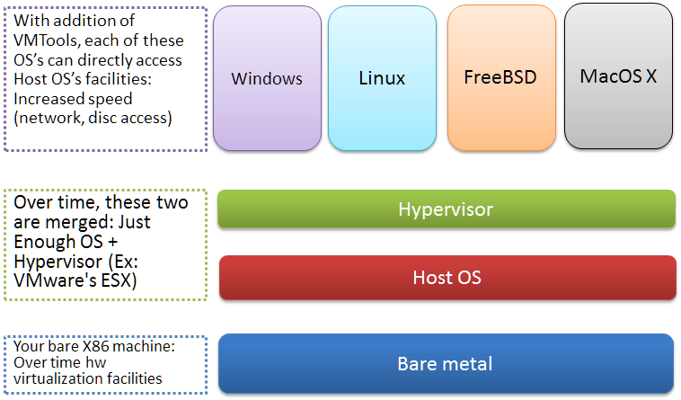
Introduction to Virtualization Hypervisor

Slide 6
Introduction to Virtualization Hypervisor
PROS
You get your own machine, where you can install your own OS.
You get root privileges, so you can install whatever you want. And, offer the services just like a physical machine would.
Backup, restore, migrate, and other management facilities are easy to manage with standard tools
CONS
Expensive
Difficult to manage

Slide 7
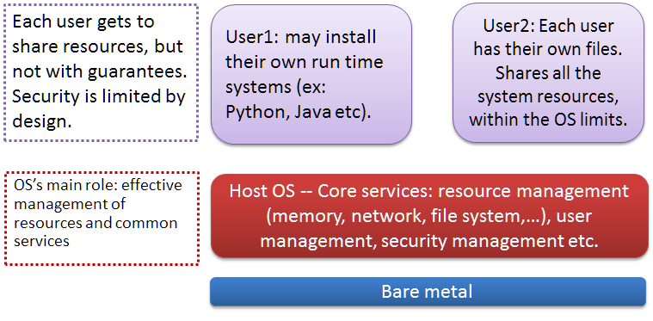
Introduction to Virtualization Multi-user operating systems

Slide 8
Introduction to Virtualization Multi-user operating systems
Multi-user OS, where each user can run their own apps like Unix
Most of the services that you may want to run on your machine, mail, web, ftp, etc, can easily be setup as a virtual service, on the same machine

Slide 9
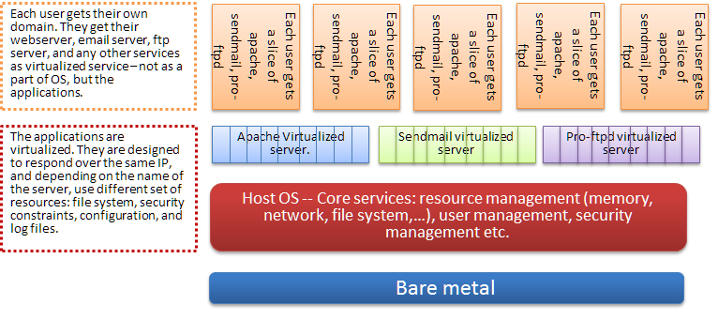
Introduction to Virtualization Application level

Slide 10
Introduction to Virtualization Application level
Uses Virtualized Servers - users share these servers for mail, web, ftp, etc
No resource limit enforcement
Difficulty of billing
Unsupported apps
Lack of security

Slide 11
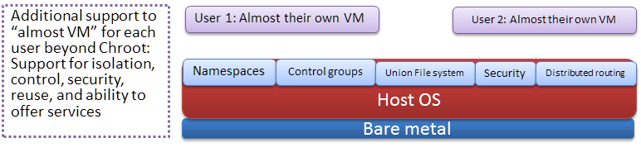
Introduction to Virtualization OS level (CONTAINERS)

Slide 12
Introduction to Virtualization OS level (CONTAINERS)
If you want full isolation with guaranteed resources then a full VM is the way to go.
If you just want to isolate processes from each other and want to run a ton of them on a reasonably sized host, then LXC might be the way to go.
LXC (LinuX Containers) let you run a Linux system within another Linux system.
A container is a group of processes on a Linux box, put together in an isolated environment.
Inside the box, it looks like a VM. Outside the box, it looks like normal processes

Slide 13
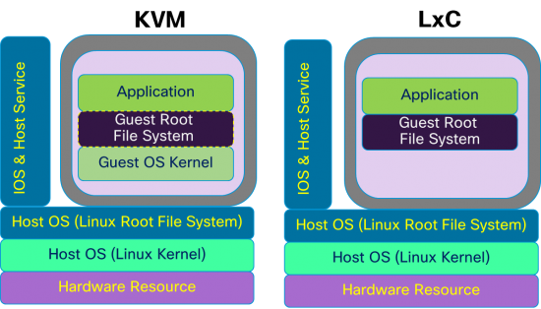
Introduction to Virtualization KVM or Containers

Slide 14
Introduction to Virtualization KVM or Containers
Startup and shutdown speed
Ease of Maintenance/Creation
System-wide changes visible in each container
Scalability: Number of containers
Process Memory Sharing
Boot multiple Different Operating Systems Including Windows
Separate kernel / Full Separation /Better Security
Kernel crash does not take down host
Guest Isolation from host changes /Features such as live migration, live storage migration

Slide 15
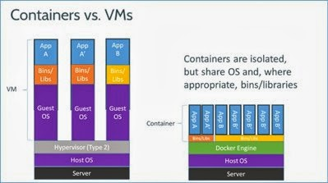
Introduction to Virtualization KVM or Containers

Slide 16
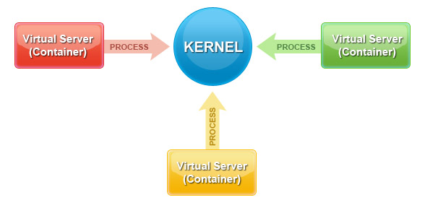
Introduction to Virtualization os level (containers)
Light weight alternative to VM’s
Solaris based SmartOS (Zones), FreeBSD Jails, Linux’s LXC, Vserver, and commercial offerings like Virtuozzo
Within that OS, the kernel cannot be changed by the container. It can, however, overwrite any libraries

Slide 17
LXC ARCHITECTURE how linux containers work
Namespaces : PID, NET, IPC, MNT, UTS
Mount : mounting/unmounting filesystems
UTS : hostname, domainname
IPC : SysV message queues, semaphore/shared memory segments
Network: IPv4/IPv6 stacks, routing, firewall
PID: Private /proc, multiple pid 1's
User: (UID) Just showing up in the Kernel now
Control groups : manage resource allocation for groups of processes. We can do accounting and resource limiting at group level. We can set the amount of RAM, swap space, cache, CPU etc. for each group

Slide 18
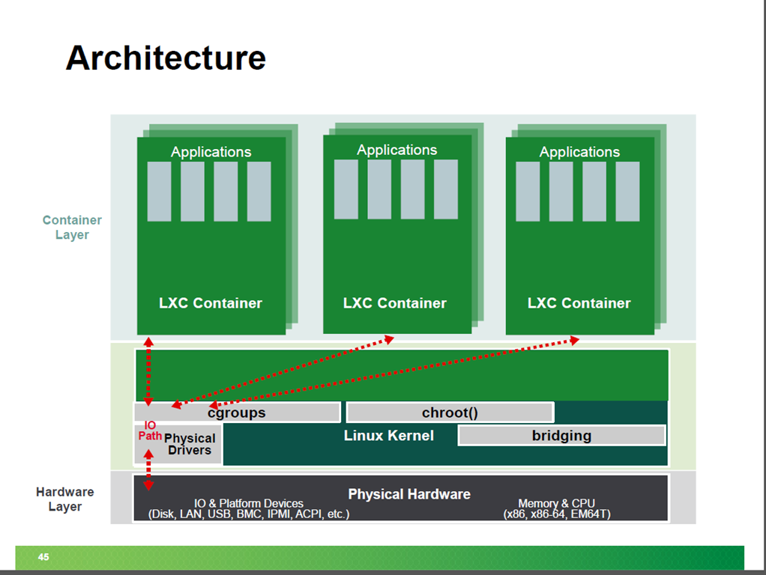
LXC ARCHITECTURE

Slide 19
LXC ARCHITECTURE how linux containers work
PID NAMESPACE - Pid isolation means a processes residing in a namespace do not even see other processes
NET NAMESPACE means that each container can bind to whatever port it wishes to. That means, port 80 is available to all containers! Of course, to make it accessible from outside, we need to do a little mapping
IPC ISOLATION means that processes in a namespace do not even see other processes for IPC[security and privacy]
MNT ISOLATION is something like chroot. In a namespace, we can have a completely independent mount points
UTS NAMESPACE lets each namespace have its own hostname

Slide 20
LXC ARCHITECTURE Cgroups (control groups)
They provide a mechanism for aggregating/partioning sets of tasks & their future children into hierarchical groups with specialized behaviour
CPU, Memory, Network, Block IO is managed by Cgroup to achieve Isolation and Resource Control

Slide 21
LXC COMMANDS
Creating / Destroying the containers
sudo lxc-create -n ubuntu -t ubuntu
sudo lxc-destroy -n ubuntu
Starting / Stopping a container
lxc-start -n debian
lxc-stop-n debian
Connect to an available tty
lxc-console -n debian -t 3
Freeze / Unfreeze a container
lxc-freeze -n armhf
lxc-unfreeze -n armhf

Slide 22
LXC COMMANDS
Monitoring the containers
sudo lxc-monitor -n armhf
'armhf' changed state to [THAWED]
'armhf' changed state to [FREEZING]‘
‘armhf' changed state to [FROZEN]
'armhf' changed state to [STOPPING]
‘armhf' changed state to [STOPPED]
Setting the control group for a container
lxc-cgroup -n <my-continer> cpuset.cpus
Getting information about the container
sudo lxc-list

Slide 23
LXC ON HOST armhf
sudo apt-get install qemu-user-static
sudo lxc-create -t ubuntu -n p3 -- -a armhf01
sudo lxc-start -n armhf01
Then login with root as both login and password
It is definitely not same as what you get on real ARM hardware

Slide 24
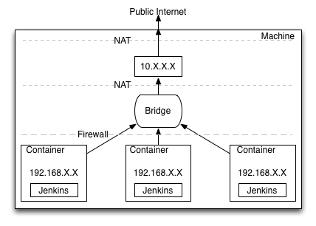
LXC INSTALLATION
Installation of lxc on Ubuntu
apt-get install libcap-dev libcap2-bin lxc
Install bridge-utils and change configuration in network file.
apt-get install debootstrap bridge-utils

Slide 25
LXC INSTALLATION
Before we can setup the first container, cgroups has to be mounted. Add the below line to fstab
vi /etc/fstab
cgroup /cgroup cgroup defaults 0 0
Now create the mount directory and mount cgroups
mkdir /cgroup
mount cgroup
This is in older kernel latest mounted in /sys/fs/cgroup
Cache for future containers. The scripts will automatically debootstrap a system for the hardware architecture you’re running (ARM in this case)
mkdir -p /usr/local/var/lib/lxc

Slide 26
Enable Kernel Config
CONFIG_CGROUPS=y
CONFIG_NAMESPACES=y
CONFIG_UTS_NS=y
CONFIG_IPC_NS=y
CONFIG_USER_NS=y
CONFIG_PID_NS=y
CONFIG_NET_NS=y
CONFIG_MACVLAN=y
CONFIG_VETH=y

Slide 27
Install LXC on PandaBoard
omapuser@omaphost$ wget http://lxc.sourceforge.net/download/lxc-0.9.0.tar.gz
omapuser@omaphost$ tar –xvf lxc-0.9.0.tar.gz
omapuser@omaphost$ cd lxc-0.9.0
omapuser@omaphost$ apt-get install libcap-dev libcap2-bin build-essential
omapuser@omaphost$ ./configure –prefix=/lxc
omapuser@omaphost$ make && make install
Debootstrap to create containers and to configure network interface as a bridge
omapuser@omaphost$ apt-get install debootstrap bridge-utils

Slide 28
CROSS COMPILE LXC
Download libcap2_2.22
Disable "libattr" and pam_cap support
Build and Install
# make
# make prefix=$OUTDIR install

Slide 29
CROSS COMPILE LXC
Downloaded LXC (lxc-0.9.0 /1.0.0 alpha)
Export the path of built "libcap" library
export CFLAGS="-marm -mcpu=cortex-a9 I${LIBCAPLIB}/include -L${LIBCAPLIB}/lib64“
Configure, Build and Install
./configure --host= arm-unknown-linux-gnueabihf- --prefix=/usr
make
make prefix=$OUTDIR install

Slide 30
Run Multiple Versions of OS
To use an minimal OS on Panda in a container
# sudo mkdir -p /home/omapuser/mypanda
# sudo cd /home/omapuser/mypanda
# sudo cp /root/precise-ti-mm-minimal-panda-rootfs-cust_GLP1.6.8.tar.gz /home/omapuser/mypanda
# sudo tar –xvf precise-ti-mm-minimal-panda-rootfs-cust_GLP1.6.8.tar.gz
This unpacks the rootfs into /home/omapuser/mypanda which is where the container will live.Create an LXC configuration file, for example /etc/lxc/lxc-mypanda.conf

Slide 31
LXC configuration file
omapuser@omaphost$ cat /etc/lxc/mypanda.conf
lxc.utname = mypanda
lxc.tty = 4
lxc.rootfs = /home/omapuser/mypanda
#network
lxc.network.type = veth
lxc.Network.flags = up
lxc.network.link = br0
lxc.network.ipv4 = 192.168.99.202
lxc.network.name = eth0
lxc.network.veth.pair = vethvm2
#mount points
lxc.mount.entry = none /home/omapuser/proc proc defaults 0 0
lxc.mount.entry = none /home/omapuser/sys sysfs defaults 0 0
….cpu memory pts names rtc devices (input.etc)

Slide 32
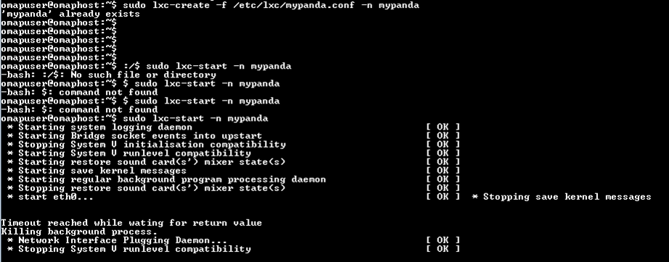

Slide 33
Use Cases
Testing and rolling out changes
No downtime for upgrades or changes
Run multiple version of OS/applications/web stacks
Test applications on or run multiple Linux distributions

Slide 34
SUMMARY
Customers get Application running in a Container so they are not aware of the Processes running or Underlying File system
We can Limit the Applications which grab resources [Memory, Cpu, IO etc.] achieved using Cgroups
If Server-Client Architecture can be achieved then Some Customers get Guaranteed Services for a set of Applications[Server Farms of ARM ]
Multiple Version of Software Can be run like Production Software [Debug Software] and Regular OS
Cloud Applications can be Run on Containers
Developer is given root access but not with full root access giving higher security [LXD ]

Slide 35
REFERENCES
http://en.wikipedia.org/wiki/LXC
http://sourceforge.net/projects/lxc/
http://www.ibm.com/developerworks/linux/library/l-lxc-containers/
https://help.ubuntu.com/lts/serverguide/lxc.html
http://www.linuxcertif.com/man/search/?keywords=lxc
https://github.com/lxc/lxc
https://launchpad.net/ubuntu/+source/lxc/1.0.0~alpha1-0ubuntu6
http://www.omappedia.com/wiki/OMAP_Ubuntu_Core>
http://rhsummit.files.wordpress.com/2013/06/sarathy_w_0340_secure_linux_containers_roadmap.pdf
http://linuxcontainers.org/
http://www.kanneganti.com/technical/virtualization-with-containers-a-primer/
http://elinux.org/Toolchains

Slide 36
Questions?

