Slide 1

Illuminating Insights for Global Electronics
Kavitha Jimnath
21-Sep-2024

Slide 2
Project Objective
Global Electronics, a leading retailer of consumer electronics, has provided you with several datasets containing information about their customers, products, sales, stores, and currency exchange rates.
The company seeks to leverage this data to better understand their business and identify areas for improvement

Slide 3
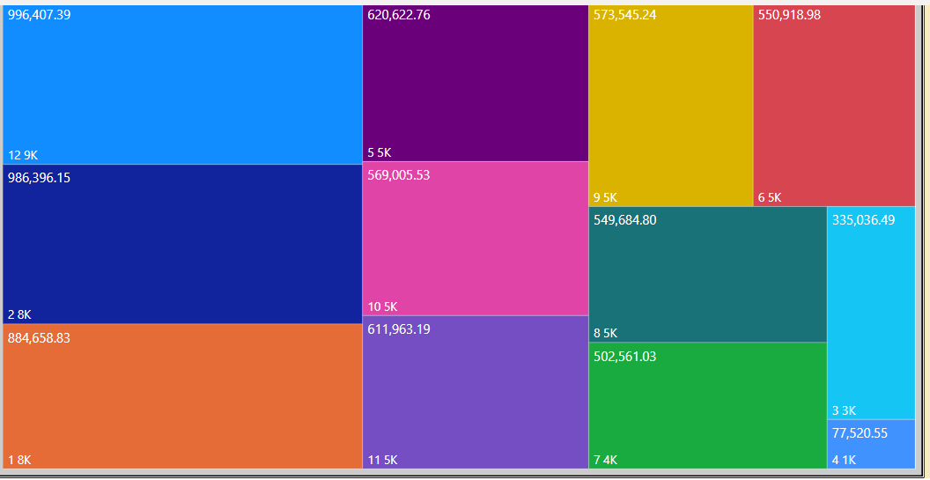
Overall Sales Performance
Observation:
Product sales is good during Dec, Jan, and Feb months

Slide 4
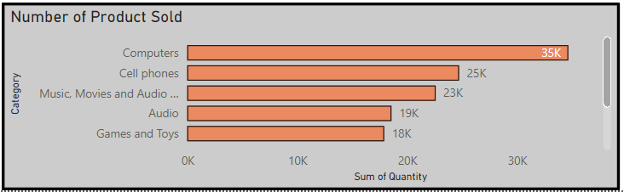
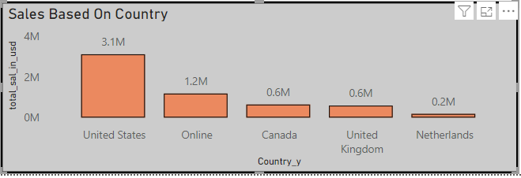
Sales by Product & Country
Observation:
>Computer is the most sold product in terms of quantity and cost.
>Compare to other currency, USD is presiding, more marketing required to increase sale in EUR and GBP.

Slide 5
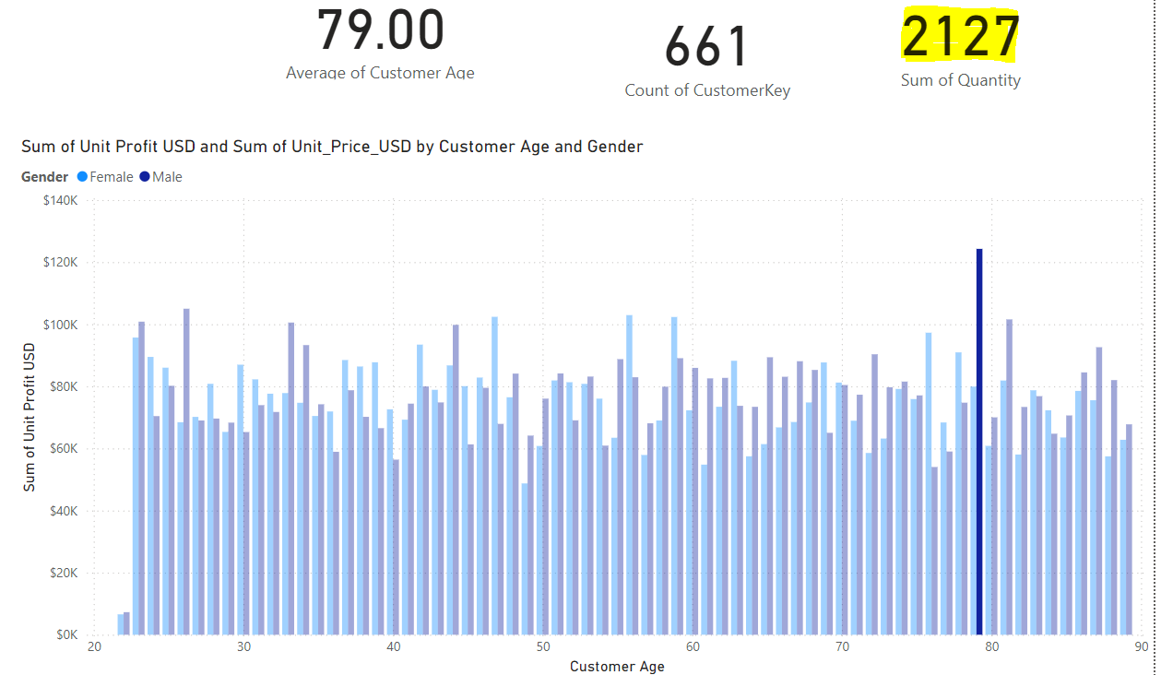
Sales By Age
Observation:
>People around age group 79 brought mor number of products.

Slide 6
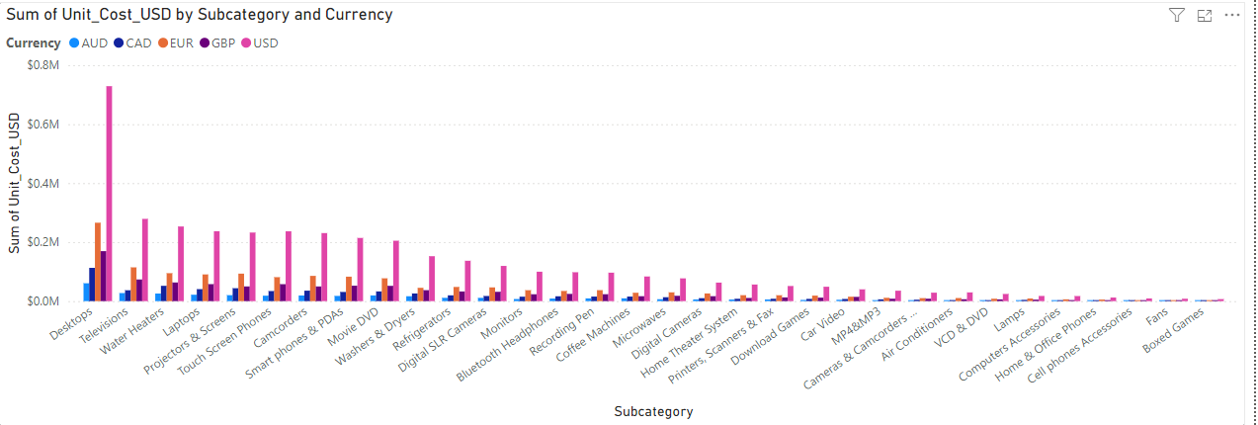
Sales By Product
Observation:
>Following products are top selling in most of the currency,
Desktop, Television, Water heater, laptops, touch screens, movie DVD etc.

Slide 7
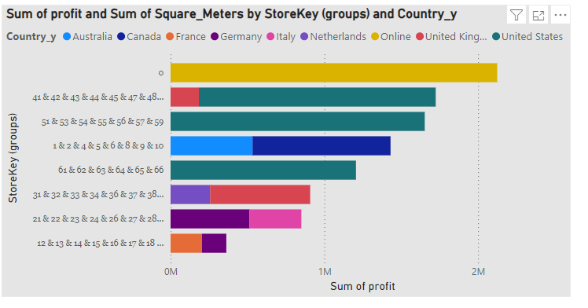
Sales By Store
Observation:
>Online store performance is good.

Slide 8
Conclusion
Online sale is good, so invest more on including more products on online sales.
More online advertisements can also improve online sale.
Promote seasonal promotions.
Increase store size to improve sales

Slide 9
Thank you

