Slide 1
Custom Test IDP for Federated Access – OIDC & SAML
Kavitha Kodidhanam [506795]
FSE3 HACKSE 2022
GIT hub: http://git03/kavithak/customidp/-/tree/main/SpringBoot

Slide 2
BUSINESS SCENARIO
BENEFIT
SOLUTION / APPROACH
Our application provides authentication to the individual users and users from Institutions using the Oauth framework. The institution logins are made by Federated Authentication which comprise of SAML and OIDC authentication and we act as Service Provider(SP). We have test Identity Providers (IDP) currently in place to simulate the Production IDPs. We face some difficulties in the test IDPs
Complete simulation of the IDPs in PROD
Easy for stake holders to do customization
Reusable components across any authentication application using Shibboleth/OIDC
Reduces the frequent loss of test IDP and their data and solves manual configuration to EC2s
Adoption to custom solution to create IDPs simulating the IDPs we currently have in PROD
Enabling registration of Identity providers and add users under the IDP
Enabling the customization of the IDP configuration.
Allows to enable/disable users in the IDP
Providing configuration updates to the Shibboleth or OIDC
Provides dashboard for testers to view the IDP configurations and user’s configs
Creation of Admins and admin roles to the users who will be authorized to do these customization
Interactive UI by the ReactJS makes view and customization easier
Hosted in Cloud and reduces cost of many EC2’s running currently to the same job
OPPORTUNITY
Iteration 1
Lot of effort is spent on the following
- The Test IDPs are running on individual EC2 instances Apache server and we have configured Shibboleth/OIDC to contact to the individual EC2s to act as IDPs.
- The configuration of the IDPs are to be manually added to EC2 server and they go away when the instance restarts
- Frequent loss of test IDPs and configuration which makes difficult to fix it and do testing in non prod.
- Customization of the IDPs are challenging as it requires manual work and experienced to do that in the system
- Developers or Testers doesn’t have a view to look at the configurations currently there in non prod.
This provides an opportunity to leverage benefits of Custom IDP IAM solution to solve the problems faced by team.
Create IDP
Create IDP Users
Dashboard of IDPUsers for team to view

Slide 3
Tech Stack - Java FSE 3 track
 | Tech stack
Front End | React JS
Back End | Sprint boot microservices
Platform | AWS
Content Delivery | Zuul server
Middleware | Kafka
Database | Mongo db , PostgreSql

Slide 4



User service Command Microservice
Custom Idpuser Query Microservice
Create User Command
Create Idp Command
GetAll Idps Query
GetAllIdpUsers with pagination, sorting , filtering Query

Slide 5
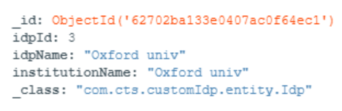
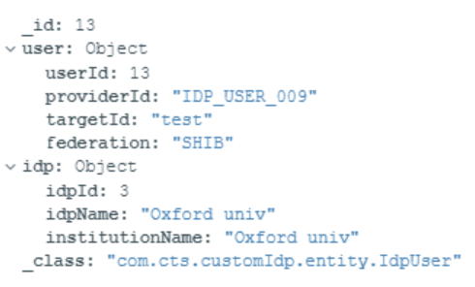

Database design
Idp document
IDP_Id (Primary Key)
IDP name
Institution name
UserId (Primary Key)
provider
target
person
federation
Idp (FK of IDP table)
IdpUser document
IDP table
Users table

Slide 6
Use Case diagram
Login
User
Create IDP
Create IDP users
View Dashboard of IDP users

Slide 7
Technical reference GIT hub: http://git03/kavithak/customidp/-/tree/main/SpringBoot
cqrs-command-user-service Microservice
API to create Idp(IdentityProvider) and IdpUsers(IdentityProviderUsers). Those details are persisted to postgresql tables and also posted to Kafka topics (user-service and idp-service).
http://localhost:8083/api/user/createUser
http://localhost:8083/api/idp/createIdp
Kafka messages:
kafka-console-consumer.bat -bootstrap-server localhost:9092 -topic user-service -from-beginning
kafka-console-consumer.bat -bootstrap-server localhost:9092 -topic idp-service -from-beginning
cqrs-query-customidpuser-service Microservice
API to query Idp(IdentityProvider) and IdpUsers(IdentityProviderUsers).The kafka topics(user-service and idp-service) are listened and the data are persisted to Mongodb collection
http://localhost:8084/api/idpuser/getIdpuser
http://localhost:8084/api/idpuser/getAllIdps
Swagger Documentation of both services:
http://localhost:8083/v2/api-docs
http://localhost:8084/v2/api-docs
http://localhost:8083/swagger-ui.html
http://localhost:8084/swagger-ui.html

Slide 8
OWASP principles followed
Prevented sql injection
Basic token based authentication
Csrf token implementation

Slide 9
Sql scripts and kafka scripts:
CREATE TABLE idp(id serial PRIMARY KEY,institution varchar(50),name varchar(20));
CREATE TABLE users(
id serial PRIMARY KEY,
provider VARCHAR(20),
target VARCHAR(20),
person VARCHAR(20),
federation VARCHAR(20),
idp integer references idp (id));
Consume messages:
kafka-console-consumer.bat -bootstrap-server localhost:9092 -topic user-service -from-beginning
kafka-console-consumer.bat -bootstrap-server localhost:9092 -topic idp-service -from-beginning

