Slide 1
DSCI – 6612 – 02 Intro to Artificial Intelligence EARLY PREDICTION OF SEPSIS USING DECISION TREES
Professor : Vahid Behzadan Team Members : Hemanth Pathipati
Kavitha Madiraju

Slide 2
Problem Definition
Sepsis is defined as a life-threatening organ disfunction caused by a dysregulated host response to infection, is a major cause of death worldwide. Using Machine learning integrated with neural networks helps to predict with higher accuracy. To predict the disease earlier than the test reports which takes longer time to confirm, the machine learning based software gives out quicker and assured results when provided with the samples.

Slide 3
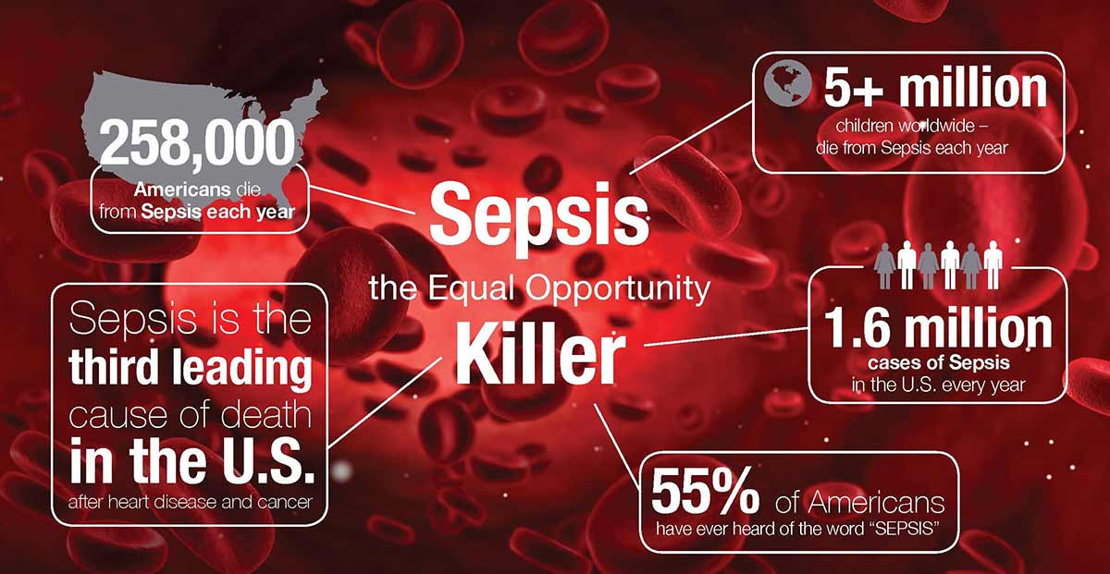
Sepsis-Statistics

Slide 4
Goals & Objectives
The goal of this project is to predict sepsis using physiological data.
We aim to predict it before the generation of clinical reports.
The main objective of the project is to detect the infection of sepsis in early stages rather than at final.
As the generation of clinical reports takes a lot more time to and consume heavy hospital resources the risk of increase in contamination grows rapidly.
Our project predicts sepsis early and reduce the risk of death with help of patient’s physiological report.

Slide 5
Existing Method
The current existing method mainly relies on XGBoost algorithms. The missing values are handled by categoriocally encoding the features. Features with missingness greater than 92% are removed. The feature selection is done by checking the correlation of feature contributions to the presence of sepsis. Data imbalance is handled using a balanced bagging classifier which automatically create balanced samples of the input data. The XGBoost algorithm is used in the training phase to boost the speed of the training process as it is an optimized distributed gradient boosting library designed to be highly efficient, flexible and portable.

Slide 6
Limitations of Existing method
1.XGBoosters are hardly scalable. Gradient boosting is extremely sensitive to outliers since each classifier is obliged to correct the errors made by the previous learners.
2.A few studies employed neural network-based techniques, which take a long time to generate nodes and provide no information about the structure of the function being approximated.
3.When using Random Forest (many trees), the process may become too sluggish and useless for real-time predictions. Despite the fact that this algorithm is too fast to train, it is fairly slow to generate predictions once trained.

Slide 7
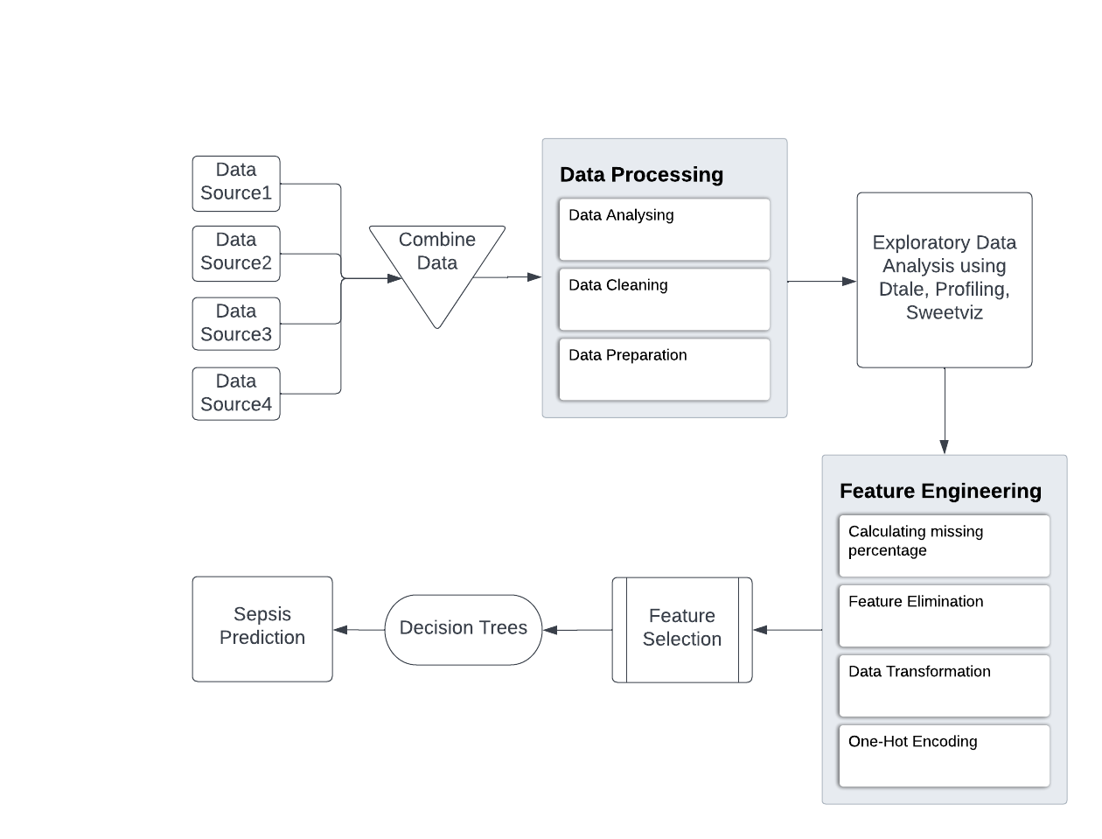
Proposed Model

Slide 8
Decision Trees
Decision Trees (DTs) are a non-parametric supervised learning method used for classification and regression. The goal is to create a model that predicts the value of a target variable by learning simple decision rules inferred from the data features. A tree can be seen as a piecewise constant approximation.
The cost of using the tree (i.e., predicting data) is logarithmic in the number of data points used to train the tree.
Able to handle both numerical and categorical data.

Slide 9

Decision Tree Working model

Slide 10
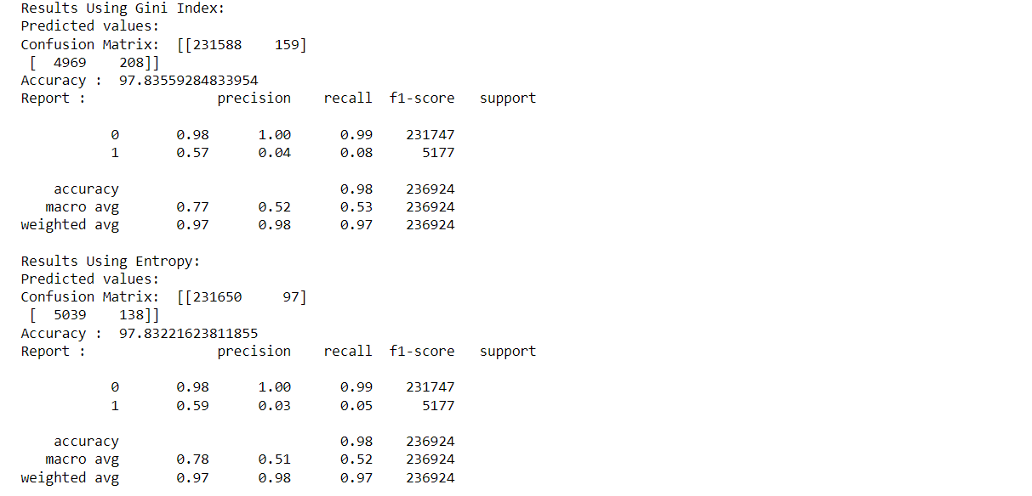
Result

Slide 11
Conclusion
Decision trees have a stronger potential for categorization than the other algorithm types. Label encoding is used instead of typical imputation approaches to achieve better results. This strategy enabled us to train the model efficiently while also taking into account other factors such as minimum leaves, split, random value, and maximum depth. This model ensured the confusion matrix: [[231650 97]] [5039 138]]with an AUC is 97.83221623811855.

Slide 12
References
https://www.upgrad.com/blog/gini-index-for-decision-trees/
https://physionet.org/content/challenge-2019/1.0.0/
https://github.com/kskaran94/Sepsis_Identification
https://github.com/sedab/EarlySepsisPrediction
https://github.com/onurhalityenice/Diabetes-Feature-Enginnering

Slide 13
THANK YOU!

