Slide 1
Spring Boot Setup Guide

Slide 2
Installing Spring Boot

Slide 3
Installing Spring Boot
This guide shows you how to install Spring Boot.
Software pre-requisites:
Java SDK
Eclipse
If you do not have the above installed, please refer to this guide:

Slide 4
Installing Spring Boot
We will be installing the following packages:
Spring Tools 4 (Include Spring Boot)
Eclipse Web developer tools (Includes HTML, CSS, JS editors)

Slide 5
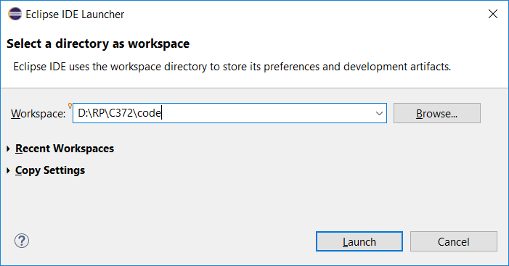
Installing Spring Boot
Start Eclipse and select your workspace.
Note: You should create a new workspace to organize your files better. Ensure that you know where to find your files later.
See sample location below:

Slide 6
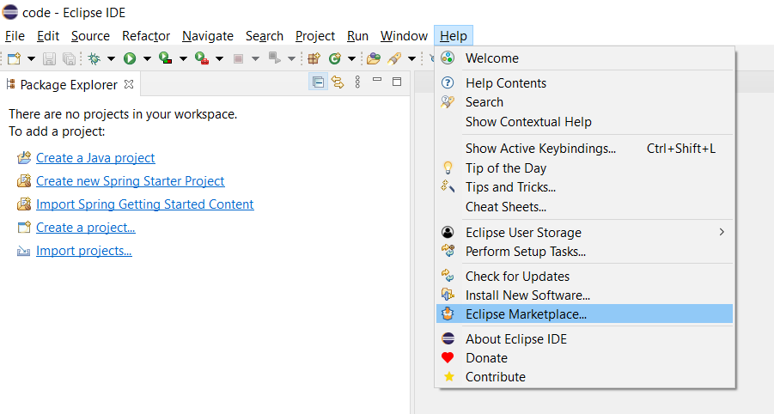
Installing Spring Boot
Go to Help > Eclipse Marketplace

Slide 7
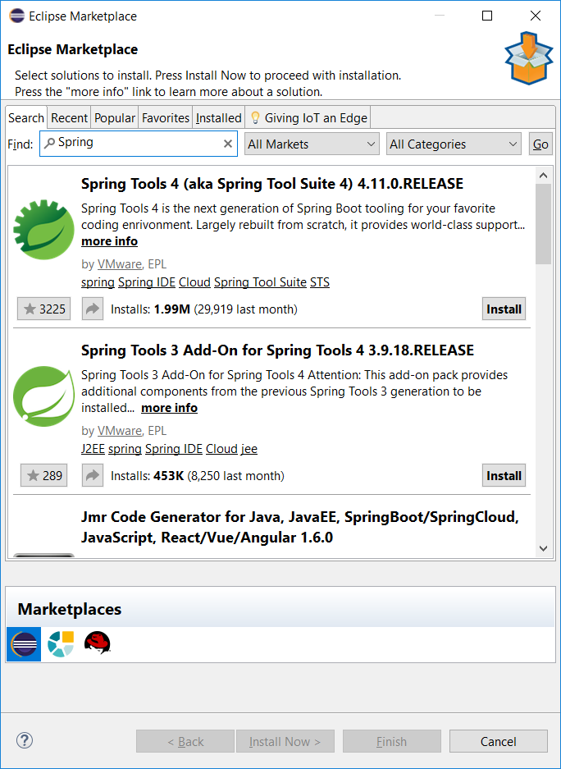
Installing Spring Boot
Type Spring in the search bar.
Spring Tools 4 should appear, click Install.

Slide 8
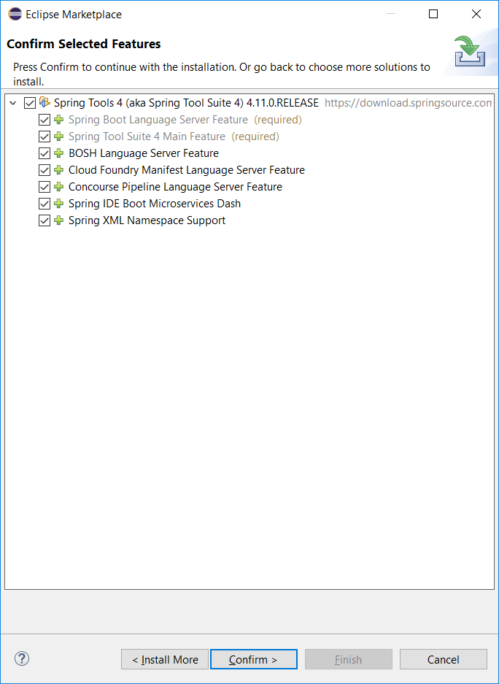
Installing Spring Boot
You will be asked to confirm the features to be installed.
Click Confirm.

Slide 9
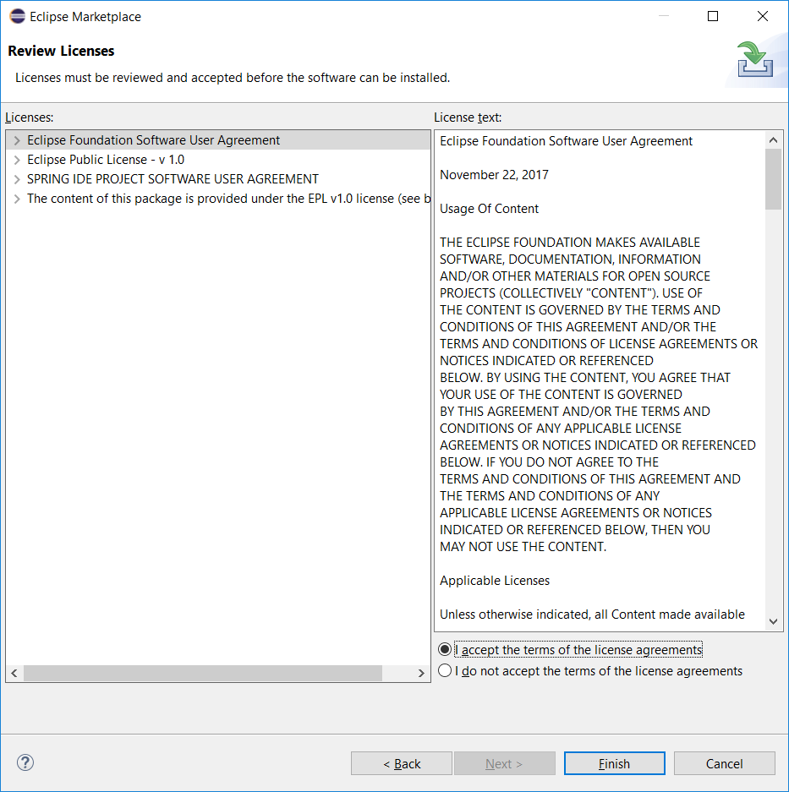
Installing Spring Boot
Accept the terms of license and click Finish.

Slide 10
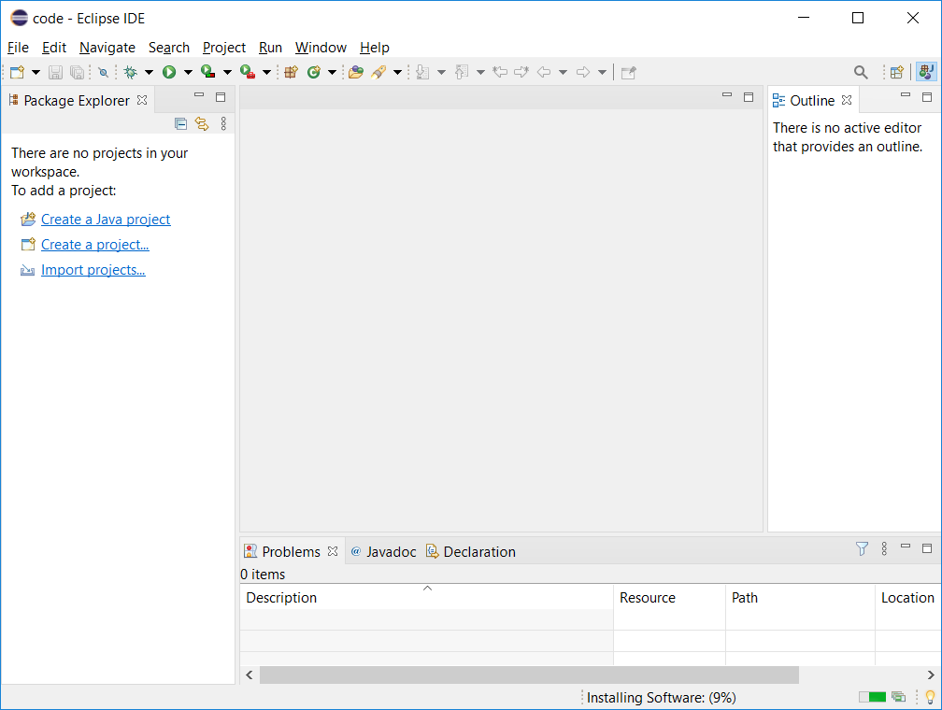
Installing Spring Boot
It will take about 5 minutes to complete installation of Spring Tools.

Slide 11
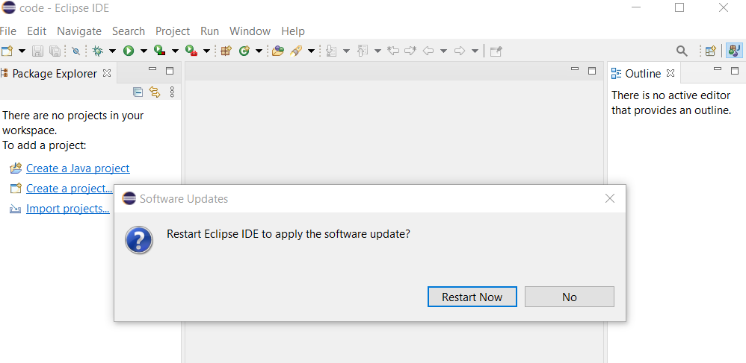
Installing Spring Boot
Once installed, you will be asked to restart Eclipse.
Click Restart Now.

Slide 12
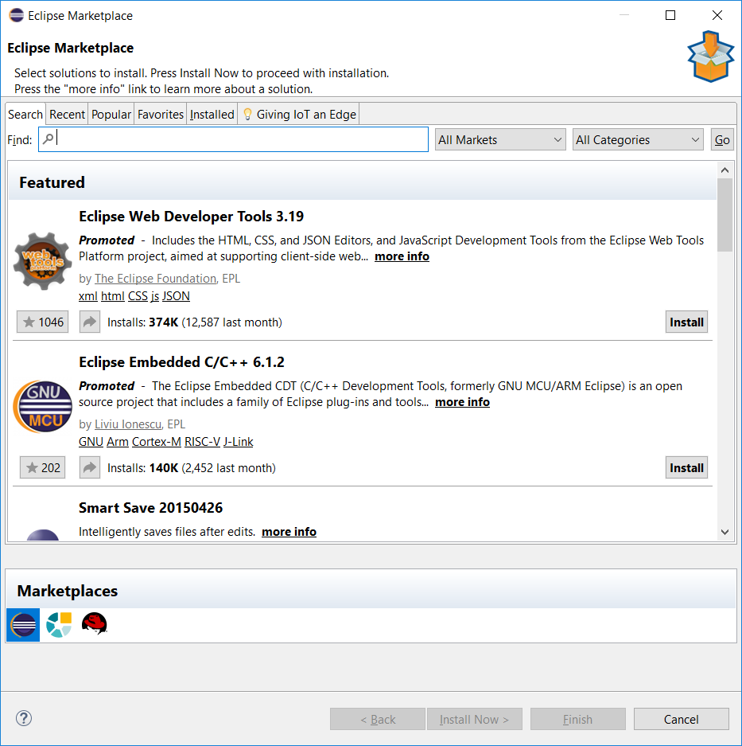
Installing Spring Boot
Once restarted, we will now go to the Eclipse Marketplace again.
Go to Help > Eclipse Marketplace
The Eclipse Web Developer Tools is a promoted package, you should see it when the Marketplace is started. If you do not see it, you can do a search for it.
Click Install.

Slide 13
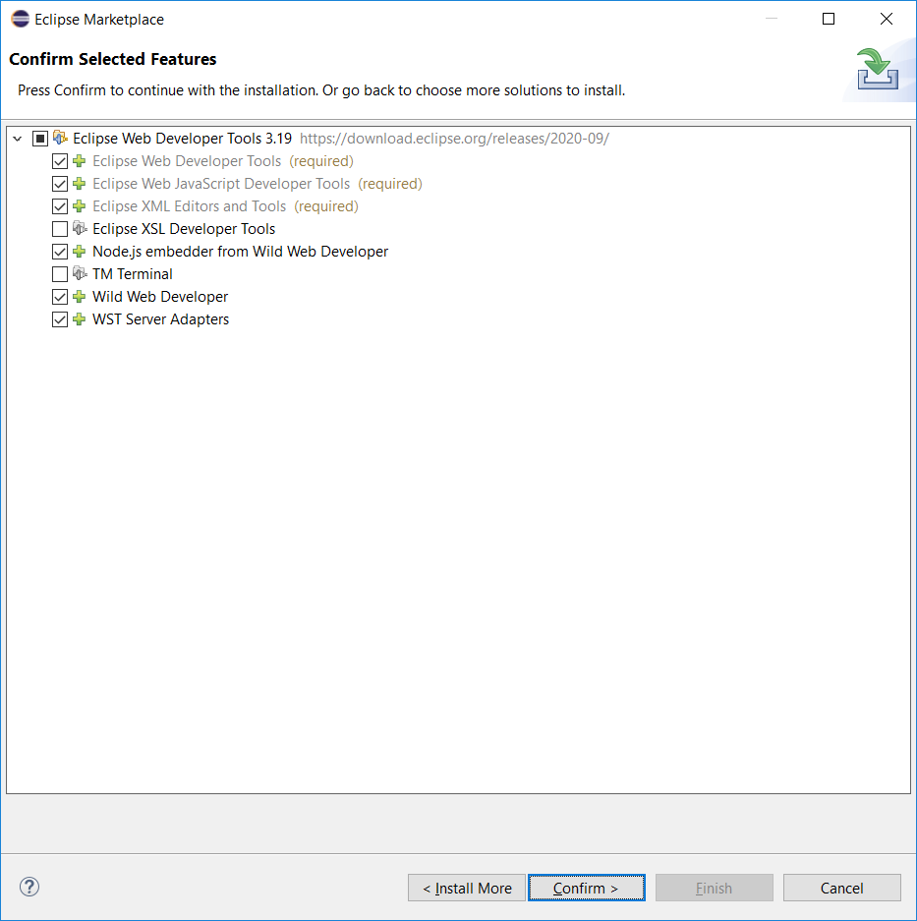
Installing Spring Boot
You will be asked to confirm the features to be installed.
Click Confirm.

Slide 14
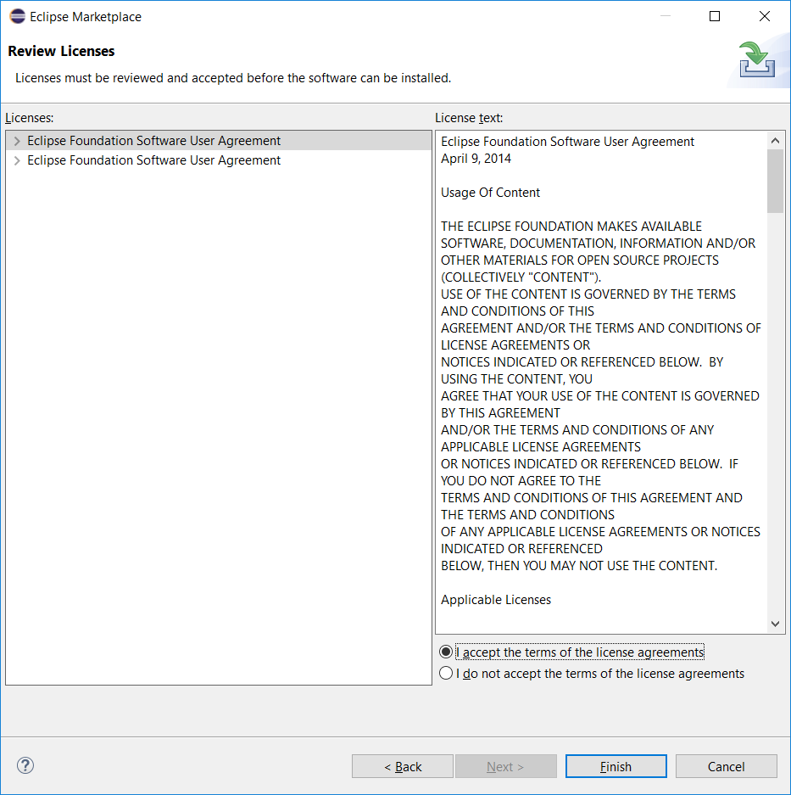
Installing Spring Boot
Accept the terms of license and click Finish.

Slide 15
Installing Spring Boot
It will take about 5 minutes to complete installation of Eclipse Web Development Tools.

Slide 16
Installing Spring Boot
Once installed, you will be asked to restart Eclipse.
Click Restart Now.

Slide 17
Creating a new Spring Boot project

Slide 18
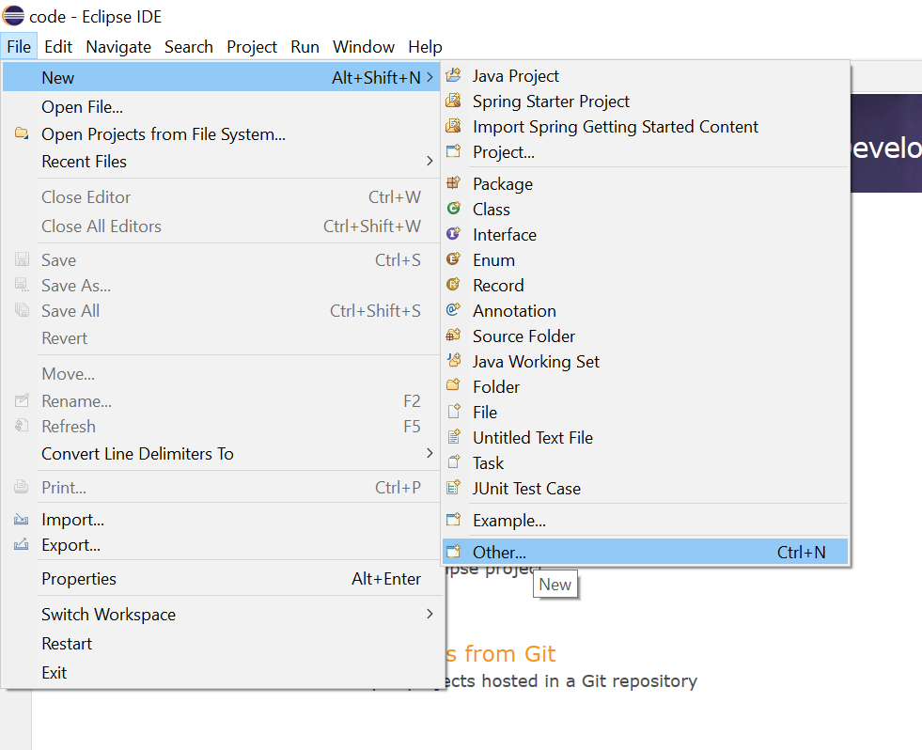
Creating a new Spring Boot project
Go to File > New > Other

Slide 19
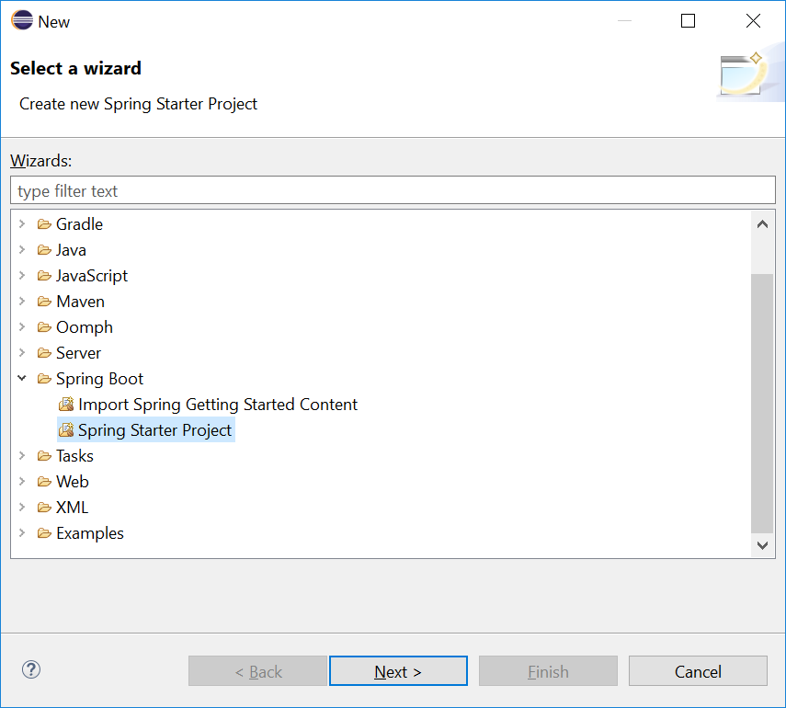
Creating a new Spring Boot project
Select Spring Starter Project and click Next.

Slide 20
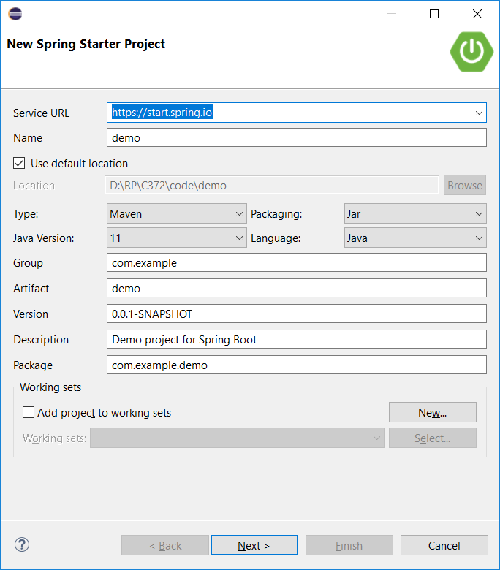
Creating a new Spring Boot project
Leave details as shown.
Click Next.
The Java version will depend on what is installed on your laptop. As long as it is above version 8, there should be no issues.

Slide 21
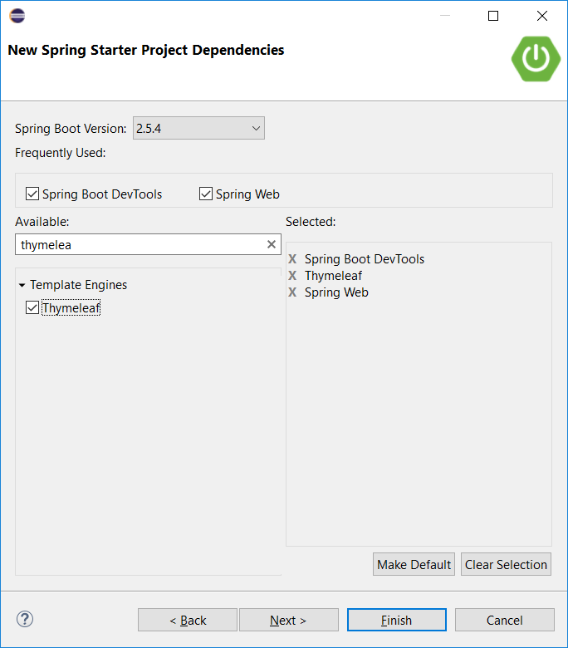
Creating a new Spring Boot project
Search for the following dependencies
Spring Boot DevTools
Thymeleaf
Spring Web
Select the dependencies
Click Finish

Slide 22
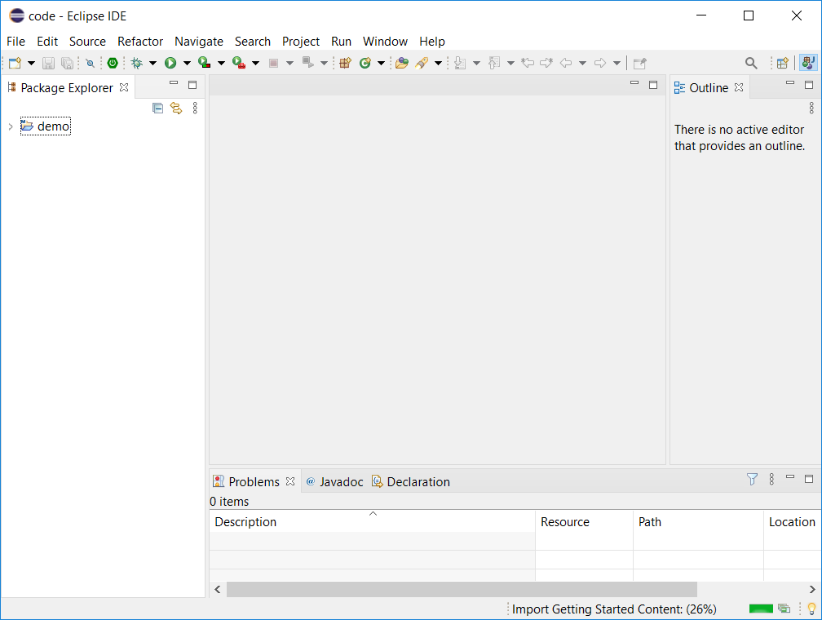
Creating a new Spring Boot project
Relevant packages are being prepared and downloaded.
The first time you create a project, it will take a few minutes.

Slide 23
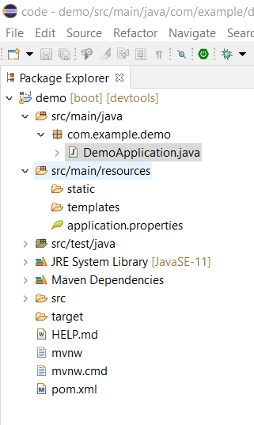
Creating a new Spring Boot project
Once your project is ready, expand the project and check that you have the following project file structure shown.

Slide 24
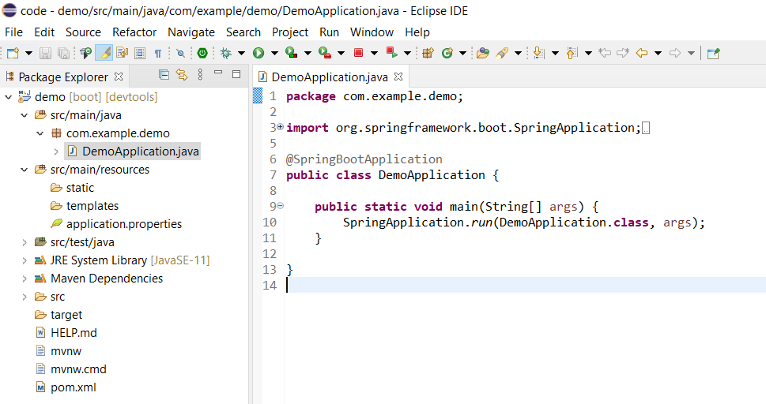
Creating a new Spring Boot project
Open DemoApplication.java, it should look like the below.
Check that there are no red lines.

Slide 25
Adding code to test the project

Slide 26
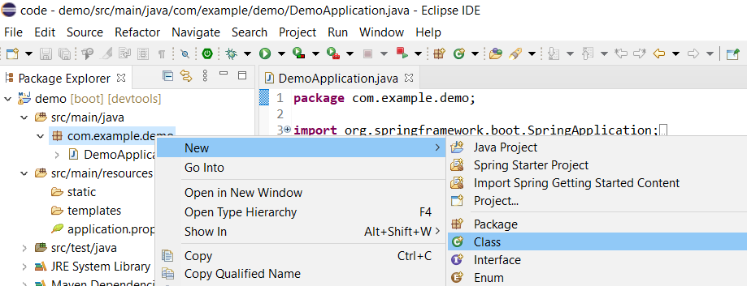
Adding code to test the project
Under src/main/java, right-click on com.example.demo.
Select New > Class.

Slide 27
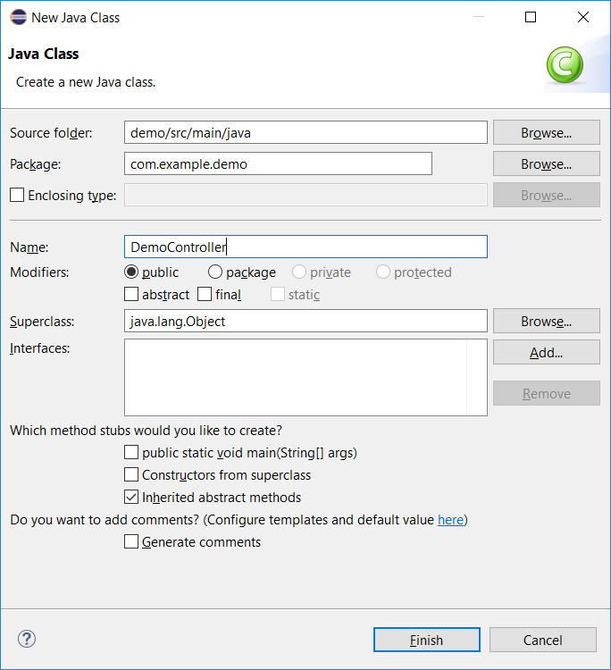
Adding code to test the project
Name the new Java class DemoController.
Click Finish.

Slide 28
Adding code to test the project
Copy the code below and replace all the code in DemoController.java
package com.example.demo;
import org.springframework.stereotype.Controller;
import org.springframework.web.bind.annotation.GetMapping;
@Controller
public class DemoController {
@GetMapping("/demo")
public String demo() {
return "demo";
}
}

Slide 29
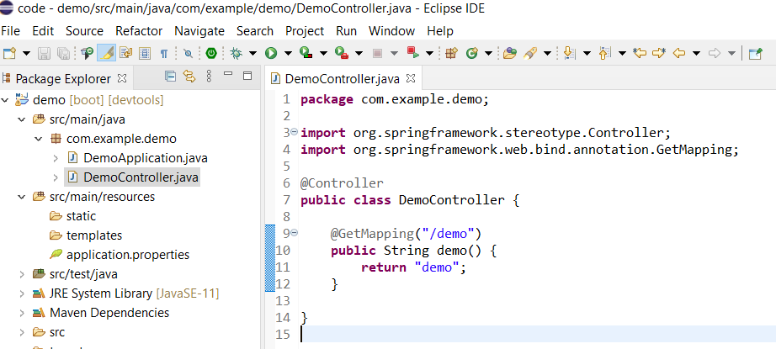
Adding code to test the project
Your project structure should now look like the below

Slide 30
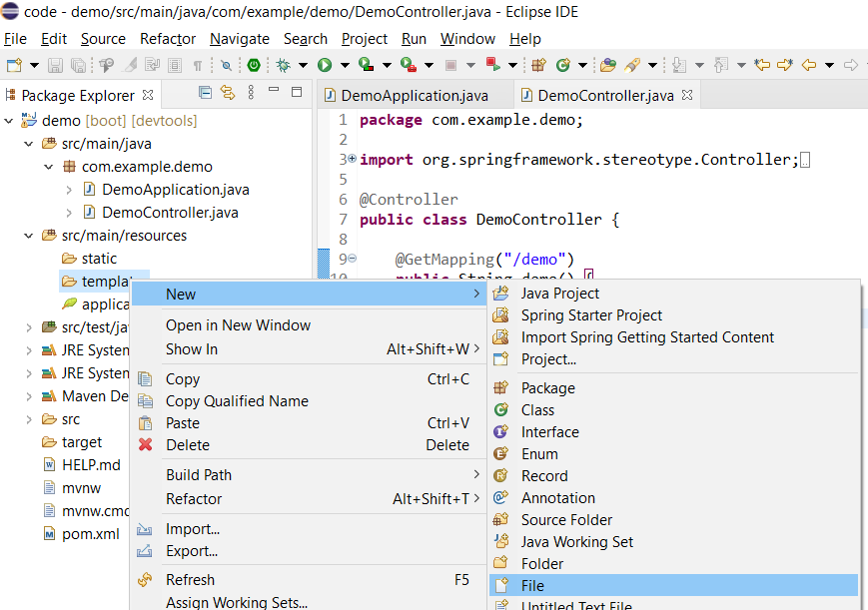
Adding code to test the project
Under src/main/resources, right-click on templates folder and select New > File

Slide 31
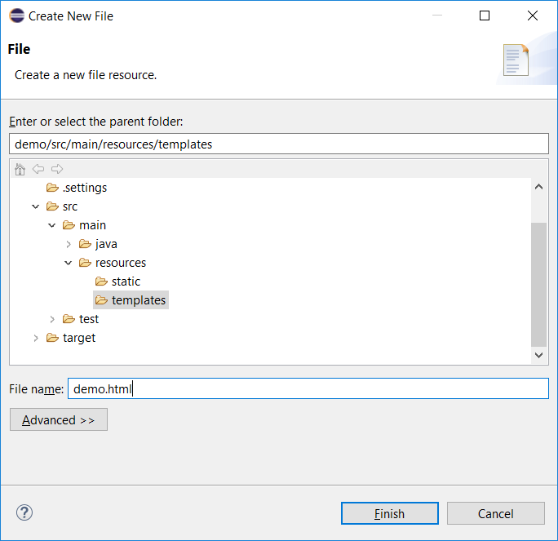
Adding code to test the project
Name the new file demo.html.
Click Finish.

Slide 32
Adding code to test the project
Copy the code below and paste it into demo.html.
<html>
<head></head>
<body>
<p>This is a demo!</p>
</body>
</html>

Slide 33
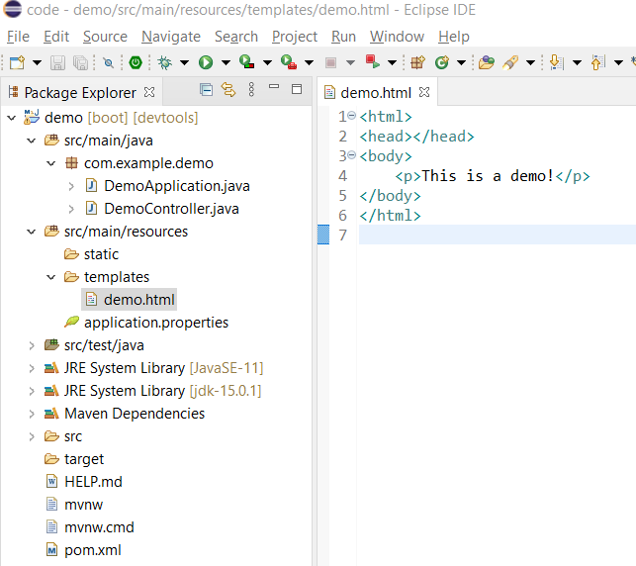
Adding code to test the project
The project structure should now look like the screenshot as shown.

Slide 34
Running a Spring Boot application

Slide 35
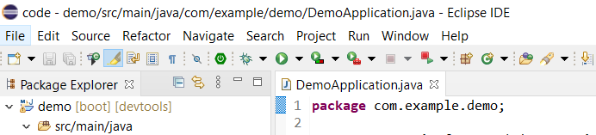
Running a Spring Boot application
Open DemoApplication.java
Click on the Run button

Slide 36
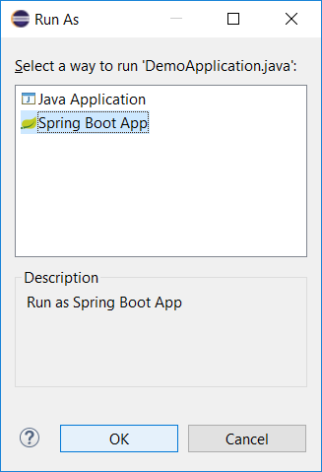
Running a Spring Boot application
If the following screen pops up, select Spring Boot App and click OK.

Slide 37
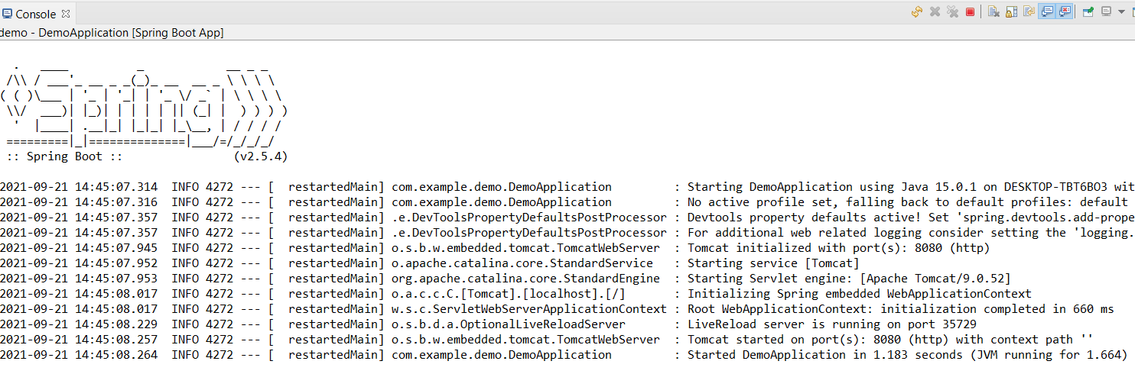
Running a Spring Boot application
You should see a trace similar to below.
If you see “Started DemoApplication…”, the application has started and you are ready to test it out.

Slide 38
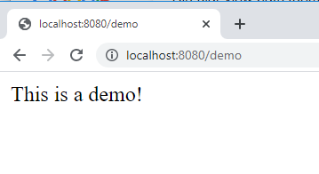
Running a Spring Boot application
Go to a web browser (Chrome, Firefox, IE or Edge) and type in the following URL:
http://localhost:8080/demo
If you see the below, Springboot and related tools are installed and working fine!

