Slide 1
Building Enterprise Java Applications with Spring
Project
Magdalene Lim,
Desmond Lee,
Kavitha Muniraj
Republic Polytechnic

Slide 2

Create a Hotel Management website
Create a project called HotelManagement and create the required files and write the code to display some information about hotel rooms, members and reservations.
The administrators should be able to:
View all rooms – http://localhost:8080/rooms
View all members – http://localhost:8080/members
Update room price
Add a new member with reservation details
Cancel reservation for a member
Notes:
Give students some time to try on their own before modelling.

Slide 3
Create a Hotel Management Controller
Create a new project File > New > Other > Spring Starter Project and name it as HotelManagement
Create a Java class named HotelMgmtController class in studentClass.studentname.hotelmgmt package.
Annotate the class with @Controller.
Create a public method named viewRooms that returns a String “view_rooms”.
Annotate the viewAll method with @GetMapping(“/rooms”)
Notes:
Give students some time to try on their own before modelling.
Package name should be their own

Slide 4
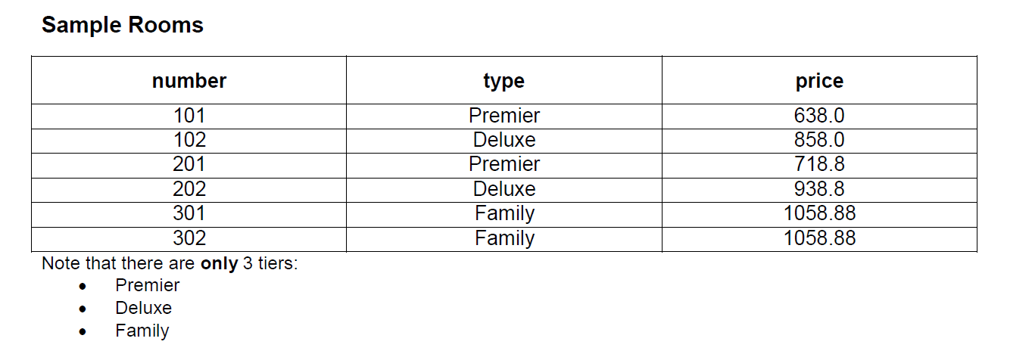
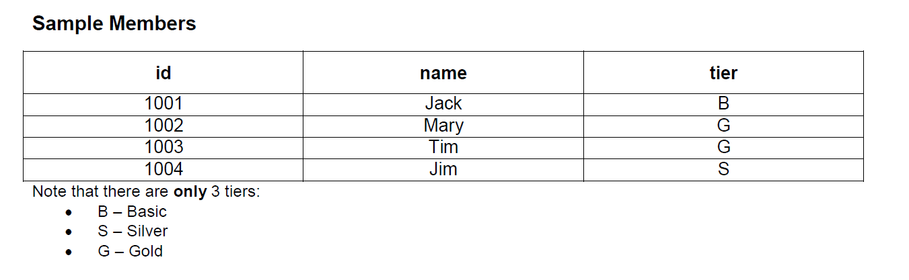
Create a Hotel Management Website
Notes:
Give students some time to try on their own before modelling.
Package name should be their own

Slide 5
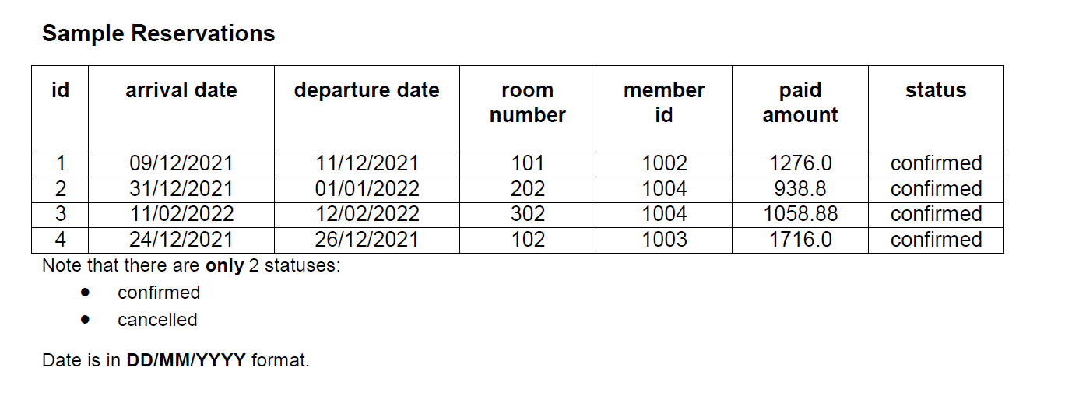
Create a Hotel Management Website
Notes:
Give students some time to try on their own before modelling.
Package name should be their own

Slide 6
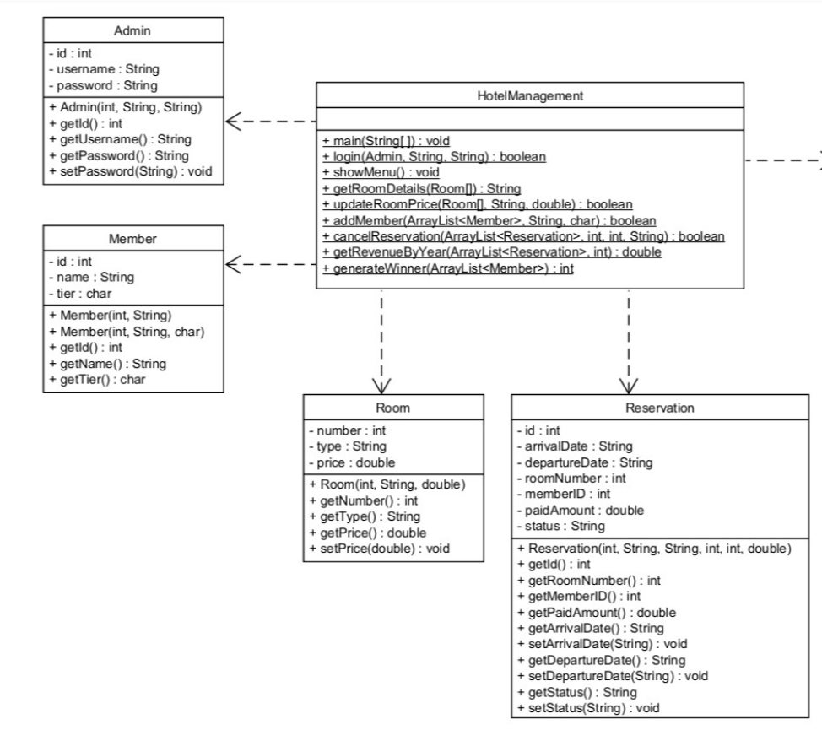
Create a Hotel Management Website
Notes:
Give students some time to try on their own before modelling.
Package name should be their own

Slide 7
Thank You Q&A

